Slide 1

A Simple Pan-Genome Approach to Short Read Mapping
PRESENTED BY:
Roger Moraga
Tea Break Bioinformatics Limited
Creative Commons Content (CC BY 3.0 NZ)

Slide 2
Introduction
From Wikipedia: "A reference genome (also known as a reference assembly) is a digital nucleic acid sequence database, assembled by scientists as a representative example of a species' set of genes."
As the name implies, it is a representative that can be used to compare your organism of choice to an idealized representation.

Slide 3
Over Time
In the 20th Century, a reference genome meant a single copy of a "model" organism.
Model
You

Slide 4
Over Time II
With the release of Next-Generation Sequencing, more organisms were starting to get sequenced.
Model
You

Slide 5
Over Time III
As sequencing got cheaper and cheaper, and better ways to bridge large genomes became available, even more genomes became available.
Model
You

Slide 6
Over Time IV
Nowadays, many projects can afford to create a genome for their own favourite species.
Model
You

Slide 7
What Does it Mean?
In the beginning, we could only see what makes, say, a mammal a mammal.
As more genomes became available, we can look into more detail into what makes a rodent a rodent, or a feline a feline.
Then, we finally could see everything that makes a species a species.
Or could we?

Slide 8
Reality
Model
You
Model
You

Slide 9
Genome
A
D
REF
B
E
C
F

Slide 10
The Problem
Given a variable portion of a genome, short reads (from Illumina technologies) will be hard to place correctly.
Reasons:
  Lack of context.
  Lack of consistency.

Slide 11
Alignment Examples
AACTGGCAGTTATTCGGCGTTTATATGCGTCATCAACGTAC
AACTGGCAGTTATTCGGCGT-TATATGCGTCATCAACGTAC
AACTGGCAGTTATTCGGCGTT-ATATGCGTCATCAACGTAC
AACTGGCAGTTATTCGGCG-TTATATGCGTCATCAACGTAC
CCGTATATTTGCGGATATATCTTCGAATTATCACTACTGGGTGTCATTATATTATGCGCGATTATCC
TGCGGATATATCTTCGAATTATCACT-C
AATTATCACTCGTGGGTGTCATTA

Slide 12
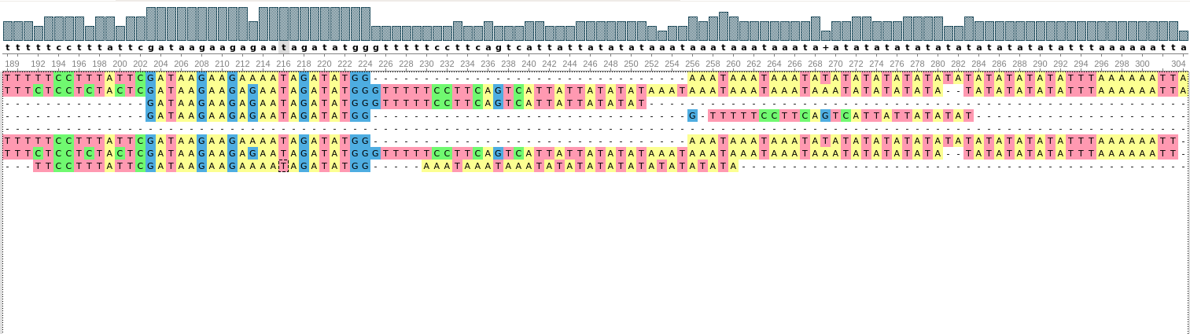
Bigger Examples
Too much for short reads!

Slide 13
Pan-Genome
A
D
REF
B
REF
E
REF
C
F

Slide 14
The Approach
A
B
C
Align
Align
Align
D

Slide 15
The Pan-Reference
(etc.)
Origin of Sequence
Original Reference it aligned to
Mapped Position
Alignment Information (CIGAR)

Slide 16
Read Mapping
Translate

Slide 17
Why?
Longer sequence alignments provide better context to place divergent regions or larger insertions/deletions.
Alignment of more divergent regions becomes fixed.
Even in the case of poorly aligned regions, these become consistent.

Slide 18
The Example
Plasmodium Falciparum.
29 genomes in NCBI.
Compact (24 Mb) genome.
Parasite with strong variations to avoid immune system of the host.

Slide 19
Basic Stats
Take main reference plus five examples of additional genomes.
Take three examples of Illumina data not from any of the reference genomes.
How much difference is there?

Slide 20
Read Mapping
Reads from the three examples were mapped to all reference genomes.
Scores for each read alignment were compared across all genomes.

Slide 21
Read Pan-Mapping
A pan-genome was constructed from three reference genomes.
Each genome added ~8-10 Mb to the reference.
Reads were compared with their score and position when mapped to the original reference, vs. mapped to the pan-reference.

Slide 22
Mild Optimism
About ~7% of the reads had their mapping changed with only three genomes.
Multimapping can be dealt with by translating coordinates.
Still adding a bit too much to the reference relative to the gains.

Slide 23
More Work
Long sequence alignments better than short read alignments. True?
Adding more genomes requires a multiple sequence alignment approach.
Better simplification of the alignments (do not keep lone SNPs surrounded by conserved sequence?).
What to do with large structural variants.

Slide 24
Questions?
https://github.com/Lanilen/WafGen
CONTACT:
r.moraga@protonmail.com
Creative Commons Content (CC BY 3.0 NZ)

