Slide 1

Information Management
Attributes of intelligence
Scale
 | Capability | Information Management | Performance Evaluation
Intelligence of individual tools | Autonomy | Flexibility | Progress toward individual goal
Intelligence of distributed system | Modularity | Fusion | Collective progress/quality
Distribution & Task Difficulty Generation
Database Server
Ground Searcher Tool
Auto-Pilot
Distribution & Task Difficulty Modification
See-ability Evaluation
GUI-Based
UAV Control
Path Planner Algorithms & Sliding Autonomy
Anomaly Detection
Database Client
DatabaseClient

Slide 2
Attributes of intelligence
Organizational Scale
 | Capability | Information Management | Performance Evaluation
Intelligence of individual tools | Autonomy | Flexibility | Progress toward individual goal
Intelligence of collaborative agents | Interactivity | Manageability | Team progress (individual or collective goal)
Intelligence of distributed system | Modularity | Fusion | Collective progress/quality

Slide 3
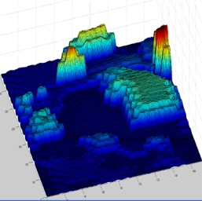
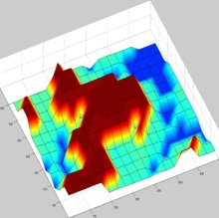


Proposed Solution
Using UAV to support Wilderness Search and Rescue
What does the three scales mean?
What are the information representations?
Probability Distribution Map
Task-Difficulty Map
UAV for WiSAR
Strategic
Areas of Focus
Task Difficulty
Information
Between-Episodes
Information
Within-Episode
Information
Notes:
Explain why areas of focus changed into prob. Dist.

Slide 4
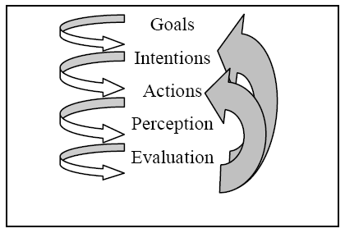
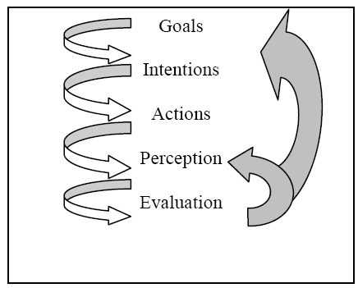
Research Area – Managing Autonomy
J. Scholtz (1992) Theory and evaluation of human robot interactions
Taxonomy of HRI roles:
Supervisor
Operator
Mechanic
Peer
Bystander
M. A. Goodrich & A. C. Schultz (2007) Human-robot interaction: a survey
Added two roles:
Mentor
Information Consumer
C. M. Humphrey & J. A. Adams (2009) Information abstraction visualization for human-robot interaction.
Added another role:
Abstract Supervisor
Norman’s HCI Model
HRI Model – Supervisor Role
Notes:
D. Normal 7 stages: 1. Formulation of the goal. 2. Formulation of the intention. 3. Specification of the action. 4. Execution of the action. 5. Perception of the system state. 6. Interpretation of the system state. 7. Evaluation of the outcome.
Gulf of execution is a mismatch between the user’s intentions and the allowable actions in the system.
Gulf of evaluation is a mismatch between the system’s representation and the user’s expectations.
Abstract Supervisor: Division Chief, Logistics Technical Specialist, Staging Area Manager, Operations Chief, Incident Unified Commander

Slide 5

Project Description
Proposed components with respect to the two information representations:
 | Probability Distribution Map | Task-Difficulty Map
Strategic | DistCreate for map creation | DiffCreate for map creation
Between-Episodes | DistEdit for map update and info management | DiffEdit for map update and info management
Within-Episode | IPPA path planning algorithms that support: real-time feedback and partial detection
 | SlidingAutonomy interface for autonomy management

