Slide 1

How does obesity related to Covid-19?
Lan Pham

Slide 2
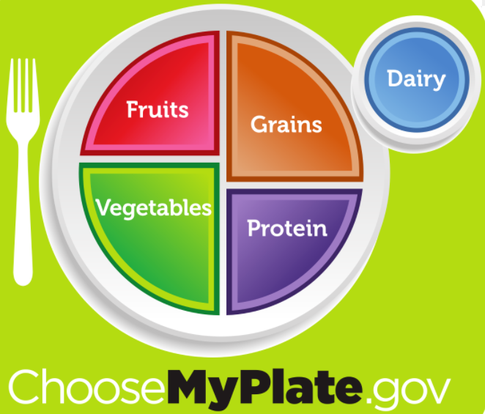
Project Overview
1. Cleaning Data: Python- pandas
2. Join database tables: Postgres SQL
3. Analysis:
Connect with database: SqlAlchemy
Further analysis: Pandas, Mathplotlib

Slide 3
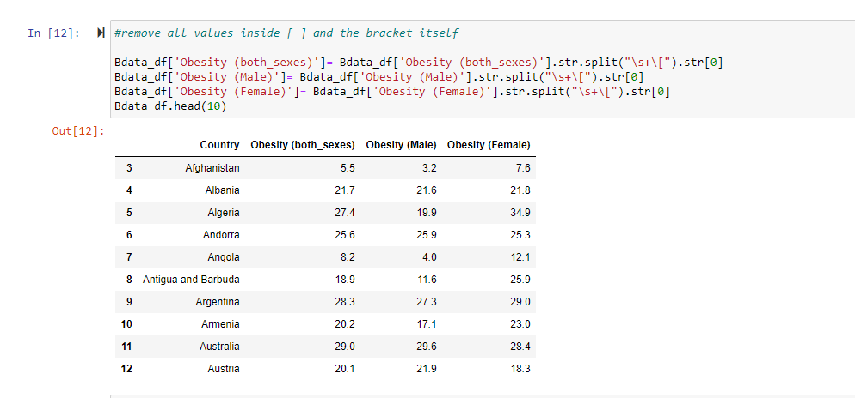
Cleaning Data

Slide 4

Postgres SQL

Slide 5
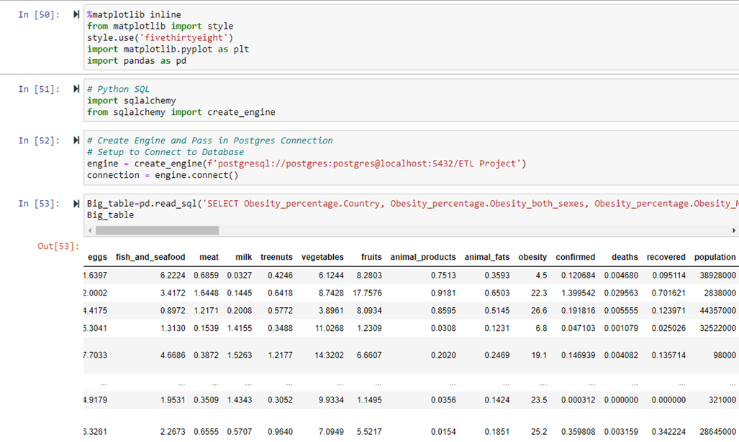
Analysis
SqlAlchemy

Slide 6
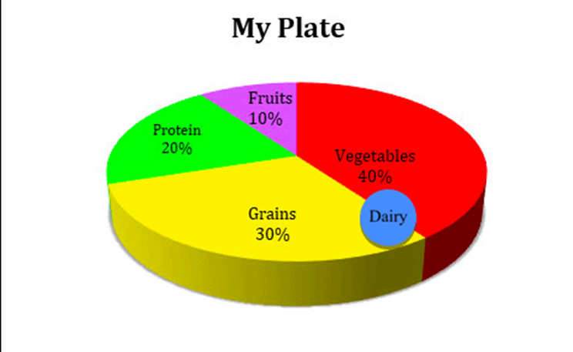
Daily diet intake recommended: 30% grains 40% vegetables 10% fruit 20% protein

Slide 7
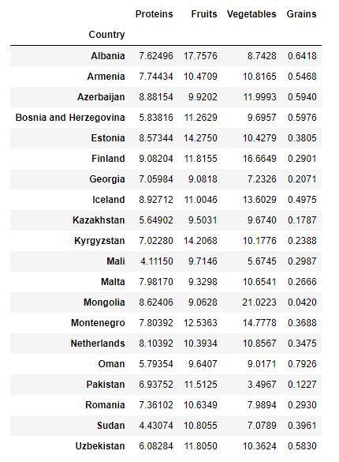
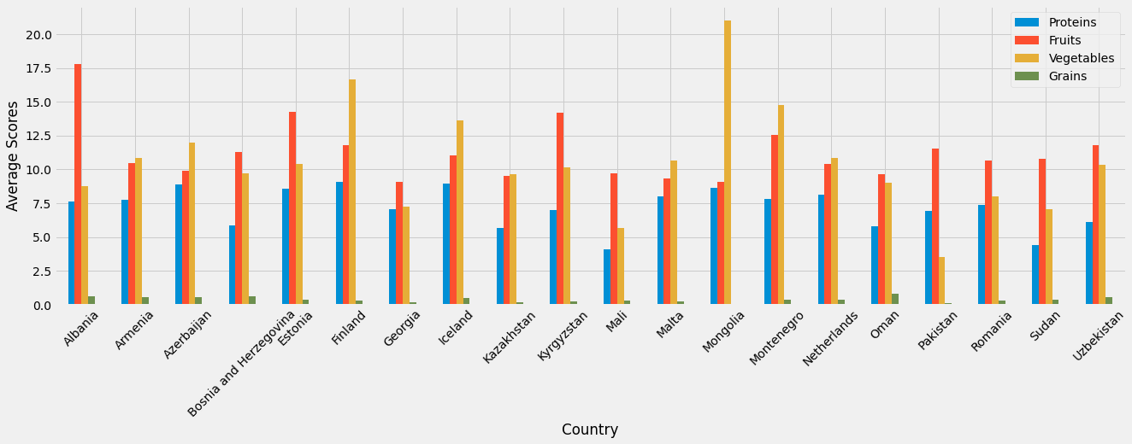
Which country has good nutrition?
Countries have met “at least” one of these four categories are:
some countries like Kiribati and Liberia has much better vegetables and protein but so low on fruits and grains
Haiti seems to have most balanced nutrients and its average is above other countries.

Slide 8
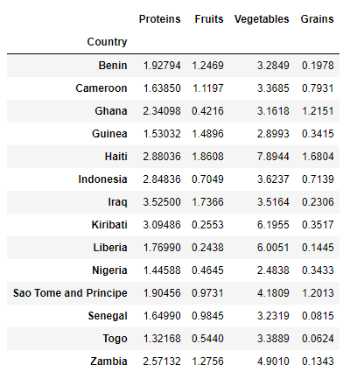
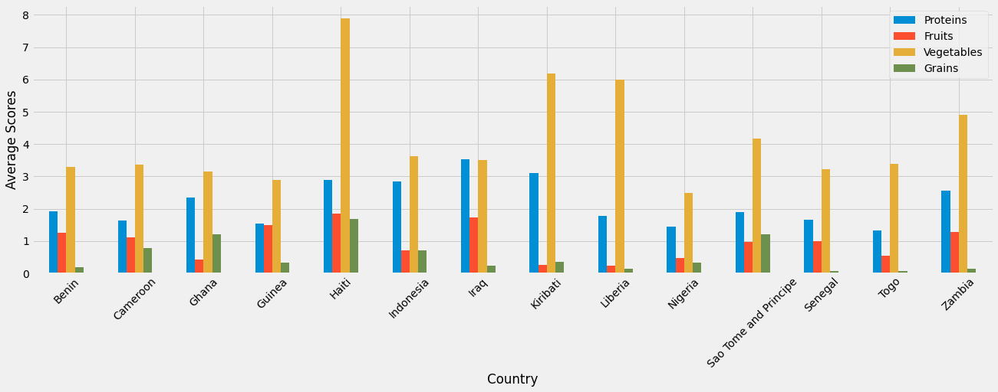
Which country has poor nutrition?
Countries have met “at least” one of these four categories are:
Nigeria seems to have the poorest nutrition

Slide 9
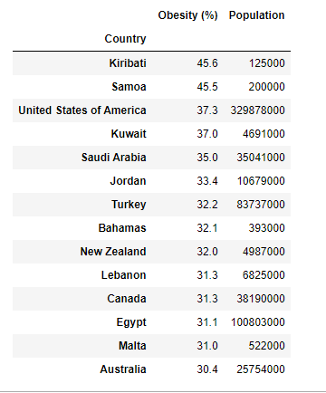
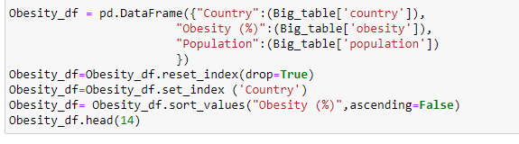
Which country has higher Rate of Obesity?
United State is the 4th country with highest obesity rate.
United State is not in the list of countries that met 90% of USDA suggestion for daily diet.

Slide 10

Is there any country with poor nutrition but still has high obesity rate?
Iraq and Kiribati are both countries with very low nutrition intake but have very high obesity rate.
Since nutrients are one of the key factor that could lead to obesity but other factors such as genetics, exercises could play a role in this as well.

Slide 11
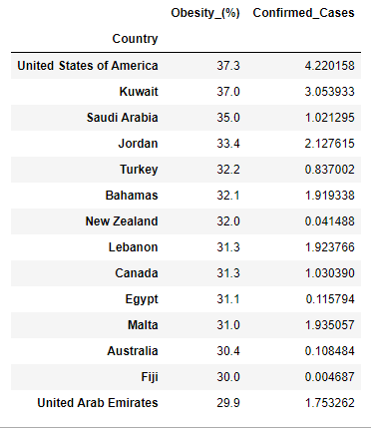
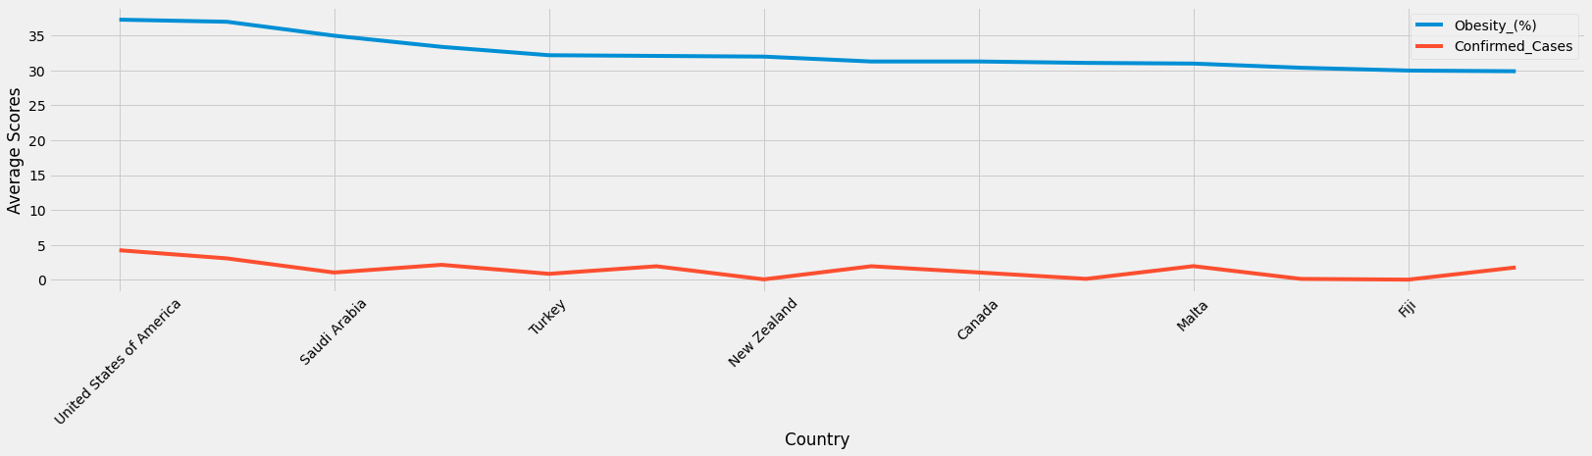
How does obesity relate to Corona Virus?
There is a parallel trend where countries with higher obesity rate have higher confirmed cases of Covid.

Slide 12
Conclusion
For the countries with better daily nutrition intake, they have lower chance of getting obese.
They have better immune system to fight the virus.
For those countries like United States and Kuwait who doesn't have too good of daily nutrition lead them to higher rate of obesity and more confirmed cases of Covid-19.

