Slide 1
ZenZone
Bom, Daniel, Ifeyemi, Lanre

Slide 2
People need refreshing online content
What’s wrong?
How can ZenZone help?
Digital era means everything is uploaded, compared and judged
Social media has been linked to higher rates of anxiety, depression
38% adults do not trust social media
Many users are dependent on digital content that contributes to poor mental health.
ZenZone provides an alternatively positive online experience
Takes user input to assess wellbeing and find most relevant resources in RT
Equips people to take charge of their own wellbeing in face of global digitalisation

Slide 3
ZenZone Assessment Process
User answers personalized questions about on and offline behaviour
1
Answers feed into our ZenZone algorithm and determine the area in need of most support
2
ZenZone feedbacks on development area, and provides a link to get started in real-time
3

Slide 4

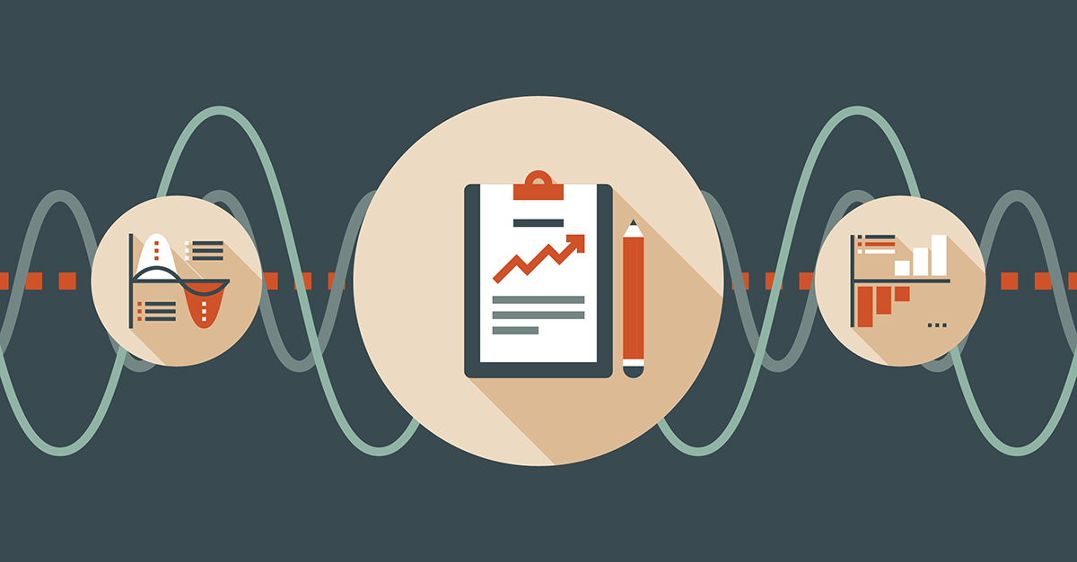
With more time and funding, we would aim to…
Include counselling chatbot service for real-time conversations with licensed counsellors
Create a software that monitors and tracks User behaviour to create ZenZone reports that are sent by email periodically

Slide 5
Thank you
Team ZenZone

