Slide 1

healthcare ANALYTICS solution
LANRE SEUN DATA ANALYST

Slide 2

Business problems
Prolife is a healthcare facility that has seen revenue instability despite serving a substantial patient base, and is currently faced with the challenge of sustaining and optimizing revenue growth amid these fluctuations. Understanding how key operational factors, such as patient demographics, types of health conditions treated, average length of stay (LOS), and the doctor-to-patient ratio, interact with patient volume and revenue can help address inefficiencies and align resources effectively.

Slide 3

Key insights
Revenue showed a strong positive correlation with patient numbers, highlighting the importance of patient throughput.
Patients aged 36-65 contributed the most to revenue, with a near-equal gender split and a focus on chronic conditions like arthritis, diabetes, and hypertension.
Extended LOS beyond the average of 16 days did not result in higher revenue, signaling resource misallocation.
Over 50% of revenue came from treating arthritis, diabetes, and hypertension, making these conditions critical for targeted healthcare programs.
The current 1:1 doctor-to-patient ratio did not show operational efficiency and may not be economically sustainable.
Revenue dropped in 2021 but began recovering in 2023, with the 2024 dip attributed to incomplete data, showing potential for sustained recovery with strategic improvements.

Slide 4



ANSWERING THE BUSINESS QUESTIONS
How does the length of stay (LOS) impact revenue, and where are potential inefficiencies in LOS management?
Which patient demographics and conditions contribute the most to revenue?
What are the trends in revenue and patient volume from 2019 to the current year, and how are they correlated?
The average LOS was around 16 days, but an extended LOS did not necessarily correspond to increased revenue.
Analysis indicates that 50% of cases where LOS exceeded the average did not show significant revenue gains, highlighting inefficiencies.
Patients occupying beds for extended periods without corresponding revenue gains suggest that the facility’s resources may be better allocated to manage patient flow, reduce unnecessary LOS, and increase throughput.
Patients aged 36-65 are the highest revenue contributors, especially those presenting with urgent medical needs.
This age group is balanced across genders, implying that both male and female patients within this age range contribute comparably.
Key health conditions among these patients include arthritis, diabetes, and hypertension, accounting for over 50% of the patient base.
This demographic and their specific health conditions represent a high-value segment that could be targeted with specialized, focused healthcare services.
From 2019 to 2020, revenue increased, showing a positive trend in alignment with rising patient volumes. However, revenue declined significantly in 2021, suggesting potential operational or external challenges that impacted both revenue and patient numbers.
A gradual recovery is seen in 2023, with a dip again in 2024 due to the partial year, showing a high dependence on patient volume to sustain revenue.
Scatterplot data indicates a strong positive correlation between revenue and patient volume, suggesting that an increase in patient numbers generally translates to higher revenue, although exact correlation values are unavailable.

Slide 5

Explanation of key insights and metrics
In an era where healthcare facilities must balance quality care with financial sustainability, this healthcare center, Prolife, faced the dual challenge of stabilizing revenue while addressing operational inefficiencies. With a total revenue of 1.42 billion dollars derived from treating over 40,000 patients, the center witnessed fluctuations in revenue linked closely to patient volumes and length of stay. Through an in-depth look at patient demographics, key health conditions, and service efficiency, this analysis uncovered pathways to enhance revenue stability and optimize patient care.
Over the years, revenue trends have reflected direct correlation with patient volume. From 2019 to 2020, both patient volume and revenue showed an encouraging rise. However, the downward shift in 2021 raised concerns over potential inefficiencies or external disruptions that reduced throughput. Partial recovery in 2023 suggested renewed patient interest, yet revenue again dipped in 2024 which may likely have been due to incomplete data for the year. A scatterplot analysis supports a direct positive correlation between revenue and patient numbers, painting a promising scenario: with strategic patient intake and flow management, the center could harness this correlation to bolster revenue consistency.
The analysis spotlights patients aged 36-65 as the facility’s primary revenue drivers, equally divided across genders. These patients predominantly present with chronic conditions such as arthritis, diabetes, and hypertension, which constitute over 50% of the facility’s treated cases.

Slide 6
Explanation of key insights and metrics
Patients within the range of 36-65 offer a promising opportunity: by focusing on specialized care for these conditions, the center can cater effectively to this high-value group. Enhancing services specifically tailored for chronic conditions among middle-aged adults could foster patient loyalty and potentially increase revenue from repeat visits and referrals.
Further investigation revealed that LOS exceeding the current average of around 16 days, did not correspond to higher revenue. Around 50% of cases with above-average LOS did not contribute significantly to revenue, suggesting that patients remained in the system longer than necessary. In fact, extended stays often strain resources without yielding proportional revenue benefits. Addressing these inefficiencies through optimized discharge and patient flow management would enable the facility to admit more patients, ultimately enhancing both patient satisfaction and revenue potential.
Doctor-to-Patient Ratio Analysis Currently operating at a 1:1 doctor-to-patient ratio, the facility maintains an economically sustainable model for managing patient care. With a throughput of 3,384 patients in the current year versus a previous high of 9,318, this ratio appears adequate. However, as the facility works to streamline LOS and increase patient admissions, a slightly adjusted ratio could support both patient

Slide 7
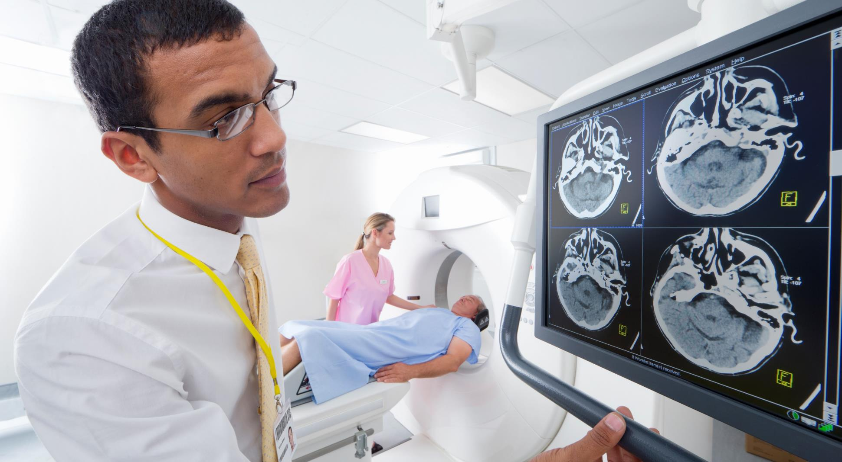




Critical metrics
40K
$1.42B
372.22
1:1
-0.65%
Patient Base
Healthcare Revenue
Average LOS
Ratio of Doctor to Patient
YoY Revenue
Current Situation

Slide 8
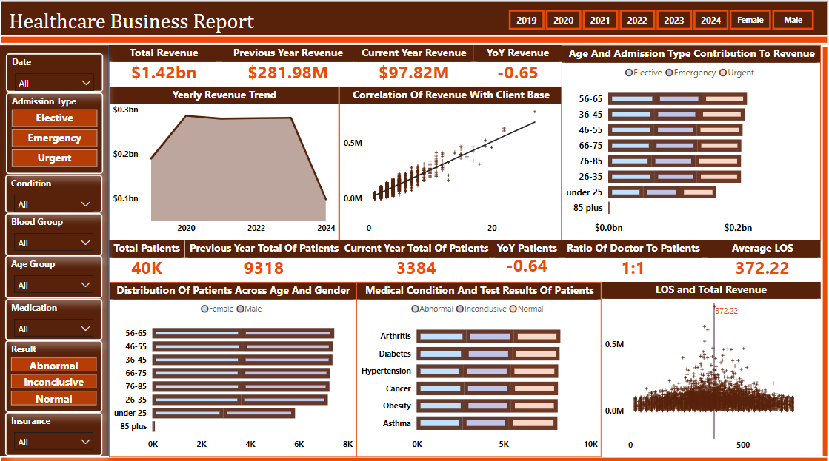
THE MARKET
CUSTOMER SEGMENTATION
22%
45%
38%
10%
8%
Pediatrics
General
Cosmetic Procedures
Orthodontics
Emergency

Slide 9
RECOMMENDATIONS
Concentrating on patients aged 36-65 with chronic conditions (arthritis, diabetes, and hypertension) will allow the center to build specialized programs that can address the needs of its most profitable demographic.
By refining LOS practices to reduce unnecessary extensions, the facility can free up resources, improve patient throughput, and potentially increase revenue.
Monitoring and adjusting the doctor-to-patient ratio as patient throughput grows, will help maintain a sustainable model for optimal healthcare service delivery.

Slide 10
conclusion
The healthcare facility's performance highlights critical opportunities to improve operational efficiency and stabilize revenue. A strong correlation between patient volume and revenue underscores the importance of optimizing patient throughput, while the demographic analysis reveals that patients aged 36-65 with chronic conditions are the most valuable contributors. However, inefficiencies in managing length of stay limit the facility’s revenue potential, and the current doctor-to-patient ratio is an imperative for recalibration as patient numbers are expected to increase. By targeting high-value patient segments, streamlining LOS management, and optimizing resources, the facility can achieve sustainable growth while maintaining high standards of care.

