Slide 1
Technathon: Problem Description
Abdulkareem M AlSofi
26/10/2018

Slide 2
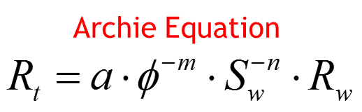

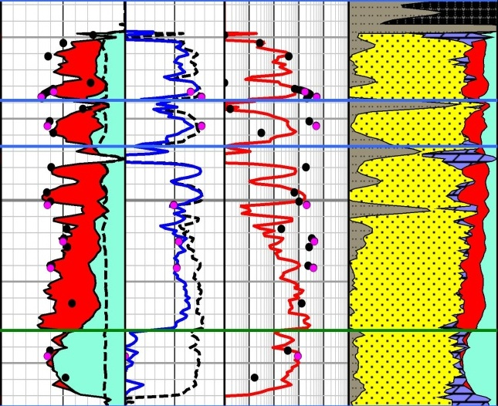
Technathon Problem Statement
The Norm: Predict saturation through the resistivity log.
Resistivity Log

Slide 3
Technathon Problem Statement
The Norm: Predict saturation through the resistivity log.
The Problem: Estimate fluid saturation across a well without relying on a resistivity log.
Unavailable: Tool size limitation.
Unreliable: Unfavorable geology.
Resistivity Log

Slide 4
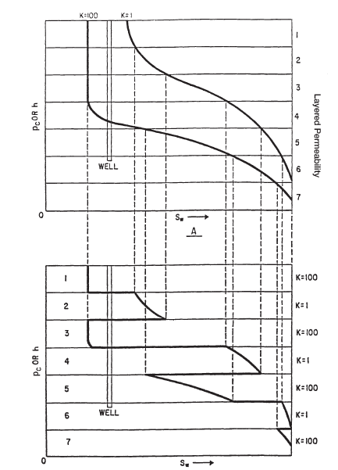
Technathon Problem Statement
The Norm: Predict saturation through the resistivity log.
The Problem: Estimate fluid saturation across a well without relying on a resistivity log.
Unavailable: Tool size limitation.
Unreliable: Unfavorable geology.
Non-representative: Initial state not current.
Resistivity Log

Slide 5
Technathon Problem Schematic
Log Data
Missing Log

Slide 6
Technathon Problem Schematic
Log Data
Predict Rock Type
Estimate Fluid Fraction
Missing Log

Slide 7

Technathon Problem Schematic
Log Data
Predict Rock Type
$$P_{c}^{Lab_Eq}=\frac{H_{aWL}}{0.085215}$$
Estimate Fluid Fraction
Missing Log

Slide 8
Technathon Problem Schematic
Log Data
Predict Rock Type
$$P_{c}^{Lab_Eq}=\frac{H_{aWL}}{0.085215}$$
Estimate Fluid Fraction
Missing Log

Slide 9
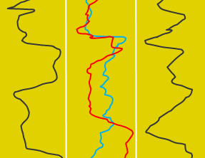
Technathon Problem Schematic
Logs
Lab Intrusion
Log Data
Predict Rock Type
$$P_{c}^{Lab_Eq}=\frac{H_{aWL}}{0.085215}$$
Estimate Fluid Fraction
Missing Log

Slide 10
Technathon Data Provided
Logs
Lab Intrusion
Log Data
Predict Rock Type
$$P_{c}^{Lab_Eq}=\frac{H_{aWL}}{0.085215}$$
Estimate Fluid Fraction
Missing Log

Slide 11
Technathon Data Provided
Logs
Lab Intrusion
1 Clustering
Lab_Curves
Logs-5
Logs-4
Log Data
Predict Rock Type
$$P_{c}^{Lab_Eq}=\frac{H_{aWL}}{0.085215}$$
Estimate Fluid Fraction
Missing Log

Slide 12
Technathon Data Provided
Logs
Lab Intrusion
1 Clustering
Lab_Curves
Logs-5
Logs-4
Log Data
2 Training
Logs-B
Logs-C
Logs-D_Lost_Sections
Predict Rock Type
$$P_{c}^{Lab_Eq}=\frac{H_{aWL}}{0.085215}$$
Estimate Fluid Fraction
Missing Log

Slide 13
Technathon Data Provided
Logs
Lab Intrusion
1 Clustering
Lab_Curves
Logs-5
Logs-4
Log Data
2 Training
Logs-B
Logs-C
Logs-D_Lost_Sections
Predict Rock Type
$$P_{c}^{Lab_Eq}=\frac{H_{aWL}}{0.085215}$$
3 Testing
Logs-A
Logs-D_Lost_Sections
Estimate Fluid Fraction
Missing Log

Slide 14
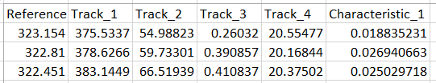
Technathon Data Structure
Lab_Curves
1 Clustering
Lab_Curves
Logs-5
Logs-4
Logs

Slide 15
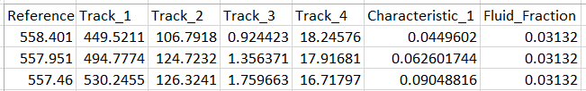
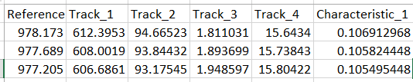
Technathon Data Structure
Lab_Curves
1 Clustering
Lab_Curves
Logs-5
Logs-4
Logs
2 Training
Logs
Logs-B
Logs-C
Logs-D_Lost_Sections
Logs
3 Testing
Logs-A
Logs-D_Lost_Sections

Slide 16
Technathon One Approach
Logs
Lab Intrusion
1 Clustering
Lab_Curves
Logs-5
Logs-4
Log Data
2 Training
Logs-B
Logs-C
Logs-D_Lost_Sections
Predict Rock Type
$$P_{c}^{Lab_Eq}=\frac{H_{aWL}}{0.085215}$$
3 Testing
Logs-A
Logs-D_Lost_Sections
Estimate Fluid Fraction
Missing Log

Slide 17
Technathon Goal: Generate Missing Log
Logs
Lab Intrusion
1 Clustering
Lab_Curves
Logs-5
Logs-4
Log Data
2 Training
Logs-B
Logs-C
Logs-D_Lost_Sections
3 Testing
Logs-A
Logs-D_Lost_Sections
Missing Log

Slide 18
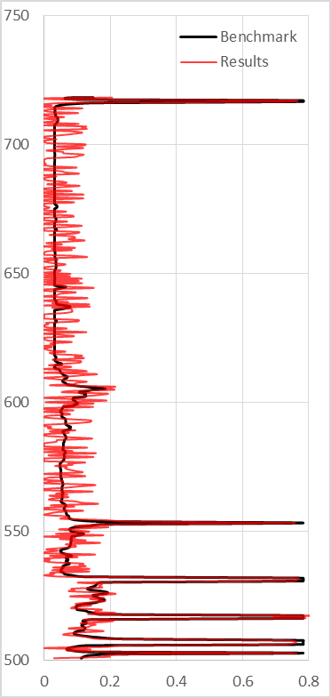
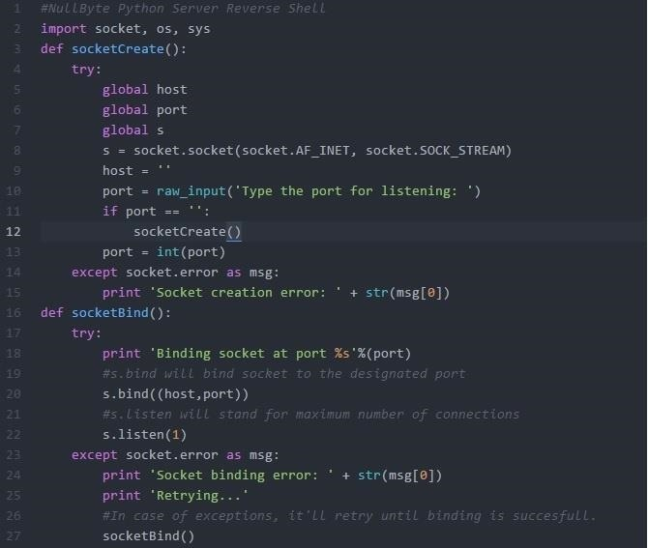

Technathon Evaluation
Results
Presentation
Algorithm

