Slide 1
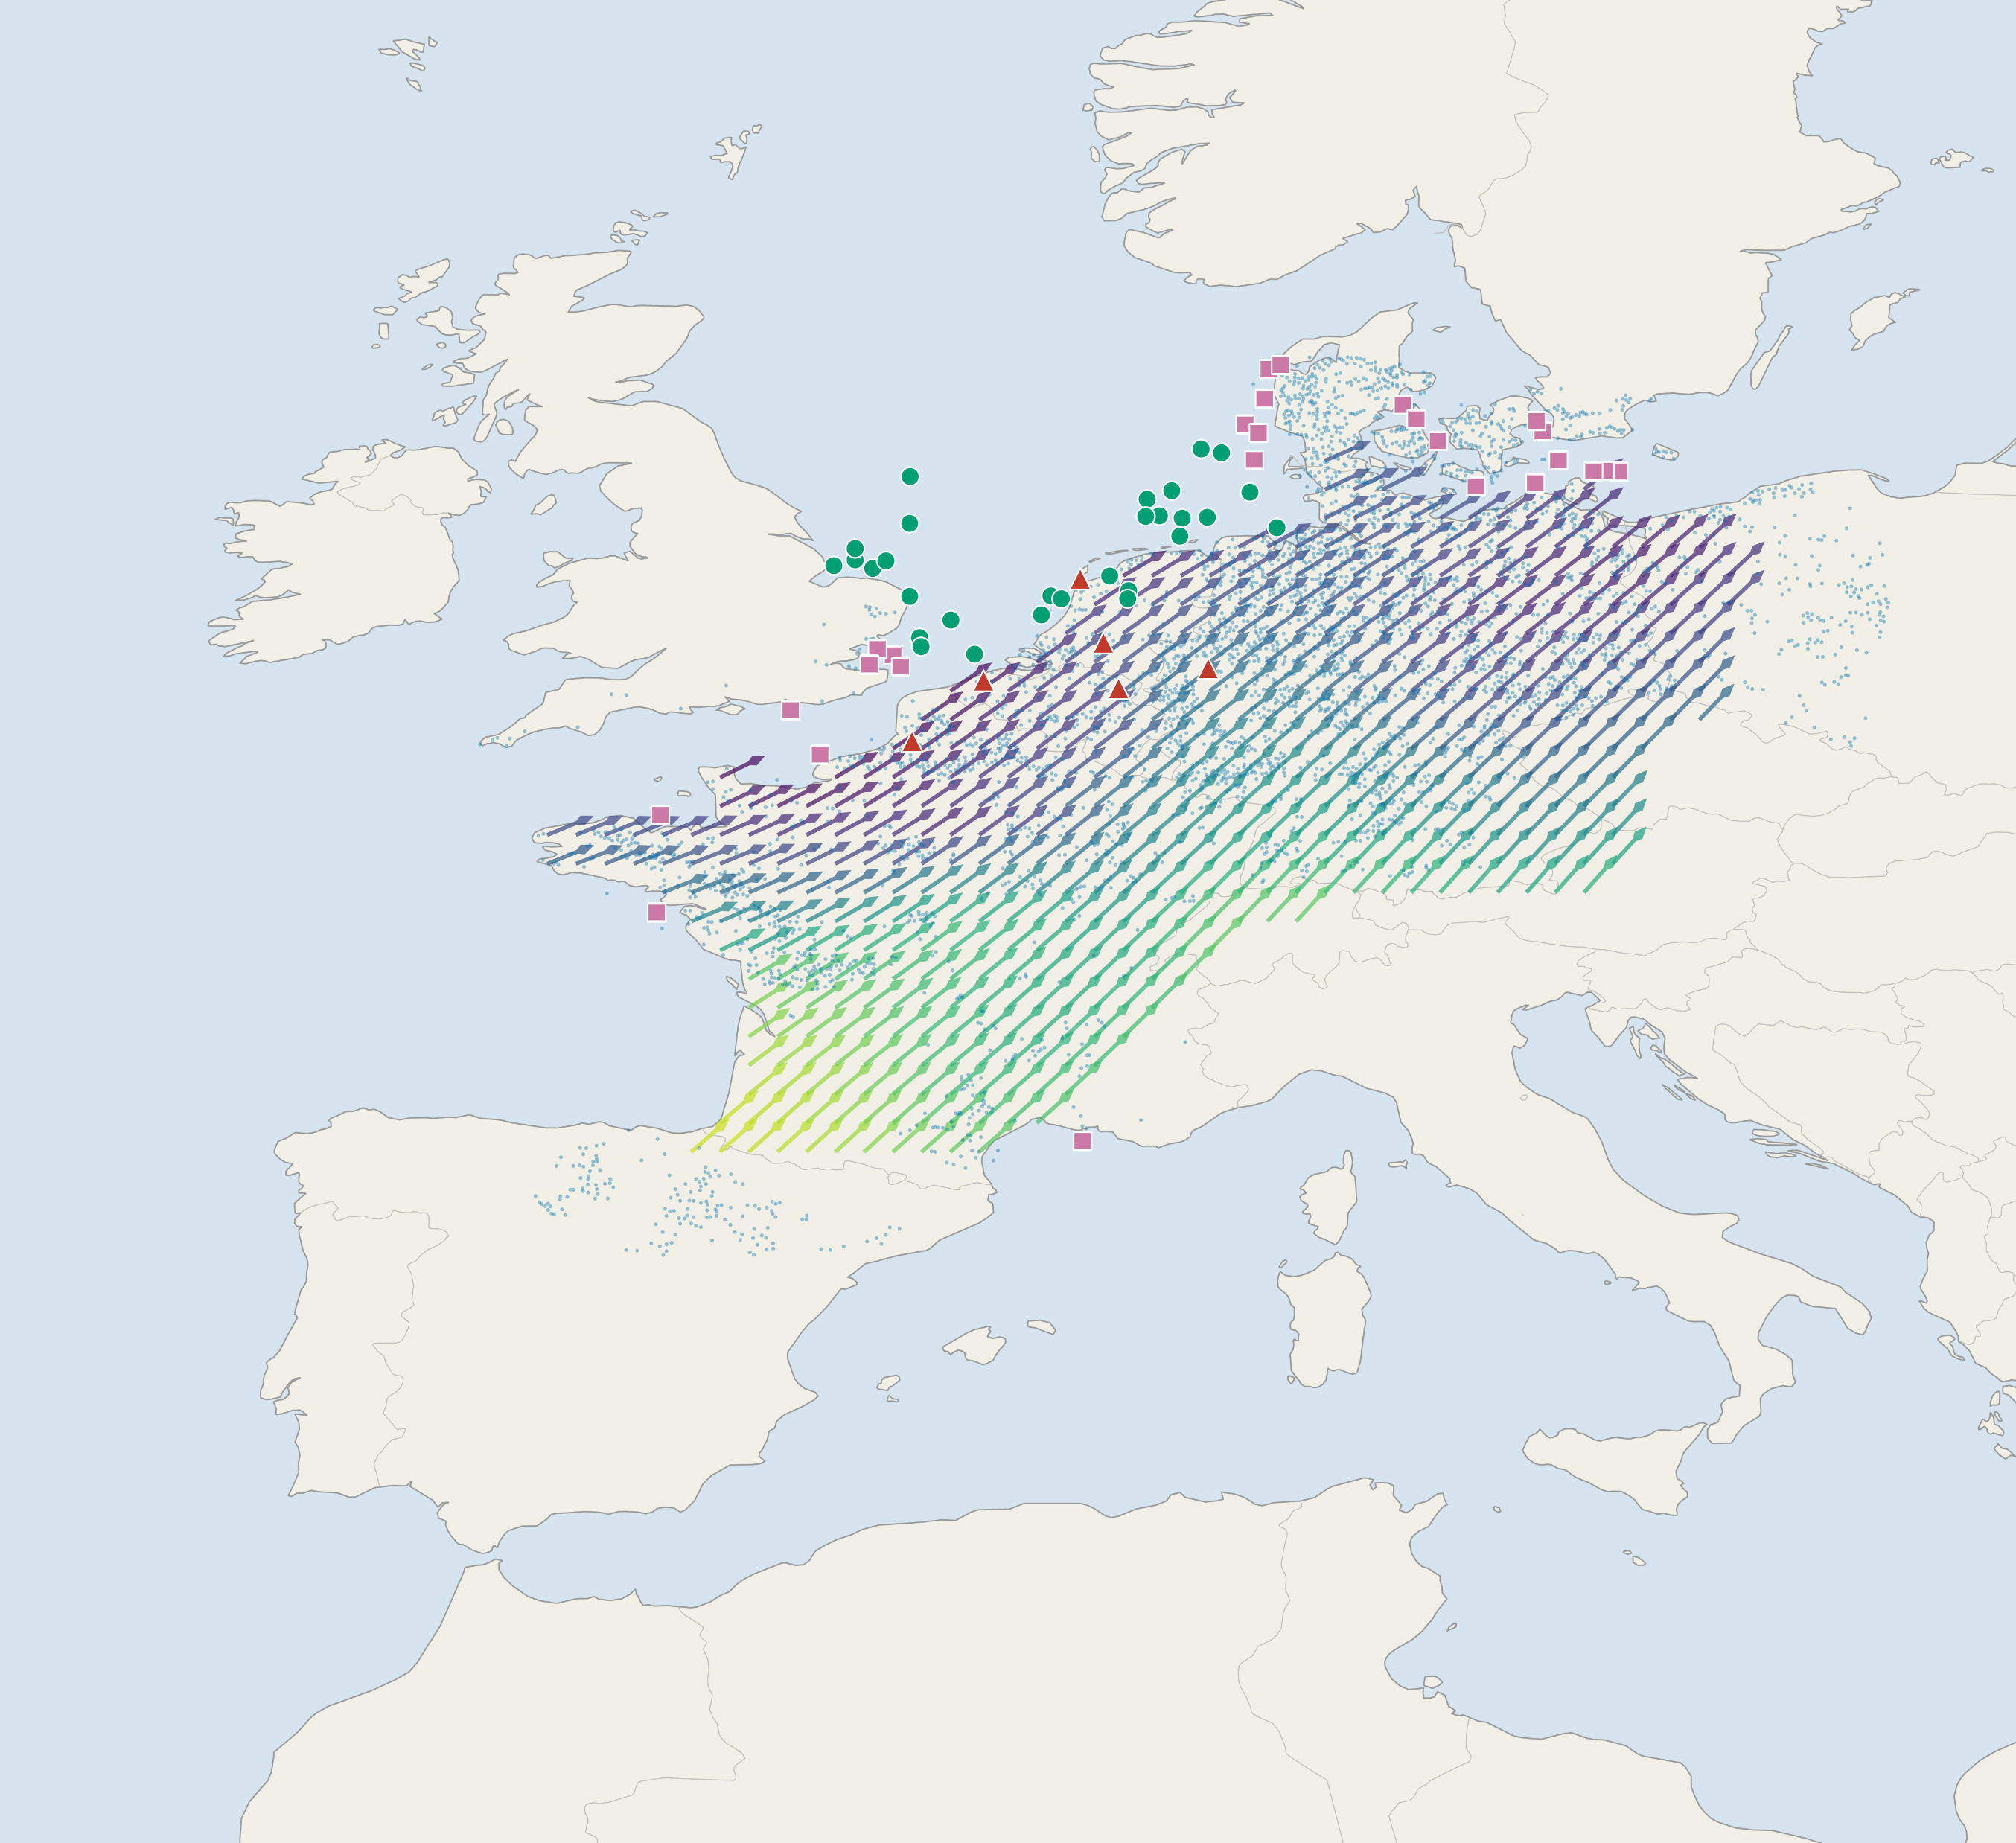
a
Study region and spring migration direction field
Spring migration direction concentration
Onshore wind farm (n = 4,191)
Offshore farm, VPTS radar (n = 29)
0.85
0.90
0.95
1.00
Offshore farm, Bauer grid (n = 26)
Weather radar station (n = 6)
Mechanism chain (b → f): array orientation, not siting alone, sets exposure
b
Migration field φ
φ ≈ 52°
2,025 cells; mean bearing 52 deg, concentration 0.89
c
Array orientation θ
φ
f
A ≤1% AEP budget buys nearly all of it
θ ∥ φ
θ ⊥ φ
low exposure
high exposure
Exposure is purely geometric: E ∝ sin²(θ − φ)
At a 1% AEP budget the median exposure cut is 97% onshore, 84% VPTS, 48% Bauer
d
Energy vs ecological optimum
e
A small rotation captures most of the gain
≤20°
0°
30°
60°
90°
misalignment Δ (°)
Median misalignment 48 / 40 / 45 deg; bars = IQR
Δθ₅₀ = 17° onshore; a ≤20° rotation already captures 55% of the avoidable exposure

