Slide 1
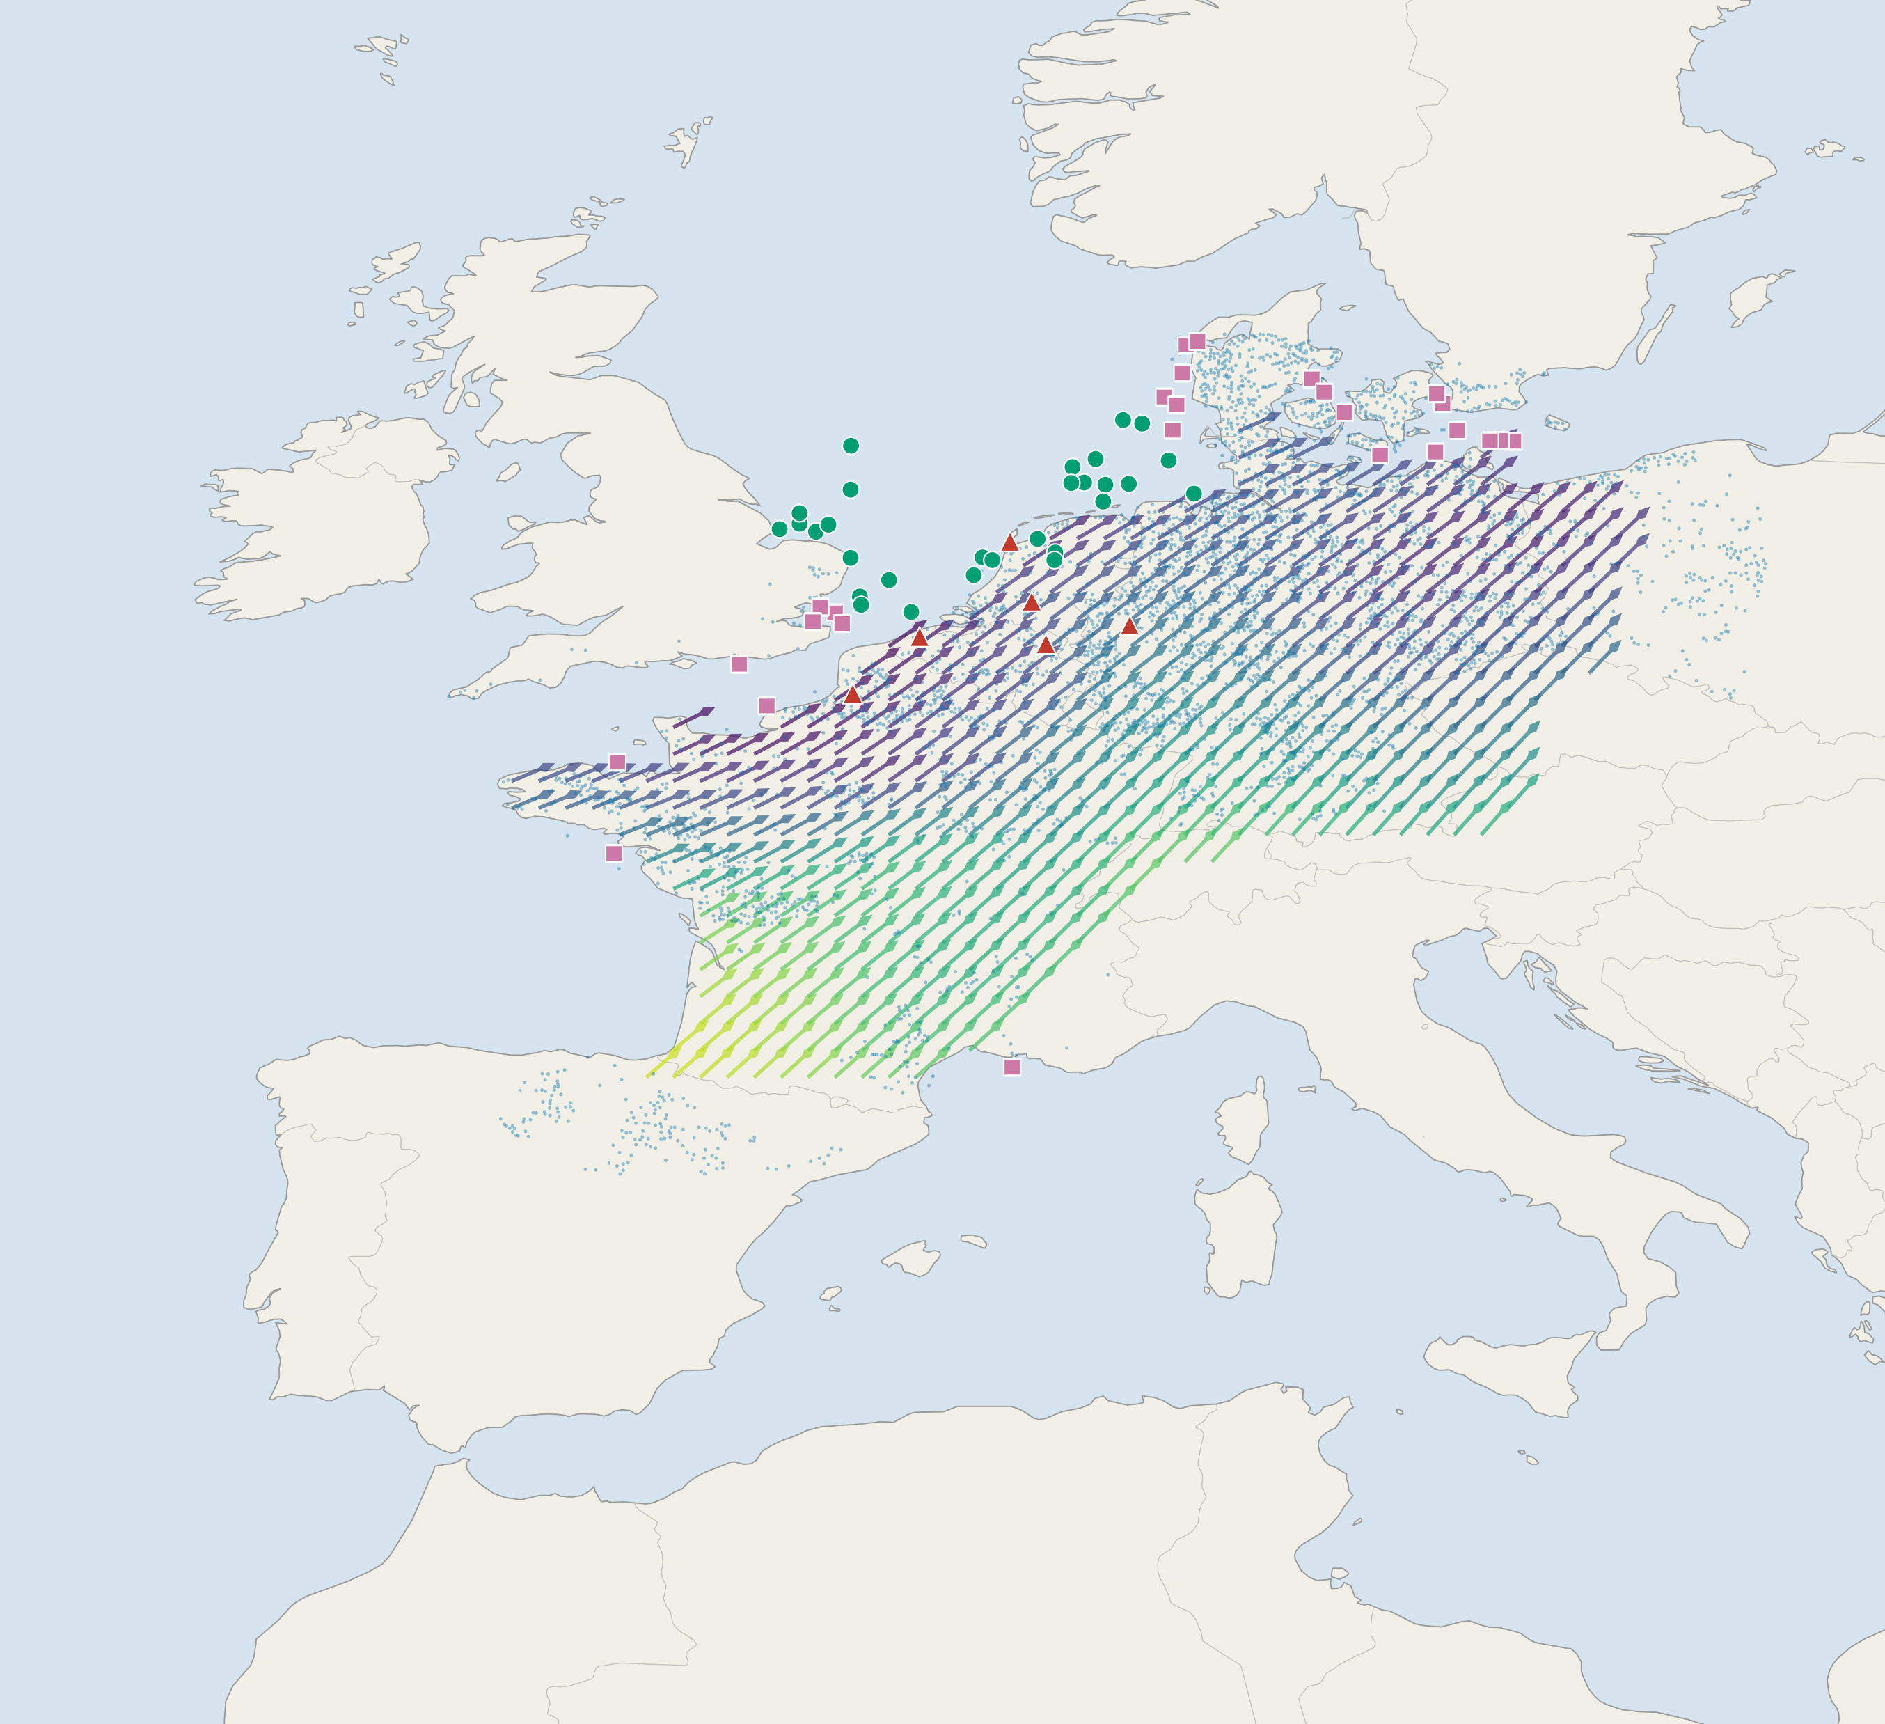
a
Study region and spring migration direction field
Spring migration direction concentration
Onshore wind farm (n = 4,191)
Offshore farm, VPTS radar (n = 29)
0.85
0.90
0.95
1.00
Offshore farm, Bauer grid (n = 26)
Weather radar station (n = 6)
Mechanism — why array orientation, not siting alone, controls migratory collision exposure
b
Migration field φ
c
Array orientation θ
d
Energy optimum ≠ ecological optimum
e
A small rotation captures most of the gain
f
A ≤1% AEP budget buys nearly all of it
φ ≈ 52°
φ
≤20°
θ ∥ φ
θ ⊥ φ
0°
30°
60°
90°
low exposure
high exposure
misalignment Δ (°)
2,025 grid cells; mean spring bearing 52°, direction concentration 0.89
Exposure is purely geometric: E ∝ sin²(θ − φ)
Median Δ = 48° onshore, 40° VPTS, 45° Bauer (top to bottom); bars = IQR
Δθ₅₀ = 17° onshore; a ≤20° rotation already captures 55% of the avoidable exposure
At a 1% AEP budget the median exposure cut is 97% onshore, 84% VPTS, 48% Bauer

