Slide 1
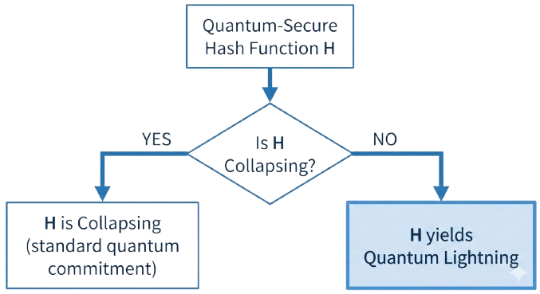
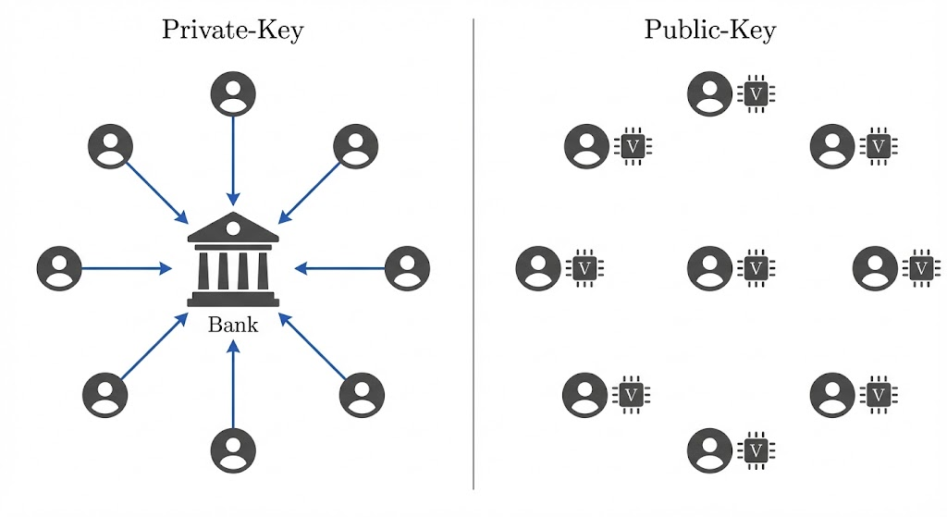

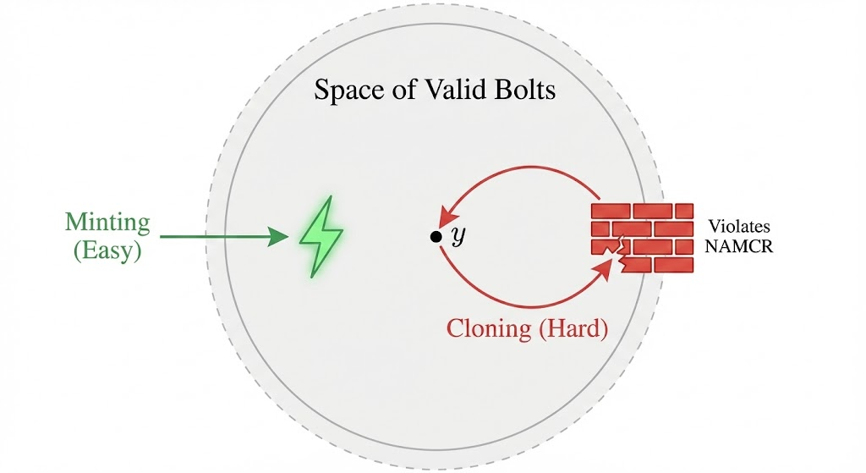





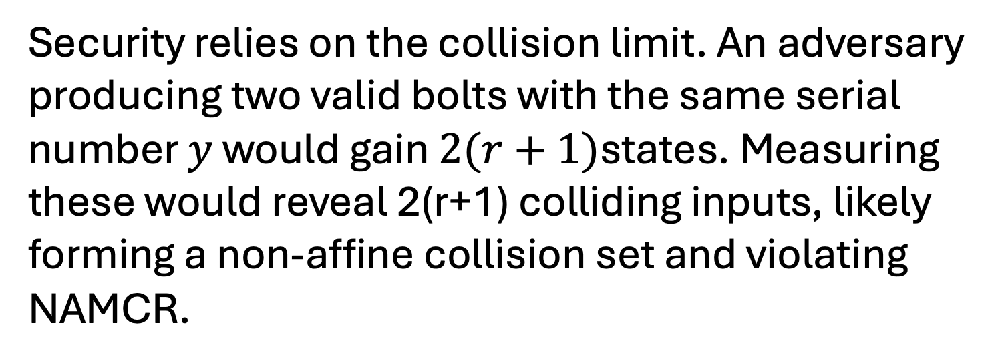
Quantum Lightning: Intuition, Construction, and the Limits of Public-Key Money
Juncheng Ding, Tian Ariyaratrangsee, Xiaoyang Zheng
PHYS-C191A Final Report, UC Berkeley
Foundations & Motivation
Core Mechanism
Limitation & Conclusion
1.Introduction to Quantum Money
4. The "Win-Win" Framework
7. The Inflation Problem
Core concept: Quantum money utilizes quantum states as banknotes, leveraging physical laws for security.
How do we build this? Zhandry proved that quantum-secure hash functions fall into a strict dichotomy:
Collapsing: Measuring the hash output destroys the superposition, collapsing the state to a classical preimage.
Not Collapsing: The state remains in a superposition indistinguishable from the original. If a hash function is not collapsing, it inherently yields Quantum Lightning.
* *Theorem: Unbounded Generation:* For any polynomial $N$, a QPT algorithm can produce $N$ valid, distinct banknotes with overwhelming probability.* *Public Verification => Public Generation:* Since the generation algorithm Storm uses only public operations, anyone with a quantum computer can execute it.* Unlike private-key schemes, there is no secret key to restrict minting.* Public Mint -> Unlimited Supply
The No-Cloning Theorem: The security backbone is the impossibility of copying unknown quantum states. There is no mapC such that
8. The Cloning-Generation Dichotomy
* *Targeted Cloning is Intractable:* Duplicating a specific serial number $y$ requires solving the specific multi-collision problem for that $y$, which is hard under NAMCR.* *Random Minting is Trivial:* Generating new money implies sampling random inputs for a random $y'$. Due to the large output space ($2^n$), collisions with existing notes are negligible, making inflation easy.* Targeted Cloning: Hard (NAMCR)* Random Minting: Easy (Generate New)
2. Private-key vs Public-key Schemes
Private-Key (Wiesner's Scheme): Relies on a trusted authority (Bank) holding secret information. Verification requires measuring qubits in secret bases known only to the bank.* *Public-Key Quantum Money:* * *
5. The Degree-2 Polynomial Hash
We utilize a specific hash function believed to be non-collapsing.
The Function: Defined by random upper-triangular matrices $A_{i}$ over
Lack of Collision Resistance: This function is not collision-resistant. Affine collisions (inputs lying on a line) can be found efficiently by solving linear equations.
The Hardness Assumption (NAMCR): While finding affine collisions is easy, finding a large set of Non-Affine Multi-Collisions is computationally infeasible.
Goal: Allow anyone to verify a banknote using a public circuit, eliminating the need for a central authority for verification.
9. Conclusion
The Challenge: Verification must be public, yet counterfeiting must remain computationally infeasible.
*Summary:* Quantum lightning achieves perfect anti-counterfeiting (uniqueness) but fails to solve supply control.* *Implication:* Public-key quantum money cannot function as a scarcity-based currency because any user can act as a "mint".* *Future Outlook:* While "lightning never strikes the same state twice," it can strike anywhere. Restricting generation remains a major open problem in quantum cryptography.
Definition: A scheme is sound if no adversary can produce two valid states ………. that both pass verification
6. Anatomy of a Bolt
Because single copies are vulnerable to affine attacks, we must enforce structure.
Tensor Structure: A valid bolt $B_{y}$ is the tensor product of $r+1$ entangled copies of the preimage superposition state
Mini-Verification (Span Check): The verifier checks that each register lies in the valid span of preimages
Consistency Check: The verifier measures the hash $f_{A}$ on all $r+1$ registers. To pass, they must all yield the same serial number $y$.
3. Zhandry’s Quantum Lightning
Definition:* A stronger form of public-key quantum money where "lightning never strikes the same place twice".* *Bolts:* Quantum states generated via a public procedure Storm.* *The "No Double-Strike" Property:* It is computationally infeasible to produce two distinct bolts, $\rho_1$ and $\rho_2$, that verify to the same serial number $s$. This is stronger than standard no-cloning; it prevents an adversary from generating any collision, not just copying a specific target.
References
7. Why Security Holds
[1] S. Wiesner, SIGACT News (1983).
[2] S. Aaronson & P. Christiano, STOC (2012).
[3] M. Zhandry, Journal of Cryptology (2021).
Security relies on the collision limit. An adversary producing two valid bolts with the same serial number $y$ would gain $2(r+1)$states. Measuring these would reveal 2(r+1) colliding inputs, likely forming a non-affine collision set and violating NAMCR.

