Slide 1
Joins and Subqueries
Charles Laurence Gula, Krizzel Taripe, Earl Kim Hernani

Slide 2
01
What are Joins?
What do they do?

Slide 3
Joins
The join expression can also be referred to as table reference
It combines rows from two or more tables, based on a related column between them.
There are multiple types of joins

Slide 4
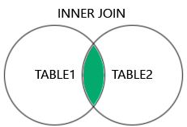
Inner Join
Inner Join combines rows from two or more tables based on a shared value between them.
Matches rows from tables
Excludes non-matching rows
Works on common columns

Slide 5
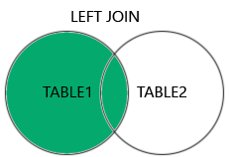
Left Join
Returns all the rows from the left side table and matching rows from the right side table.
Fills non-matching rows with null

Slide 6
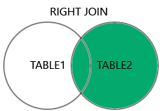
Right Join
Returns all the rows from the right side table and matching rows from the left side table.
Fills non-matching rows with null

Slide 7
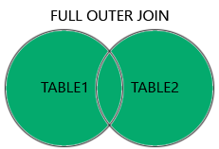
Cross Join
Returns all combinations of rows from both tables.
Susceptible to duplication

Slide 8
Self Join
A Self Join is a regular join, but the table is joined with itself
It’s basically a copy of the table
Used for comparing rows of the same table
Helps in displaying the hierarchy of data

Slide 9
02
What are Subqueries?
How are they different from queries?

Slide 10
SQL Subqueries
An SQL subquery is a SELECT statement within another statement:
They allow queries that are structured so that it is possible to isolate each part of a statement
They provide alternative ways to perform operations that would otherwise require complex joins and unions
Many people find subqueries more readable than complex joins or unions. Indeed, it was the innovation of subqueries that gave people the original idea of calling the early SQL “Structured Query Language.”

Slide 11
Subquery Clauses and Keywords
WHERE Clause
ALL and ANY keywords
Correlated Subquery
Uses a subquery within the WHERE clause to filter results
The ALL operator checks if a condition is true for every value in a subquery, while ANY checks if the condition is true for at least one value in the subquery.
A correlated subquery is a subquery that contains a reference to a table (in the parent query) that also appears in the outer query. MySQL evaluates from inside to outside.
EXISTS and NOT EXISTS
SELECT and FROM Clause
The EXISTS operator tests for the existence of rows in the results set of the subquery. If a subquery row value is found, EXISTS subquery is TRUE and in this case NOT EXISTS subquery is FALSE.
Subqueries work in a SELECT statement's FROM clause

