Slide 1
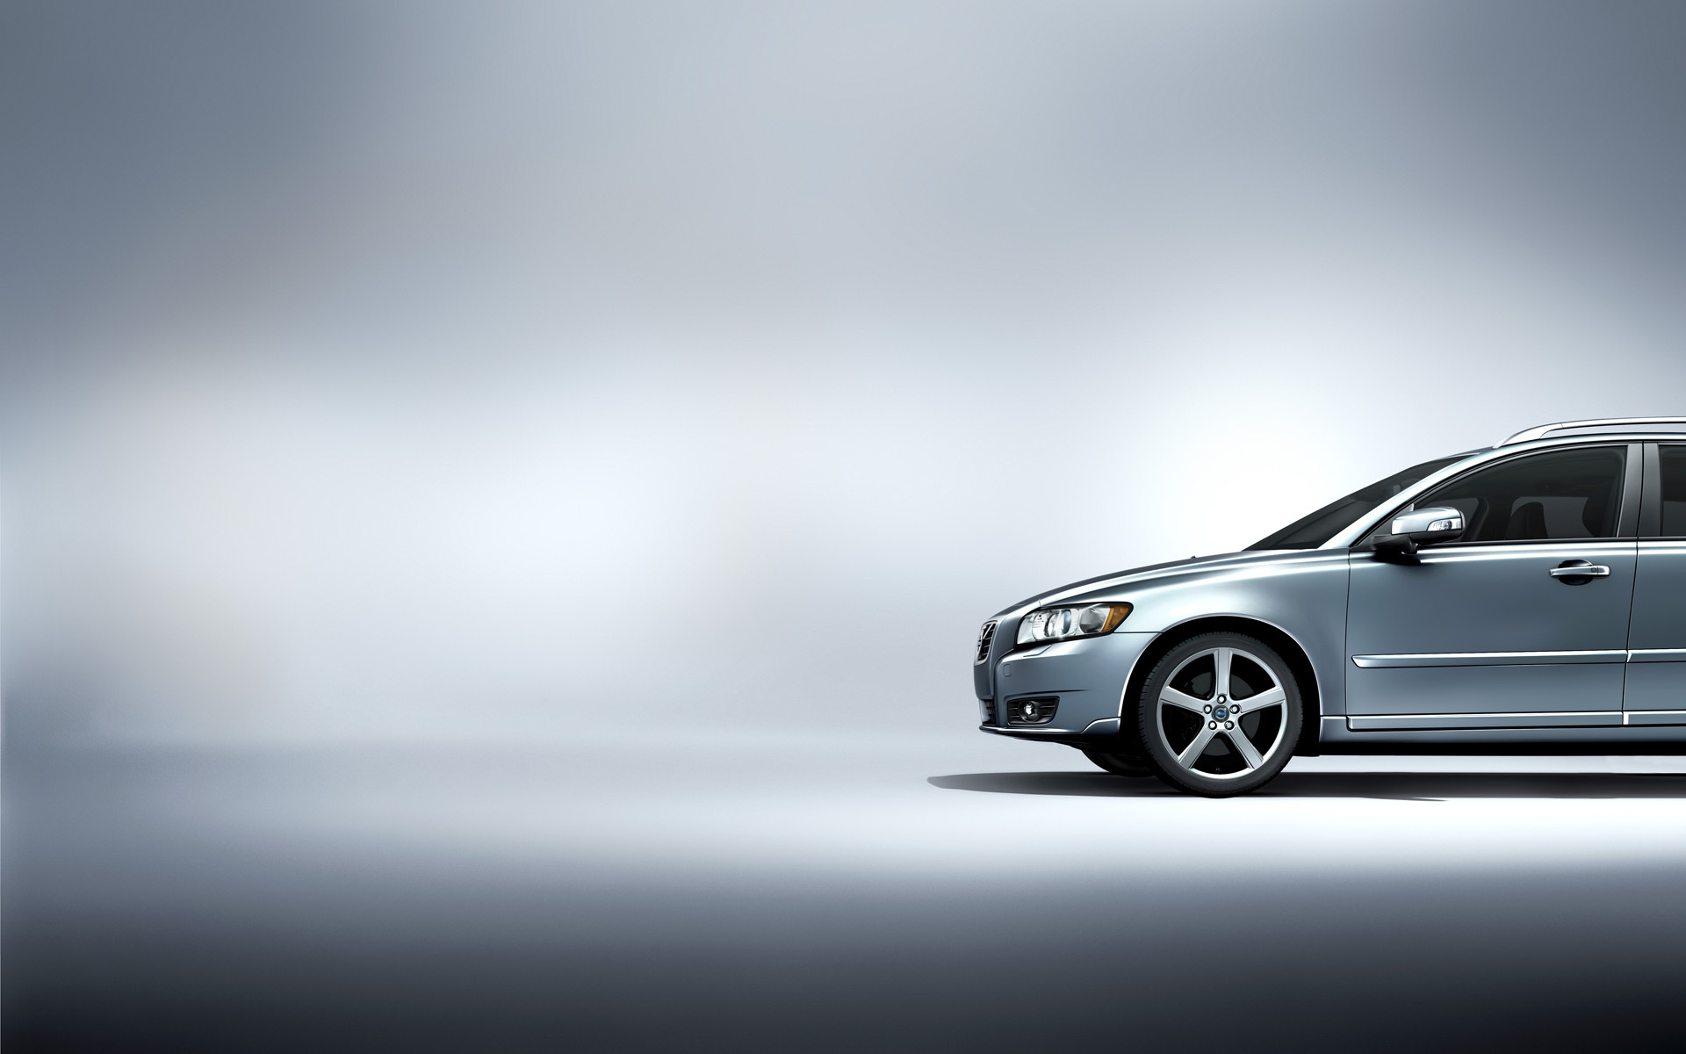
Car Manufacturer Suggested Retail Price Prediction
Lanxi Liu
URL: https://github.com/LanxyL/Capstone2

Slide 2
Why?
Demand for cars is high in US:
89% of all American adults have a driver’s license (>25 years old)
The U.S. auto industry sold over 3.4 million cars in 2020
Buying a car is stressful:
There is no much transparency about the price
Too many brands, models and features to choose from

Slide 3
Who might be the potential user?
Car Buyers
Car Manufacturers
Car Dealers
What kind of car I can afford?
Which feature affect the most on price?
What will be a reasonable price for a set of features I chose?
Is this car model overpriced?
What price should we set for the new launched car?
What would be a reasonable price for a particular car?

Slide 4
What features might affect the retail price?
Data source: Kaggle dataset scraped from Edmunds and Twitter
Market Category
Year
Horsepower
Popularity
Size

Slide 5
About the Data
Year range: 1990-2017
It covers 48 brands with 11914 entries
Price range: $2,000-$2,065,902
16 Features included:
(Make; Model; Year; Engine Fuel Type; Driven Wheels; Number of Doors; Market Category; Vehicle Size; Vehicle Style; Highway/City MPG; Popularity; MSRP)

Slide 6
Data Wrangling
There are 5 columns with missing values.
Most missing values on “Market Category”
No clear pattern about the reason
Data might be lost at the parsing process or the original data has no category assigned
Engine horsepower has second-most missing data
Most information were filled up with horsepower found on the internet
The rest are for electric car which has no horsepower information
Dropping all duplicate rows: 11914 entries left
Correct a wrong entries which found as an outlier

Slide 7
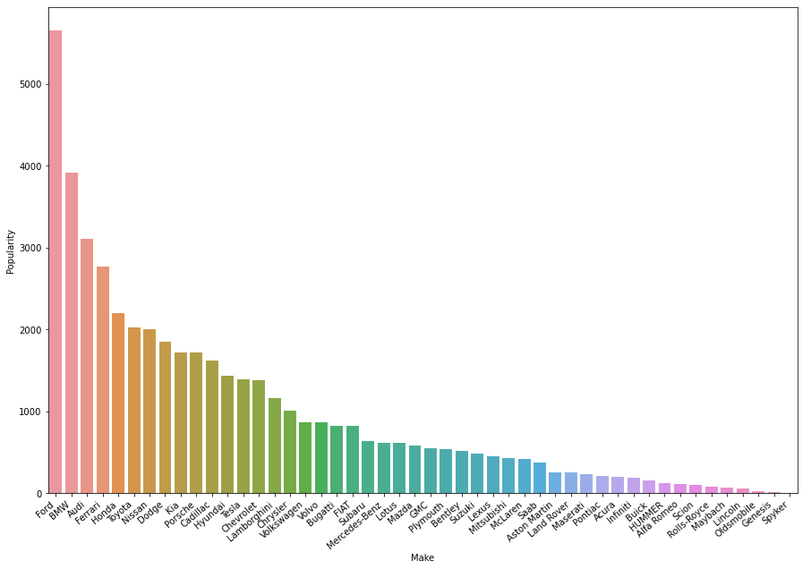
Exploratory Data Analysis
The popularity variable is directly associated with brand
The top 3 brands are:
Ford
BMW
Audi

Slide 8
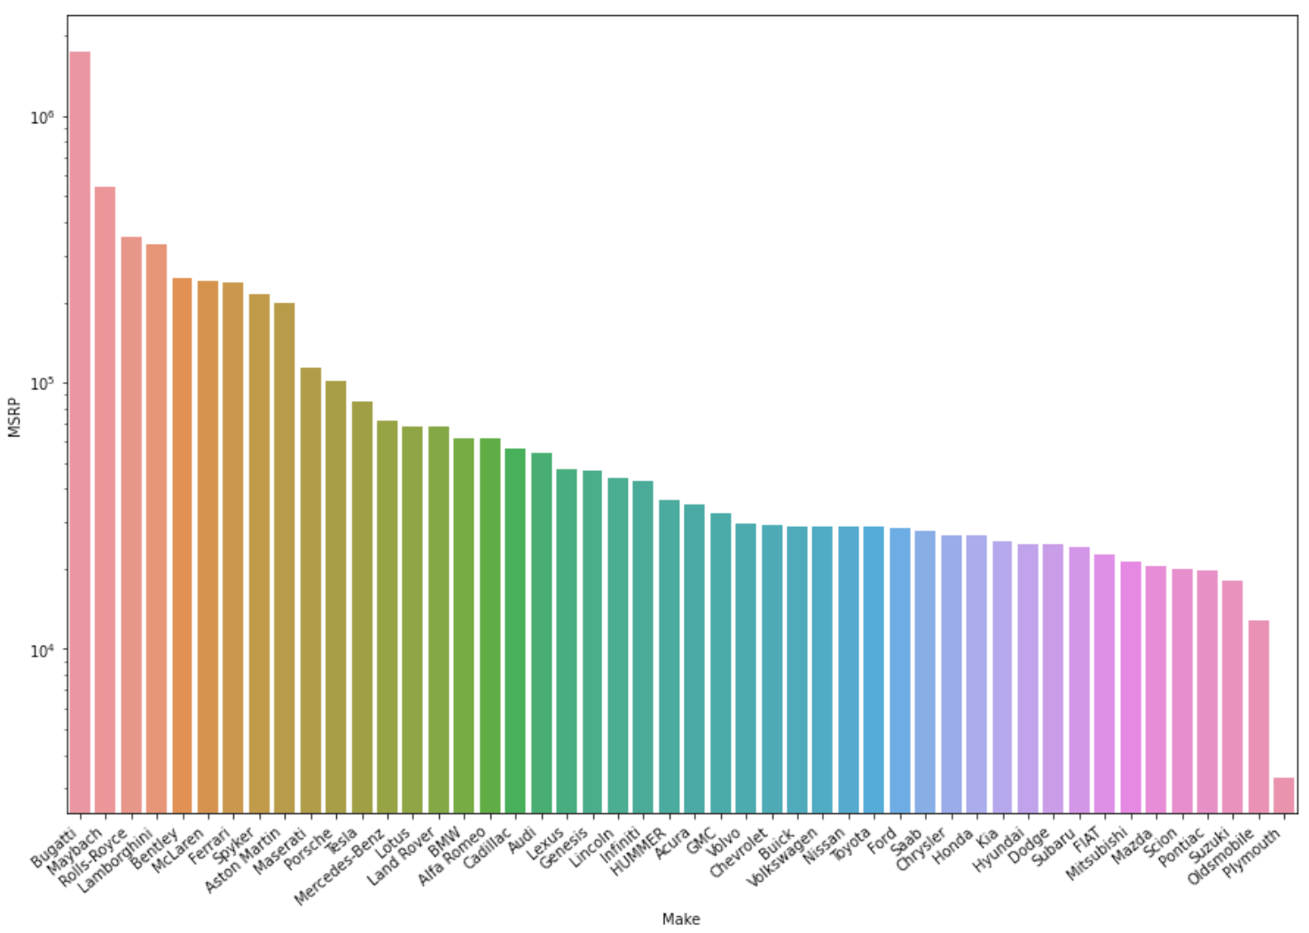
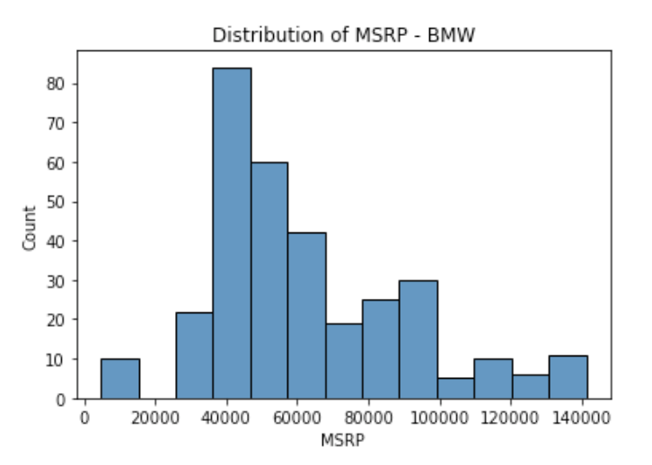
Brands vs. MSRP
Some brands like Bugatti, Maybach, Rolls-Royce and Lamborghini focus more on the high performance cars which typically sold for more than $200,000
However, each brand typically has several models that covers a range of prices.

Slide 9
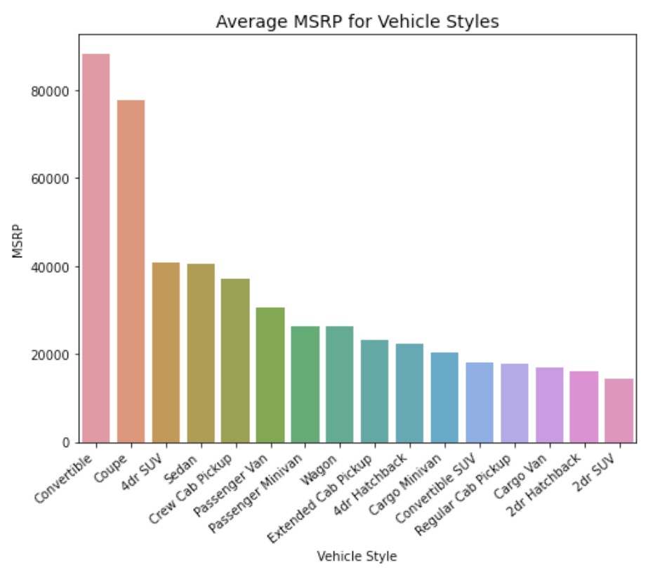
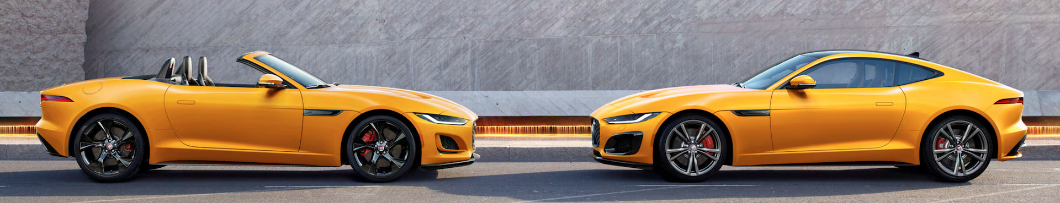
Styles vs. MSRP
Top two styles:
Convertible
Coupe
These two styles tend to show up on luxury cars.

Slide 10
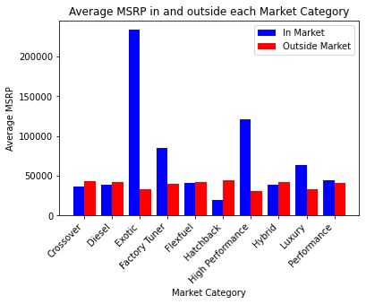
Market Categories vs. MSRP
Exotic
High Performance
Factory Tuner
Luxury
These 4 market categories obviously affect the price.

Slide 11
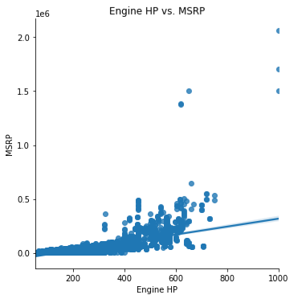
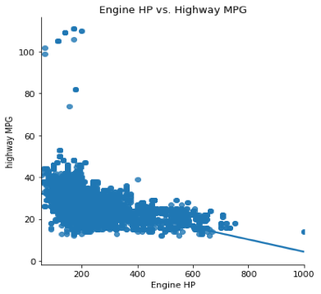
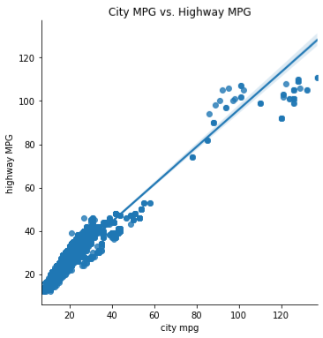
Numerical Features
Engine Horse Power ↑
MSRP ↑
Engine Horse Power ↑
Highway MPG ↓
City MPG ↑
Highway MPG ↑

Slide 12
Machine Learning Modeling
Type: Supervised Learning
Data Separation: 70% - Train Set; 30% - Test Set
Two models were tested:
Linear regression model
Random forest regression model

Slide 13
Linear Regression Model
Random Forest Model
Pipeline Steps:
Missing data imputation
Scaler
Feature Selection
With “SelectKBest” function
f_regression as soring method
Cross validation (CV) for hyperparameter tuning:
5 fold cv
Using Scikit-learn Grid Search method
Pick K with highest accuracy
Pipeline Steps:
Missing data imputation
Scaler
Cross validation (CV) for hyperparameter tuning:
5 fold cv
Using Scikit-learn Grid Search method
Choose best parameters that give highest accuracy:
Depth of tree
Number of estimator
Imputer method
Scale or not

Slide 14
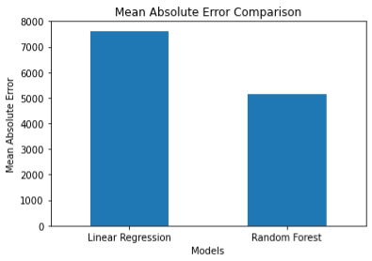
Model Performance
Mean absolute error was used to exam the model performance
Linear regression: $7622
Random forest: $5133
Random forest model not only has lower MAE, also higher R² score and higher accuracy

Slide 15
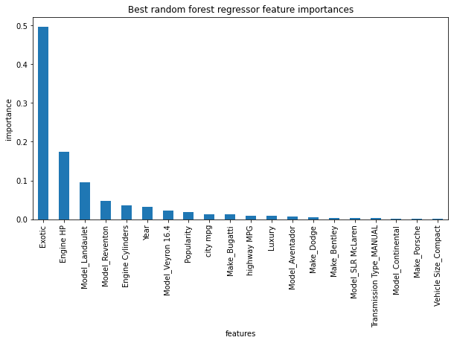
Important Features
Top 3 features which have biggest influence on price:
Market Category – Exotic
Engine Horsepower
Model – Landaulet
Brands and Models are important features to the prediction model, but what if we hide them all?

Slide 16
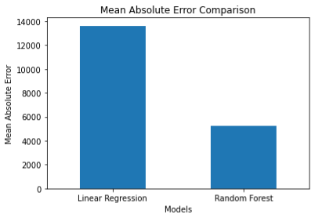
With or Without Info about Brands and Models
The performance for random forest model is slight better without brands and models, which the performance for linear regression model got worst with twice the error without brands and models.
7622
13616
5133
4948

Slide 17
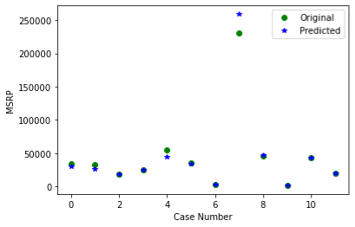
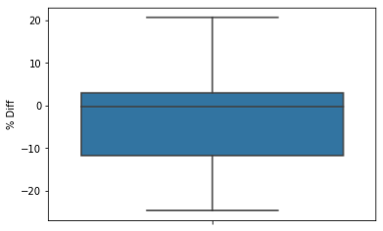
Prediction
% of difference between Predicted price and the actual MSRP ranges from -24.7% to 21.2% while 75% of the cases are within 12%.
The model meets the initial target of 80% accuracy.

Slide 18
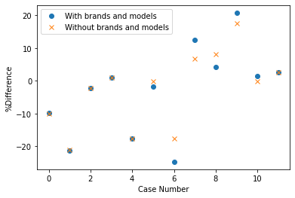
Prediction with/without brands and models
The prediction was generally more accurate without information about brands and models.

Slide 19
Conclusions
Random Forest Model provided the best results
The average error of prediction is about $5000
Future improvements:
Use more recent data
(there are no data between 2017 to 2021)
More features
(Material, Quality, Brand reputation, etc.)
Model flexibility
(ability to fit the model with missing inputs, output a price range instead of a exact price)

