Slide 1
Amazon Home & Kitchen Recommendation System
Lanxi Liu
URL: https://github.com/LanxyL/Capstone3---Recommendation-System

Slide 2
Why?
Surge in Demand for Home Improvement in US:
Highest levels of home improvement spending in the history of US
Real estate market is booming because of low interest rate
Recommendation System:
Prompts more sales
Improve customer shopping experience

Slide 3
Who might be the potential user?
Amazon User
Marketing Team
I am looking for some decorating ideas for my new house.
How is the item I am browsing compared to others?
What is the most popular / highest rated item in this category?
How to attract more user to buy products?
How to increase the exposure of items to users?
How to increase the amount of sales per order?

Slide 4
About the Data
Data source: Amazon product data from lab lead by Professor Julian McAuley at UCSD.
Two datasets: Reviews Data & Meta Data
Reviews:
4,253,926 entries
Info about review contents, summary, rating and review time, etc.
Meta:
436,988 entries
Info about sales rank, categories, item name, item description, product relationship, brand and price

Slide 5
Data Wrangling
Source files in JSON format
Many missing data on product information
Key information: Reviewer ID, Item ID and ratings do not have missing data
Dropping all redundant columns
Convert time-dependent objects to datetime object
Merge reviews and meta datasets

Slide 6
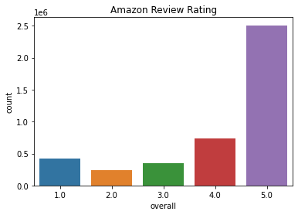
Exploratory Data Analysis
Highly skewed
Mean rating: 4.1
Standard Deviation: 1.33
Quantiles:
25%: 4 50%: 5 75%: 5

Slide 7
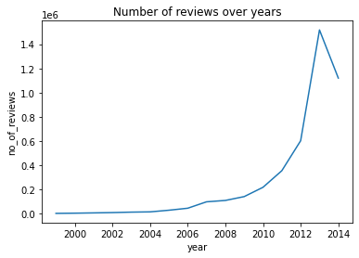
Number of Reviews over Years
Exponentially increase over time
Steep drop between 2013 to 2014
Overall trend: More and more users using Amazon

Slide 8
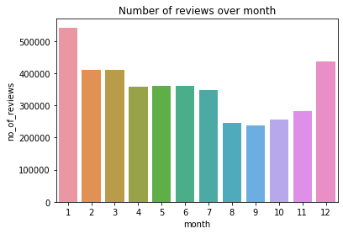
Number of Reviews Over Month
Highest: January & December
Lowest: August to November
Possible reason: Holiday Season surges the sales

Slide 9
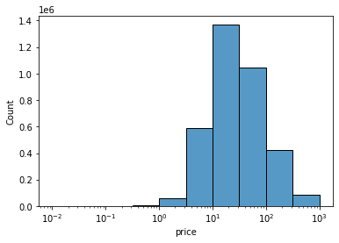
Product Price Distribution
Mean: $5.72
STD: $8.74
Quantiles:
25%: $12.99
50%: $26.20
75%: $59.99
If we ignore those very cheap items, the price distribution is almost a normal distribution. Most of items that got reviews range between 13 to 60 dollars.

Slide 10
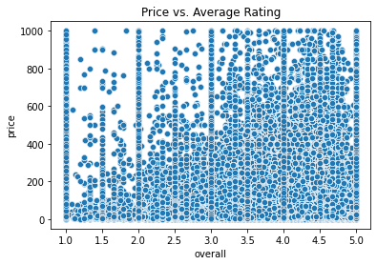
Price vs. Average Rating
Items with higher price turn to get higher rating.
Cheap items has wider range of ratings

Slide 11
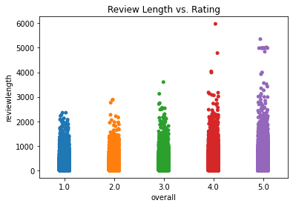
Review Length vs. Average Rating
Longer the review, higher chance for a high rating

Slide 12
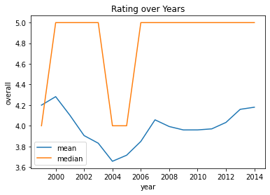
Rating over Years
Highest of average rating on 2000
1999, 2004 and 2005 have lower median rating

Slide 13
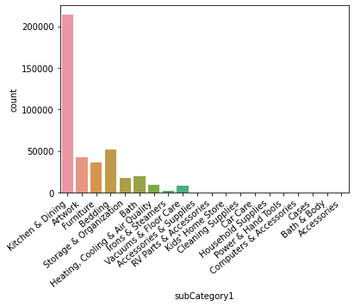
Category Reviews Count
Kitchen & Dining category has most reviews
Total 2,575,376 entries
Use Kitchen & Dining subcategory for Modeling purpose
(Only include items with >10 reviews & users gave>10 reviews)
Final dataset size:
81,948

Slide 14
Modeling
Type: Supervised Learning
Data Separation: 80% - Train Set; 20% - Test Set
Feature Engineering:
Average rating of user
Average rating of item
Number of users rate the item
Number of items user rated
Etc.
Metrics: RMSE & MAE
RMSE weights more for large error, so it is more preferable

Slide 15
Algorithms
4 Base Model:
5-star model (RMSE 1.168)
Content-filtering based model with mean rating of users (RMSE 1.016)
Collaborative-filtering based with mean rating of items (RMSE 0.98)
Collaborative-filtering based with mean rating of items bought together (RMSE 0.972)
Surprise Library & XGBoost: (Individual & combinations of ML algorithms)
XGBoost regression
BaselineOnly
KNN-Baseline
SVD
SVD++

Slide 16
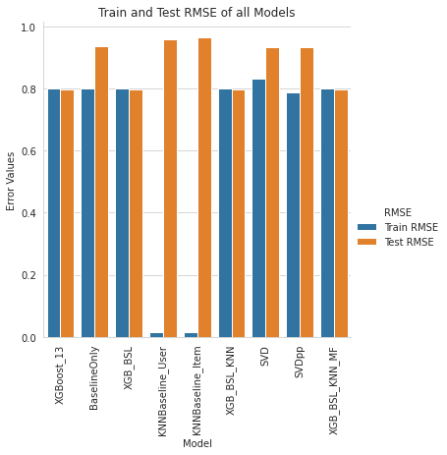
Model Performance
XGBoost regression gave the lowest RMSE: 0.795
The combination of different algorisms didn’t improve the XGBoost model and the difference was tiny.

Slide 17
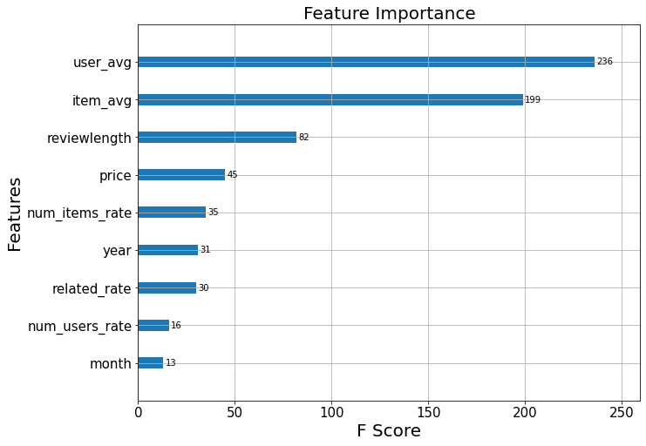
Important Features
Top 3 features which have biggest influence on rating prediction:
Average rating of user
Average rating of item
Review length

Slide 18
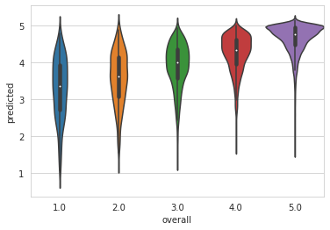
Prediction
Predicted ratings skew to the higher values
Distribution range gets wider when original rating gets lower
Mean Absolute Error = 0.54
The error may lead to one rating lower or higher

Slide 19
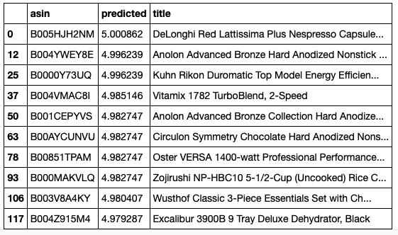
Prediction with/without brands and models
User can get the top ten items recommend to them based on the prediction model

Slide 20
Conclusions
XGB Regression Model provided the best results
Future improvements:
Use more recent data and whole data
(there are no data between after 2014; trimmed data was used for this project)
More features
(Collect more information about users and items; NLP about the review content)
Edge Cases
(Recommend to new users with no review history)
More Algorithms
(There are more algorithms to try)

