Slide 1
Bed and Breakfast
Group 2 : Team G² : Jacob Barrick, Colin Blower, Honming Chen,
Curtis Davis, Victor Frandsen, Sam Lanzo, Andrew Miller, Yu-Ching Wang
CS160-Fall/Spring 2012

Slide 2
Overview
What service area is the spec for ?
  Bed and Breakfast
What are the listed core features? (C1 and C2)
  Unified Search Bar (C1)
  Suggested Location (C1)
  Nearby Landmarks (C2)
  Local Restaurants (C2)
Is any core feature missing or misinterpreted?
  How will the user book the lodging? Their website or lodgings website?
  Without registration or login, how will users retrieve previous bookings?

Slide 3
Overview
How can the core features be modified to fit the user need better?
  Unified Search Form
    Allow the user to enter zip codes
    Some cities are very large, using zip codes will help narrow the results
  Suggested Locations
    Suggest locations based on destination instead of user’s geographic location
    The user will likely be familiar with their current location, suggestions would be more helpful if they were based on the destination
  Nearby Landmarks
    Display nearby landmarks on a map in addition to the list so the user can see where the landmarks are at.

Slide 4
Core Features
Do matching use cases describe each of the listed core features properly?
  Inconsistency between nearby landmarks and local restaurant results
    Nearby landmarks: Default search results is a list of bed and breakfast venues. The user needs to select a location before a list of nearby landmarks will be displayed.
    Local Restaurants: Default search results are a list of bed and breakfast venues, list of local restaurants, and a map.
  When a user clicks on a location, what detailed information will be displayed?
Do you see any conflict or overlap with other features in other service areas?
  No overlap with other service areas

Slide 5
Core Features
  Does any of the core features fit the user need and why?
    Nearby Landmarks is a good fit for user needs
    They allow the user to select bed and breakfast venues based on how close they are to landmarks

Slide 6
Suggested features
Show the suggested features by a list
  Comparator with scrolling
    This feature is relevant to the service area.
    It fits the users need by allowing them to compare up to 8 bed and breakfast venues.
    For this feature, there will be no possible integration or communication with other service areas.
    It is feasible

Slide 7
Suggested features
Show the suggested features by a list
  Recent Bookings Feed
    This feature is relevant to the service area.
    It fits the users need by allowing them to see which bed and break venues are the most popular
    For this feature, there will be no possible integration or communication with other service areas.
    It is feasible

Slide 8
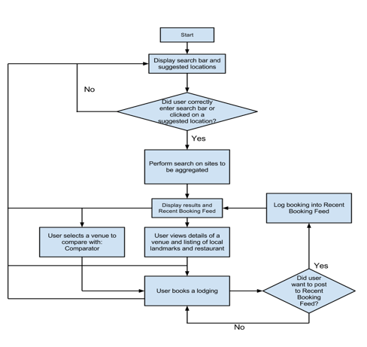
sitemap flowchart

Slide 9
sitemap flowchart
All use cases and features are mapped to the sitemap
Unified search bar and suggested locations are combined in one node. So are landmarks and restaurants. They should be split into two nodes.

Slide 10
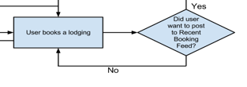
sitemap flowchart
Does the flow stop at some node and cannot proceed? Where?
  Infinite loop when the user does not post recent bookings

Slide 11
sitemap flowchart
Unified search bar and suggested locations are combined in one node. So are landmarks and restaurants. They should be split into two nodes.

Slide 12
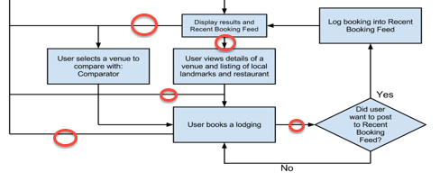
sitemap flowchart
Some nodes have multiple exits but the sitemap does not state which conditions will lead to which nodes.

