Slide 1
Job Mashup Website
Group 2 : Team G2 : Jacob Barrick, Colin Blower, Honming Chen,
Curtis Davis, Victor Frandsen, Sam Lanzo, Andrew Miller, Yu-Ching Wang

Slide 2
Features Implemented
Simple Search Interface
Location
Keyword
Salary
Education
Map of Results

Slide 3
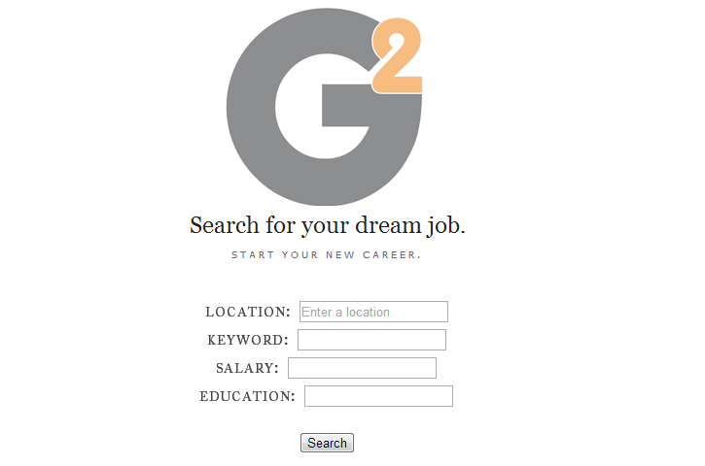
Landing page

Slide 4
Index.html
<form action="scrap.php" method="get">
<input id="location" type="text“ name="location">
<input type="submit" value="Search">

Slide 5
Scrap.php
We have a fuction for each site to form a URL based on the search criteria
function createDiceURL()
$url = "http://seeker.dice.com/jobsearch/...
This URL is fed into our results parsing functions.

Slide 6
Scrap.php
Use Two different functions to find Job Postings
function getMonsterJobPostings($page)
function getDiceJobPostings($page)
Each function has a version of the below
$html = file_get_html($page);
$items = $html->find('tr.even, tr.odd');
Loop through the results and parse the data
foreach ($items as $element)
$title = $element->children(1)->children(0)->children(0)->first_child()->title;

Slide 7
Scrap.php
Results are merged into a single Array
Data is output to JSON and HTML
redirect

Slide 8
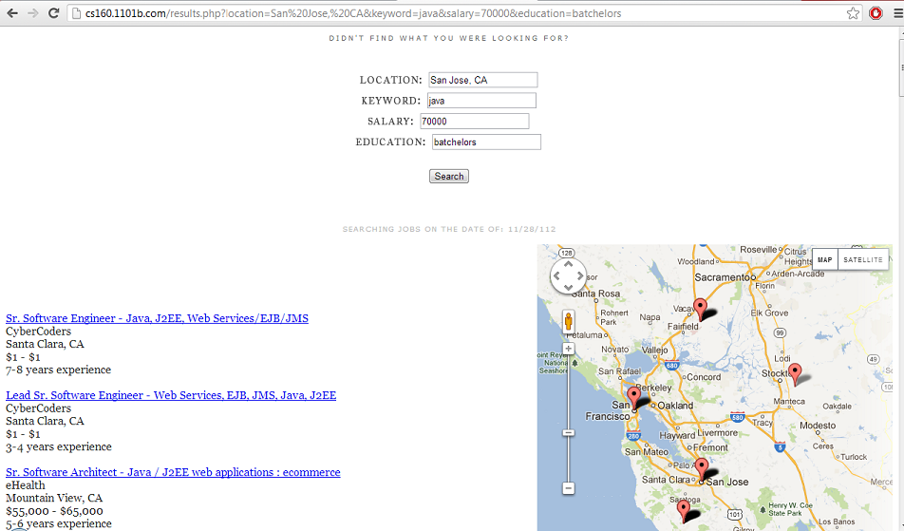
results

Slide 9
Results.php
<script>
$("document").ready(function() {
$.getJSON("./results/results.json",function(data) {
$("#div-my-table").text("<table>");
$.each(data, function(i, item) {

Slide 10
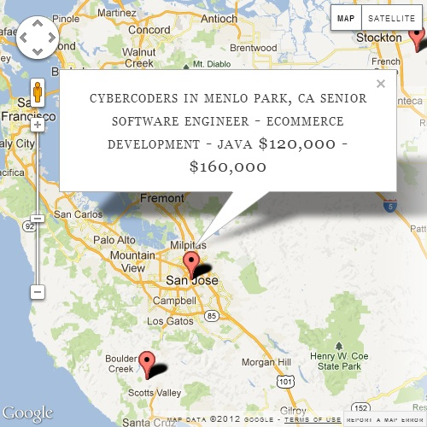
Map
It parses scraped JSON object for company name/city to determine marker position
<div id="map_canvas" style="width:500px; height:500px"></div>
Hovering over a marker gives details for that job.
Moving the map recalculates center position, initializes new search.

