Slide 1
Job Mashup Website
Group 2 : Team G² : Jacob Barrick, Colin Blower, Honming Chen,
Curtis Davis, Victor Frandsen, Sam Lanzo, Andrew Miller, Yu-Ching Wang

Slide 2
Overview
This spec is for a job mashup site that spans various areas of employment, ranging from tech-related to service-related jobs.
We intend on implementing features similar to some functionality on the following websites:
CareerBuilder
Dice
Indeed
Monster
Yelp

Slide 3
List of Proposed Features
Filtering of Job Openings using Education/Experience Requirements
Searching for Job Openings
by Interactive Map
by General Region
by Job Titles
by Form of Employment (Full/Part-time)
Upload of User Resume to enhance service results

Slide 4
Common Inputs and Outputs
Common Input:
User-describing Keywords, Search Parameters
May need to submit to websites in differing manners for advanced search filters
Common Output:
Job Opening information: Pull text description, also note the original source of information
Location information: Parse from job description, match up with Google Maps location info
Additional Features:
Keyword Suggestions: Weigh existing keywords in user’s resume, suggest hot skills to further their specialty

Slide 5
Feature 1 - Filter by Ed/Ex Requirements
Provide results for a type of position based on user’s Education and Experience
Innovates by keeping search relevant to user
Avoid results not matching user’s experience and skills
Keeps search results short and simple: Find the job you want faster

Slide 6
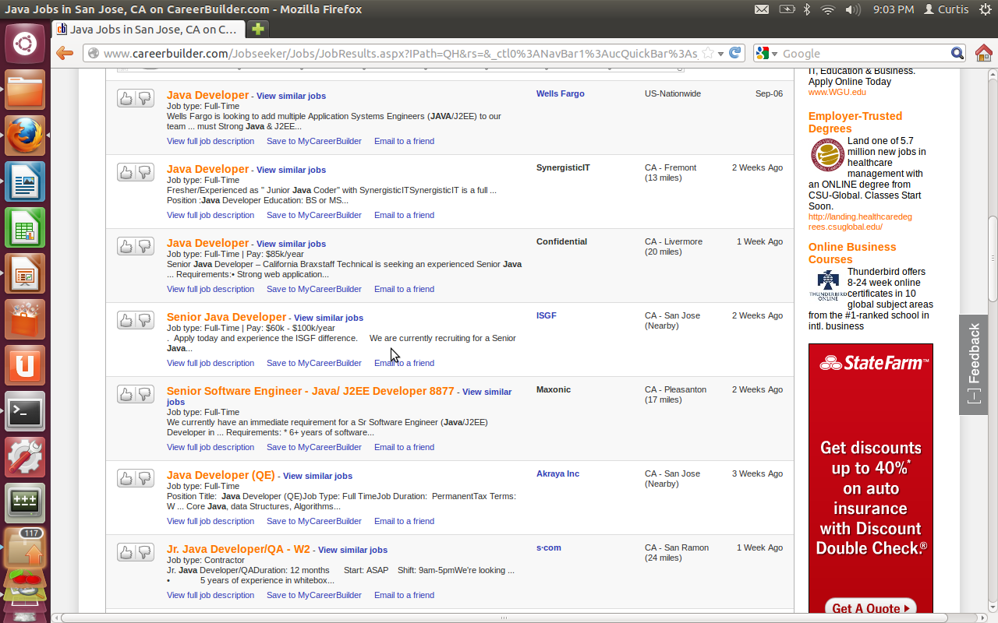
Feature 1 - Filter by Ed/Ex Requirements

Slide 7
Feature 1 - Filter by Ed/Ex Requirements
Functionality achieved by querying results from source websites
Parse user search parameters, look up from sources
Pull Requirements information from source results
Filter search results to avoid duplicates
Filter search results to ensure relevance
Display in organized format
No projected overlap with other functions, builds on top of and synergizes with additional features

Slide 8
Feature 2 – Search by Interactive Map
Provide results for jobs based on map view
See where the jobs are on the map
Innovates by displaying results within to target area
Check for culture-rich region
Check for proximity to other businesses
Check relative to commute from home
Example: Yelp.com

Slide 9
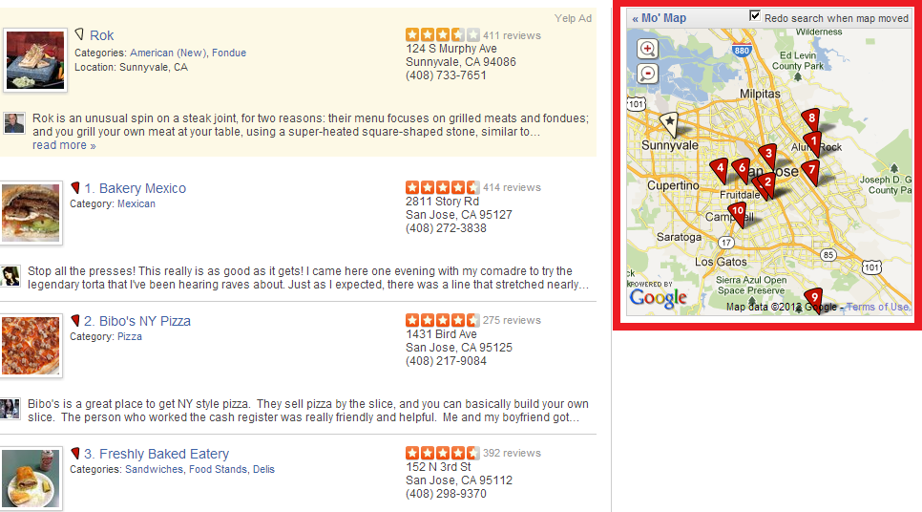
Feature 2 – Search by Interactive Map

Slide 10
Feature 2 – Search by Interactive Map
Render map view using Google Maps
Pull Central Zip Code and Map Size
Overlaps with Search by Location
Adds additional functionality to this search
Allow user to use as alternate view to Search by Location

Slide 11
Feature 3 – Search by Location
Allow user to search for jobs by general location
City, State
Innovative by allowing narrowing of search range using this parameter
Refine results, keeping it closer to user desired info

Slide 12
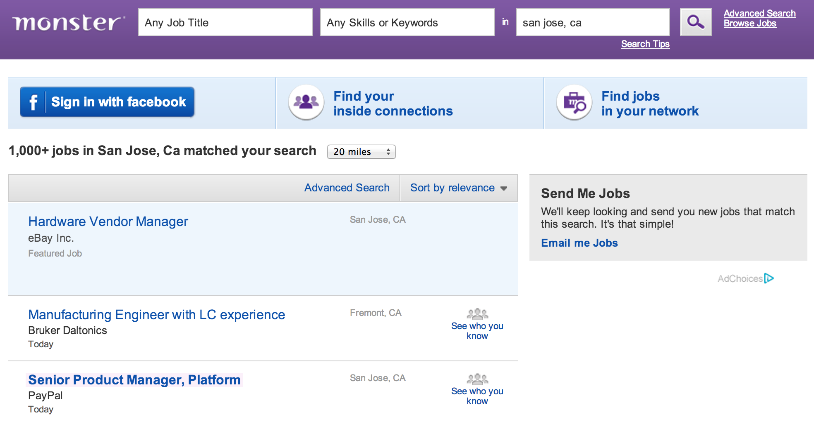
Feature 3 – Search by Location
Monster.com

Slide 13
Feature 3 – Search by Location
Jobs listed using location data will:
Include location when displayed to user
Be saved to database for matchup to similar openings or similar locations by company in future
Be queried and fetch only jobs near location
Slight overlap with Search by Interactive Map
Resolved by allowing user to use Search by Interactive Map as alternate visual view
Normal Search by Location used as text view of results.

Slide 14
Feature 4 – Search by Job Title
Allow user to search for jobs using Job Title
Show similar job titles
Auto-complete job title search
Not innovative but core, basic functionality

Slide 15
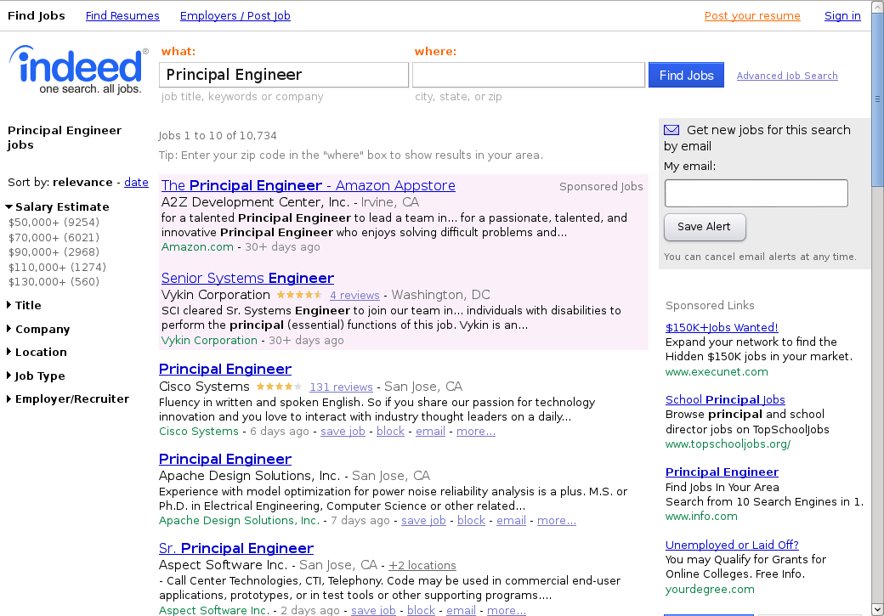
Feature 4 – Search by Job Title

Slide 16
Feature 4 – Search by Job Title
Parse user input
Check source websites
Show directly relevant and related results
No overlap with other search features
Core feature, everything builds on top of this

Slide 17
Feature 5 – Search by Form of Employment
Allow user to search for jobs based on time commitment
Innovative in how it enables users who have specific time commitments to get relevant results
User may have existing job or education
Outside obligations

Slide 18
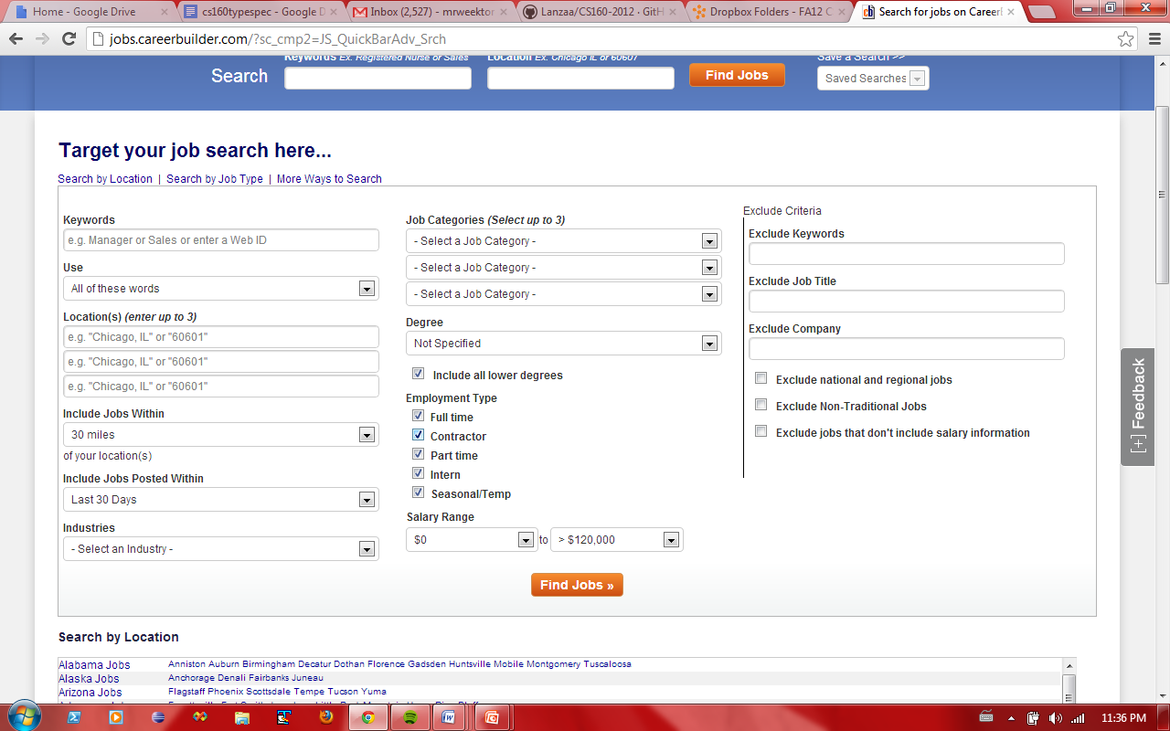
Feature 5 – Search by Form of Employment

Slide 19
Feature 5 – Search by Form of Employment
Jobs listed by forms of employment will:
Have availability parsed/fetched from source results
Be displayed to user in organized manner
No overlap with other forms of searching
Refines search functionality without stepping over another feature’s work

Slide 20
Feature 6 – Upload Resume Features
Allow user to upload resume, save it on server for additional functions
Innovative if applied properly
“Resume Search”: Use keywords matching a given field of work to suggest results
Resume suggestions: Suggest keywords user can look into given common keywords used in desired field not found in their resume
Resume Pool: Allow employers to look at user resumes with keywords they define

Slide 21
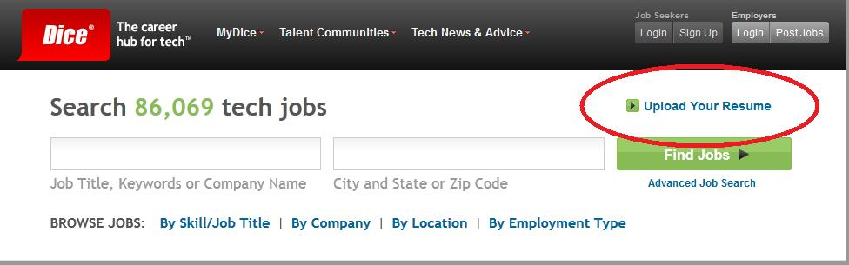
Feature 6 – Upload Resume Features

Slide 22
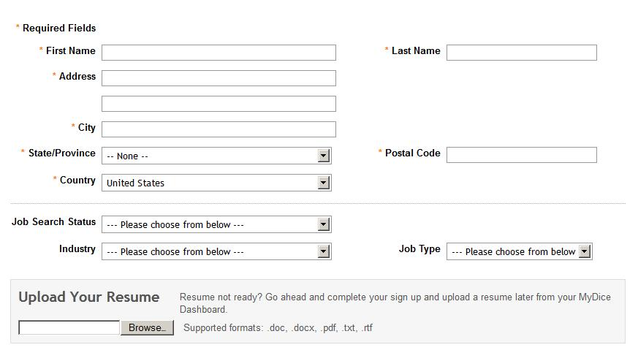
Feature 6 – Upload Resume Features

Slide 23
Feature 6 – Upload Resume Features
Resume Document uploaded to server
Save copy
Parse for keyword analysis
Use dictionary of keywords
Store results in DB
Dependency on strong keyword search function
Results from differing search features need to be robust to allow use of functionality for automated searching

Slide 24
Analysis – Possible Risk Factors
Lookup on source websites may prove troublesome depending on data use policy
Interactive map and Search by Location heavily dependent on up-to-date and accurate location info
Offices may move
Manual moderation too costly
Additional resume features dependent on robust dictionary and weighted “scoring”

