Slide 1
Core Feature #3 (Search by Location)
Search by Location allows the user to search for jobs by location. The common requirement Location is needed before the user can search by location.
This feature is innovative and useful to users because it allows them to refine their search results based on location
The requirement is achievable in the technical environment of the project
  Jobs listed on the job mashup site will include location
  The location of the job will be saved in the database
  The query system will filter jobs near the location entered
There will be no conflict or overlap with other features.

Slide 2
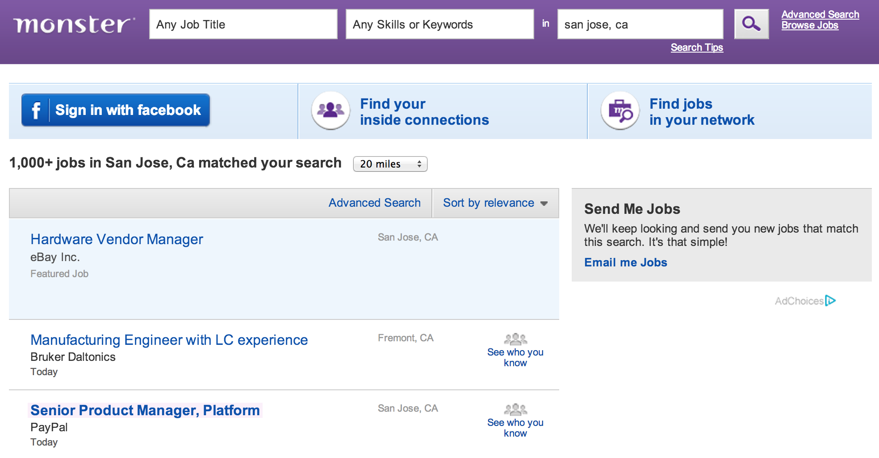
Core Feature #3 (Search by Location)
Reference site URL
  http://jobsearch.monster.com/search/?where=san-jose__2C-ca
Snapshot

