Slide 1
Feature 5
Allow users to search for jobs by salary range
Useful for users who want a certain salary range.

Slide 2
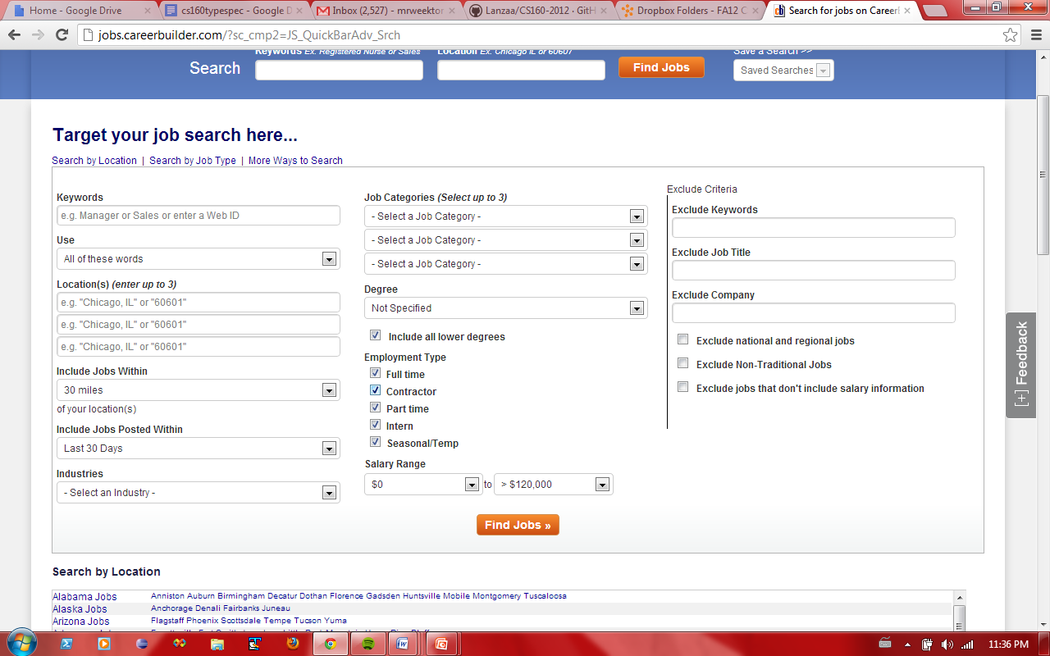

Slide 3
Use Case
User searches for Salary
User clicks on ‘Advanced Search’ link
Advanced search page is displayed
User mat specify minimum range
User may specify maximum range
User clicks ‘search’
Search page is displayed
Pre-conditions
User is at home page.
Post-conditions
Only jobs within specified pay range are shown.
Required Input
None
Output
List of jobs in range

