Slide 1
Feature 2:
User Searches Jobs Via Movable Map
What is it and how it relates to which common requirement?
-Use can change search area via built in map, instead of by city/zip code.
Why is it innovative and useful to users?
-allows search of adjacent cities
-allows search by distance from home (commute time)

Slide 2
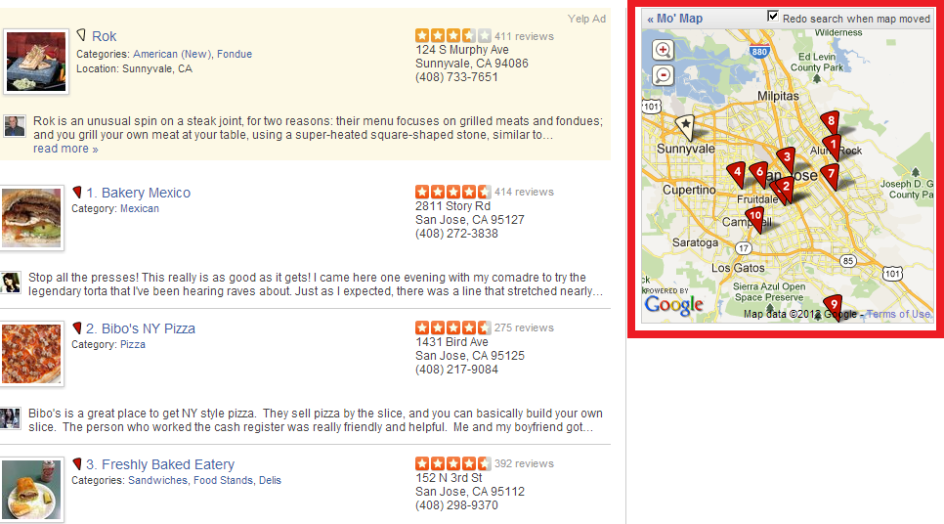
yelp.com

Slide 3
Is the requirement achievable in the technical environment of this project? (Describe in high level how it may be achieved.)
-google maps for display
-pull central zip code and map size
Do you see any conflict or overlap with other features?
-overlap with search by location.
-adds extra, not conflicting, functionality.

Slide 4
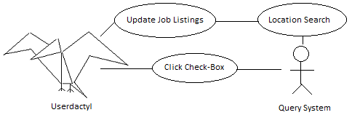
Use Case Diagram

