Slide 1
Validation of Bed & Breakfast
Milestone 3 Part B
Group 2 : Team G2 : Jacob Barrick, Colin Blower, Honming Chen,
Curtis Davis, Victor Frandsen, Sam Lanzo, Andrew Miller, Yu-Ching Wang

Slide 2
Features
Unified Search Form
  User can manually type incorrect dates or invalid locations.
  Documentation says error checking for incorrect date, but the user can type incorrect dates or a nonsense location manually without error.
Unified Output
  Price broken for Homeaway, '&' broken for Airbnb
Suggested Locations
  No Issue

Slide 3
Features
Local Restaurants
  No information about restaurants
  Not Sorted
Comparator
  Not Enough Room
Google Map
  Works for first display, off-center every subsequent time

Slide 4
Bugs: Nonsense Location, Bad Dates

Slide 5
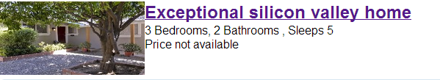
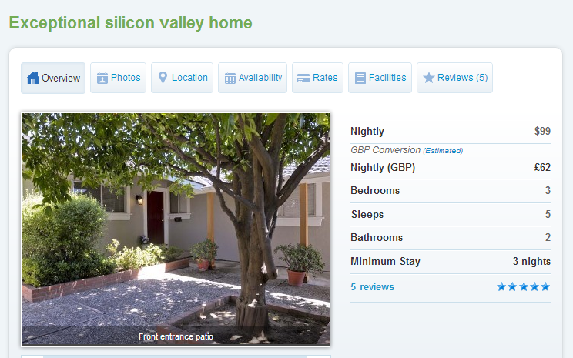
Bugs: Incorrect Prices

Slide 6
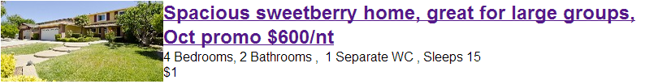
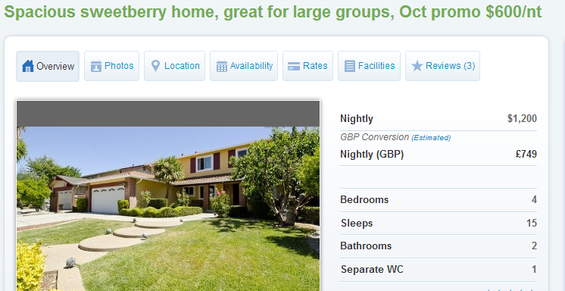
Bugs: Incorrect Prices

Slide 7
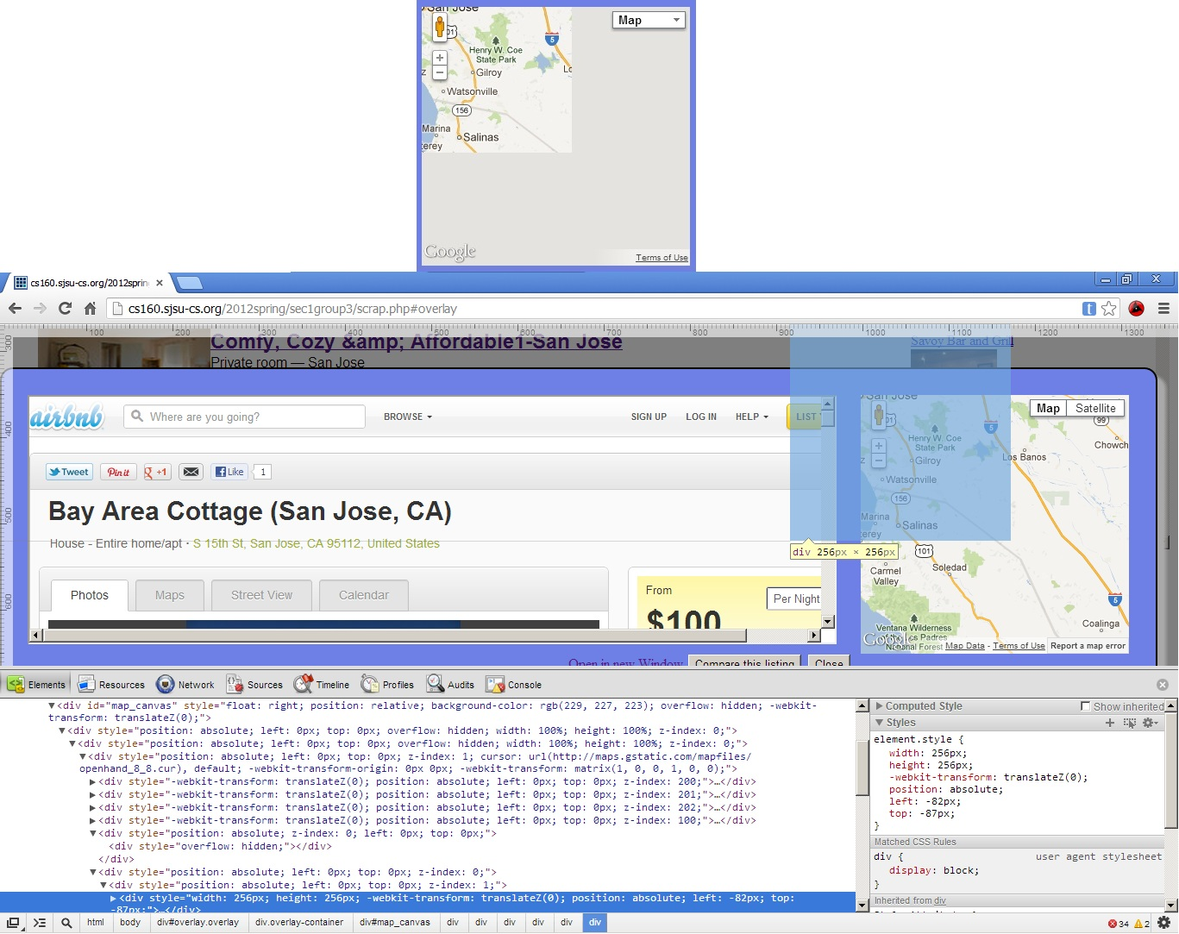
Bugs: Map

Slide 8


Bugs: ‘&’ Displays Incorrectly
Airbnb’s listing:
Group 3’s Listing
Only broken for Airbnb

Slide 9
Other Suggestions
Loading full JQueryUI library causes homepage to load slowly
  Homepage about 1MB
  http://www.websiteoptimization.com/services/analyze/
  May be possible to use a lighter weight date library
Results page could be formatted better
  Add more space and maybe lines/colors between each listing
  Add more space between listings and images
  Yelp feature covers listings on small windows

Slide 10
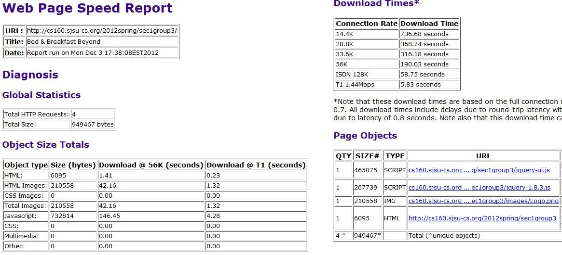

Slide 11
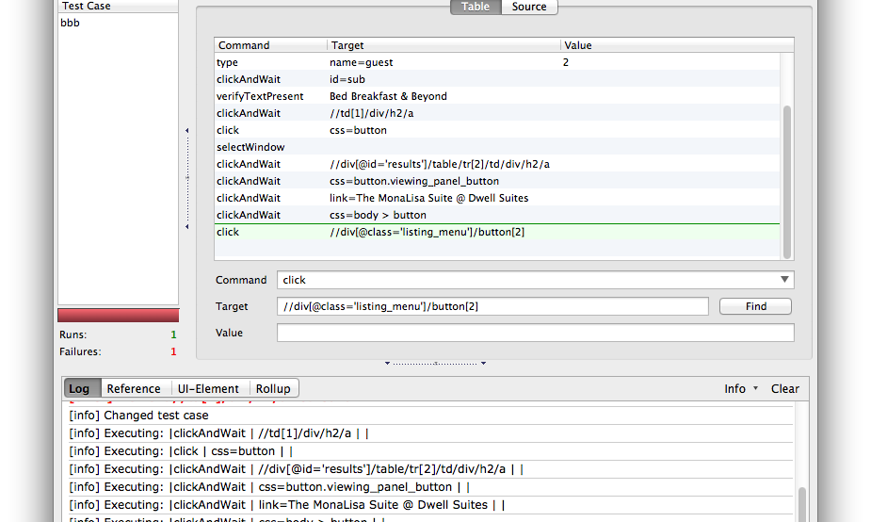
Selenium Test Cases
Fail Point
Fail Point

Slide 12
Selenium Test Cases
Comparator pops up in a new tab
  Selenium cannot select new tab because the new tab does not have a title or a name.
  Look at Selenium API: selectWindow
Possible Fix
  Add a title to the comparator page

Slide 13
Sequence Diagram
Many Asynchronous Calls
  Hard to determine website flow
  Multiple sequence diagrams?
Several bars slightly wrong
  Input.html, Scrap.php bars are too long
  Output.html has double bars at one point

Slide 14
