Slide 1
9865 project digital clock
201990309 LAN ZHIJIE
201991139 WANG ZHONGTIAN

Slide 2
Introduction
Design Objectives:
a) Normal clock function: design a digital clock circuit with hour, minute, second displaying via LED digital tubes, and timing by 24 hours.
b) Stopwatch function: design a stopwatch that can accurately measure time, through the dynamic digital tube displaying minutes, seconds and milliseconds.
c) Alarm clock function: can be set in a time to ring alarm bells.
d) Calibration function: can manually adjust hours, minutes and seconds to calibrate the time.

Slide 3
Background
Digital Clock
VHDL Overview
Entity
Architecture
Dataflow Modelling
Structural Modelling
Behavioral Modelling
Test Bench

Slide 4
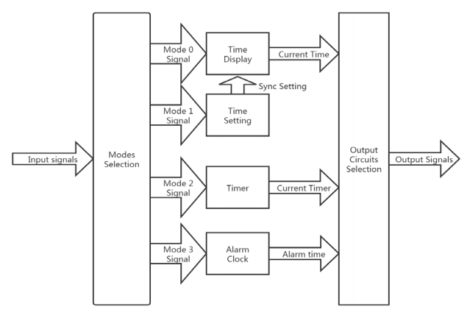
Methodology

Slide 5
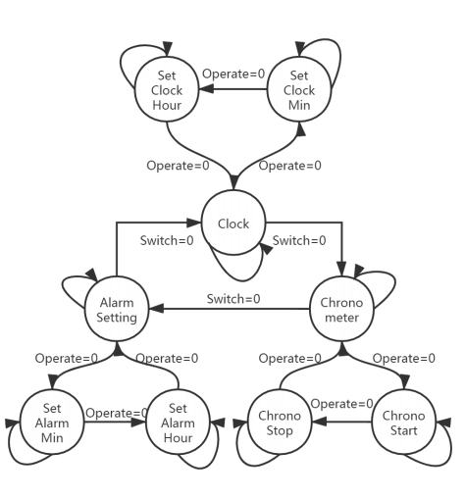
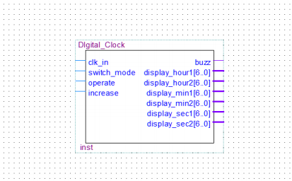
Design and Implementation

Slide 6
Code and Testing
Demonstrate on Modelsim

Slide 7
Conclusion
The digital clock we designed in the project has three functions: clock, alarm clock, and stopwatch. The clock can be displayed on the digital tube, showing the corresponding hours, minutes, and seconds. Modifying the corresponding count in the code can change the frequency to achieve a real-world clock. The alarm clock function can set a time when the clock reaches this event; it will start ringing, corresponding to buzz = 1 in the code. The stopwatch function can accurately record the time after the start of the timing. Since the Quartus or ModelSim we use are tough to simulate a considerable time, we just set the frequency of milliseconds in the code to be several times of seconds, rather than 1000 times accurate. Overall, we have achieved what we wanted to accomplish in the expected goal.

