Slide 1
begin simulation
begin simulation
Match Pending Orders
Match Pending Orders
Process Traders
Process Traders
Increment Time
Increment Time
if time < total time
if time >= total time
if time < total time
end simulation
end simulation

Slide 2
Order book
trades
Trader manager
past prices
number of buy and sell orders
orders
Order book
trades
Trader manager
past prices
number of buy and sell orders
orders

Slide 3
begin simulation
Check for pending order
no pending order
found a pending order
Match Pending Orders
Pop pending order from front of queue
Process Traders
Increment Time
Find suitable matching order
if time < total time
couldn’t find a matching order
found a matched order
end simulation
Order book
Add order to collection of buy or sell orders
Create Trade
Remove matched order from collection of buy or sell orders
Publish Trade
trade sent to trader manager

Slide 4
begin simulation
Check for pending order
no pending order
found a pending order
Match Pending Orders
Pop pending order from front of queue
Process Traders
Increment Time
Find suitable matching order
if time < total time
couldn’t find a matching order
found a matched order
end simulation
Order book
Add order to collection of buy or sell orders
Create Trade
Remove matched order from collection of buy or sell orders
Publish Trade
trade sent to trader manager

Slide 5
begin simulation
order book published trade
Receive trade
Match Pending Orders
Update trader positions
no new trade
Process Traders
no traders ready
Check if a trader is ready
Increment Time
trader ready
if time < total time
Receive past price and order count data
end simulation
Trader manager
Execute trading algorithms using OpenCL or other means
no orders generated
new orders generated
Add orders to pending orders queue in order book
orders sent to order book

Slide 6
begin simulation
order book published trade
Receive trade
Match Pending Orders
Update trader positions
no new trade
Process Traders
no traders ready
Check if a trader is ready
Increment Time
trader ready
if time < total time
Receive past price and order count data
end simulation
Trader manager
Execute trading algorithms using OpenCL or other means
no orders generated
new orders generated
Add orders to pending orders queue in order book
orders sent to order book

Slide 7
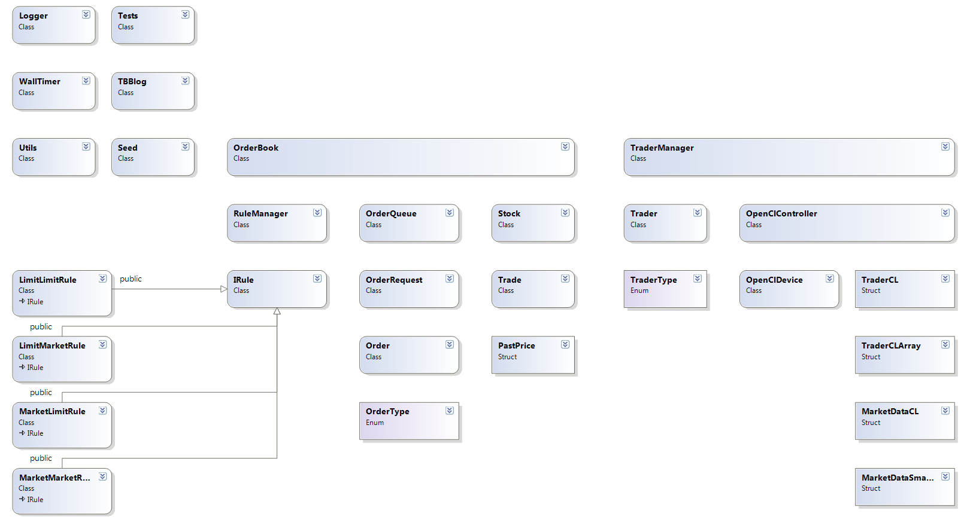

Slide 8
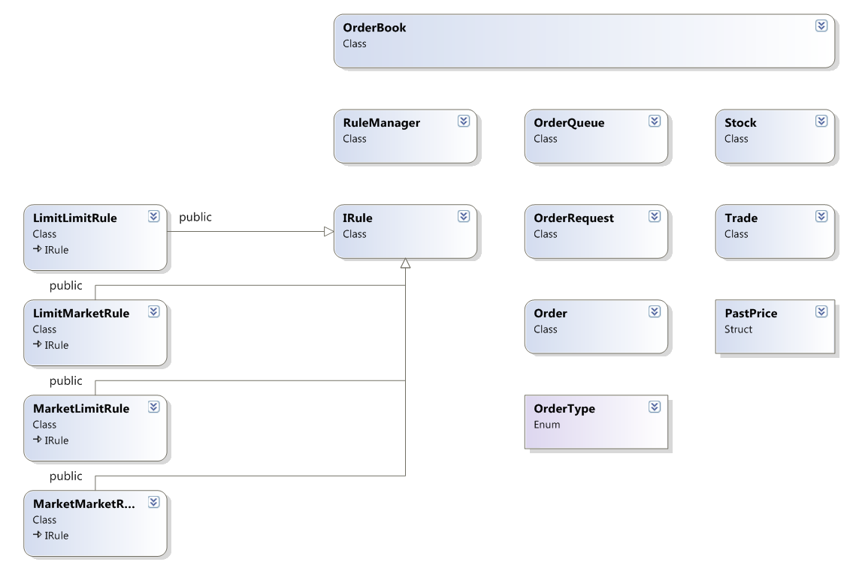

Slide 9
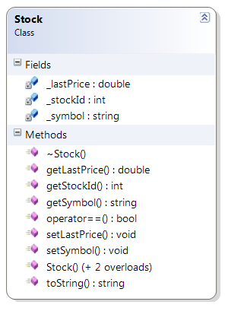

Slide 10
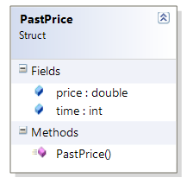

Slide 11
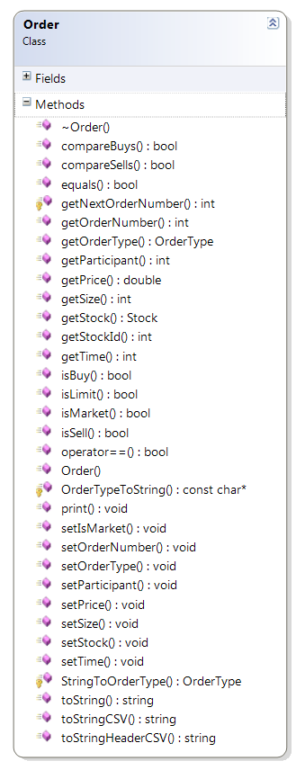
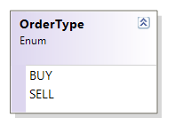
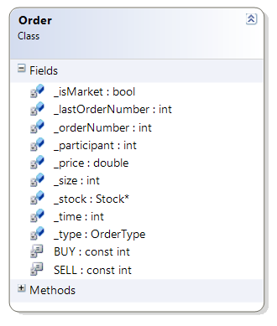

Slide 12
Order
Type: Market
Direction: Sell
Price: N.A.
Volume: Random
cash < (start cash / PT_BOUNDS)
yes
no
Order
Type: Market
Direction: Buy
Price: N.A.
Volume: Random
cash > (start cash x PT_BOUNDS)
yes
no
Order
Type: Limit
Direction: Sell
Price: Random <= Last Price
Volume: Return to Start Cash
cash < start cash
&&
cash > (start cash / PT_BOUND)
yes
no
Order
Type: Limit
Direction: Buy
Price: Random >= Last Price
Volume: Return to Start Cash
cash > start cash
&&
cash < (start cash x PT_BOUND)
yes
no
Order
Type: Market
Direction: Sell
Price: N.A.
Volume: All
cash with orders <= 0
yes
no
Order
Type: Market
Direction: Buy
Price: Random >= Last Price
Volume: Start/100
volume with orders == start volume
yes
Order
Type: None
Direction: None
Price: 0
Volume: 0
Any other case.

Slide 13
Order
Type: Market
Direction: Sell
Price: N.A.
Volume: Random
cash < (start cash / PT_BOUNDS)
yes
no
Order
Type: Market
Direction: Buy
Price: N.A.
Volume: Random
cash > (start cash x PT_BOUNDS)
yes
no
cash < start cash
&&
cash > (start cash / PT_BOUND)
Order
Type: Limit
Direction: Sell
Price: Random <= Last Price
Volume: Return to Start Cash
yes
no
cash > start cash
&&
cash < (start cash x PT_BOUND)
Order
Type: Limit
Direction: Buy
Price: Random >= Last Price
Volume: Return to Start Cash
yes
no
Order
Type: Market
Direction: Sell
Price: N.A.
Volume: All
cash with orders <= 0
yes
no
yes
Order
Type: Market
Direction: Buy
Price: Random >= Last Price
Volume: Start/100
volume with orders == start volume
Any other case.
Order
Type: None
Direction: None
Price: 0
Volume: 0

Slide 14
Long Term Rise | Short Term Rise | Other Condition | Order | Explanation
true | true | N.A. | Type: Market Direction: Sell Price: N.A. Volume: 80 | Place a small sell order to capitalise on the rising price, to earn some profit before the price begins to fall.
true | false | Volume Position > MT_SIZE_THRESH | Type: Limit Direction: Sell Price: Random <= Last Price Volume: Volume Position/MT_SIZE_THRESH | Sell a proportion of the entire holdings of the stock as long as it is above a certain threshold. This is done slightly below the last price as the price has been rising in the long term, but has now begun to fall. The price is set just below the last price to ensure that the order isn’t left behind unfulfilled in the case of the price falling rapidly.
 |  | otherwise | Type: Market Direction: Sell Price: N.A. Volume: 80 | Sell a small amount to capitalise on the rise of prices which has now ended.
false | true | Cash Position > (Last Price x MT_SIZE_THRESH) | Type: Limit Direction: Buy Price: Random >= Last Price Volume: Volume Position/MT_SIZE_THRESH | Buy a proportion of total holdings if the amount of cash available is over a certain threshold. The price is set to just above the last price to ensure that the order is fulfilled if prices are rising rapidly.
 |  | otherwise | Type: Market Direction: Buy Price: N.A. Volume: 80 | Buy a small amount to capitalise on the low prices
false | false | N.A. | Type: Market Direction: Buy Price: N.A. Volume: 80 | Buy a small amount to capitalise on low prices.

Slide 15
Host Memory
Video Card Memory
Pointer to TraderCL array
TraderCL
TraderCL
TraderCL
TraderCL
TraderCL
Write Command Received:
Host Memory
Video Card Memory
Pointer to TraderCL array
TraderCL
TraderCL
TraderCL
TraderCL
TraderCL
TraderCL
TraderCL
TraderCL
TraderCL
TraderCL

Slide 16
Host Memory
Video Card Memory
Pointer to TraderCL array
TraderCL
TraderCL
TraderCL
TraderCL
TraderCL
Write Command Received:
Host Memory
Video Card Memory
Pointer to TraderCL array
TraderCL
TraderCL
TraderCL
TraderCL
TraderCL
TraderCL
TraderCL
TraderCL
TraderCL
TraderCL

