Slide 1
QU Datathon Project Random Forest Trading Strategy Based on Preprocessed Order Book Data
Quant FEver Team: R. Ding, D. Jiao, X. Li
M.S. Financial Engineering, Columbia University
Sep. 30, 2018

Slide 2
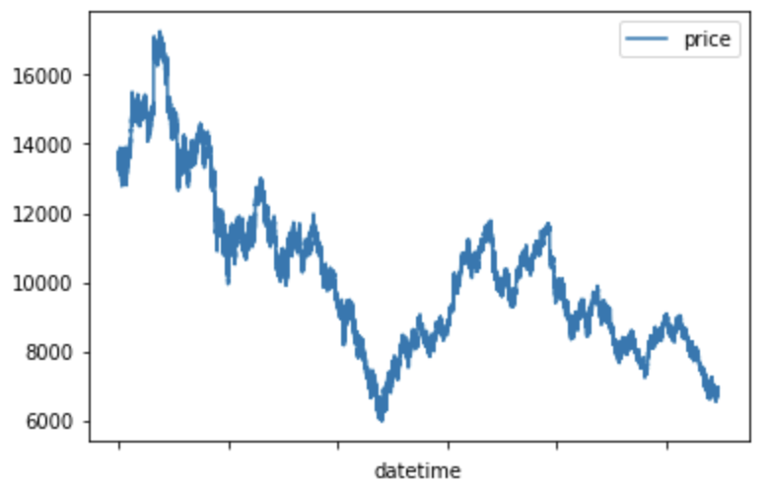
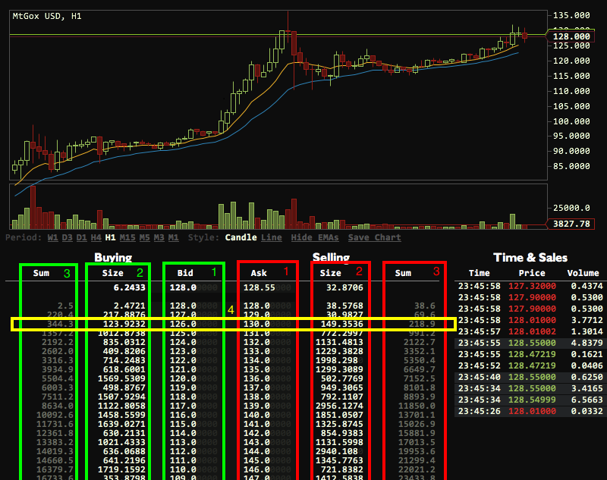
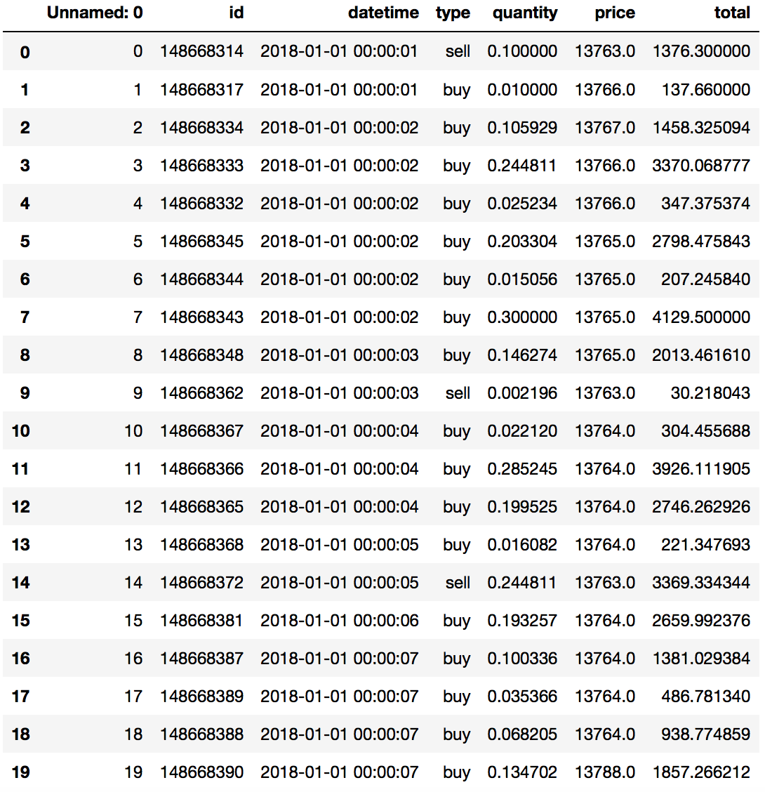
I. Data Exploration
VS
What we got as raw data
What we want as order book

Slide 3
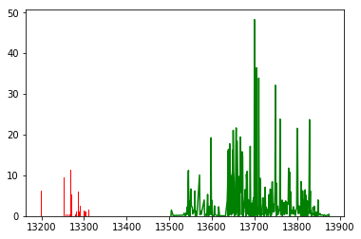
II. Order Book Construction
Object-Oriented Programming
Major variables: self.book, self.prices, self.best_bid, self.best_ask
Process the order: price, volume, direction
 | open | close | high | low | vol
2018/1/1 0:00 | 13763 | 13765 | 13788 | 13763 | 1.89
2018/1/1 0:01 | 13765 | 13746 | 13765 | 13741 | 5.71
2018/1/1 0:02 | 13746 | 13741 | 13750 | 13741 | 3.74
2018/1/1 0:03 | 13741 | 13735 | 13741 | 13735 | 3.80
2018/1/1 0:04 | 13735 | 13734 | 13735 | 13734 | 7.09
2018/1/1 0:05 | 13734 | 13564 | 13734 | 13559 | 30.76
2018/1/1 0:06 | 13559 | 13570 | 13570 | 13559 | 6.22
2018/1/1 0:07 | 13570 | 13581 | 13581 | 13570 | 13.68
2018/1/1 0:08 | 13581 | 13615 | 13615 | 13581 | 11.86
2018/1/1 0:09 | 13615 | 13634 | 13636 | 13607 | 25.70

Slide 4

III. Random Forest Prediction Model Based Trading Strategy
We have the minute candlestick data from the order book data processing phase
We can construct various technical indicators based on volume, high, low , open, and close
Using a random forest classifier to label the target, which can be thought of as some expected return in a future period
Choose features from technical indicators based on their prediction accuracy performance
Reach a test accuracy of 90% using several indicators involving both the price and volume aspects

Slide 5
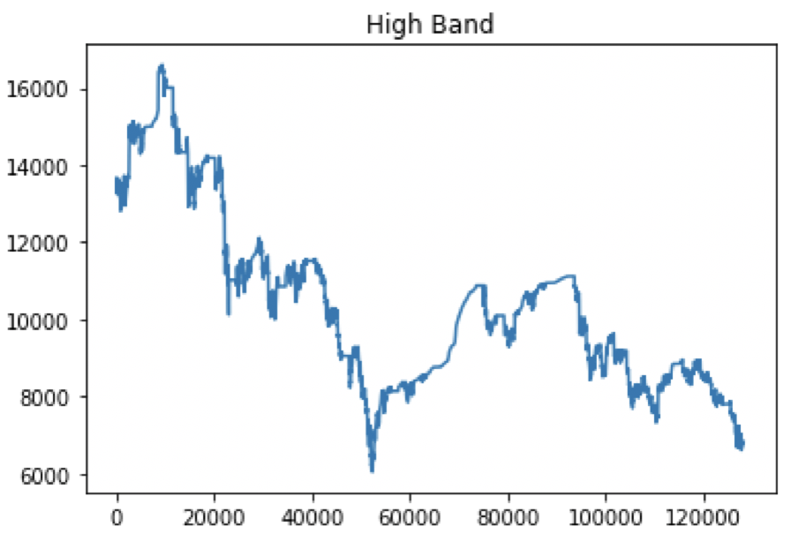
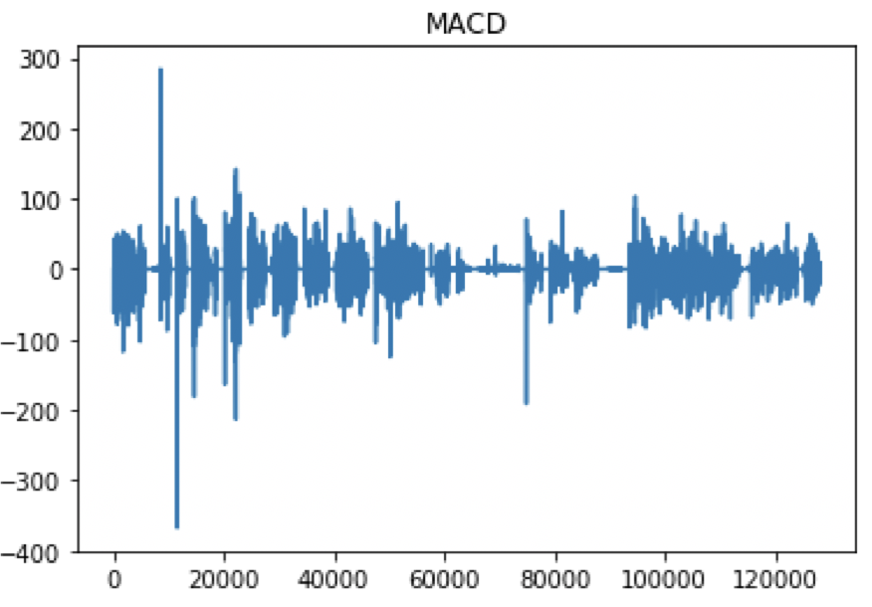
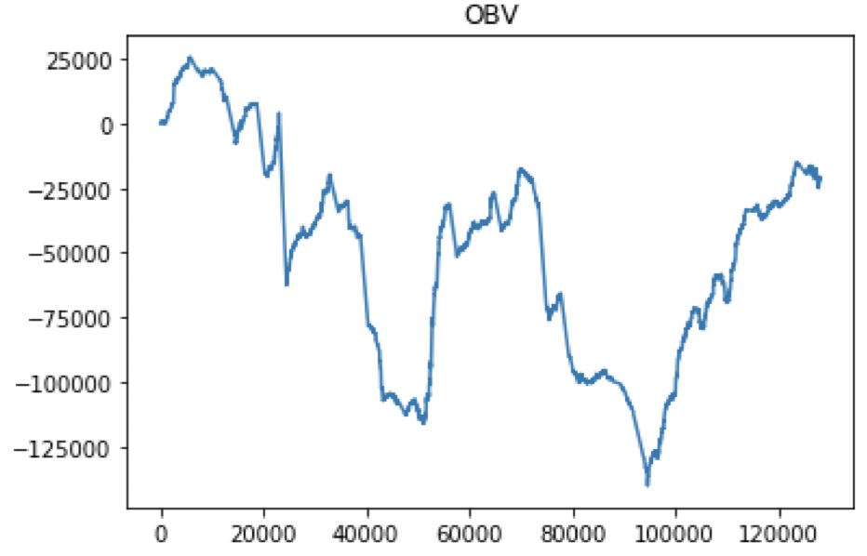
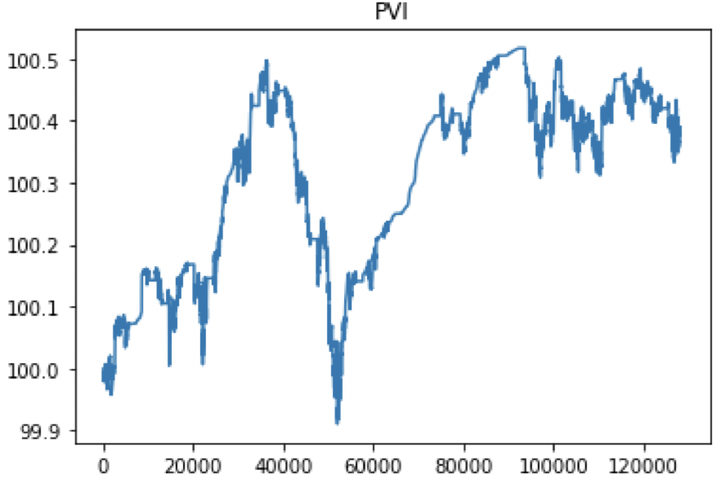
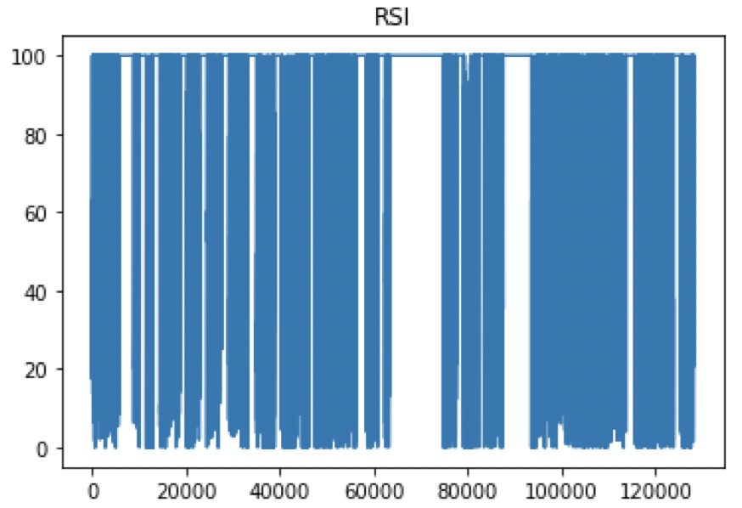
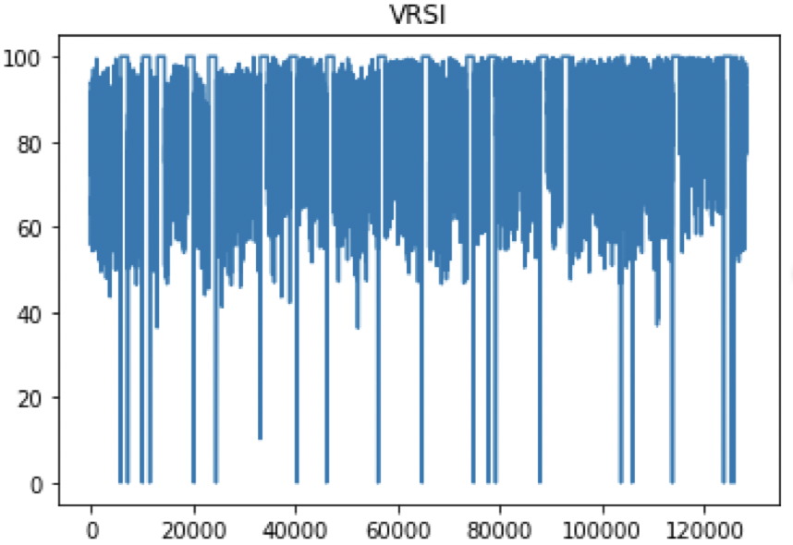
Indicators in Our Strategy

Slide 6
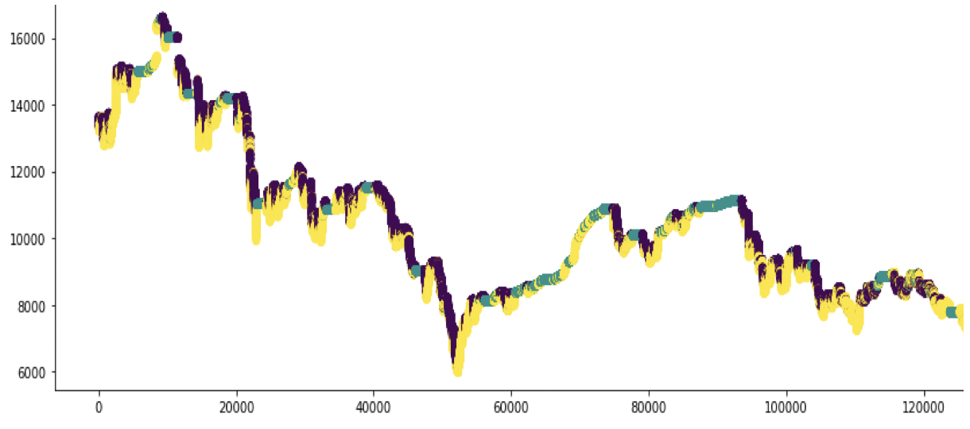
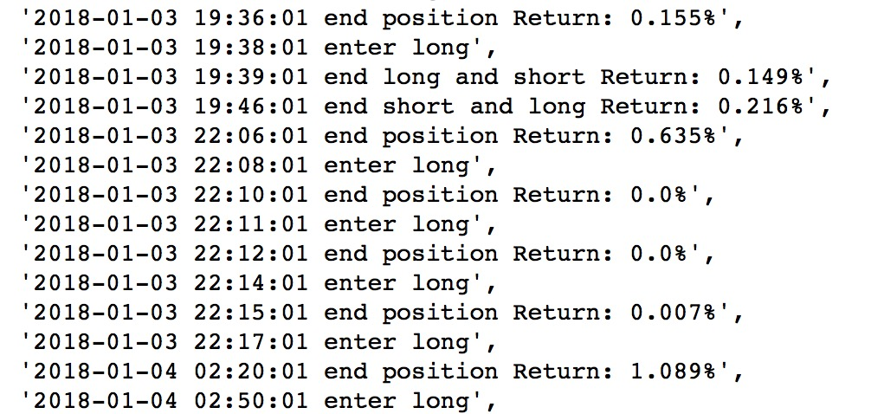
Trading Results based on the prediction model:
Use the predicted labels to generate buy/sell (long/short) signals.
The plot on top shows all predicted labels/signals and the plot on the bottom shows a small part of the trading records.

