Slide 1

„Enrich yourself“
Capstone Project Presentation.
neue fische Data Science 19/20 Bootcamp
Dr. Robin Döring – atomm Investment Club

Slide 2
Only7.7%
Why care?
of Germans own stocks.
atomm is on a mission is to bring algorithmic trading to a broader public and be a platform for exchange of knowledge.
Capstone Project Presentation neuefische Data Science 19/20 Bootcamp
1 / 12

Slide 3




What we do.
Investment Club
Research
Trading Engine
Capstone Project Presentation neuefische Data Science 19/20 Bootcamp
2 / 12

Slide 4
Data Science Lifecycle.
…the finance way
Business
understanding
Data
Visualization
Business
understanding
Data
Visualization
Predictive
Modeling
Predictive
Modelling
Data Mining
Data Mining
Feature
Engineering
Data
Cleaning
Feature
Engineering
Data
Cleaning
Exploratory
Data Analysis
Exploratory
Data Analysis
Capstone Project Presentation neuefische Data Science 19/20 Bootcamp
3 / 12

Slide 5
Data Science Lifecycle.
…the finance way
Data
Visualization
Business
understanding
Predictive
Modeling
Data Mining
Feature
Engineering
Data
Cleaning
Exploratory
Data Analysis
Capstone Project Presentation neuefische Data Science 19/20 Bootcamp
4 / 12

Slide 6
Data Science Lifecycle.
…the finance way
Data
Visualization
Business
understanding
Data Mining
Predictive
Modeling
Data Mining
Historical data for >6000 assets
Marketstore Database Server
Python class
Feature
Engineering
Data
Cleaning
Exploratory
Data Analysis
Capstone Project Presentation neuefische Data Science 19/20 Bootcamp
5 / 12

Slide 7
Data Science Lifecycle.
…the finance way
Data
Visualization
Business
understanding
Predictive
Modeling
Data Mining
Feature
Engineering
Data
Cleaning
Exploratory
Data Analysis
Capstone Project Presentation neuefische Data Science 19/20 Bootcamp
6 / 12

Slide 8
Data Science Lifecycle.
…the finance way
Data
Visualization
Business
understanding
Predictive
Modeling
Data Mining
Feature
Engineering
Data
Cleaning
Exploratory
Data Analysis
Capstone Project Presentation neuefische Data Science 19/20 Bootcamp
7 / 12

Slide 9
Data Science Lifecycle.
…the finance way
Data
Visualization
Business
understanding
Feature Engineering
Predictive
Modeling
Data Mining
Classification problem
3-class: predict “buy”, “hold”, “sell”
2-class: predict “buy”, “sell”
10+ technical trading indicators as model features
Feature
Engineering
Data
Cleaning
Exploratory
Data Analysis
Capstone Project Presentation neuefische Data Science 19/20 Bootcamp
8 / 12

Slide 10
Data Science Lifecycle.
…the finance way
Data
Visualization
Business
understanding
Feature Engineering
Predictive
Modeling
Data Mining
Classification problem
3-class: predict “buy”, “hold”, “sell”
2-class: predict “buy”, “sell”
10+ technical trading indicators as model features
Feature
Engineering
Data
Cleaning
Exploratory
Data Analysis
Capstone Project Presentation neuefische Data Science 19/20 Bootcamp
8 / 12

Slide 11
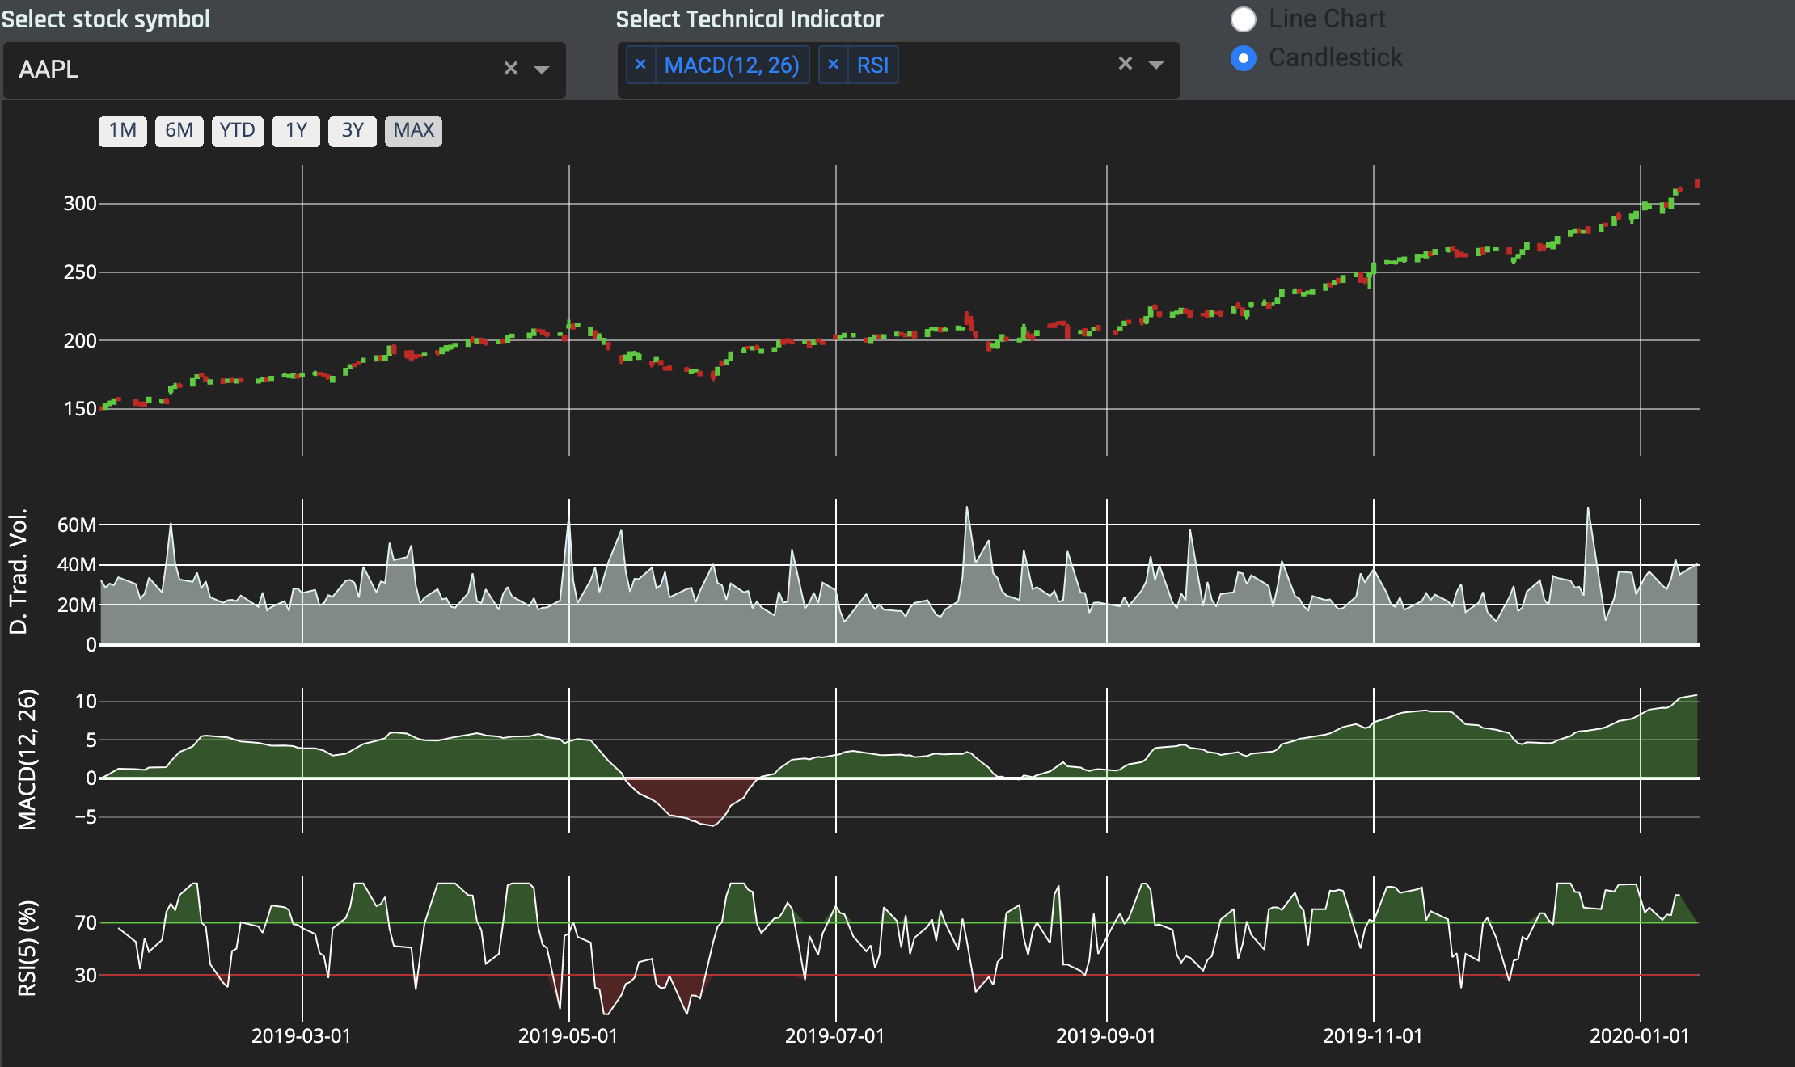
Data Science Lifecycle.
…the finance way
Data
Visualization
Business
understanding
Predictive Modelling
Predictive
Modelling
Data Mining
5 different ML algorithms
Cross validation: BlockingTimesSeriesCV
Hyperparameter tuning: Bayesian optimization
Feature
Engineering
Data
Cleaning
Exploratory
Data Analysis
Capstone Project Presentation neuefische Data Science 19/20 Bootcamp
9 / 12

Slide 12
Data Science Lifecycle.
…the finance way
Data
Visualization
Business
understanding
Predictive Modelling
Predictive
Modeling
Data Mining
50 randomly selected stock symbols
5 different ML algorithms
Cross validation: BlockingTimesSeriesCV
Hyperparameter tuning: Bayesian optimization
Feature
Engineering
Data
Cleaning
Exploratory
Data Analysis
Capstone Project Presentation neuefische Data Science 19/20 Bootcamp
9 / 12

Slide 13
Data Science Lifecycle.
…the finance way
Data
Visualization
Business
understanding
Data Visualization
Predictive
Modeling
Data Mining
→ Live Demo
Feature
Engineering
Data
Cleaning
Exploratory
Data Analysis
Capstone Project Presentation neuefische Data Science 19/20 Bootcamp
10 / 12

Slide 14

Tech Stack
atomm Web App: Monitor markets / visualize results
(
)
atomm Trading Engine: Backtesting / paper + live trading
Jupyter Lab / Spyder IDE: Research of Trading Strategies
atomm Python Library: Database API and tools
MarketStore DB: High perfomance storage of time series data

Slide 15
ML Architecture

Slide 16
ML Architecture
*Technical Indicators (moving average, directional indicator, Bollinger bands, …) mathematical calculations based on the price of a stock. By analyzing historical data, TAs are used to predict future price movements
**Label “up” is assigned to a data point if forthcoming price goes up, else it is labelled as ”down”. For three-class model, “up” is assigned if price change percentage is above a defined threshold for given forecast horizon, “down” if it is below the negative threshold, and “no move” for values in between.
***Classifiers used in this project: RandomForest, SVM, XGBoost, kNN

Slide 18
*Technical Indicators (moving average, directional indicator, Bollinger bands, …) mathematical calculations based on the price of a stock. By analyzing historical data, TAs are used to predict future price movements .
**Label “up” is assigned to a data point if forthcoming price goes up, else it is labelled as ”down”. For three-class model, “up” is assigned if price change percentage is above a defined threshold for given forecast horizon, “down” if it is below the negative threshold, and “no move” more values in between.
***Classifiers used in this project: RandomForest, SupportVectorMachine, XGBoost, kNN

Slide 19
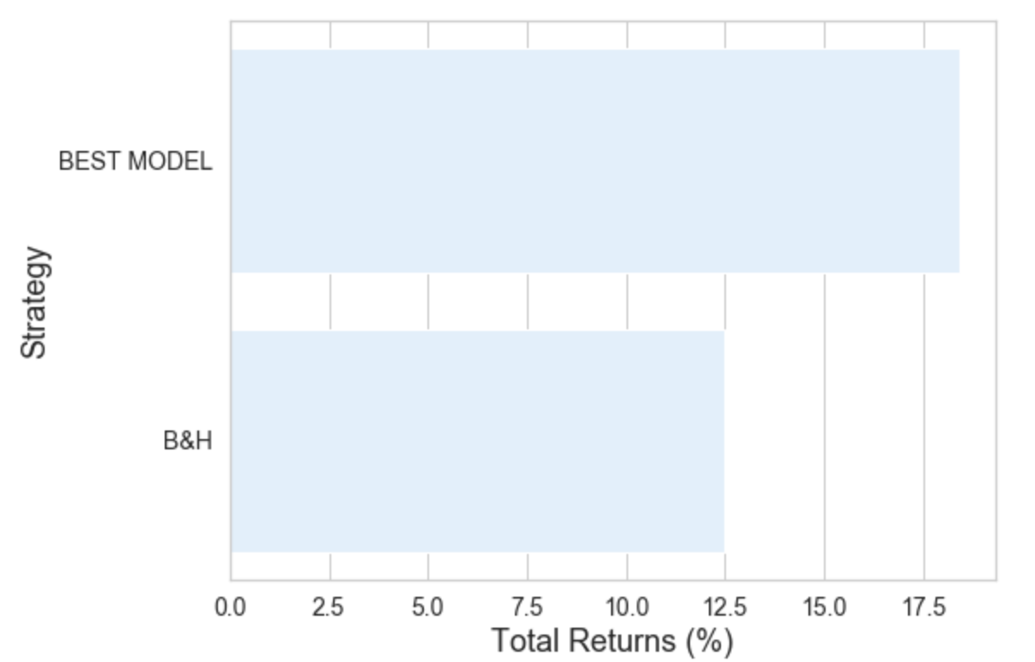
How to get rich…
…the easy way?
Random selection: AT&T
Future Challenges
Cost structure:
Transaction
Data
Infrastructure
Position sizing
Portfolio building
Paper trading
...
(Returns over a 16 trading months obtained with a Random Forest Classifier)
Capstone Project Presentation neuefische Data Science 19/20 Bootcamp
11 / 12

Slide 20
Thank you!
Capstone Project Presentation neuefische Data Science 19/20 Bootcamp
12 / 12

