Slide 1


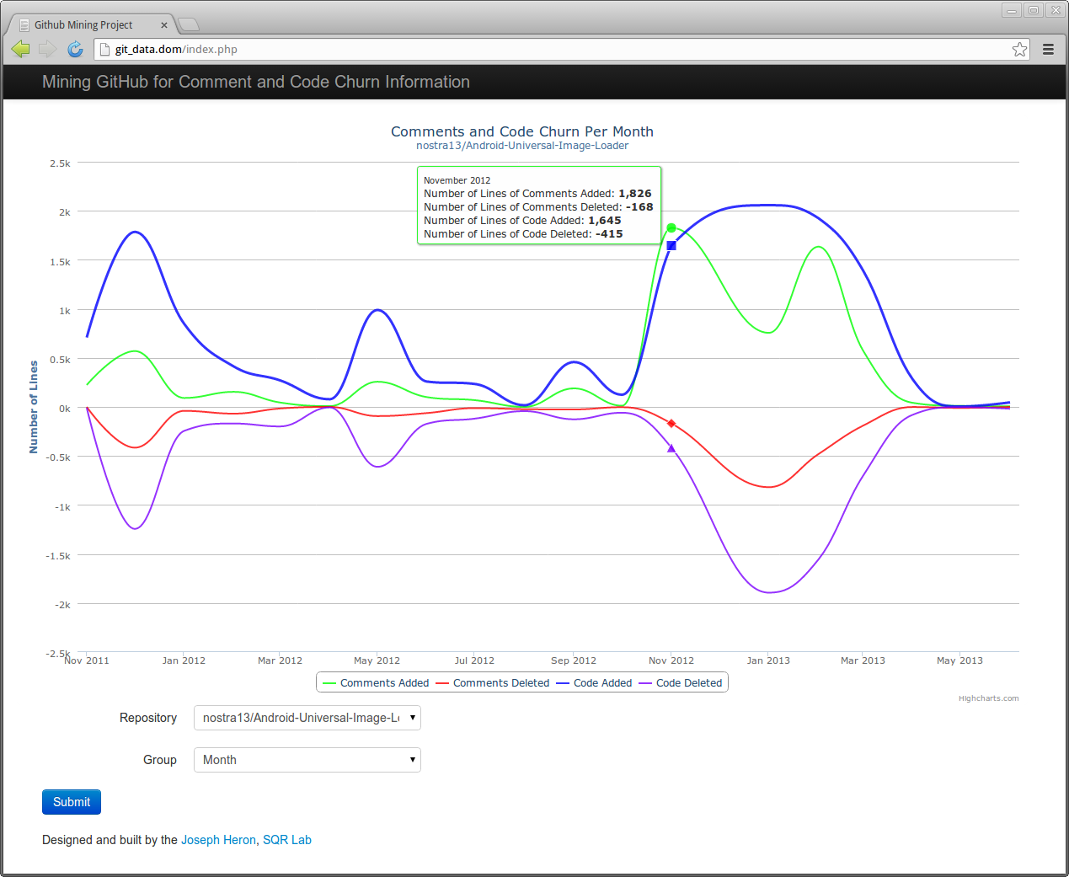
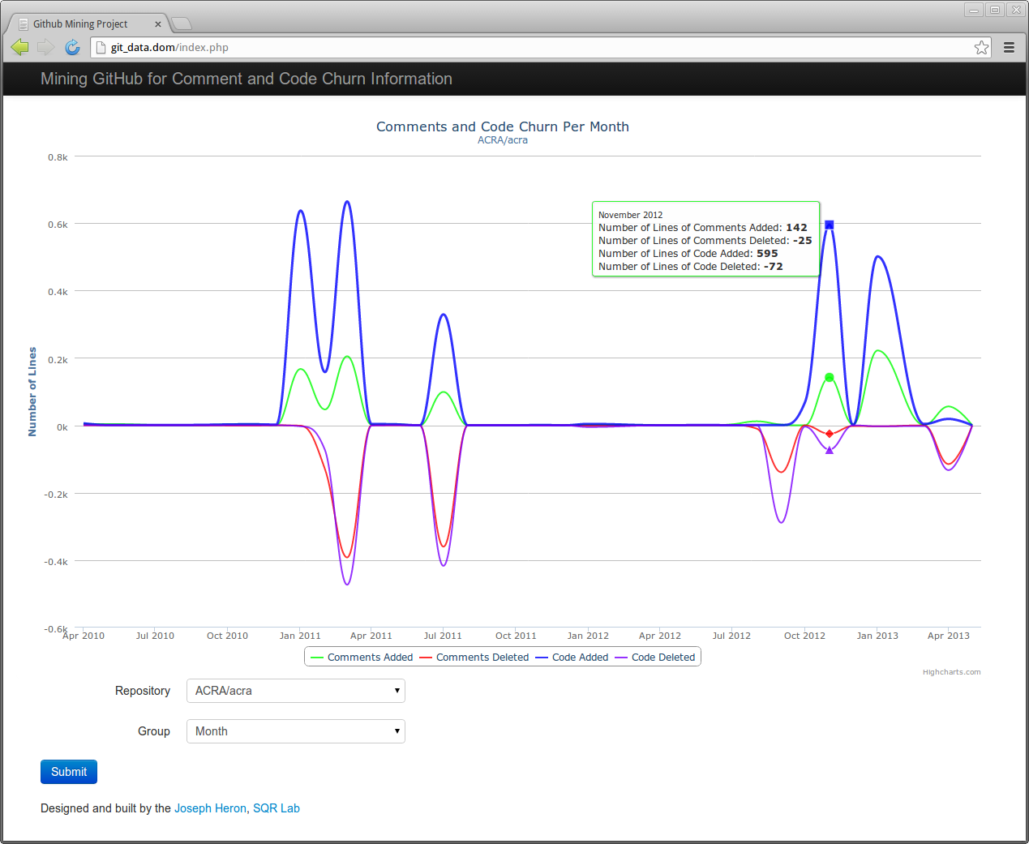

Mining GitHub for Comment and Code Churn Information
Joseph Heron ● Jeremy S. Bradbury Faculty of Science ● University of Ontario Institute of Technology ● Oshawa, Ontario, Canada {joseph.heron@uoit.net, jeremy.bradbury@uoit.ca
1. Motivation
4. Preliminary Results
Research into mining software repositories and the data collected from the mining of these repositories is vast and continues to grow.
However, less has been done on documentation of projects. Specifically, two metrics :
Comment Churn
Code Churn
These will help answer questions:
Do comments stay up-to-date over the life of the project?
How does comment churn compare to code churn?
How do developers document projects?
Built for web browsers to be viewed anywhere.
Pop-up display with the actual values at the point hovered over.
Research Goal:
Visualize the comments churn of a open source projects to determine whether documentation quality is maintained for the life of a project.
3. Approach to Data Mining Github
Github Repositories
Local MySQL DB (raw facts)
Comment/code additions are positive
Mine repositories with Ruby to acquire raw facts
Select the repository of your choice.
Comment/code deletions are negative
Remote Server
Parse & analyze raw data with Ruby
Select the group by method for aggregating the metrics
Select the repository of your choice. Interactive legend, allowing for any of the plots to be hidden
Local MySQL DB
(higher level facts)
5. Future Work
Visualization
Visualize using JavaScript (with Highcharts Library), PHP, HTML
Using our work on Java projects has allowed for the comment churn to be visualized along side the code churn. This gives some indication of how the documentation is added/updated as code is added or updated.
Further investigation can be done in:
Visualizing the progression of the comments linked to the source code that the comment describes.
Refine the visualization to view the information in different ways.
Localize the visualization to committer/author.
Use code animations to sublimit graph so allow for a more in-depth look at the information.
Recognize lines changed rather then only additions and deletions.
Client Browser
Lab Server
Funding provided by:
Consortium for Software Engineering Research (CSER) ● Montreal, Quebec, Canada ● June 2013
Notes:
1

