Slide 1

Binary Trees in CUDA
By James Sandham

Slide 2
Binary Trees in CUDA
Trees on the CPU (serial code) are typically implemented using dynamic memory allocation
e.g. we might have a Node class/struct and build our tree by dynamically allocating memory as the tree is built in a sequential fashion
struct node
{
int key_value;
struct node *left;
struct node *right;
};
We do not want to be using dynamic allocation in our GPU kernels

Slide 3
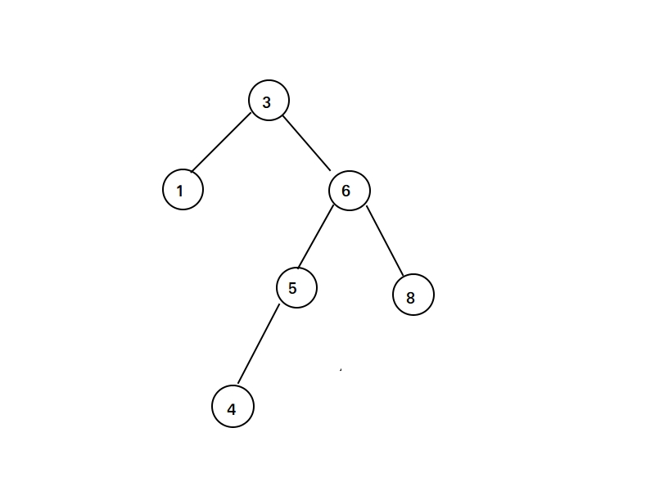
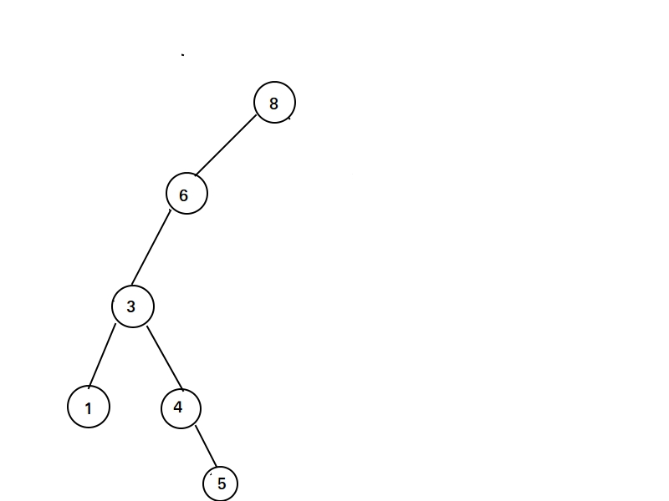
Binary Trees in CUDA
We also need to recognize that trees are often dependent on the order in which nodes are added
For example given an array of integers that we wish to sort, the resulting binary tree structure will depend on the order in which we add integers from our array
e.g. creating a binary tree to sort the two arrays A=[3,6,5,1,8,4] and B=[8,6,3,4,1,5] will result in two different binary trees even though both arrays contain the same numbers.

Slide 4
Binary Trees in CUDA
Idea: assign each integer in the array to a thread running on the GPU
But the order in which threads will execute is beyond our control
Thus we must be ok with different tree structures representing the same data
e.g. given the array A=[3,6,5,1,8,4] we assign one integer for each thread:
Thread 0 -> 3
Thread 1 -> 6 These threads can run in any order and this order will change from
Thread 2 -> 5 one instance of the program running to another. We must be
Thread 3 -> 1 ok with that for this to work.
Thread 4 -> 8
Thread 5 -> 4

Slide 5
Binary Trees in CUDA
Adding a node to a tree involves two main steps:
Traversing the partially constructed tree until we hit a leaf node
Adding the new node to the tree
Idea: We can do 1) in parallel while doing 2) sequentially!

Slide 6
Binary Trees in CUDA
Ok so to recap:
We plan on assigning each integer in our array to a different thread.
Each thread will independently add its integer to the binary tree.
Each thread can traverse the tree in parallel, but must only insert its value one at a time.
Therefore the insertion of each integer will have to be done atomically or by using locks/unlocks. This will ensure that only one thread is adding its integer at a time.
Remember however that we do not want to use dynamic memory allocation! What should our binary tree data structure look like? How is our binary tree stored in global memory on the GPU?

Slide 7
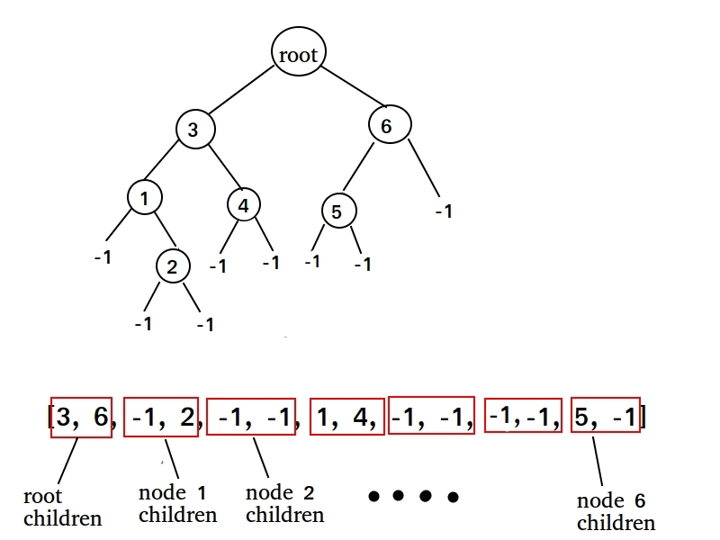
Binary Trees in CUDA
Given the array C=[3,6,5,1,2,4], the corresponding binary tree will of course contain six (non-empty) nodes
Heres an idea: what if we only record the children of all the nodes?
Because each node is its self a child node of its parent, this effectivily just means we store every node except the root (the root has no parent!).
Consider the following array data structure that records all the children nodes in a binary tree

Slide 8
Binary Trees in CUDA
Lets run through an example for creating a binary tree representation of the array C=[3,6,5,1,2,4]
Initially our tree array holding the children of all nodes is filled with -1's:
children = [-1,-1,-1,-1,-1,-1,-1,-1,-1,-1,-1,-1,-1,-1]
This array has length of 14 because each node has 2 children and in the array C there are 6 nodes. This gives us a total of 12, but we need two 2 more for the children of the root node

Slide 9
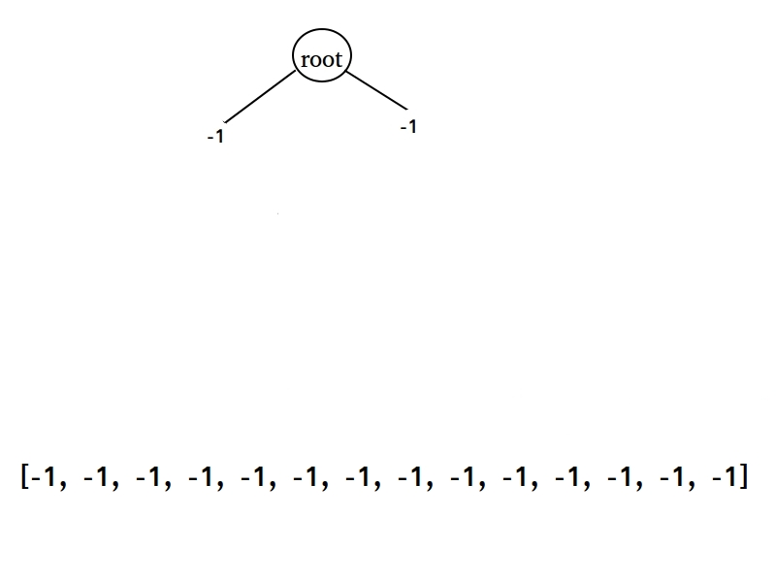
Binary Trees in CUDA

Slide 10
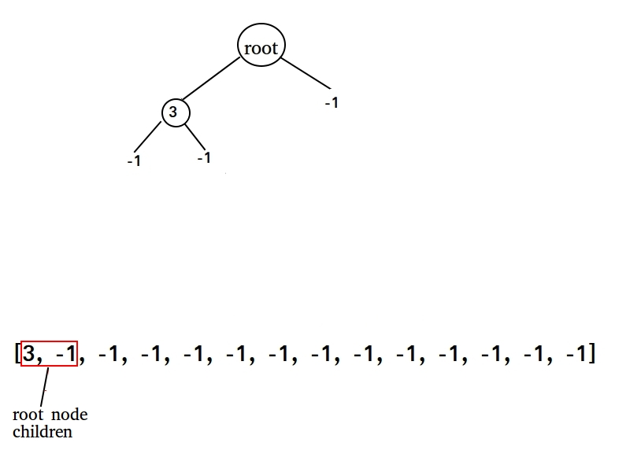
Binary Trees in CUDA

Slide 11
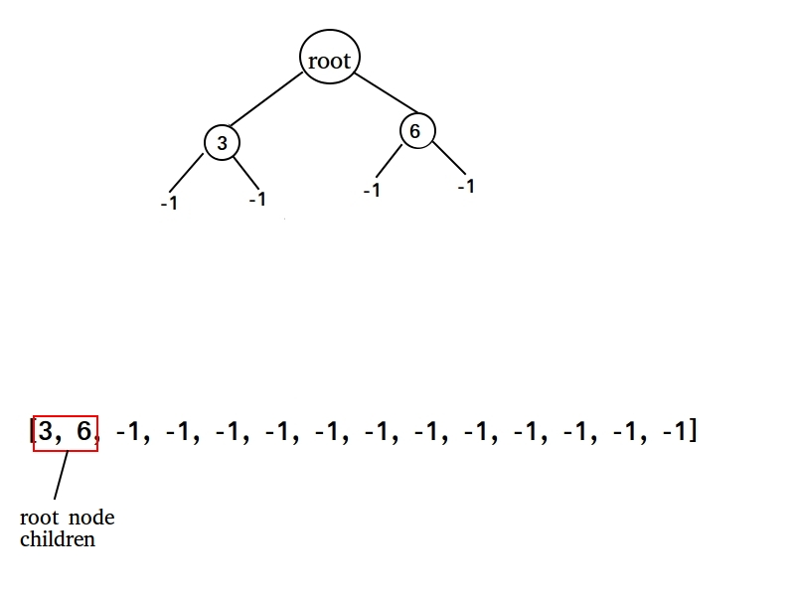
Binary Trees in CUDA

Slide 12
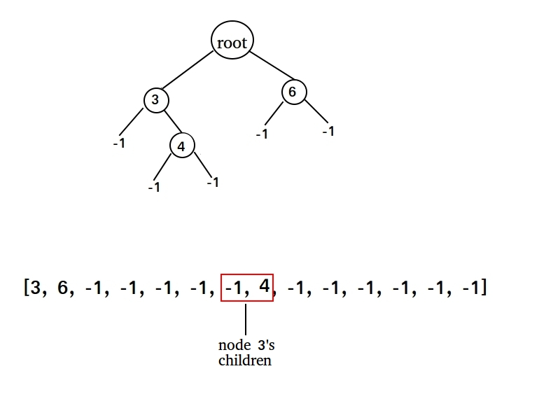
Binary Trees in CUDA

Slide 13
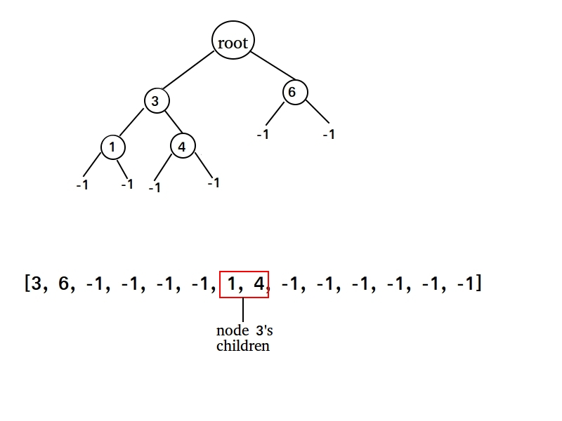
Binary Trees in CUDA

Slide 14
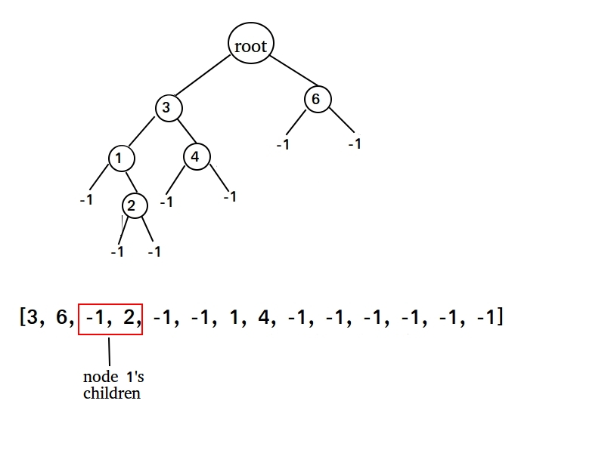
Binary Trees in CUDA

Slide 15
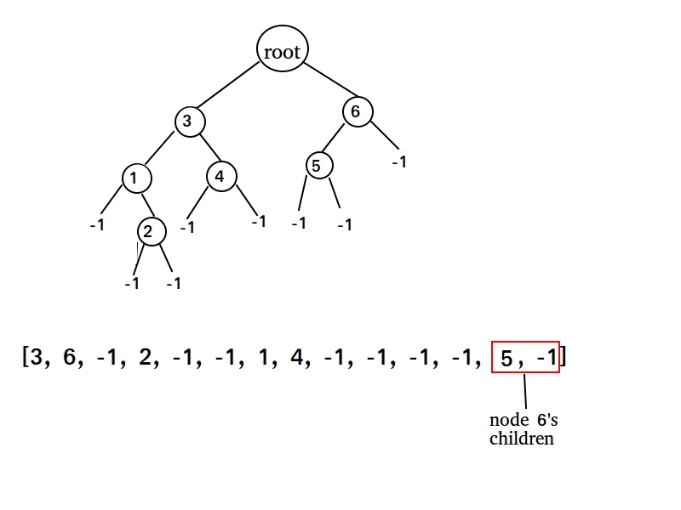
Binary Trees in CUDA

Slide 16
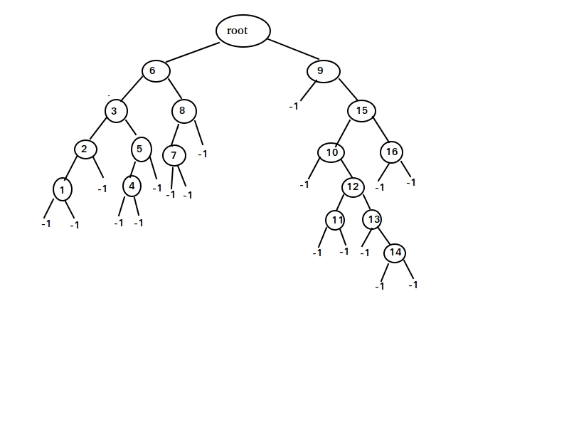
Binary Trees in CUDA
Here is an actual run of the program I am about to show for the array C=[8,3,12,1,10,5,13,11,6,7,9,14,15,4,16,2]

Slide 17
References
I learned this idea of building trees using CUDA from the work done by Benjamin Neukom. Check out his awesome n body simulation video at https://www.youtube.com/watch?v=vJ8ld5WgUz4
His simulation and code involves building oct-trees (trees where each node has 8 children), but the idea is similar to what we have done here.

