Slide 1


LaosLaser.org
Open Up Your Laser!
Peter Brier
Jaap Vermaas

Slide 2
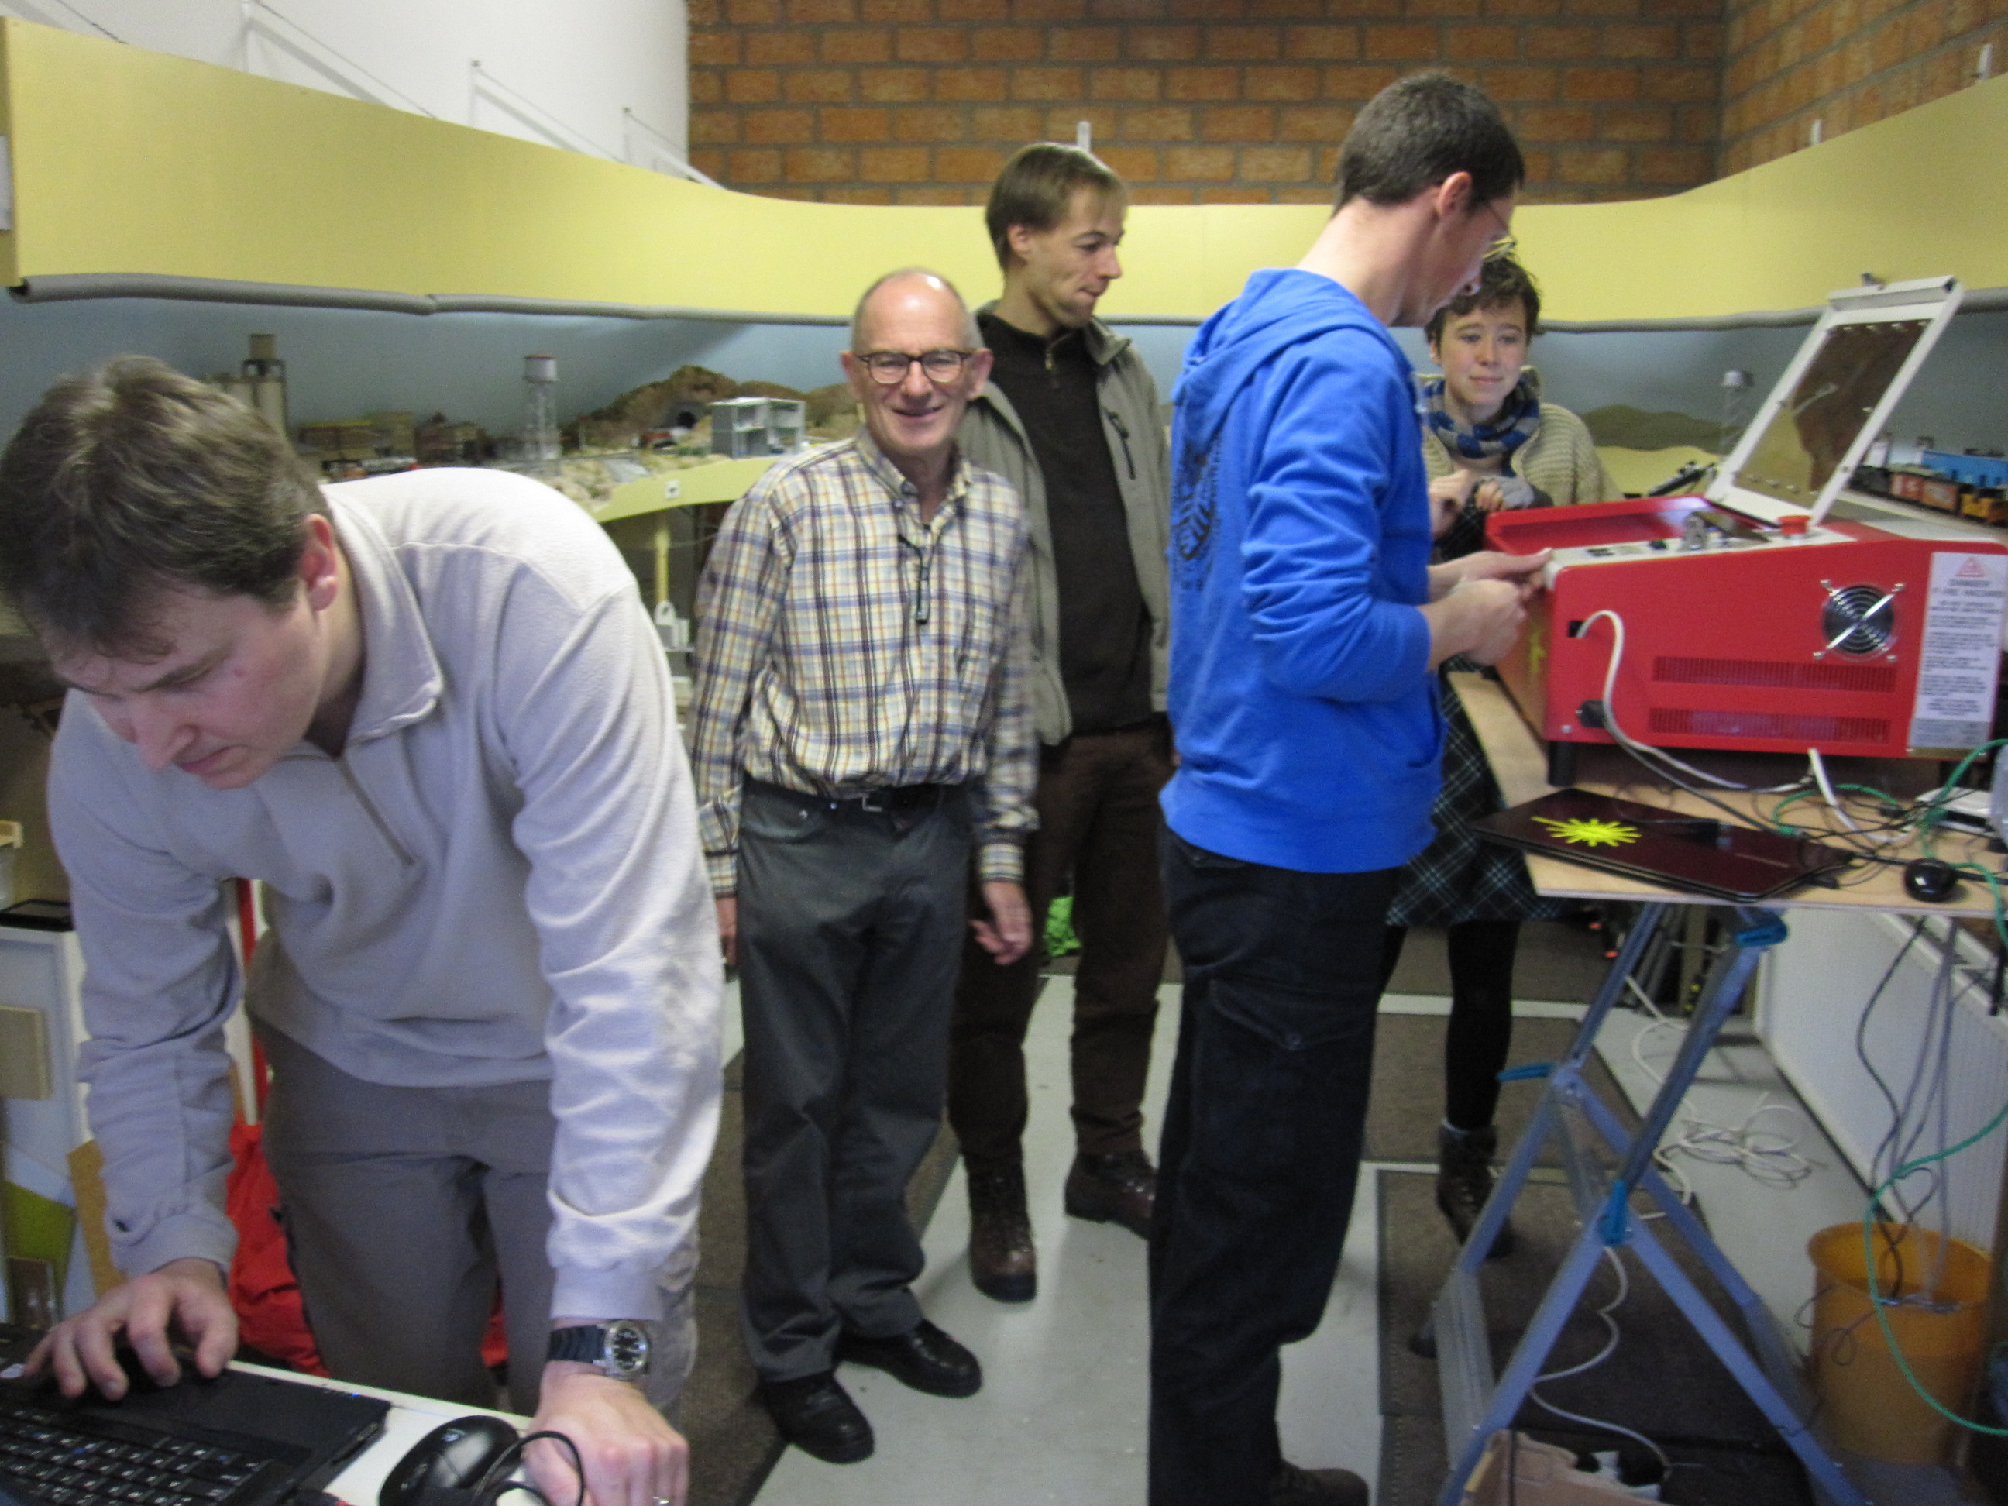
LaosLaser.org
The Project (Background)
The People
The Idea
The Technology
The Status
The Business Model
The Future

Slide 3
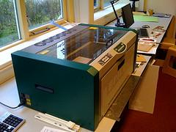
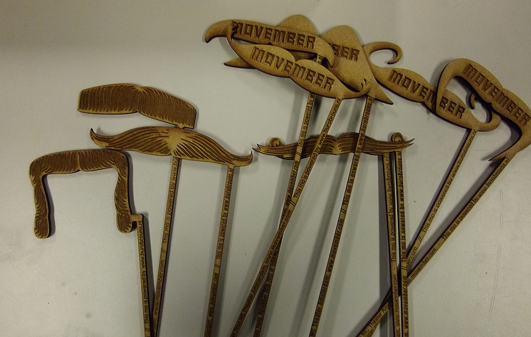
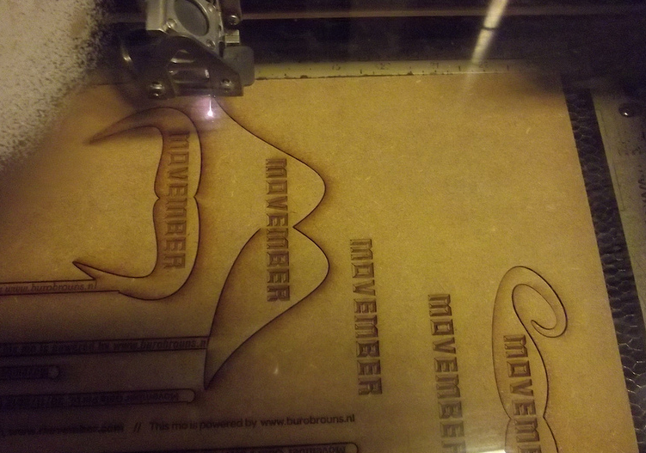
The Project: why?
Lasercutters: The workhorse of any fablab

Slide 4
The Project: why?
Some lasers come with REALLY BAD SOFTWARE
Some lasers have GOOD software but it's very EXPENSIVE (1.000+ euro for software only!)
Most (all?) software is WINDOWS ONLY and there might be people using Linux (me) and MacOS that also want to use a laser
OPEN SOURCE enables you to BUILD NEW APPLICATIONS or your own laser

Slide 5
The Project: why?
Almost all fablabs have closed (hardware & source) lasercutters
Cannot repair yourself
Cannot change hardware
Cannot change software
Expensive!

Slide 6
The People
Jaap Vermaas (fablabtruck.nl)
Peter Brier (pbrier.nl)
Jerry Jacobs (xor-gate.org, electronics pcb design)
Bart Bakker (mini fablab: offers system)
Protospace.nl: (Siert, Jelle): provide laser system and coffee
Thomas Oster (fab Lab Aachen): Visicut

Slide 7
The Idea
Make software and hardware for laser cutters
Allow you to ”JUST PRINT” from any app
Open source
Modular / Hackable
Platform idependent Linux, Windows, Mac
Stand alone laser operations

Slide 8
The Technology
Software:
  Postscript based CUPS printer driver using PSTOEDIT for conversion to gcode-like file
  VisiCUT, stand alone JAVA program for cutting
  Embedded firmware inside the laser with TCP/IP, SD-card, I2C display and stepper motor drivers
Hardware:
  MBED: LPC1678 cortex M3 ARM
  Pololu steppers or exernal driver

Slide 9
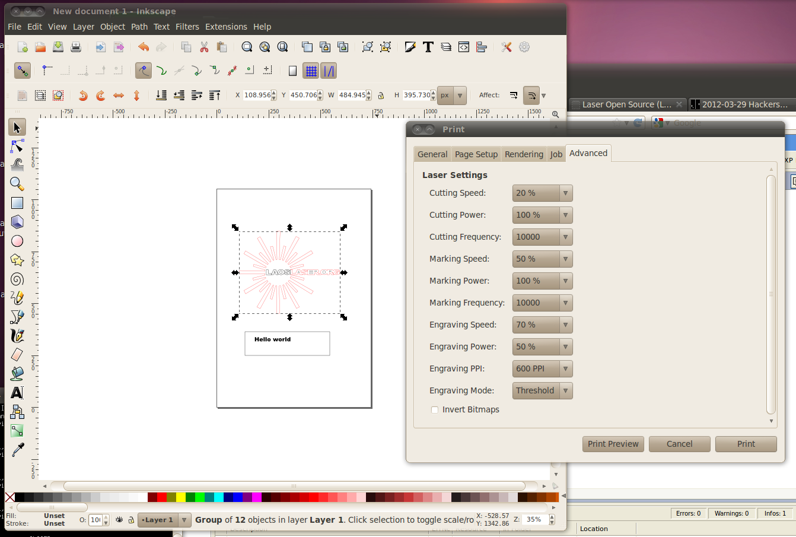
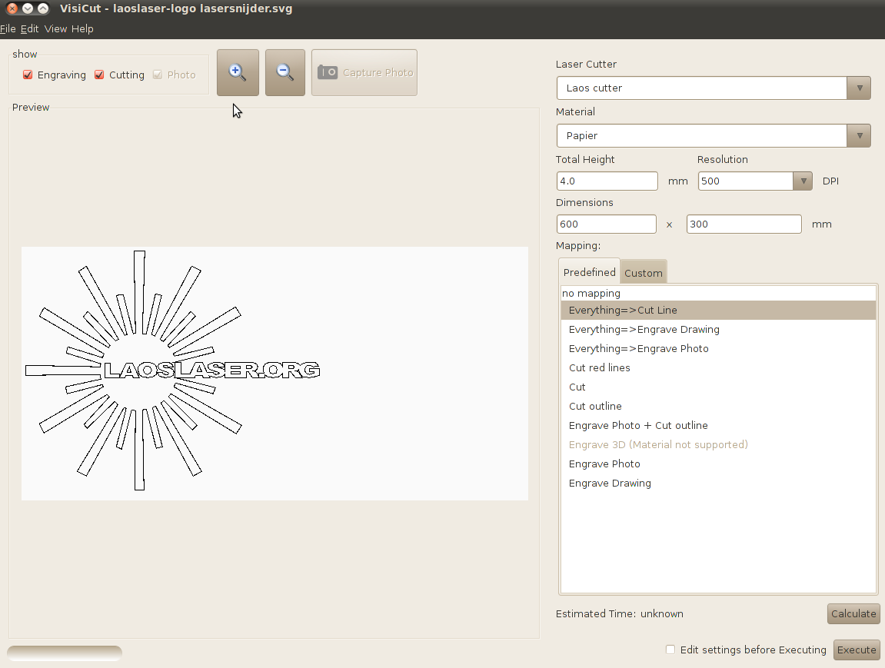
Software
Inkscape with CUPS LAOS driver
Visicut (stand alone)

Slide 10
The technology - Design
IO Board (t.b.d.)
I2C
PC
ethernet
100Mhz 32bits uC
Arduino LCD
Optional
print server
CAN
More IO & Motors
SPI
STEP/DIR
4xSteppers
M
SD card
ON/PWM
LASER

Slide 11
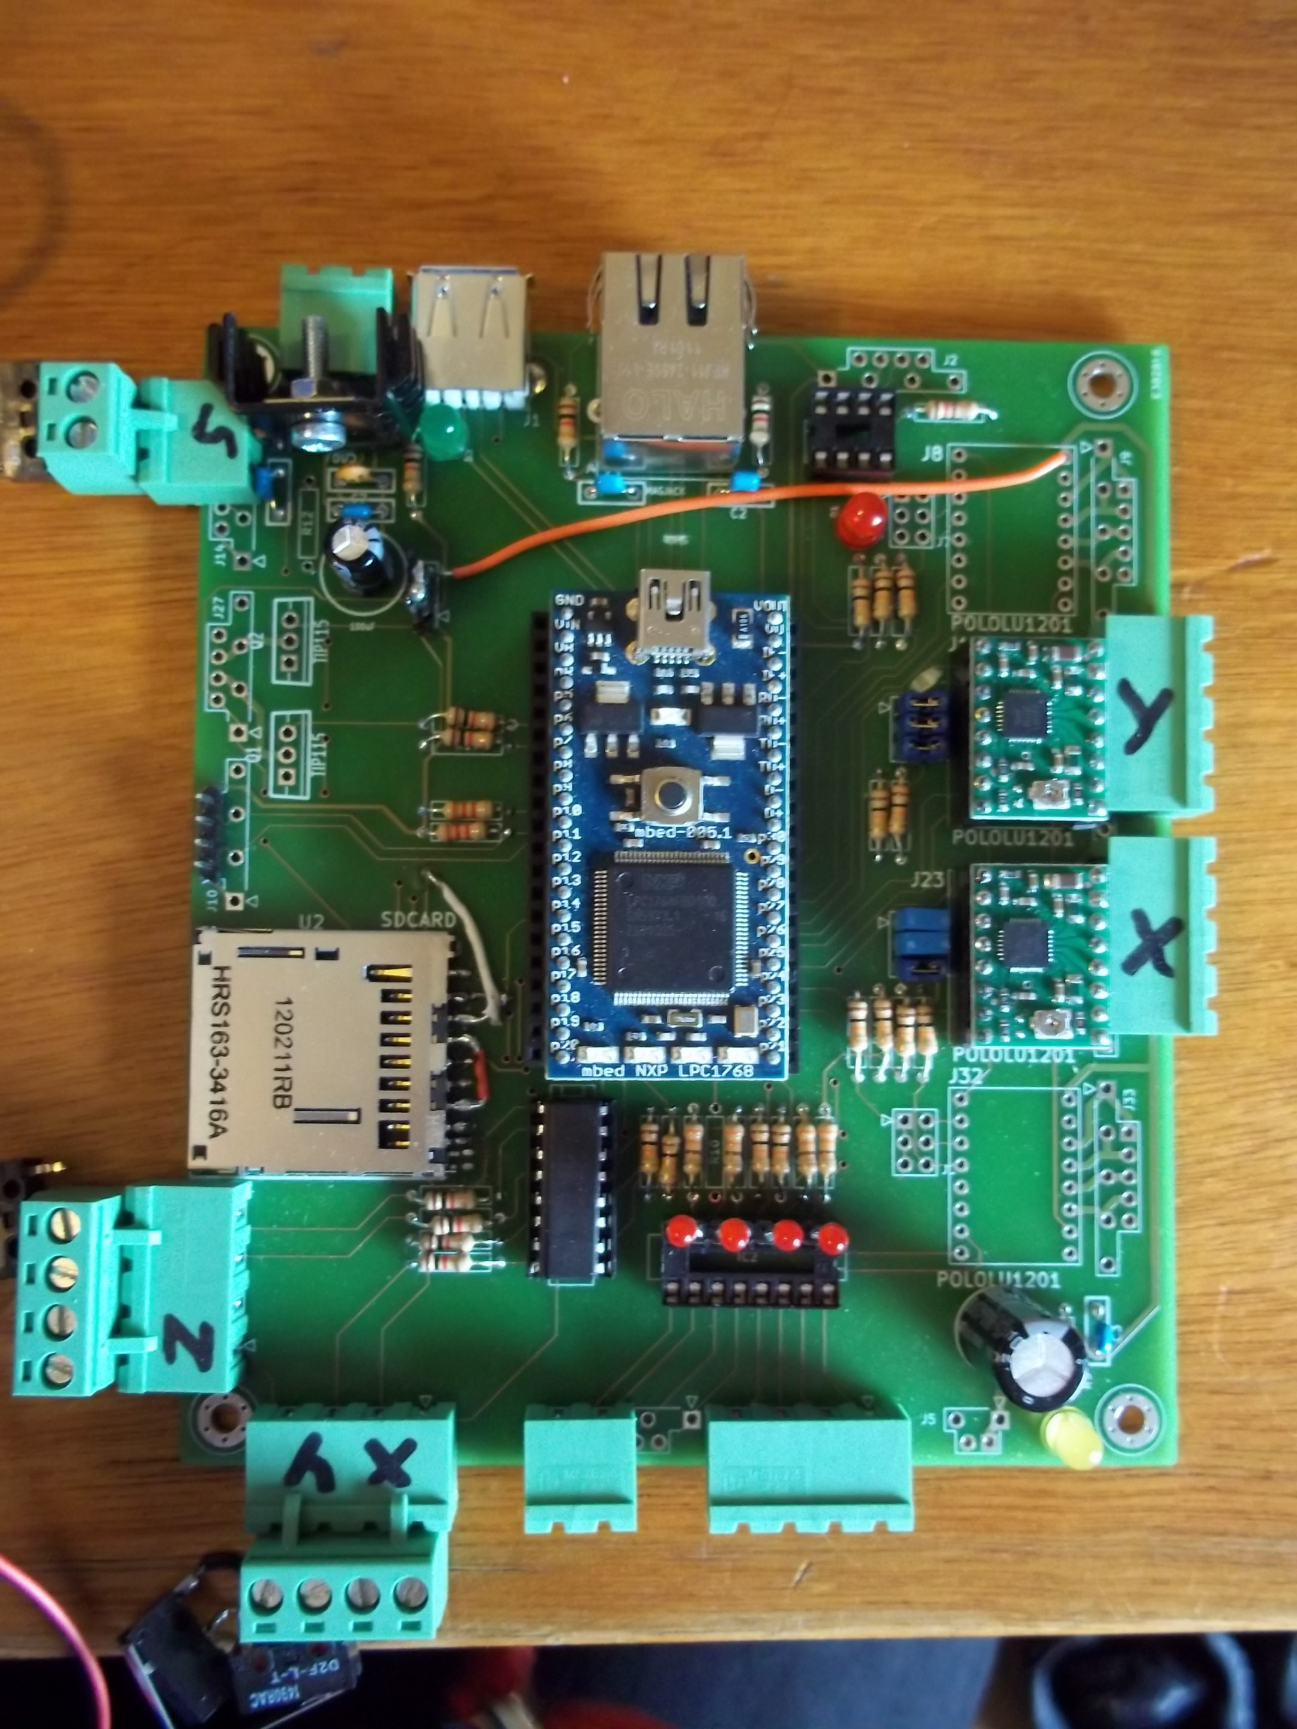
Electronics

Slide 12
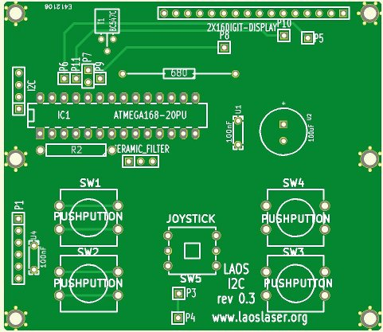
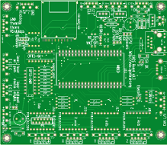
The Technology - Hardware
KiCAD used for PCB design (open source schematic, board layout package)
PCB's 3rd revision: small things always pop up:
  Text
  Pinning
  Footprint problems
Overall: a happy experience

Slide 13
The Status
Website and wiki, all info and source code online
15+ systems running LAOS already!
Printerdriver for Linux and Visicut (win/mac/linux) are operational
Basic cutting and engraving, with speed and power settings operational

Slide 14
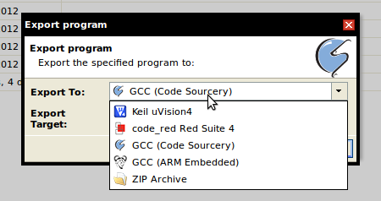
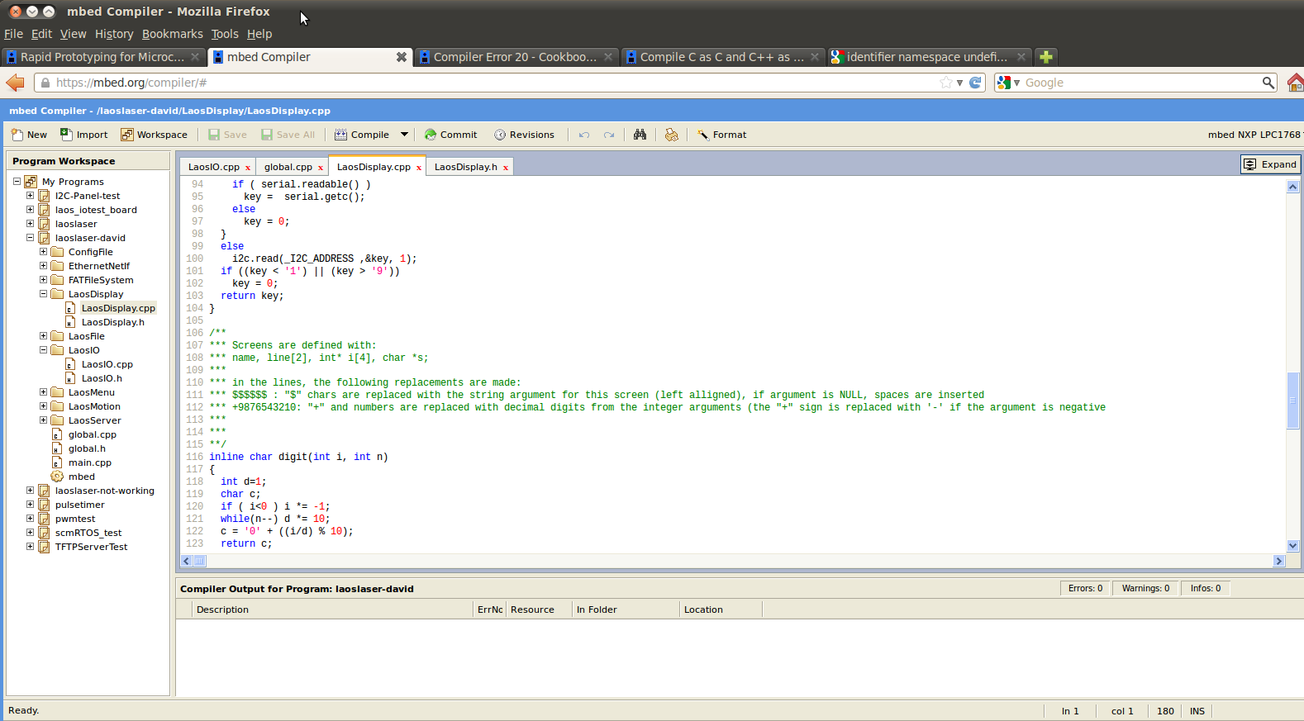
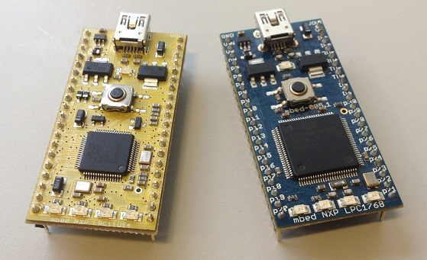
The Status –
The Joys and wonders of an online compiler
We are using LPC1768 chips on an MBED board
Plug and play board, like arduino, but more speed
Powerfull C++ libraries
ONLINE COMPILER
  PRO: It's Online
  CON: It's Online
Shift to offline GCC (same chip) and compatible board (LPC XPresso)

Slide 15
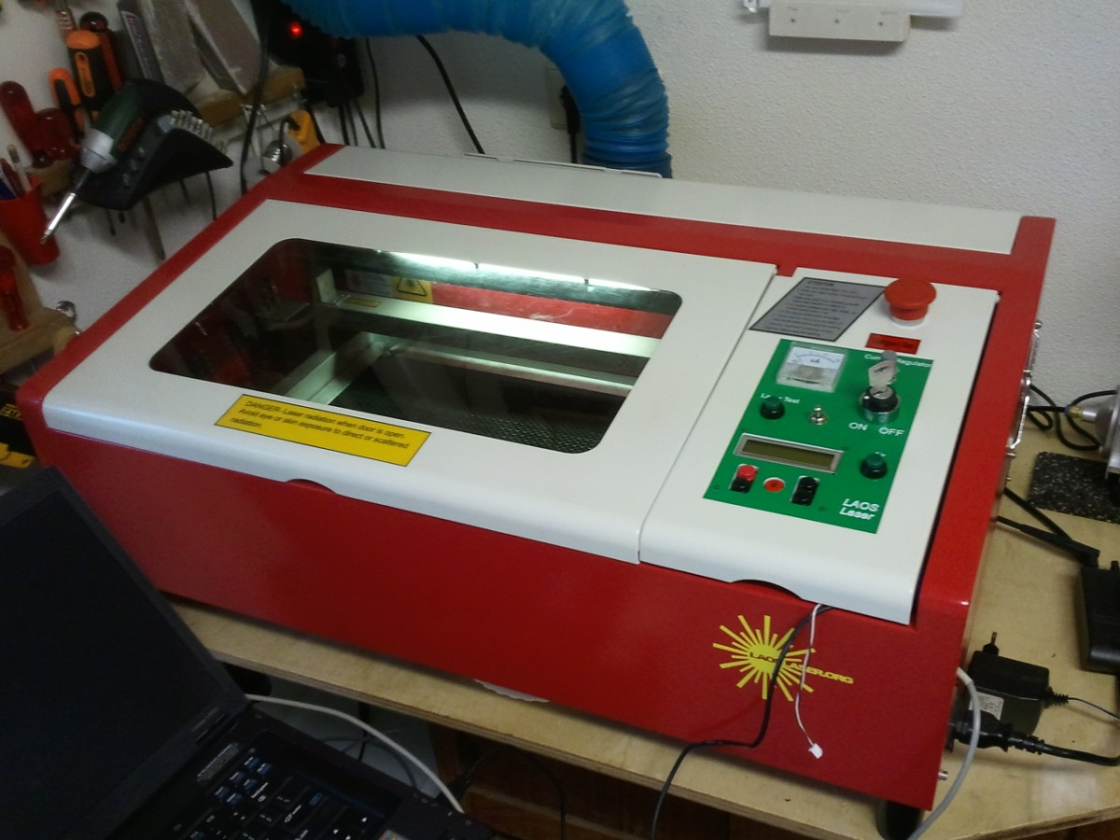
Testing machine: HPC LASER

Slide 16
The Status: practical
The board is now available for developers and early adopters.
There is a cheap desktop laser system available for early adopters

Slide 17
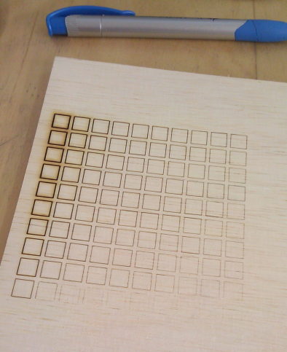
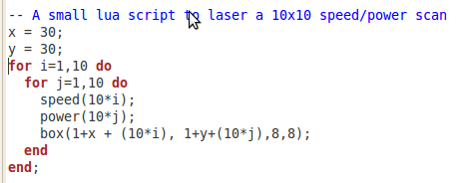
The Joys of open source:
Yesterday during a talk there was the request for a simple power/speed scan for lab use: test material settings
10 lines of lua code:

Slide 18
What we're working on?
Better marking support (in PS driver and Visicut)
Making the software fool-proof and user-friendly (not crash into endstops etc)
Implement RTOS for more modular software inside the laser. Port to Offline GCC
Stand-alone print server image:
  e.g. For OpenWRT router or Raspberry PI
  Plug and play
Laser IO (temperature, exhaust, etc)
More info: http://www.laoslaser.org

Slide 19
The business Model
Please copy!
There is no need for the Chineese to ship crippled hardware and software!
Revenues can be made by developers by assisting in design-ins
Tested Hardware + Software can be bundled and shipped as a service (adding some handling charges)

Slide 20
The future?
More systems...
More contributors...
More robust...
More plug and play...
Creative uses of the hardware!
(who says SLS machine?)

