Slide 1

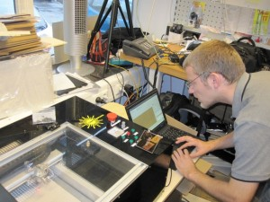
LaosLaser.org
The Project (Background)
The People
The Idea
The Technology
The Status
The Future

Slide 2
The Project: why?
Some lasers come with REALLY BAD SOFTWARE
Some lasers have GOOD software but it's very EXPENSIVE (3.000+ euro for software only!)
Most (all?) software is WINDOWS ONLY and there might be people using Linux (me) and MacOS that also want to use a laser
OPEN SOURCE enables you to BUILD NEW APPLICATIONS or your own laser

Slide 3
The People
Jaap Vermaas (fablabtruck.nl)
Peter Brier (pbrier.nl)
Jerry Jacobs (xor-gate.org, electronics pcb design)
Bart Bakker (mini fablab: offers system)
Protospace.nl: (Siert, Jelle): provide laser system and coffee
Thomas Oster (fab Lab Aachen): Visicut

Slide 4
The Idea
Make software and hardware for laser cutters
Allow you to ”JUST PRINT” from any app
Open source
Hackable
Platform idependent Linux, Windows, Mac
Stand alone laser operations

Slide 5
The Technology
Software:
  Postscript based CUPS printer driver using PSTOEDIT for conversion to gcode-like file
  Embedded firmware inside the laser with TCP/IP, SD-card, I2C display and stepper motor drivers
Hardware:
  MBED: LPC1678 cortex M3 ARM
  Pololu steppers or exernal driver

Slide 6
The Technology (software)
(CUPS) PPD file (postscript)
Cups backend (C)
PS2EDIT Backend: C++
Simulator: C#
Embedded firmware: MBED (C++)
LCD Driver: Arduino (C++)

Slide 7
The Status
Website and wiki, all info and source code online
10 systems running LAOS already!
Printboard available
Both printerdriver and Visicut are operational
Printer driver Software works for cutting
Visicut program can cut and engrave (slow)

Slide 8
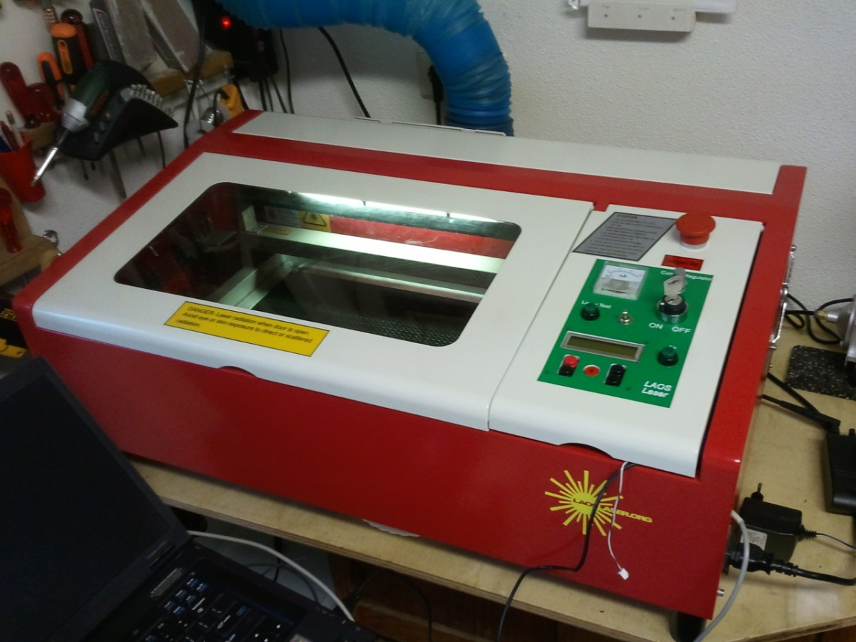
Working machine: HPC LASER

Slide 9
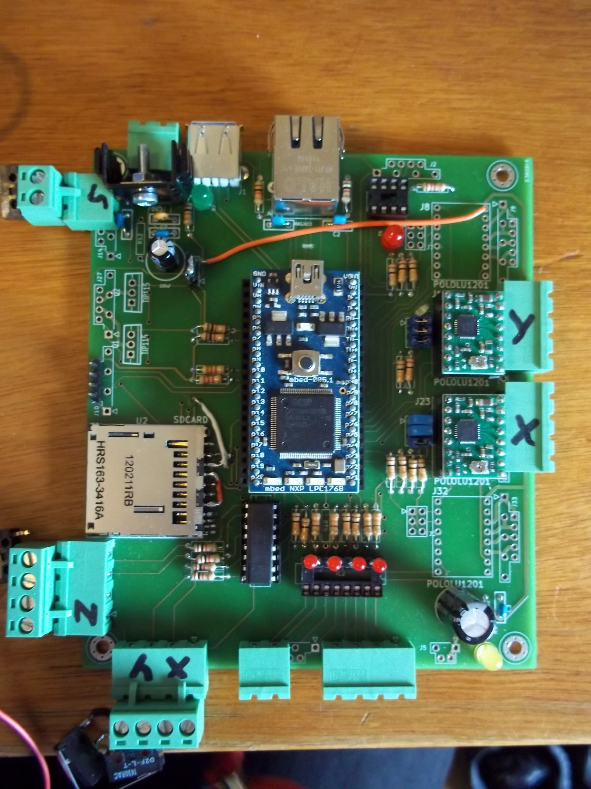
Electronics
Suitable for any laser
Hackable prototype available

Slide 10
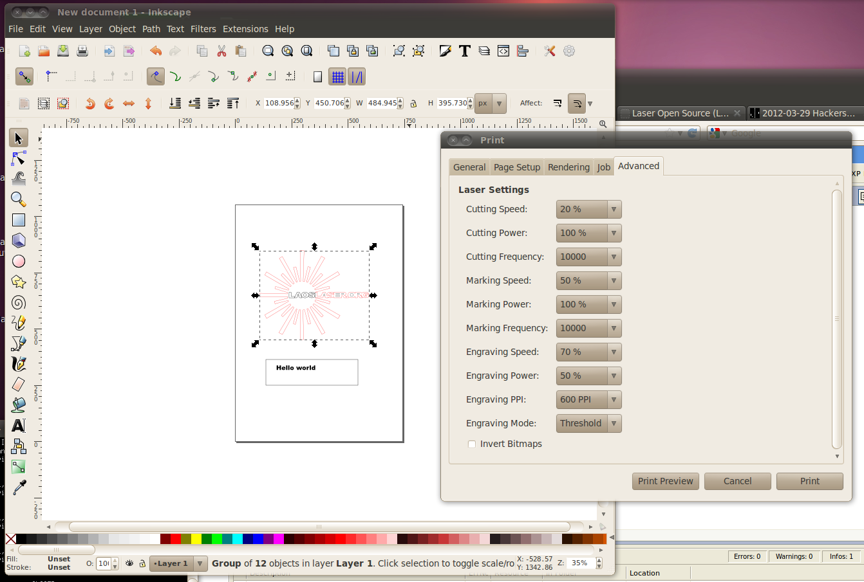
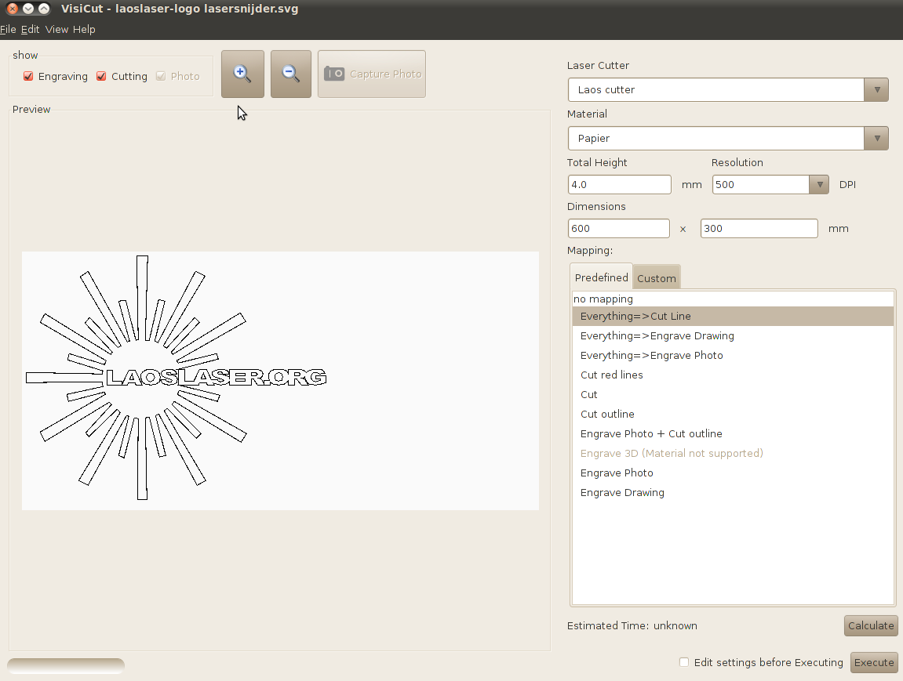
Software
Inkscape with CUPS LAOS driver
Visicut (stand alone)

Slide 11
The Status: practical
The board is now available for developers and early adopters.
Second generation of the board (bugfix) is almost sold-out.
There is a cheap desktop laser system available for early adopters

Slide 12
What we're working on?
Bitmap marking support (faster and in PS driver)
Making the software fool-proof and user-friendly (not crash into endstops etc)
Implement RTOS for more modular software inside the laser
More info: http://www.laoslaser.org

Slide 13
The future?
More systems...
More contributors...
More robust...
More plug and play...
Creative uses of the hardware!
(who says SLS machine?)

