Slide 1

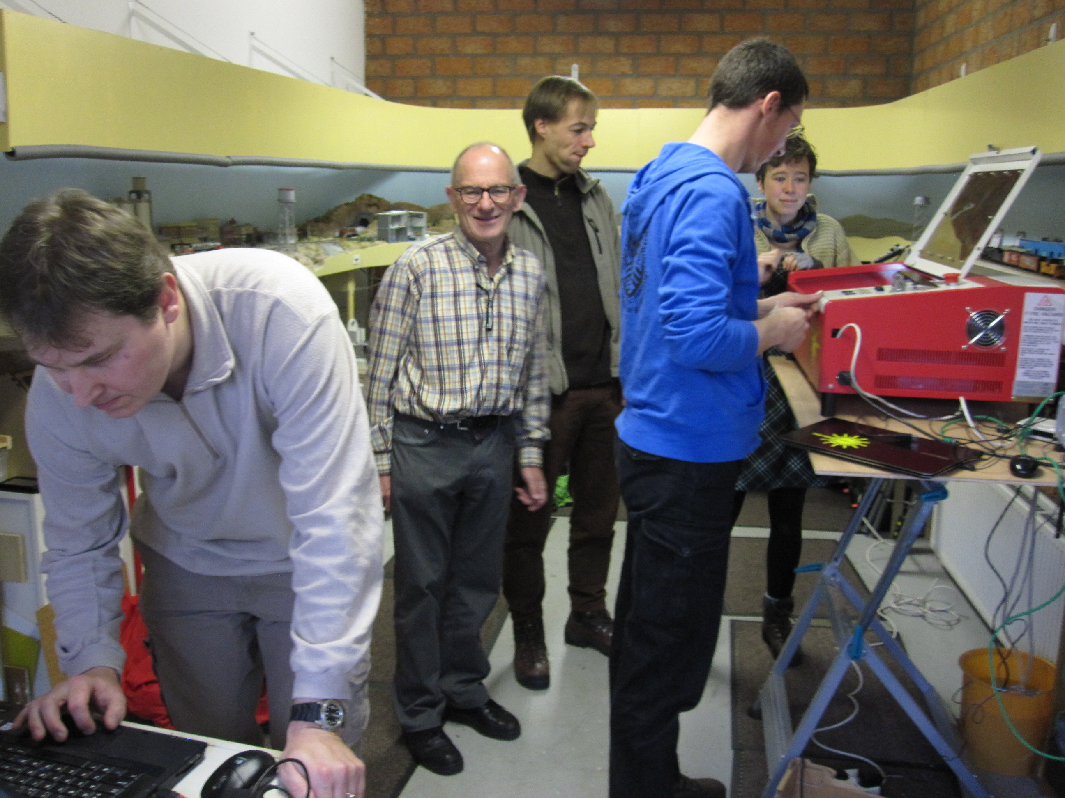
LaosLaser.org
The Project (Background)
The People
The Idea
The Technology
The Status
The Future

Slide 2
The Project: why?
Some lasers come with REALLY BAD SOFTWARE
Some lasers have GOOD software but it's very EXPENSIVE (1.000+ euro for software only!)
Most (all?) software is WINDOWS ONLY and there might be people using Linux (me) and MacOS that also want to use a laser
OPEN SOURCE enables you to BUILD NEW APPLICATIONS or your own laser

Slide 3
The People
Jaap Vermaas (fablabtruck.nl)
Peter Brier (pbrier.nl)
Jerry Jacobs (xor-gate.org, electronics pcb design)
Bart Bakker (mini fablab: offers system)
Protospace.nl: (Siert, Jelle): provide laser system and coffee
Thomas Oster (fab Lab Aachen): Visicut

Slide 4
The Idea
Make software and hardware for laser cutters
Allow you to ”JUST PRINT” from any app
Open source
Modular / Hackable
Platform idependent Linux, Windows, Mac
Stand alone laser operations

Slide 5
The Technology
Software:
  Postscript based CUPS printer driver using PSTOEDIT for conversion to gcode-like file
  VisiCUT, stand alone JAVA program for cutting
  Embedded firmware inside the laser with TCP/IP, SD-card, I2C display and stepper motor drivers
Hardware:
  MBED: LPC1678 cortex M3 ARM
  Pololu steppers or exernal driver

Slide 6
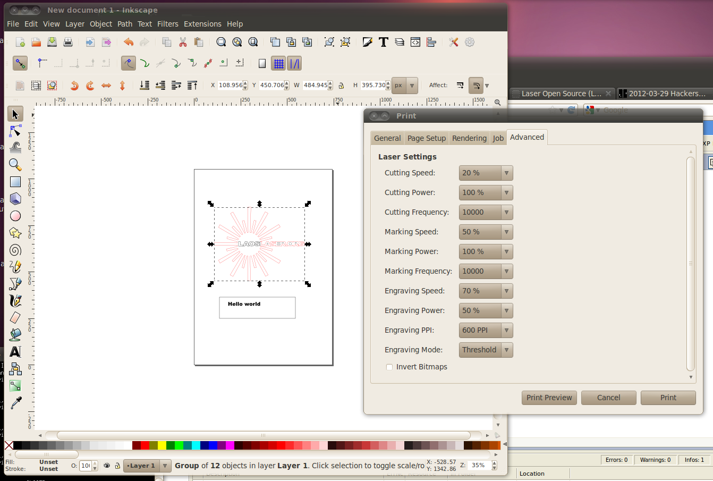
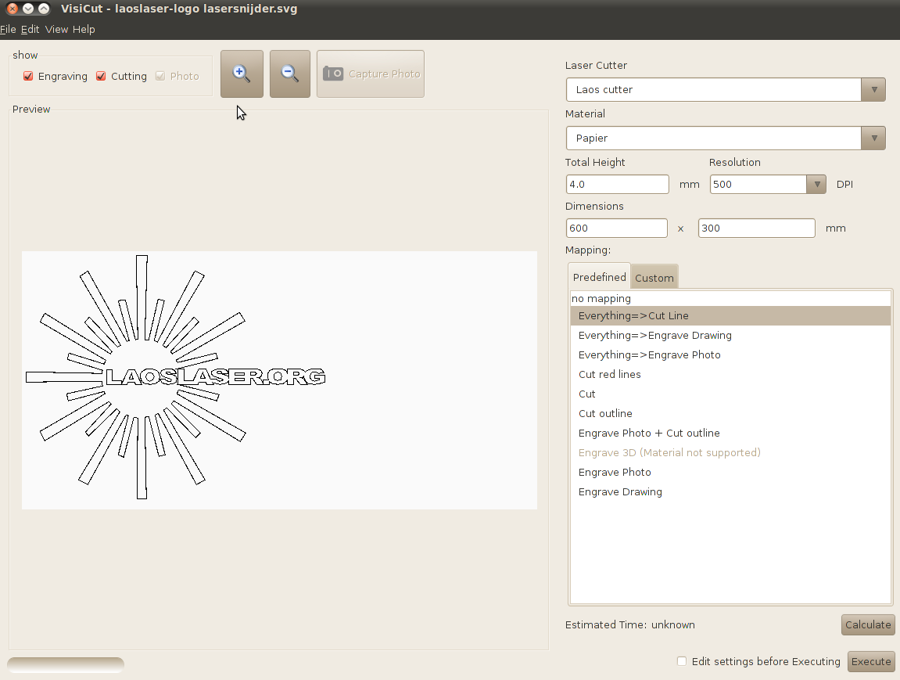
Software
Inkscape with CUPS LAOS driver
Visicut (stand alone)

Slide 7
The technology - Design
IO Board (t.b.d.)
I2C
PC
ethernet
100Mhz 32bits uC
Arduino LCD
Optional
print server
CAN
More IO & Motors
SPI
STEP/DIR
4xSteppers
M
SD card
ON/PWM
LASER

Slide 8
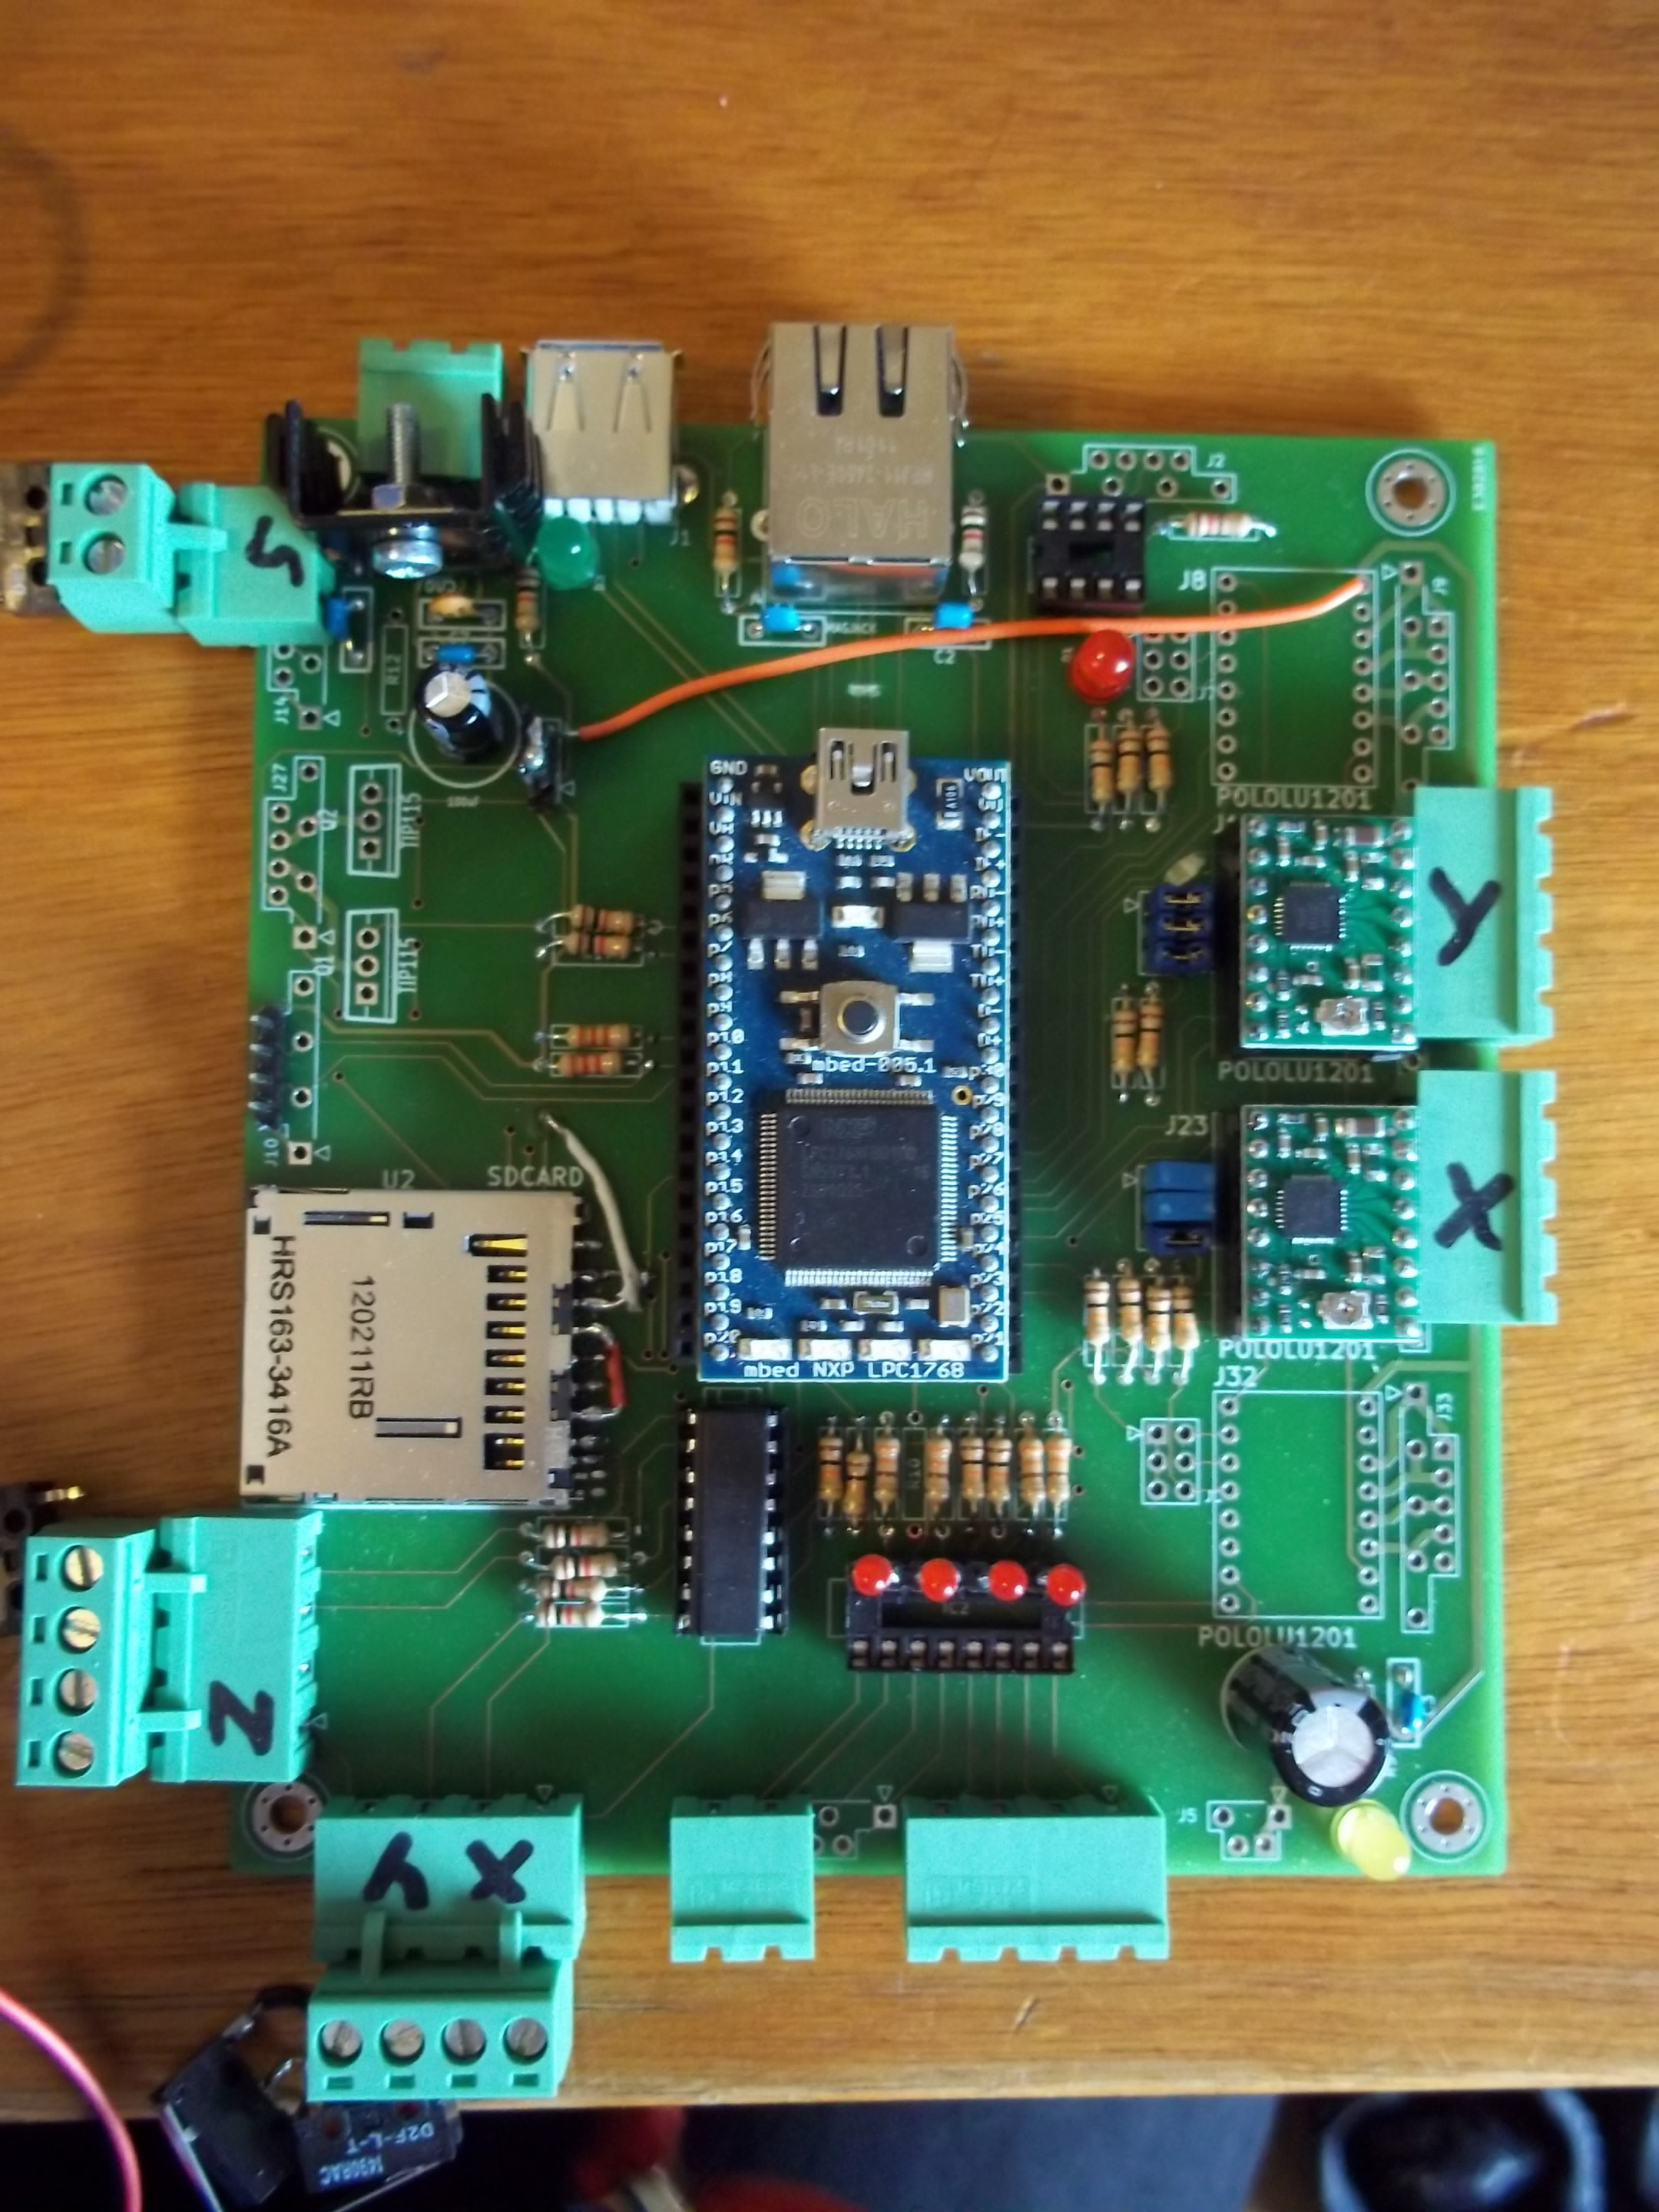
Electronics

Slide 9
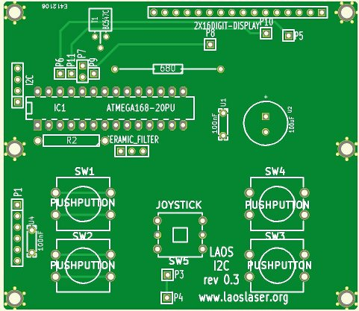
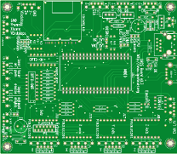
The Technology - Hardware
KiCAD used for PCB design (open source schematic, board layout package)
PCB's 3rd revision: small things always pop up:
  Text
  Pinning
  Footprint problems
Overall: a happy experience

Slide 10
The Status
Website and wiki, all info and source code online
15+ systems running LAOS already!
Printerdriver for Linux and Visicut (win/mac/linux) are operational
Basic cutting and engraving, with speed and power settings operational

Slide 11
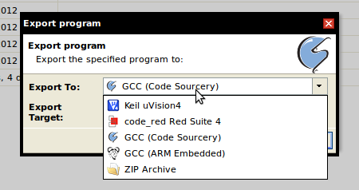
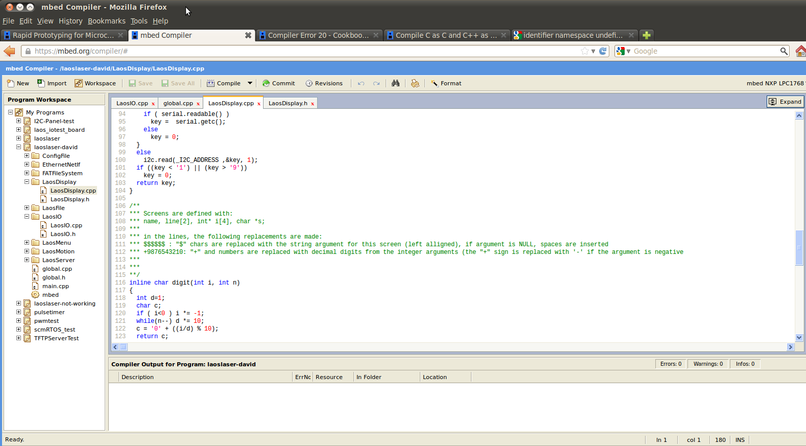
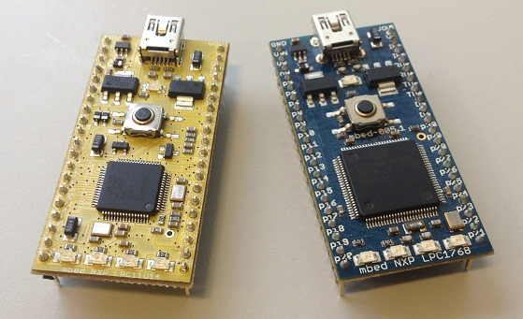
The Status –
The Joys and wonders of an online compiler
We are using LPC1768 chips on an MBED board
Plug and play board, like arduino, but more speed
Powerfull C++ libraries
ONLINE COMPILER
  PRO: It's Online
  CON: It's Online
Shift to offline GCC (same chip) and compatible board (LPC XPresso)

Slide 12
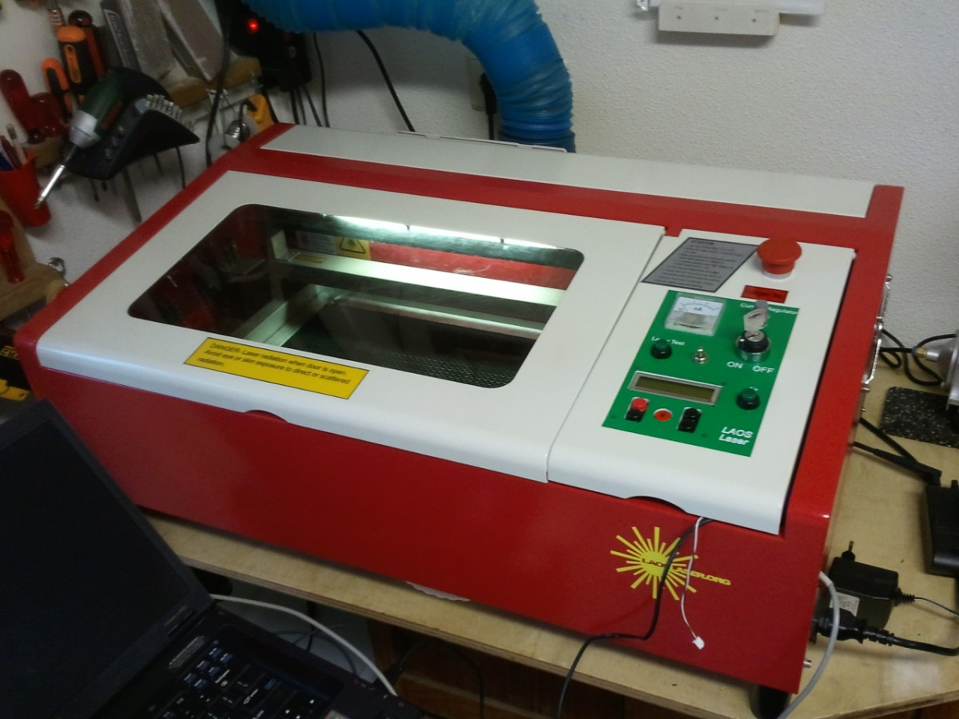
Testing machine: HPC LASER

Slide 13
The Status: practical
The board is now available for developers and early adopters.
There is a cheap desktop laser system available for early adopters

Slide 14
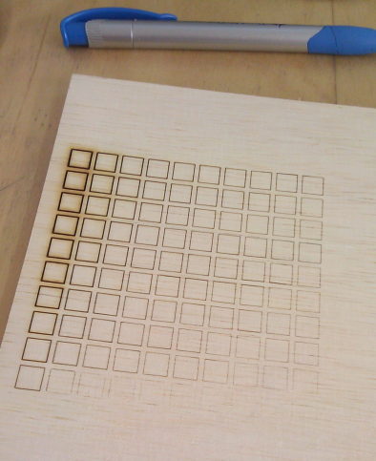
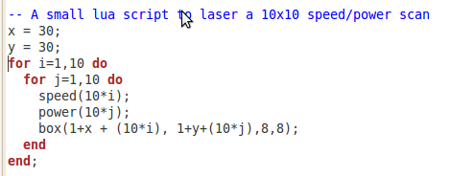
The Joys of open source:
Yesterday during a talk there was the request for a simple power/speed scan for lab use: test material settings
10 lines of lua code:

Slide 15
What we're working on?
Better marking support (in PS driver and Visicut)
Making the software fool-proof and user-friendly (not crash into endstops etc)
Implement RTOS for more modular software inside the laser. Port to Offline GCC
Stand-alone print server image:
  e.g. For OpenWRT router or Raspberry PI
  Plug and play
Laser IO (temperature, exhaust, etc)
More info: http://www.laoslaser.org

Slide 16
What we're working on?
Better marking support (in PS driver and Visicut)
Making the software fool-proof and user-friendly (not crash into endstops etc)
Implement RTOS for more modular software inside the laser. Port to Offline GCC
Stand-alone print server image:
  e.g. For OpenWRT router or Raspberry PI
  Plug and play
Laser IO (temperature, exhaust, etc)
More info: http://www.laoslaser.org

Slide 17
The future?
More systems...
More contributors...
More robust...
More plug and play...
Creative uses of the hardware!
(who says SLS machine?)

