Slide 1

LaosLaser.org
The Project (Background)
The People
The Idea
The Technology
The Status
The Future

Slide 2
The Project (Background)
The Project (Background)
The People
The Idea
The Technology
The Status
The Future

Slide 3
The Project
Started because people (Jaap) where unhappy with the closed source software and hardware offered with many (low cost) commercial laser systems
Various laser systems where standing idle because people could not work with the software
”easySeal”, ”newly draw”, ”corel draw”

Slide 4
The People
Jaap Vermaas (fablabtruck.nl)
Peter Brier (pbrier.nl)
Jerry Jacobs (xor-gate.org, electronics pcb design)
Bart Bakker (mini fablab: offers system)
(Siert, Jelle) (ProtoSpace.nl): provide laser system and coffee

Slide 5
The Idea
Make software and hardware for laser cutters
Allow you to ”JUST PRINT” from any app
Open source
Hackable
Platform idependent Linux, Windows, Mac
Stand alone laser operations

Slide 6
The Technology
Software:
  Postscript based CUPS printer driver
  Conversion to vector/bitmap data via ghostscript and PS2EDIT backend
  Embedded firmware for laser with TCP/IP, SD-card, I2C display and stepper motor drivers
Hardware:
  MBED: LPC1678 cortex M3 ARM
  Pololu steppers or exernal driver

Slide 7
The Technology
(CUPS) PPD file
Postscript (PS2EDIT postscript include file)
PS2EDIT Backend: C++
Simulator: C#
Embedded firmware: MBED (C++)
LCD Driver: Arduino (C++)

Slide 8
The Status
Website and wiki, all info online
Two systems ”converted”
First batch of prototype PCB's (KiCAD!)
Software working in ”concept phase”

Slide 9
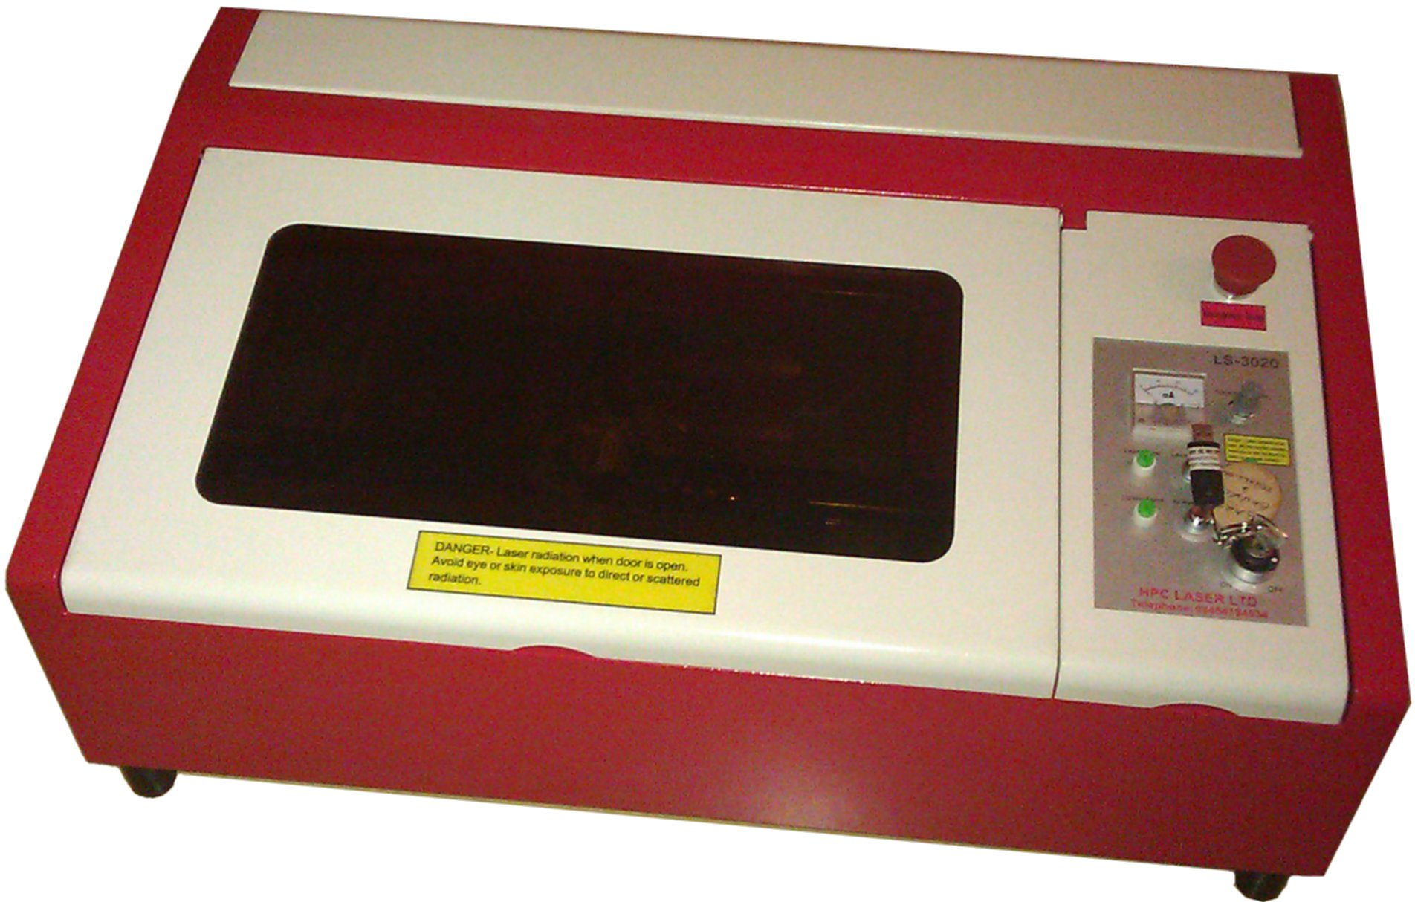
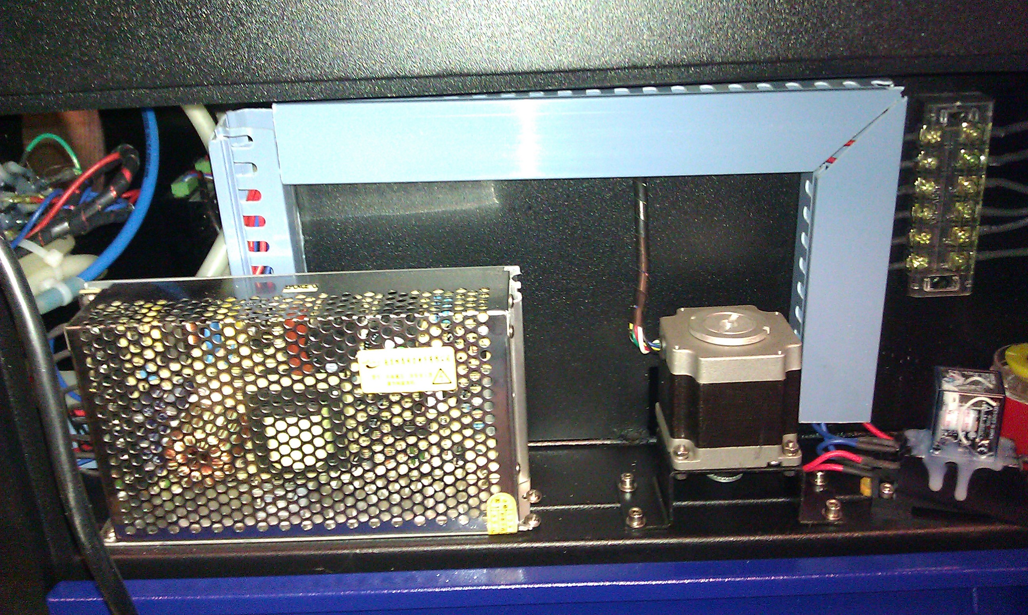
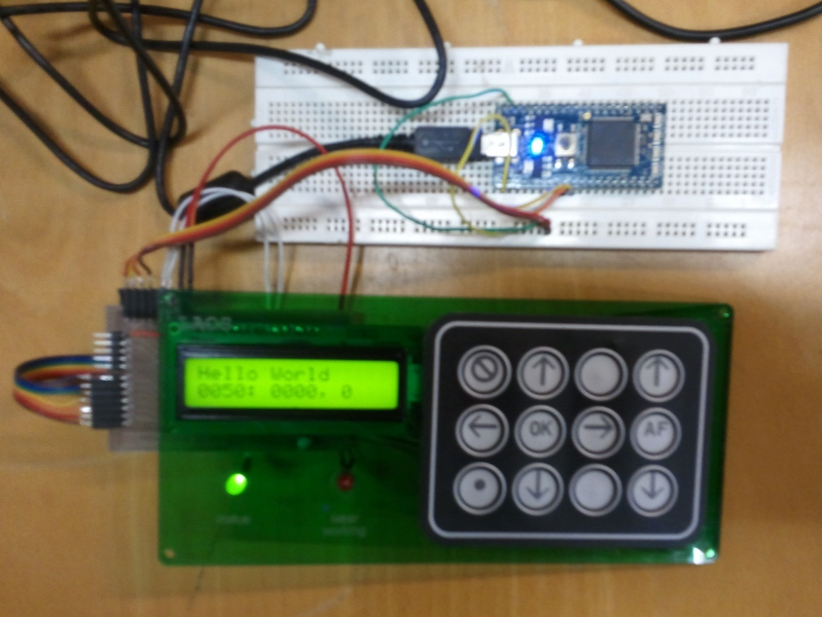
The Status: Hardware
HPC Laser
SUDA Laser
Control PCB

Slide 10
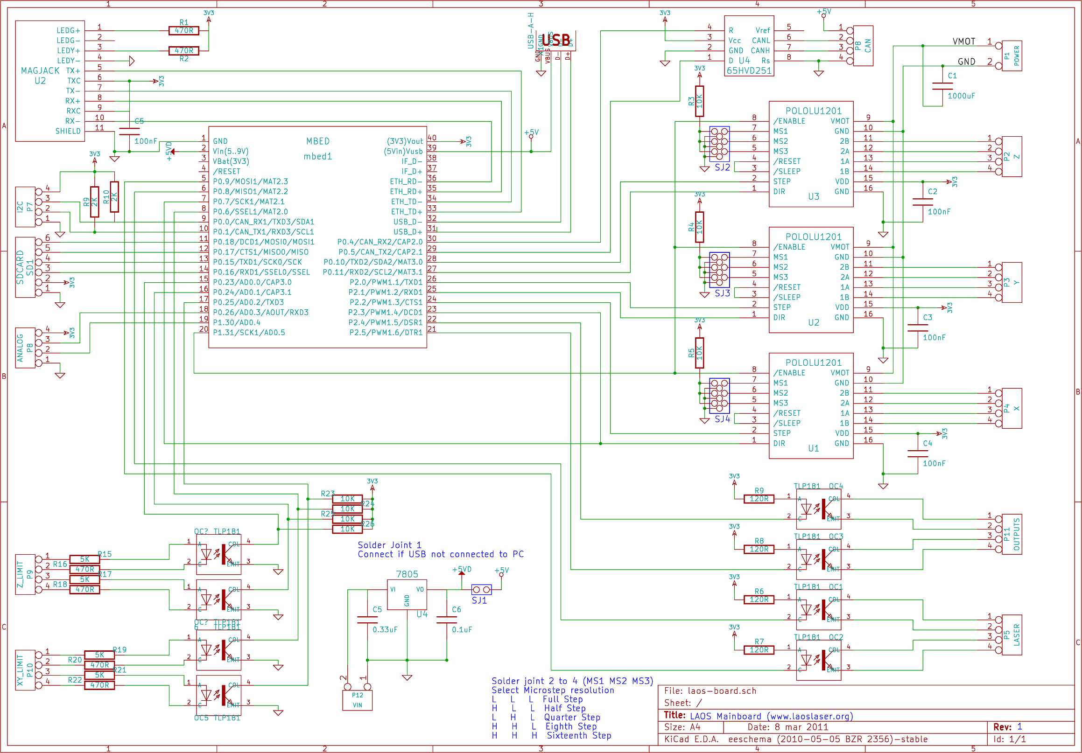
The Status: PCB

Slide 11
The Future
Make board available to developers and to upgrade existing systems
Further develop the boards
Make desktop laser system available for early adopters
Make laser systems fly to the moon!

Slide 12
Questions?
Can you contribute?

