Slide 1

Design Patterns

Slide 2
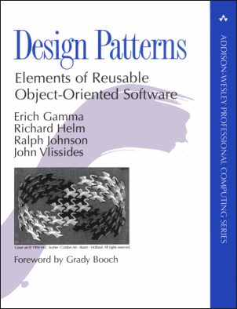
Design Patterns
What
Why (not)
Pattern Catalog
Patterns and SOLID
More GoF Patterns
Pattern pitfalls
Further Reading
Questions?
Notes:
GoF (2014): Erich Gamma, Richard Helm, Ralph Johnson, John Vlissides
23 patterns.

Slide 3
What - Definition
“Each pattern describes a problem which occurs over and over again in our environment, and then describes the core of the solution to that problem, in such a way that you can use this solution a million times over, without ever doing it the same way twice.” – Christopher Alexander
Notes:
Book: A Pattern Language (1977)

Slide 4
What - Definition
“A simple and elegant solution to a specific problem in Object Oriented Design.”
“A description of communicating objects and classes that are customized to solve a general design problem in a particular context.” - GoF
Notes:
UML & Patterns: Most simply, a good pattern is a named and well-known problem/solution pair that can be applied in new contexts, with advice on how to apply it in novel situations and discussion of its trade-offs, implementations, variations, and so forth.
It facilitates communication: “Hey Jack, for the persistence subsystem, let’s expose the services with a Facade. We’ll use an Abstract Factory for Mappers, and Proxies for lazy materialization.”

Slide 5
What - Elements
A pattern has 4 essential elements
The name
The problem
The solution
The consequences
Notes:
Name: Allow us to communicate (colleagues, documentation, ourselves) at a higher level of abstraction. Good names communicate. Poor names obfuscate.
Problem: When to apply the pattern.
Solution: The elements that make up the design, their relationships, responsibilities, and collaborations.
Consequences: The results AND the trade-offs of applying the pattern. Critical for evaluating design alternatives and for understanding the costs and benefits of applying the pattern.

Slide 6
What - Categories
The GoF patterns are divided into 3 categories
Creational: The process of object creation
Structural: The composition of classes or objects
Behavioral: The ways classes or objects interact
Notes:
Creational: Factory method, Builder, Abstract factory, Prototype, Singleton/Multiton
Structural: Adapter/Wrapper, Composite, Facade, Proxy, Flyweight
Behavioral: Command, Iterator, Memento, Mediator, Observer, Null Object, State, Strategy, Template Method, Visitor
Not covered by GoF:
GUI: MVC, MVVM, MVP, ...
Concurrency: ReadWrite lock, Monitor, ThreadPool

Slide 7
Why Patterns
Proven (!) solutions to common design problems
Leverage the experience of skilled architects
Provide design alternatives for greater flexibility
Increase our design vocabulary
Patterns play well together
Are often “Pure Fabrications”
Often decrease performance
May hurt code readability for those unfamiliar with the pattern
Notes:
One person’s pattern can be another person’s primitive building block.
Patterns are often implemented in the same way but have different intent (vb: Adapter & Decorator.)
In order to achieve flexibility, design patterns usually introduce additional levels of indirection, which in some cases may complicate the resulting designs and hurt application performance.

Slide 8
Pattern Catalog
Abstract Factory
Adapter
Composite
Decorator
Prototype
Facade
Proxy
Iterator
Memento
Factory Method
Observer
Strategy
Template Method
Singleton
Command
State
Visitor
Bridge
Notes:
Which patterns have you already implemented in your designs?

Slide 9
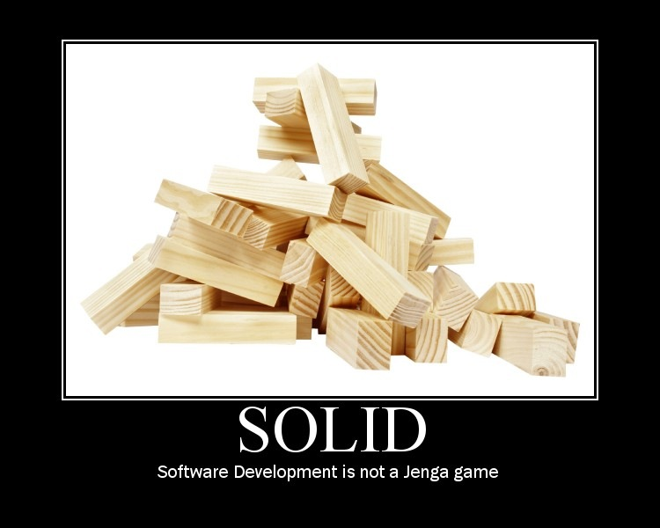
SOLID
Notes:
Robert C. Martin (Uncle Bob) – Agile Principles, Patterns and Practices

Slide 10
SOLID
An acronym of acronyms
Single Responsibility Principle
Open/Closed Principle
Liskov Substitution Principle
Interface Segregation Principle
Dependency-Inversion Principle
Notes:
Robert C. Martin (Uncle Bob) – Agile Principles, Patterns and Practices

Slide 11
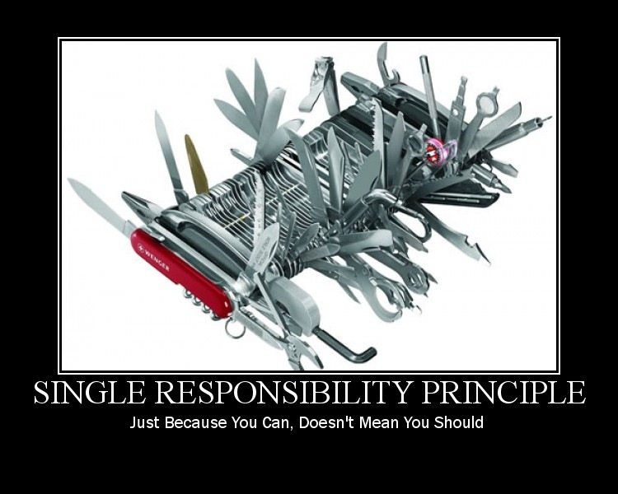
SRP Single Responsibility Principle
SOLID
Notes:
Also described as Cohesion (Tom DeMarco)
A class or method that does computations AND display
The computation and display gets mixed
When a change to the computation is required → We need to also alter the display code (since it’s mixed) → We will need to retest the display AND the new computation
It becomes difficult to add a new display (GUI, Report, Export, Graph, ...)
Persistance is often mixed with model → Persistance code is scattered everywhere. Domain Model & DAL together. Use a Repository instead?

Slide 12
SRP Single Responsibility Principle
“A class should have only one reason to change”
An object should do one thing and do it good
Each Responsibility is an axis of change
Changes will cascade
SOLID
Notes:
Also described as Cohesion (Tom DeMarco)
A class or method that does computations AND display
The computation and display gets mixed
When a change to the computation is required → We need to also alter the display code (since it’s mixed) → We will need to retest the display AND the new computation
It becomes difficult to add a new display (GUI, Report, Export, Graph, ...)
Persistance is often mixed with model → Persistance code is scattered everywhere. Domain Model & DAL together. Use a Repository instead?

Slide 13
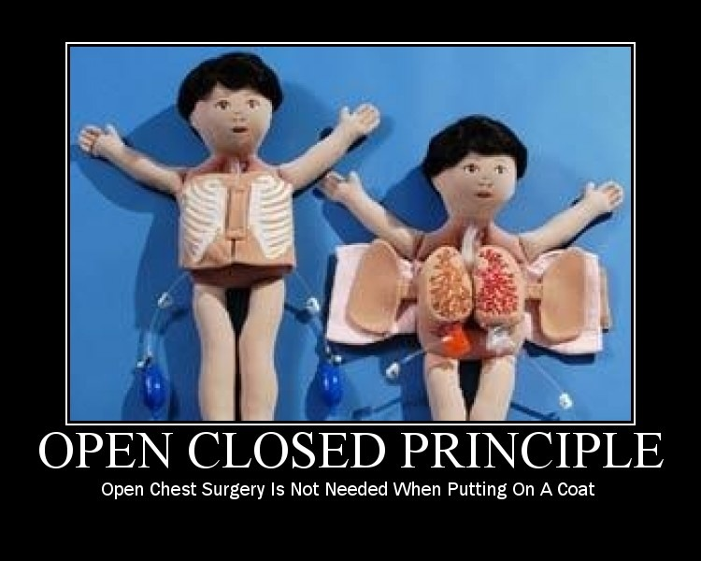
OCP Open/Closed Principle
SOLID
Notes:
Coined by Bertrand Meyer
YAGNI: You Ain’t Gonna Need It – Be very careful when designing for the Open/Closed Principle. Not everything is going to change! Know your customer or the Domain to anticipate axis of change.

Slide 14
OCP Open/Closed Principle
“Software entities (classes, modules, functions, etc) should be open for extension but closed for modification”
Modifications should be achieved by writing new code, not by changing existing code
.NET: Extension Methods, MEF
Example: Shapes – calculating area
SOLID
Notes:
Coined by Bertrand Meyer
YAGNI: You Ain’t Gonna Need It – Be very careful when designing for the Open/Closed Principle. Not everything is going to change! Know your customer or the Domain to anticipate the axis of change.

Slide 15
Pattern: Template Method
“Define the skeleton of an algorithm in an operation, deferring some steps to subclasses. Template Method lets subclasses redefine certain steps of an algorithm without changing the algorithm’s structure.”
.NET: Everywhere in the framework
Example: Uploading a file
Notes:
Class Behavioral GoF Pattern
Applicability: Implement the invariant parts of an algorithm once and leave it up to subclasses to implement the behavior that can vary.
Consequences: The Hollywoord Principle: “Don’t call us, we’ll call you” → The Parent class calls the methods defines in the subclass and not the other way around.
.NET Guideline: Add “Core” to the name of the protected virtual method. (Framework Design Guidelines)

Slide 16
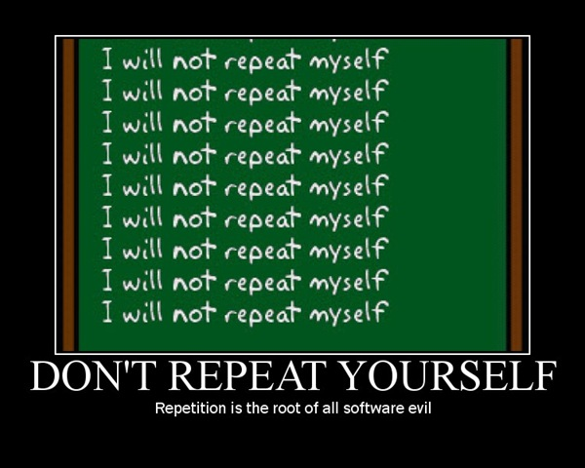
DRY Don’t Repeat Yourself
“Every piece of knowledge must have a single, unambiguous, authoritative representation within a system.“ – The Pragmatic Programmer
Notes:
Rule of three (Refactoring – Martin Fowler)
Single Source of Truth

Slide 17
Pattern: Factory Method
“Define an interface for creating an object, but let subclasses decide which class to instantiate. Factory Method lets a class defer instantiation to subclasses.”
.NET: Consider using generics to avoid subclassing.
Example: Uploading a file
Notes:
Class Creational GoF Pattern
Also known as: Virtual Constructor
Consequences:
Provides hooks for subclasses
Connects parallel class hierarchies

Slide 18
Pattern: Strategy
“Define a family of algorithms, encapsulate each one, and make them interchangeable. It lets the algorithm vary independently from clients that use it.”
.NET: new SortedDictionary(IComparer<TKey> comparer)
Example: Uploading a file
Notes:
Object Behavioral GoF Pattern
Also known as: Policy
Discount example (UML&Patterns)
Command: Een actie als Strategy. Different intent!
Composite: Groep stratgies (meerdere commands, ook bij discount)

Slide 19
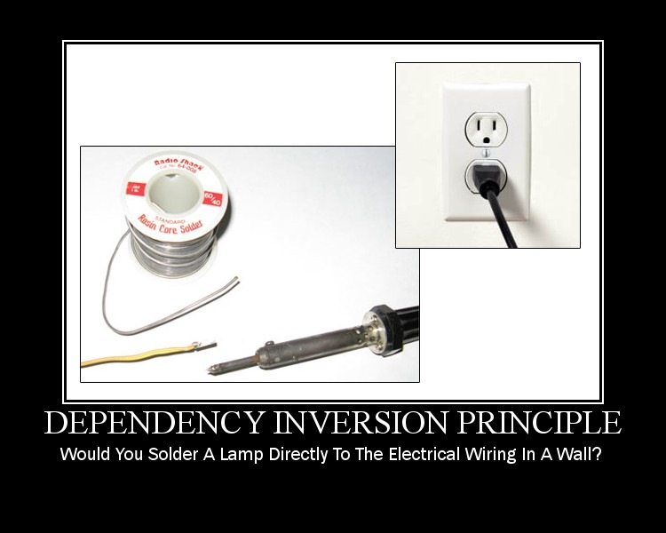
DIP Dependency-Inversion Principle
SOLID

Slide 20
DIP Dependency-Inversion Principle
“High-level modules should not depend on low-level modules. Both should depend on abstractions.”
“Abstractions should not depend upon details. Details should depend upon abstractions.”
.NET: new SortedDictionary(IComparer<TKey> comparer)
SOLID

Slide 21
Pattern: Observer
“Define a one-to-many dependency between objects so that when one object changes state, all its dependents are notified and updated automatically.”
.NET: Language feature. Used in WinForms, ASP.NET, ...
Angular: (event)=“eventEmitter.emit($event)”
Notes:
Object Behavioral GoF Pattern
Also known as: Publish/Subscribe, Dependents

Slide 22
Pattern: Decorator
“Attach additional responsibilities to an object dynamically. Decorators provide a flexible alternative to subclassing for extending functionality”
Wrapping the new decorator object around the original object
Adding/removing behavior at runtime vs compile time
Avoid explosion of classes
.NET Example: Streams
Notes:
Object Structural GoF Pattern
Also known as: Wrapper
WarTowers: ShieldTower, GunTower, BazookaTower, ShieldGunTower, ShieldGunBazookaTower, ...
Decorator is an adapter!

Slide 23
Pattern: Iterator
“Provide a way to access the elements of an aggregate object sequentially without exposing its underlying representation”
.NET:
IEnumerable<T> en IEnumerator<T>
Alles LINQ
yield return
Notes:
Object Behavioral GoF Pattern
Also known as: Cursor

Slide 24
Pattern: Composite
“Compose objects into tree structures to represent part-whole hierarchies. Composite lets clients treat individual objects and compositions of objects uniformly.”
Wordt dikwijls gecombineerd met Visitor, Chain of Command, Iterator, ...
Andere patterns worden soms door Composite ge-encapsuleerd (Strategy/Policy, Commands, ...)
.NET: WinForms and ASP.NET Controls/Component
Notes:
Object Structural GoF

Slide 25



Pattern: Adapter
“Convert the interface of a class to an interface expected by the users of the class.”
Allows classes to work together even though they have incompatible interfaces.
.NET: Managed COM wrappers (System.String -> BSTR)
“Real world” example:
U.S. electrical system: 110 VAC @ 60 Hz.
European electrical system: 220 VAC @ 50 Hz.
How can we use U.S. appliances in Europe?
Adapters!
Notes:
Add a reference to the COM via the Add Reference dialog in Visual Studio .NET. Behind the scenes, Visual Studio® .NET invokes the tlbimp.exe tool to create a Runtime Callable Wrapper (RCW) class, contained in an interop assembly.
http://msdn.microsoft.com/en-us/magazine/cc188707.aspx#S4

Slide 26
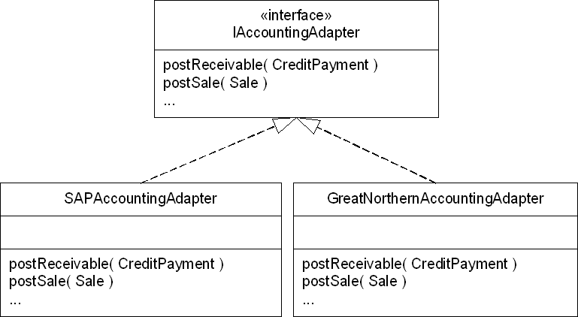
Pattern: Adapter
Notes:
Creditkaarten voor online betalingen:
VisaAdapter
MasterCardAdapter

Slide 27
Pattern Pitfalls
“When all you have is a hammer, everything looks like a nail.” - Maslow's hammer
- Molding the problem to fit a pattern.
“When one is designing the successor to a relatively small, elegant, and successful system, there is a tendency to become grandiose in one's success and design an elephantine feature-laden monstrosity.” – Fred Brooks (The Second System Effect)
Notes:
Overuse
Misuse

Slide 28
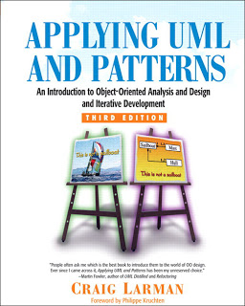
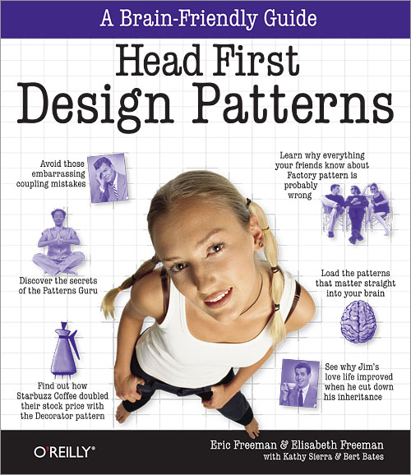
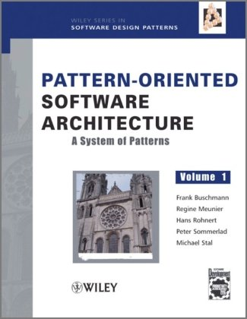
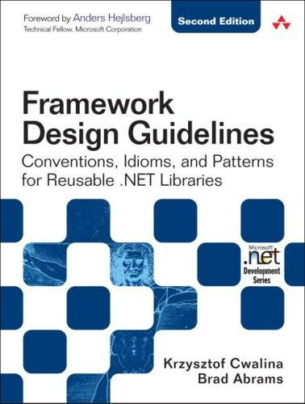

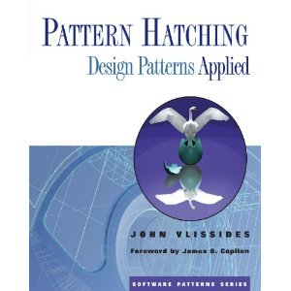

Further Reading

Slide 29
Vragen?

Slide 30
Pattern Catalog
Abstract Factory
Adapter
Composite
Decorator
Prototype
Facade
Proxy
Iterator
Memento
Factory Method
Observer
Strategy
Template Method
Singleton
Command
State
Visitor
Bridge
Notes:
Which patterns have you already implemented in your designs?

Slide 31
Pattern: Prototype
“Specify the kinds of objects to create using a prototypical instance, and create new objects by copying this prototype”
JavaScript uses prototype
<>
.NET uses inheritance
Notes:
Object Creational GoF Pattern

Slide 32
Pattern: Prototype
String.prototype.times = function(count) {
return count < 1 ? '' : new Array(count + 1).join(this);
}
Usage:
"hello!".times(3); //"hello!hello!hello!";
"please...".times(6); //"please...please...please.. .........."

Slide 33
Pattern: Facade
“Provide an interface to a set of interfaces in a subsystem. Facade defines a higher-level interface that makes the subsystem easier to use.”
MVC: Controller is een facade
Notes:
Object Structural GoF Pattern

Slide 34
Even More GoF Patterns
Abstract Factory
Provide an interface for creating families of related or dependent objects without specifying their concrete classes.
Singleton
Ensure a class has only one instance and provide a global point of access to it.

Slide 35
Even More GoF Patterns
Proxy
Provide a surrogate or placeholder for another object to control access to it.
Bridge
Decouple an abstraction from its implementation so that the two can vary independently.

Slide 36
Even More GoF Patterns
Adapter | Match interfaces of different classes
Bridge | Separates an object’s interface from its implementation
Composite | A tree structure of simple and composite objects
Decorator | Add responsibilities to objects dynamically
Facade | A single class that represents an entire subsystem
Flyweight | A fine-grained instance used for efficient sharing
Proxy | An object representing another object

Slide 37
Even More GoF Patterns
Chain of Resp. | A way of passing a request between a chain of objects
Command | Encapsulate a command request as an object
Interpreter | A way to include language elements in a program
Iterator | Sequentially access the elements of a collection
Mediator | Defines simplified communication between classes
Memento | Capture and restore an object's internal state
Observer | A way of notifying change to a number of classes
State | Alter an object's behavior when its state changes
Strategy | Encapsulates an algorithm inside a class
Template Method | Defer the exact steps of an algorithm to a subclass
Visitor | Defines a new operation to a class without change

Slide 38
GoF Patterns
Principles of reusable object-oriented design
Program to an interface, not an implementation
Favor object composition over class inheritance
Notes:
Program to an interface:
Loosely coupled system: Clients remain unaware of the specific types of objects they use, as long as the objects adhere to the interface that clients expect.
Creational patterns can be used to instantiate the concrete classes

Slide 39
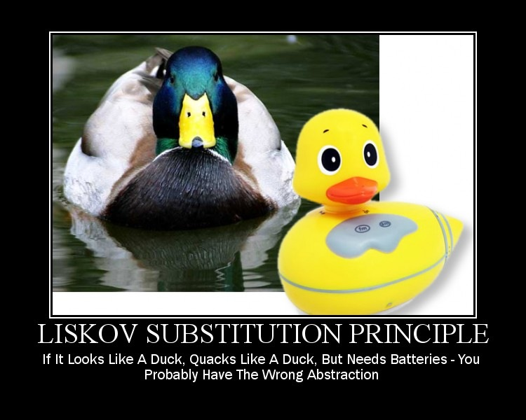
LSP Liskov Substitution Principle
SOLID
Notes:
void g(Rectangle r) {
r.Width= 5;
r.Height = 4;
if (r.Area() != 20)
throw new Exception(“Bad Area”);

Slide 40
LSP Liskov Substitution Principle
“Subtypes must be substitutable for their subtypes.”
Rectangle with Height/Width
Square cannot inherit from Rectangle
SOLID
Notes:
void g(Rectangle r) {
r.Width= 5;
r.Height = 4;
if (r.Area() != 20)
throw new Exception(“Bad Area”);

Slide 41
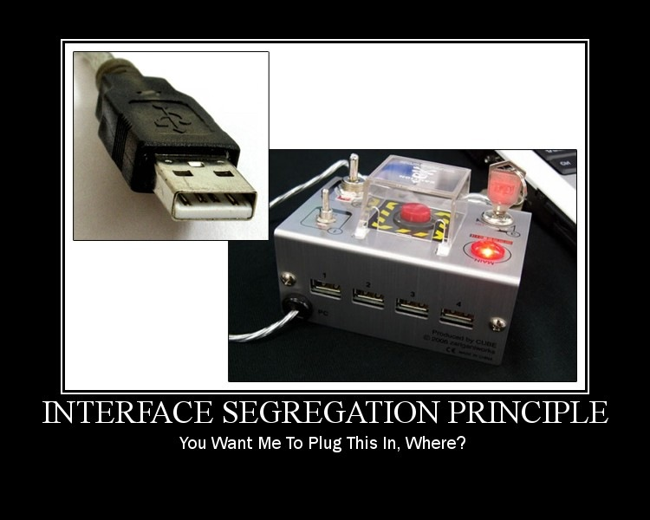
SRP Interface Segregation Principle
SOLID

Slide 42
SRP Interface Segregation Principle
“Clients should not be forced to depend on methods they do not use.”
SOLID

