Slide 1

Pirateflix
3-4h
How to fill all the terabytes, get on the FBI most wanted list … without ever leaving your sofa
FunTechTrack
Hands-On
Introduction

Slide 2
MENU
What
Why
Let’s go!

Slide 3

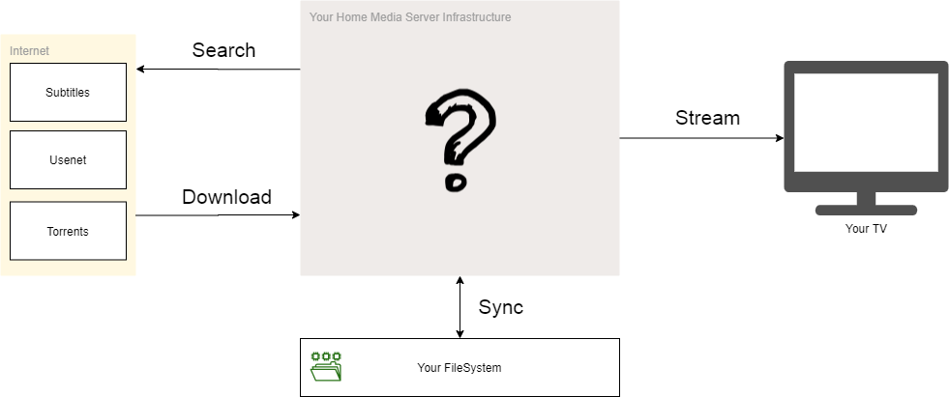
WHAT

Slide 4
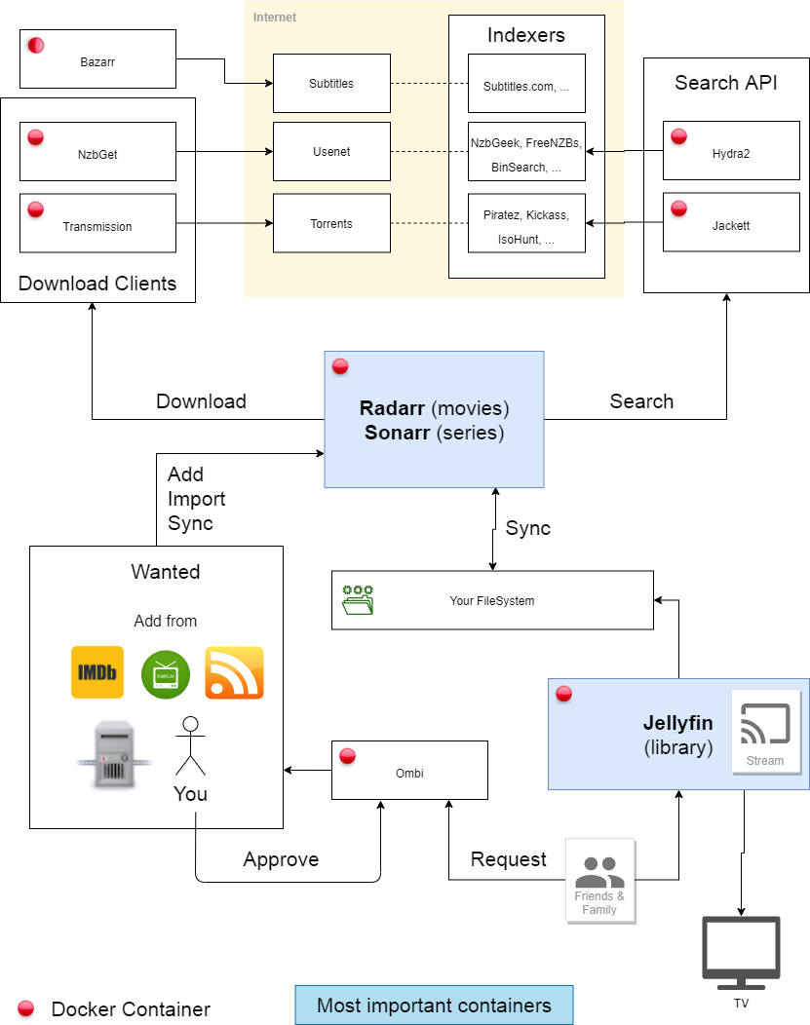
WHAT

Slide 5
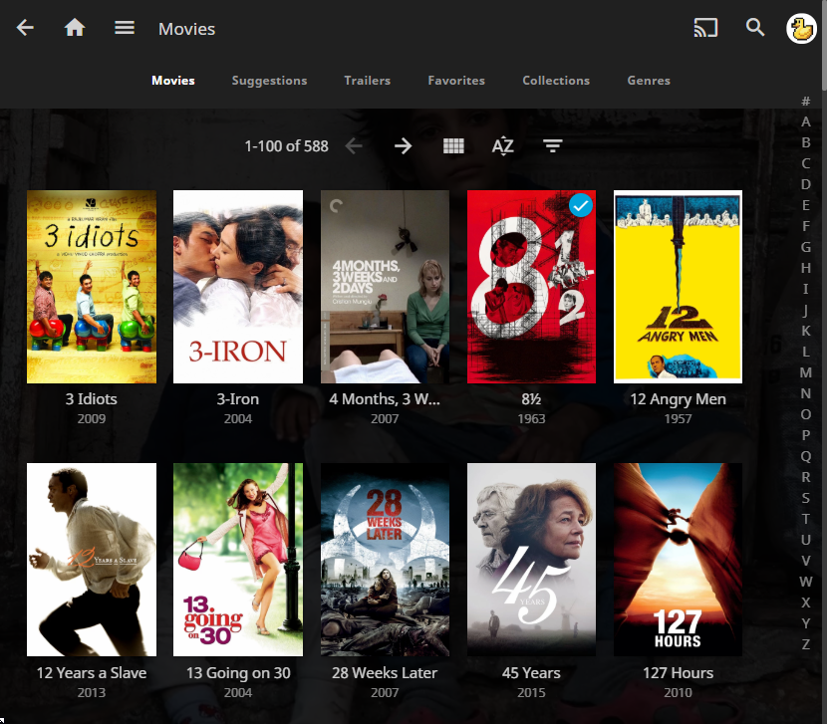
Players:
Jellyfin
Plex
VLC
HDMI Cable

Slide 6
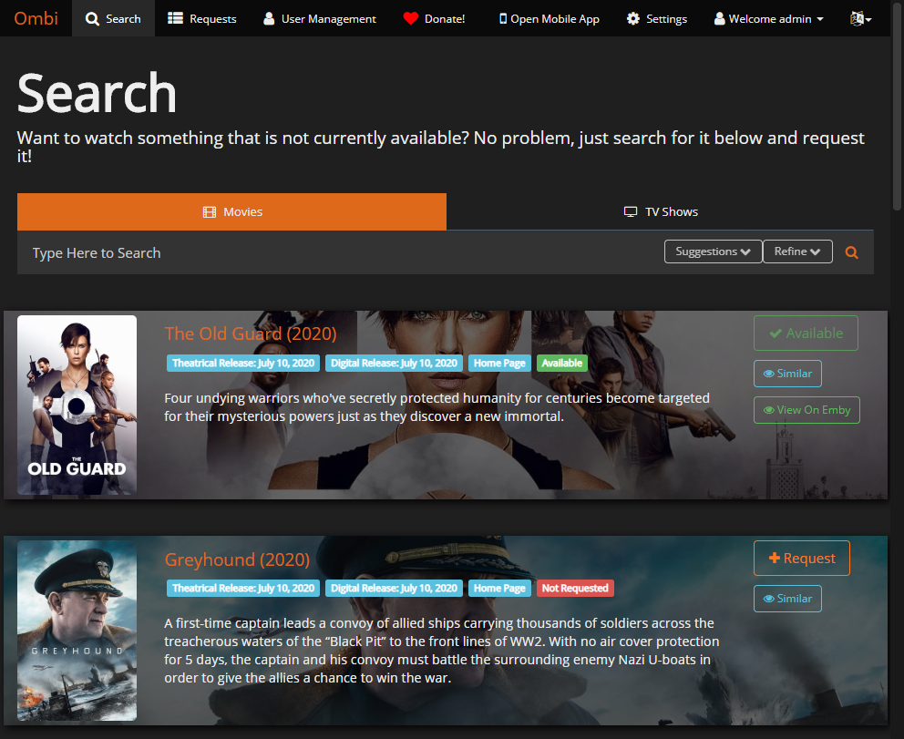
OMBI:
Ez Requests

Slide 7
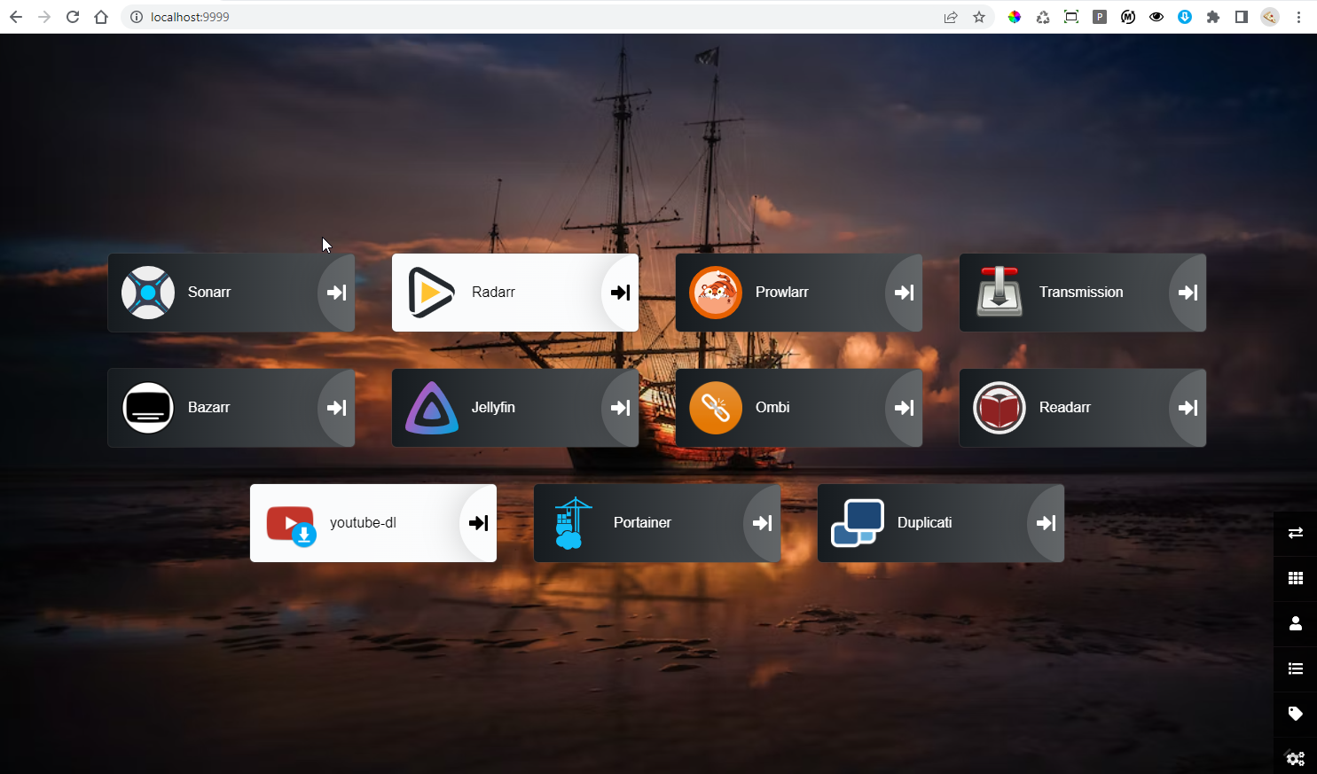

Slide 8
WHY
Waste time configuring stuff
vs
Waste time actually searching & downloading

Slide 9
Let’s GO
Step 1: git clone https://github.com/Laoujin/Htpc
Step 2: Run setup.ps1
Step 3: Configure docker-compose.yml & .env files
Step 4: docker-compose up -d
Step 5: Configure the setup

Slide 10
resources
Sangu Htpc
Servarr : Official Docs
Linuxserver.io : *Arr & many other Docker images
Free Indexers List (piratebay, …)
Trash Guides
TrakTV Director Lists

Slide 11
Questions?

