Slide 1
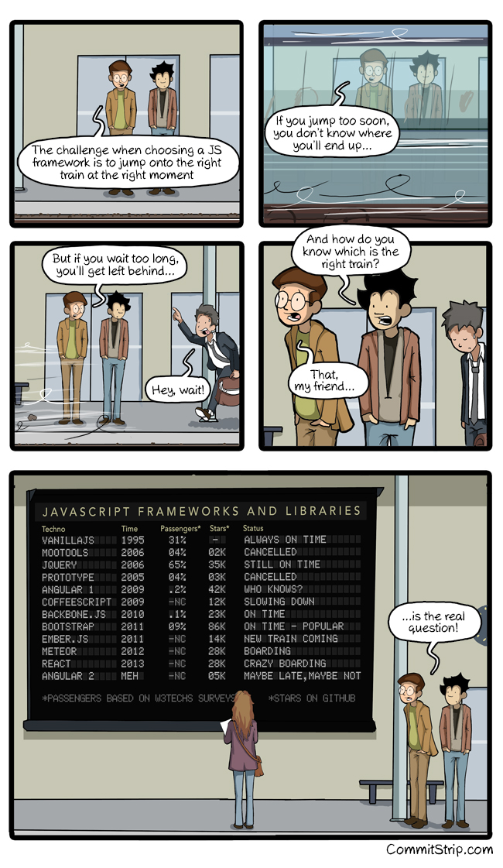


React
Leavin' the DOM behind

Slide 2
React Menu
React High Level
React Technical
React Setup
Codez
Flux
More Codez

Slide 3

React High Level
React is
Open-Source, maintained by Facebook
Used at Instagram, Netflix, Paypal, Imgur, Feedly, ...
Current version v0.14 (Breaking changes!)
Just the View in MVC
IE8 and above (polyfills required)
Flux
Relay & GraphQL

Slide 4
React Technical
Plain JavaScript
ES6, TypeScript, ... possible
Optionally with JSX: Composable HTML in JavaScript
React == "This is my state, you render it"
Declarative
One Way Data Flow
Virtual DOM

Slide 5
JSX Technical
var x = React.createClass({ render: function() { return (<div id="yaye">ouch</div>); }});
return React.createElement( "div", { id: "yaye" }, "ouch");
https://facebook.github.io/react/html-jsx.html
https://babeljs.io/repl/

Slide 6
React Setup
Sublime Text
Babel + ES6
EsLint
Gulp + Browserify
Yo template
Chrome Web Store: React Dev Tools

Slide 7
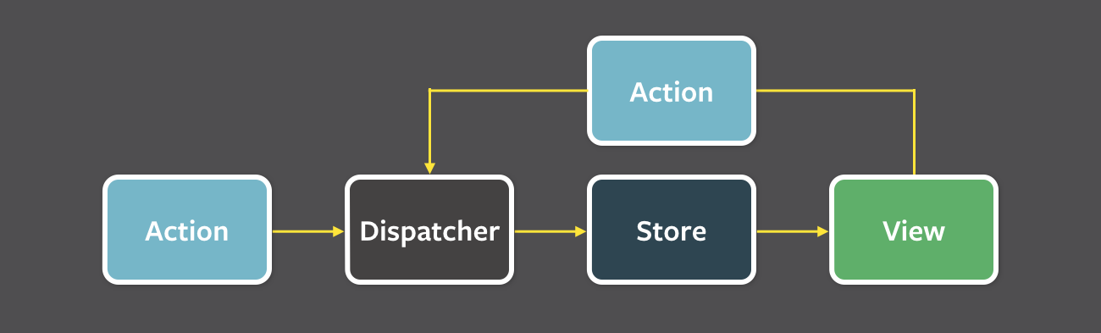
Flux

