Slide 1
DIAM P703 CAN API Services
ChiTT
FGA.AIS
HCM - 22/10/2019

Slide 2

AGENDA
DIAM P703 Requirement
PDU Flow through the Layered Architecture
2. DaVinci Configuration
PDU Transmission and Reception

Slide 3
DIAM P703 Requirement

Slide 4
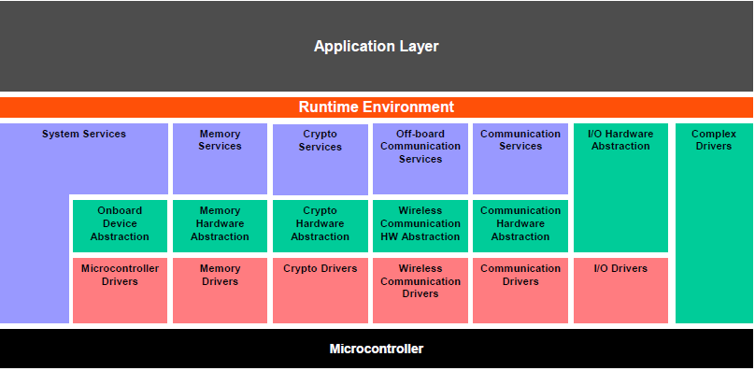
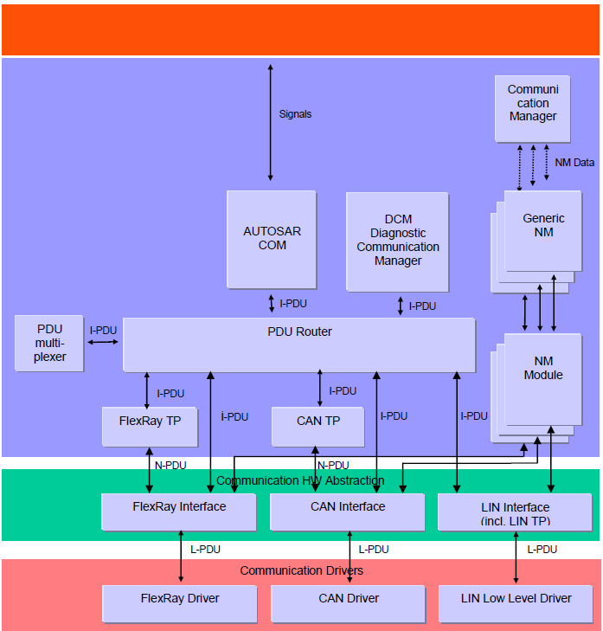
1. DIAM P703 Requirement
Disable Ethernet, using Can API Services for OVTP applications (OTA, PARSED, PARSEDPUSH)
CddOvtp
CddOvtp handles Connection and FunctionID of OVTP applications
I-PDU
PduR
PduR provides services for routing of I-PDUs
(Interaction Layer Protocol Data Units) between upper and lower layers
I-PDU
CanTp
CanTp offers services for segmentation and reassembly of messages.
(E.g: Messages that do not fit into a single CAN frame are segmented into
multiple parts, such that each can be transmitted in a single CAN frame. )
- Classis CAN: longer than 8 bytes
- CAN FD: longer than 64
N-PDU
CanIf
CanIf represents the interface to the services of the CAN Driver
for the upper communication layers.
L-PDU
On L-PDU transmission, the Can module writes the L-PDU in an
appropriate buffer inside the CAN controller hardware.
On L-PDU reception, the Can module calls the RX indication
callback function with ID, Data Length and pointer to L-SDU as parameter.
CanDrv

Slide 5
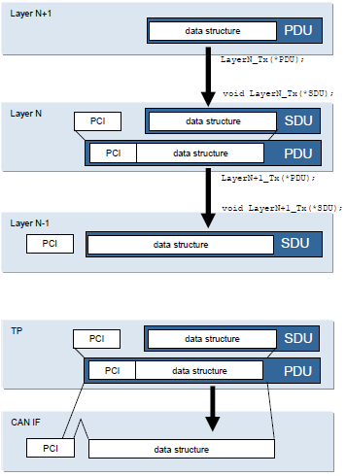
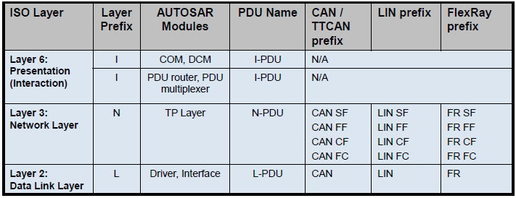
1. PDU Flow through the Layered Architecture
SDU
Service Data Unit is the data passed by an upper layer, with the request to transmit the data. It is as well the data which is extracted after reception by the lower layer and passed to the upper layer.
A SDU is part of a PDU.
PCI
PCI is the abbreviation of “Protocol Control Information”. This Information is needed to pass a SDU from one instance of a specific protocol layer to another instance. E.g. it contains source and target information.
The PCI is added by a protocol layer on the transmission side and is removed again on the receiving side.
PDU
PDU is the abbreviation of “Protocol Data Unit”. The PDU contains SDU and PCI.
PDU is passed from the upper layer to the lower layer,
which interprets this PDU as its SDU.

Slide 6
DaVinci Configuration

Slide 7
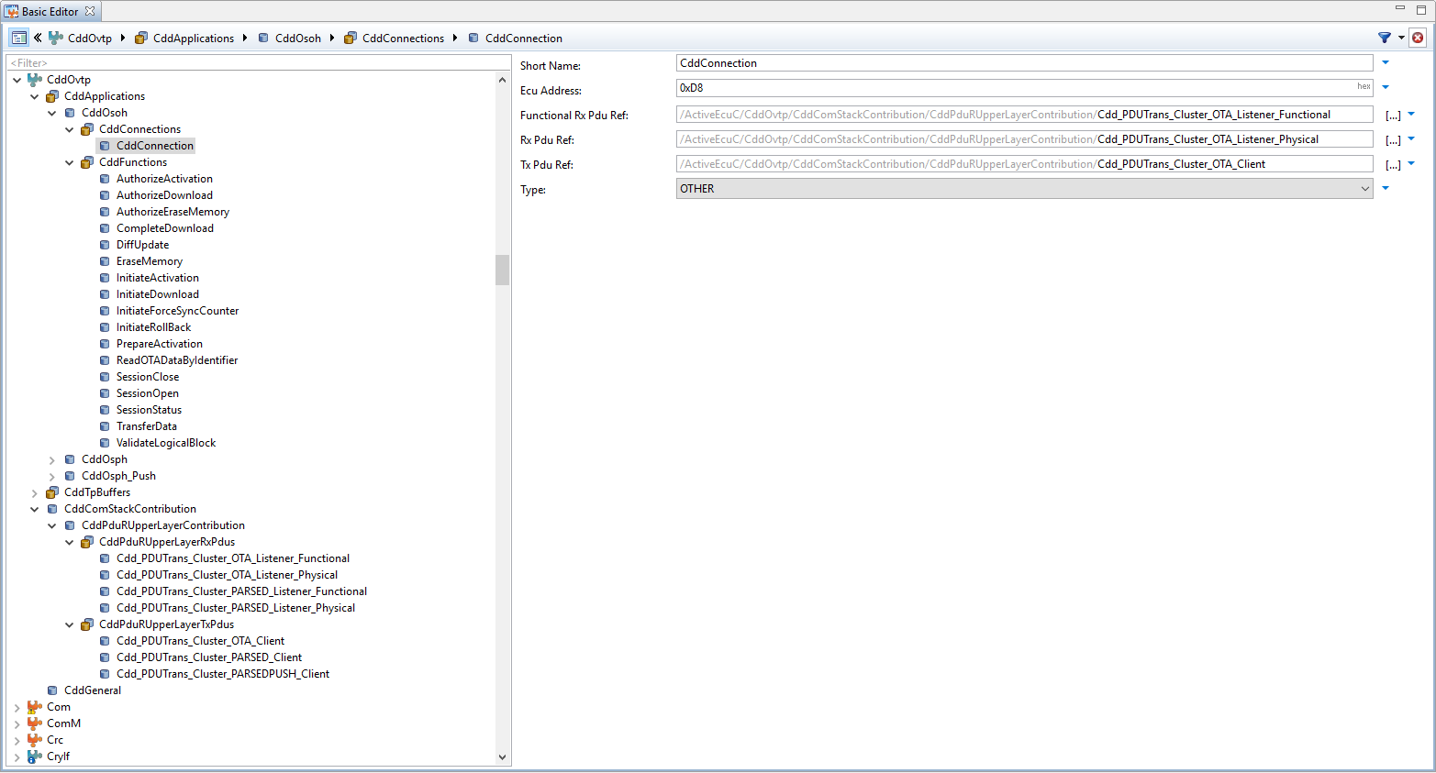
2. DaVinci Configuration
OVTP applications includes Connection and FunctionID:
CddOsoh (OTA)
CddOsph (PARSED)
CddOsph_Push (PARSEDPUSH)
CddOsoh CddConnection
CddFunctionalRxPduRef: Server only: Reference to RxPdu for functional requests.
Only required if this Application supports functional Addressing. Only allowed for Request/Response Applications.
PUSH applications must not have a functional RxPdu configured.
Rx Pdu Ref: Reference to RxPdu. Not required for PUSH applications on Server.
Tx Pdu Ref: Reference to TxPdu. Not required for PUSH Applications on Client.
CddOvtp
PduR
CanTp
CanIf
CanDrv

Slide 8
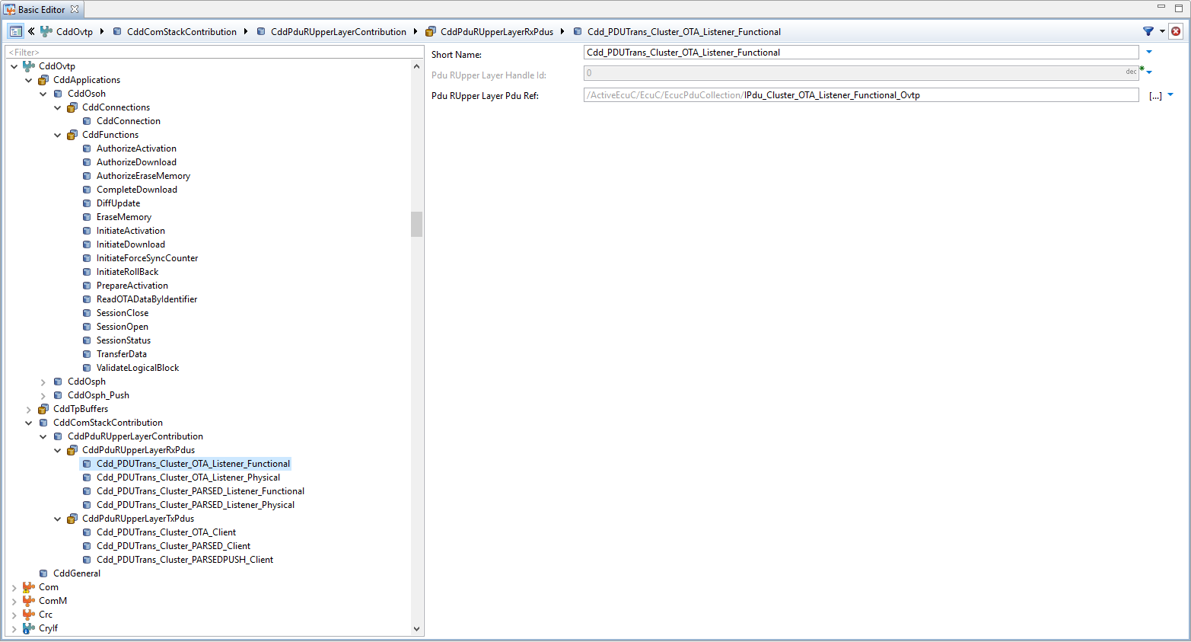
2. DaVinci Configuration
CddPduRUpperLayerContribution
CddPduRUpperLayerRxPdus: This container specifies Rx PDUs that are exchanged between the CDD and the standardized BSW module.
CddPduRUpperLayerTxPdus: This container specifies Tx PDUs that are exchanged between the CDD and the standardized BSW module.
CddPduRUpperLayerRxPdus Cdd_PDUTrans_Cluster_OTA_Listener_Functional
Pdu Rupper Layer Handle Id: ECU wide unique, symbolic handle for the Pdu.
Pdu Rupper Layer Pdu Ref: Reference to the "global" Pdu structure to allow harmonization of handle IDs in the COM-Stack.
CddOvtp
EcucPduCollection/IPdu_Cluster_OTA_Listener_Functional_Ovtp
PduR
CanTp
CanIf
CanDrv

Slide 9
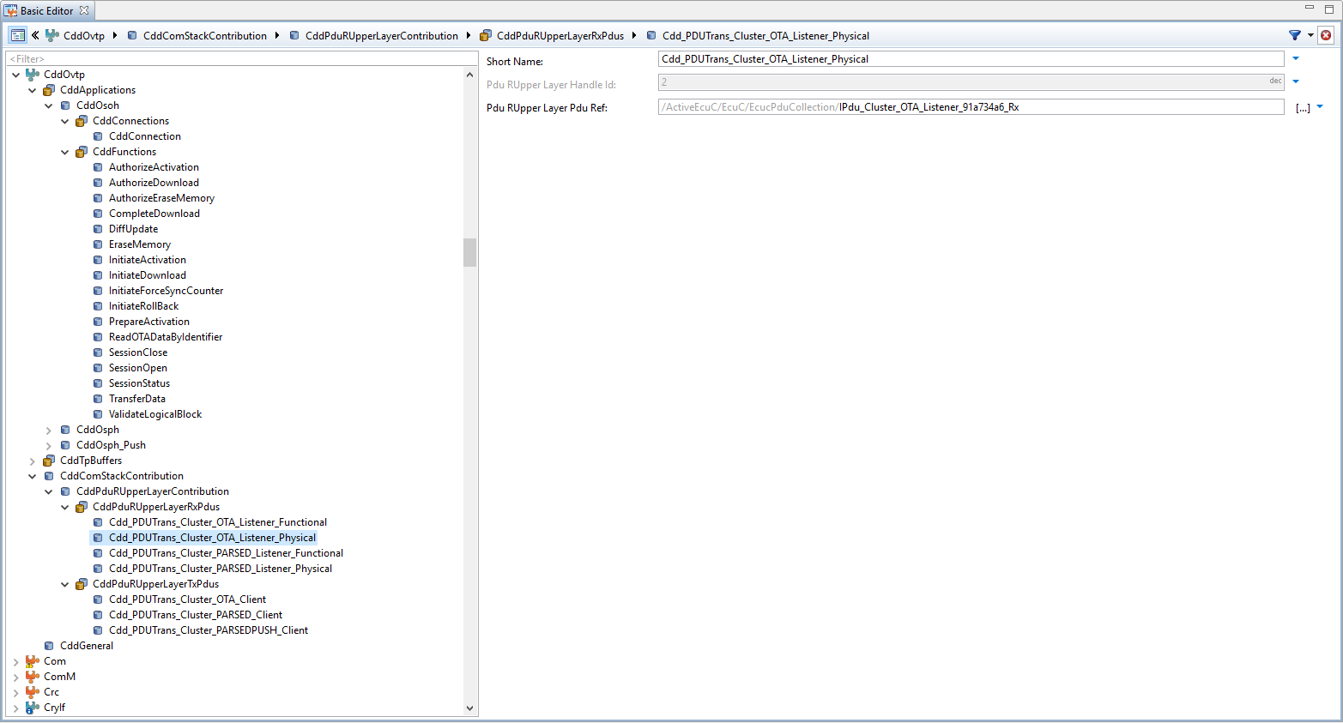
2. DaVinci Configuration
CddPduRUpperLayerContribution
CddPduRUpperLayerRxPdus: This container specifies Rx PDUs that are exchanged between the CDD and the standardized BSW module.
CddPduRUpperLayerTxPdus: This container specifies Tx PDUs that are exchanged between the CDD and the standardized BSW module.
CddPduRUpperLayerRxPdus Cdd_PDUTrans_Cluster_OTA_Listener_Physical
Pdu Rupper Layer Handle Id: ECU wide unique, symbolic handle for the Pdu.
Pdu Rupper Layer Pdu Ref: Reference to the "global" Pdu structure to allow harmonization of handle IDs in the COM-Stack.
CddOvtp
EcucPduCollection/IPdu_Cluster_OTA_Listener_Functional_Ovtp
EcucPduCollection/IPdu_Cluster_OTA_Listener_91a734a6_Rx
PduR
CanTp
CanIf
CanDrv

Slide 10
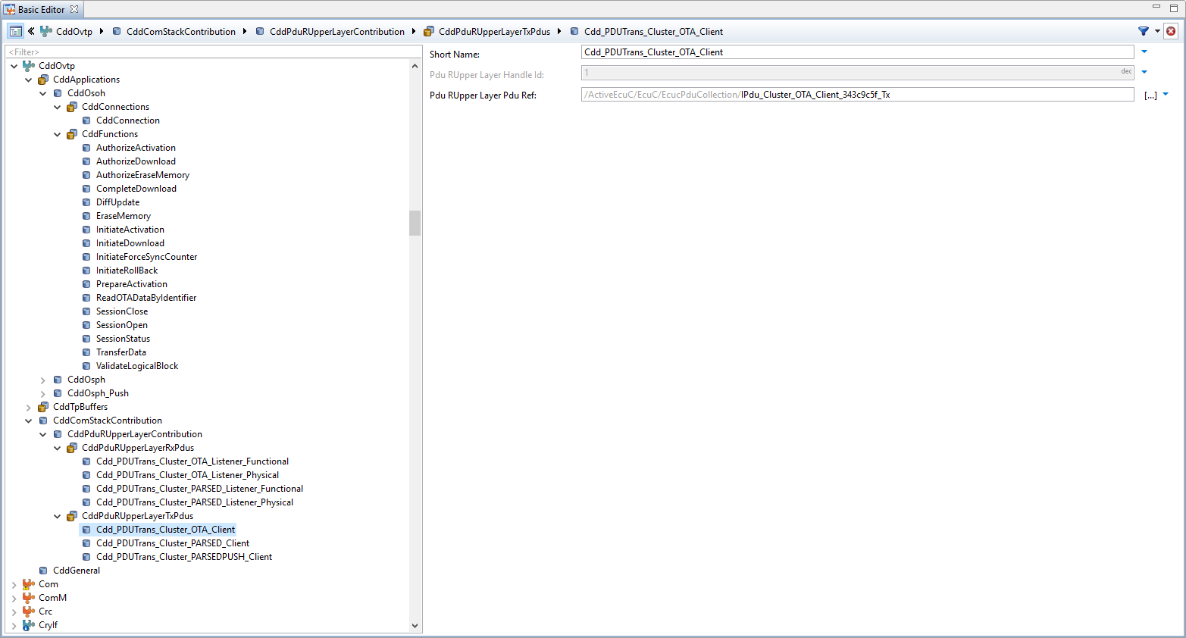
2. DaVinci Configuration
CddPduRUpperLayerContribution
CddPduRUpperLayerRxPdus: This container specifies Rx PDUs that are exchanged between the CDD and the standardized BSW module.
CddPduRUpperLayerTxPdus: This container specifies Tx PDUs that are exchanged between the CDD and the standardized BSW module.
CddPduRUpperLayerTxPdus Cdd_PDUTrans_Cluster_OTA_Client
Pdu Rupper Layer Handle Id: ECU wide unique, symbolic handle for the Pdu.
Pdu Rupper Layer Pdu Ref: Reference to the "global" Pdu structure to allow harmonization of handle IDs in the COM-Stack.
CddOvtp
EcucPduCollection/IPdu_Cluster_OTA_Listener_Functional_Ovtp
EcucPduCollection/IPdu_Cluster_OTA_Listener_91a734a6_Rx
EcucPduCollection/IPdu_Cluster_OTA_Client_343c9c5f_Tx
PduR
CanTp
CanIf
CanDrv

Slide 11
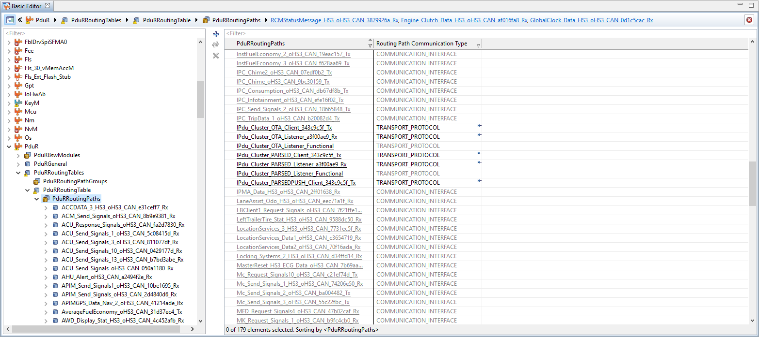
2. DaVinci Configuration
PduRRoutingPaths: This container contains the routing pathways.
Short name
Routing Path Communication Type: PduR routing path communication type.
The communication type determines the used API type of the routing path:
COMMUNICATION_INTERFACE: Unsegmented Pdus.
TRANSPORT_PROTOCOL: Segmented Pdus
UNDEFINED: The communication type cannot be determined.
CddOvtp
EcucPduCollection/IPdu_Cluster_OTA_Listener_Functional_Ovtp
EcucPduCollection/IPdu_Cluster_OTA_Listener_91a734a6_Rx
EcucPduCollection/IPdu_Cluster_OTA_Client_343c9c5f_Tx
PduR
CanTp
CanIf
CanDrv

Slide 12
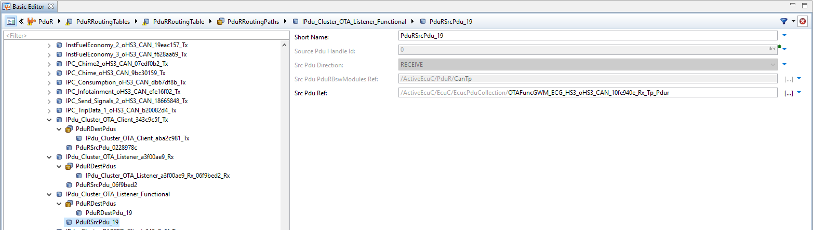
2. DaVinci Configuration
IPdu_Cluster_PARSED_Listener_Functional
PduRSrcPdu_20
Source Pdu Handle Id: PDU identifier assigned by PDU Router.
Src Pdu Direction: PduR routing path source Pdu communication direction.
RECEIVE: The routing path source is a reception Pdu.
TRANSMIT: The routing path source is a transmission Pdu.
UNDEFINED: The communication direction cannot be determined.
Src Pdu PduRBswModules Ref: Related PduRBswModules of the PduR routing path source Pdu.
Src Pdu Ref: This reference selects a source of the routing path.
PduRDestPdu_20
CddOvtp
EcucPduCollection/IPdu_Cluster_OTA_Listener_Functional_Ovtp
EcucPduCollection/IPdu_Cluster_OTA_Listener_91a734a6_Rx
EcucPduCollection/IPdu_Cluster_OTA_Client_343c9c5f_Tx
PduR
EcucPduCollection/OTAFuncGWM_ECG_HS3_oHS3_CAN_10fe940e_Rx_Tp_Pdur
CanTp
CanIf
CanDrv

Slide 13
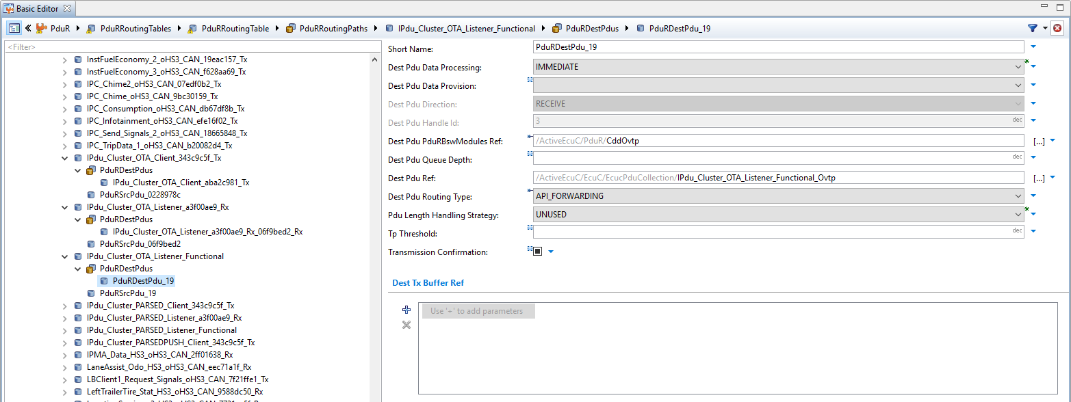
2. DaVinci Configuration
IPdu_Cluster_PARSED_Listener_Functional
PduRDestPdu_20
Dest Pdu Data Processing: This option determines in which context the routing to the destination module is performed.
IMMEDIATE: The routing is performed in either transmit or indication function.
DEFERRED: The routing is performed in the context of a main function.
Dest Pdu Direction: PduR routing path destination Pdu communication direction.
RECEIVE: The routing path destination is a reception Pdu.
TRANSMIT: The routing path destination is a transmission Pdu.
UNDEFINED: The communication direction cannot be determined.
Dest Pdu Ref: This reference selects a destination of the routing path.
Dest Pdu Routing Type: The routing type determines the routing operation mode of the routing path:
API_FORWARDING: Routing between a lower layer and an upper layer module.
GATEWAY_ROUTING: Routing between a lower layer module(s).
UNDEFINED: The routing type cannot be determined.
Pdu Length Handling Strategy: This parameter is only used for communication interface routings. It is ignored for transport protocol routings.
UNUSED: use this value for Tp routing paths or unbuffered If routing paths
SHORTEN: the If Pdu is shortened to the configured global Pdu length if a larger Pdu is received at the source (default value from previous PduR versions)
DISCARD: the If Pdu is discarded if a larger Pdu than configured is received at the source
CddOvtp
EcucPduCollection/IPdu_Cluster_OTA_Listener_Functional_Ovtp
EcucPduCollection/IPdu_Cluster_OTA_Listener_91a734a6_Rx
EcucPduCollection/IPdu_Cluster_OTA_Client_343c9c5f_Tx
PduR
EcucPduCollection/OTAFuncGWM_ECG_HS3_oHS3_CAN_10fe940e_Rx_Tp_Pdur
CanTp
CanIf
CanDrv

Slide 14
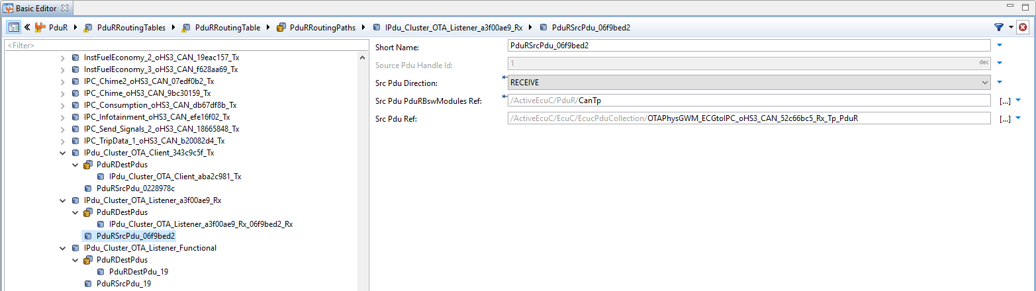
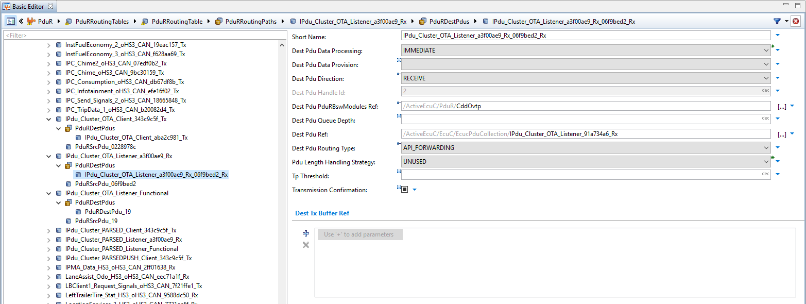
2. DaVinci Configuration
IPdu_Cluster_OTA_Listener_a3f00ae9_Rx
PduRSrcPdu_06f9bed2
PduRDestPdus IPdu_Cluster_OTA_Listener_a3f00ae9_Rx_06f9bed2_Rx
CddOvtp
EcucPduCollection/IPdu_Cluster_OTA_Listener_Functional_Ovtp
EcucPduCollection/IPdu_Cluster_OTA_Listener_91a734a6_Rx
EcucPduCollection/IPdu_Cluster_OTA_Client_343c9c5f_Tx
PduR
EcucPduCollection/OTAFuncGWM_ECG_HS3_oHS3_CAN_10fe940e_Rx_Tp_Pdur
EcucPduCollection/OTAPhysGWM_ECGtoIPC_oHS3_CAN_52c66bc5_Rx_Tp_PduR
CanTp
CanIf
CanDrv

Slide 15
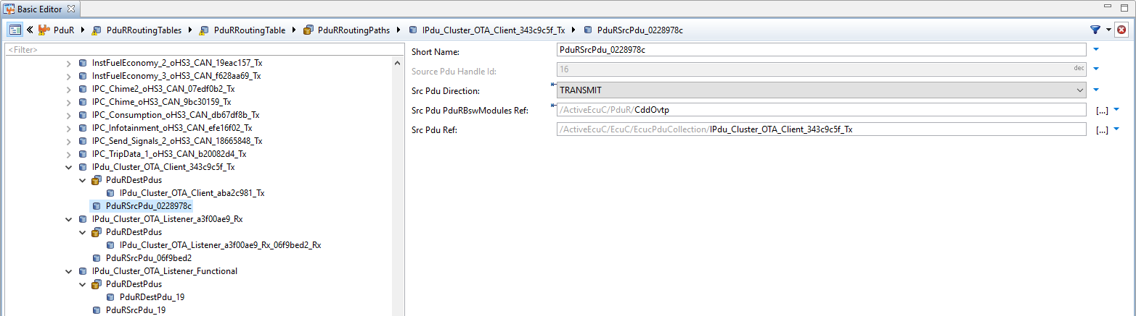
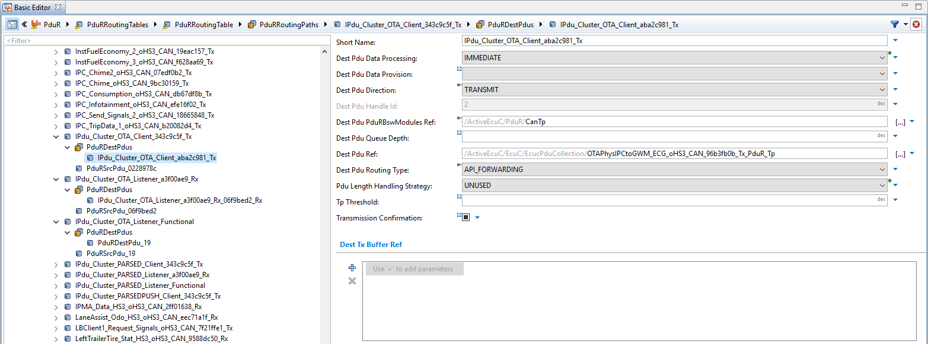
2. DaVinci Configuration
IPdu_Cluster_OTA_Client_343c9c5f_Tx
PduRSrcPdu_0228978c
PduRDestPdus IPdu_Cluster_OTA_Client_aba2c981_Tx
CddOvtp
EcucPduCollection/IPdu_Cluster_OTA_Listener_Functional_Ovtp
EcucPduCollection/IPdu_Cluster_OTA_Listener_91a734a6_Rx
EcucPduCollection/IPdu_Cluster_OTA_Client_343c9c5f_Tx
PduR
EcucPduCollection/OTAFuncGWM_ECG_HS3_oHS3_CAN_10fe940e_Rx_Tp_Pdur
EcucPduCollection/OTAPhysGWM_ECGtoIPC_oHS3_CAN_52c66bc5_Rx_Tp_PduR
EcucPduCollection/OTAPhysIPCtoGWM_ECG_oHS3_CAN_96b3fb0b_Tx_PduR_Tp
CanTp
CanIf
CanDrv

Slide 16
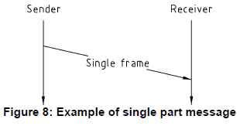
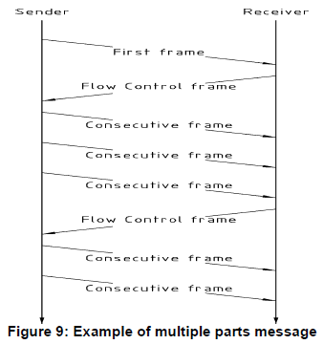
2. DaVinci Configuration
Tx and Rx data flow:
N_Ar timeout = 1400 ms
is the time for transmission
of a CAN frame
N_As timeout = 1400 ms
is the time for transmission
of a CAN frame
N_Bs timeout = 1400 ms
must be > (N_Ar + N_Br)
N_Cr timeout = 1400 ms
must be > (N_As + N_Cs)
N_Cs performance = 200 ms
Source: Page 37 and 38 of Document ID: AUTOSAR_SWS_CANTransportLayer

Slide 17
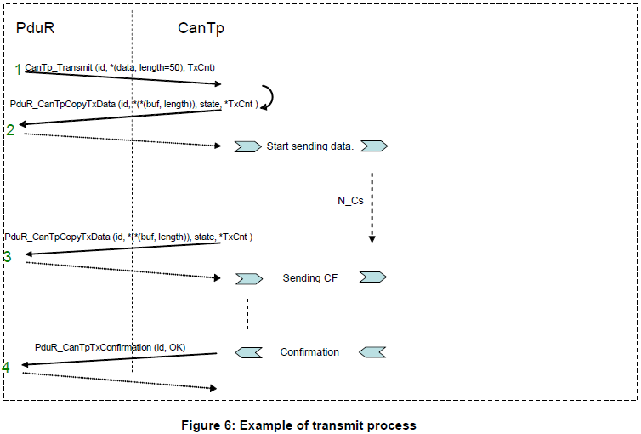
2. DaVinci Configuration
Transmit process:
The PduR asks for the transmission of 50 data bytes;
The CanTp asks the PduR for the payload data; the CanTp send the First Frame;
The CanTp send the rest of payload data as sequences of Consecutive Frames; 6 or 7 payload data bytes are copied by the upper layer on each CF;
The CanTp confirms transmission of the payload data.
Source: Page 35 of Document ID: AUTOSAR_SWS_CANTransportLayer

Slide 18
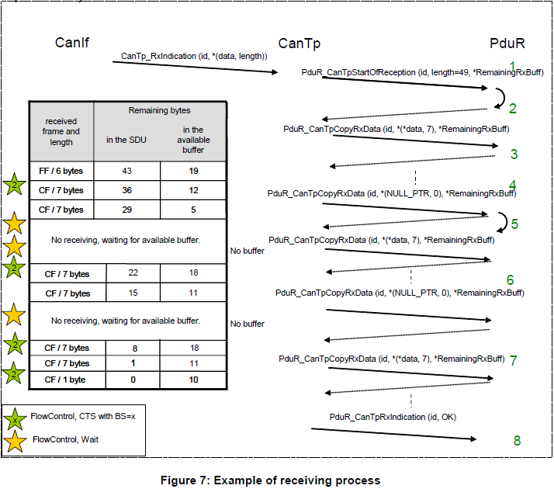
2. DaVinci Configuration
Receiving process:
The CanIf notifies a new reception with CanTp_RxIndication().The CanTp forwards this notification to the PduR;
The PduR returns an available buffer size of 25 bytes, CanTp sends a FlowControl CTS to the originator;
The CanTp provides the data of each received frame to the PduR and monitors the remaining buffer size. After the second consecutive frame, the remaining buffer size is not enough for the next block (two Consecutive Frames);
The CanTp asks the PduR for the remaining buffer size by calling PduR_CanTpCopyRxData() with 0 as data length and NULL_PTR as data, and sends a FlowControl Wait to the originator. This is done until sufficient buffer for the next block is available;
When the buffer size is finally sufficient for the next block, the CanTp will send a FlowControl CTS to the originator and continues the reception of the next Consecutive Frames block;
After copying the last consecutive frame of the block, the remaining buffer is too low for the next block, so CanTp again sends wait frames and monitors the remaining buffer size;
When the buffer for the last block is available, CanTp will continue the reception;
The CanTp informs the PduR of the end of reception by a call to PduR_CanTpRxIndication().
Source: Page 36 of Document ID: AUTOSAR_SWS_CANTransportLayer

Slide 19
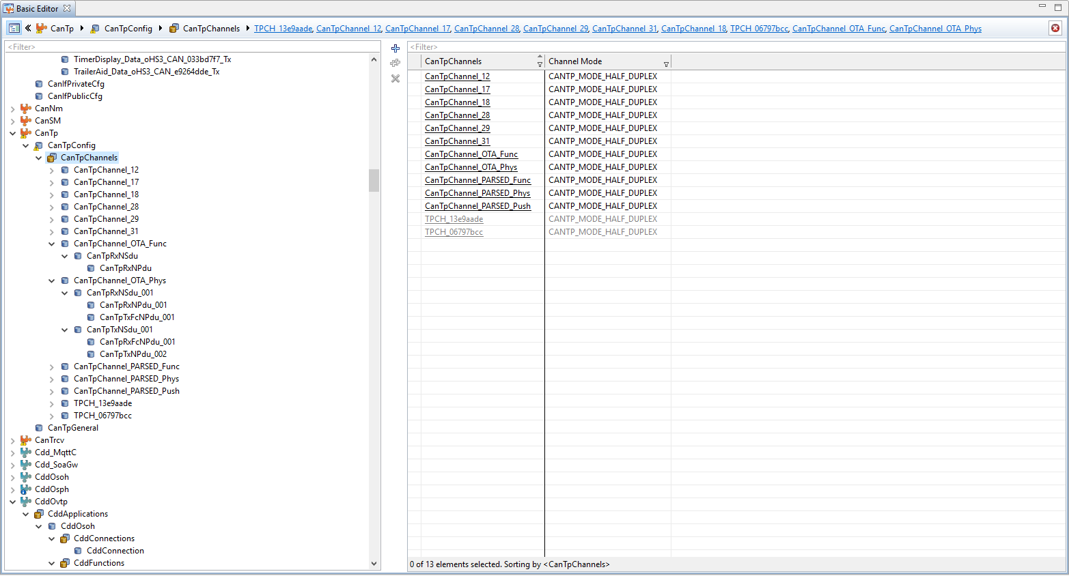
2. DaVinci Configuration
CanTpChannels:
Short name:
CanTpChannel_OTA_Func
CanTpChannel_OTA_Phys
CanTpChannel_PARSED_Func
CanTpChannel_PARSED_Phys
CanTpChannel_PARSED_Push
CanTpChannelMode: This parameter defines whether this channel is half or full duplex.
CANTP_MODE_FULL_DUPLEX: on one channel, reception and transmission can be performed simultaneously
CANTP_MODE_HALF_DUPLEX: starting a new connection is only possible if on the same channel, the opposite direction is not active.
CddOvtp
EcucPduCollection/IPdu_Cluster_OTA_Listener_Functional_Ovtp
EcucPduCollection/IPdu_Cluster_OTA_Listener_91a734a6_Rx
EcucPduCollection/IPdu_Cluster_OTA_Client_343c9c5f_Tx
PduR
EcucPduCollection/OTAFuncGWM_ECG_HS3_oHS3_CAN_10fe940e_Rx_Tp_Pdur
EcucPduCollection/OTAPhysGWM_ECGtoIPC_oHS3_CAN_52c66bc5_Rx_Tp_PduR
EcucPduCollection/OTAPhysIPCtoGWM_ECG_oHS3_CAN_96b3fb0b_Tx_PduR_Tp
CanTp
CanIf
CanDrv

Slide 20
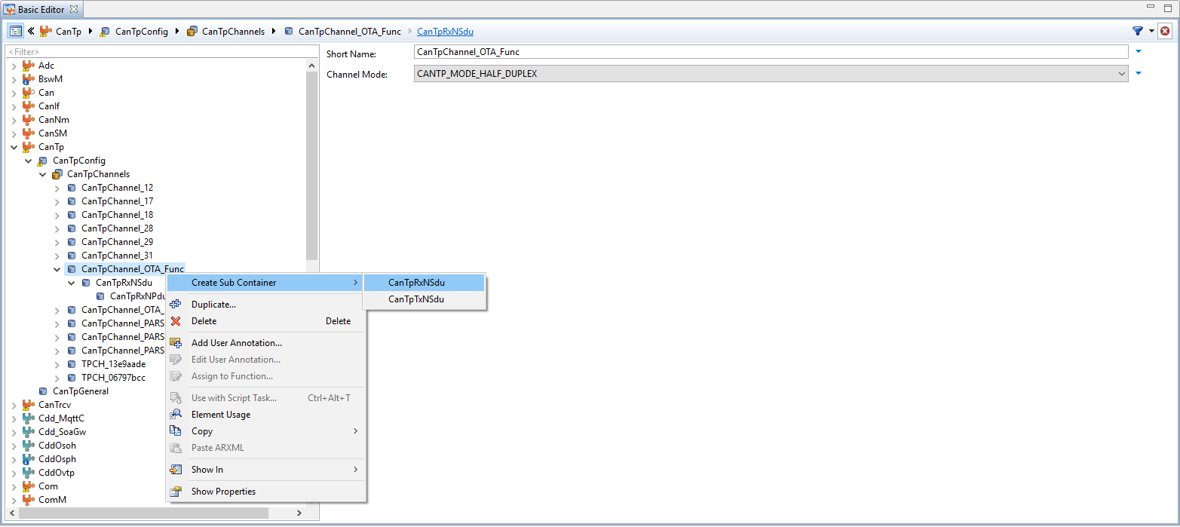
2. DaVinci Configuration
CanTpChannel_OTA_Func:
CanTpRxNSdu: This container includes the configuration (parameters) needed for each CAN N-SDU that the CanTp module receives via this CanTpChannel.
CanTpTxNSdu: This container includes the configuration (parameters) needed for each CAN N-SDU that the CanTp module transmits via this CanTpChannel.
CddOvtp
EcucPduCollection/IPdu_Cluster_OTA_Listener_Functional_Ovtp
EcucPduCollection/IPdu_Cluster_OTA_Listener_91a734a6_Rx
EcucPduCollection/IPdu_Cluster_OTA_Client_343c9c5f_Tx
PduR
EcucPduCollection/OTAFuncGWM_ECG_HS3_oHS3_CAN_10fe940e_Rx_Tp_Pdur
EcucPduCollection/OTAPhysGWM_ECGtoIPC_oHS3_CAN_52c66bc5_Rx_Tp_PduR
EcucPduCollection/OTAPhysIPCtoGWM_ECG_oHS3_CAN_96b3fb0b_Tx_PduR_Tp
CanTp
CanIf
CanDrv

Slide 21
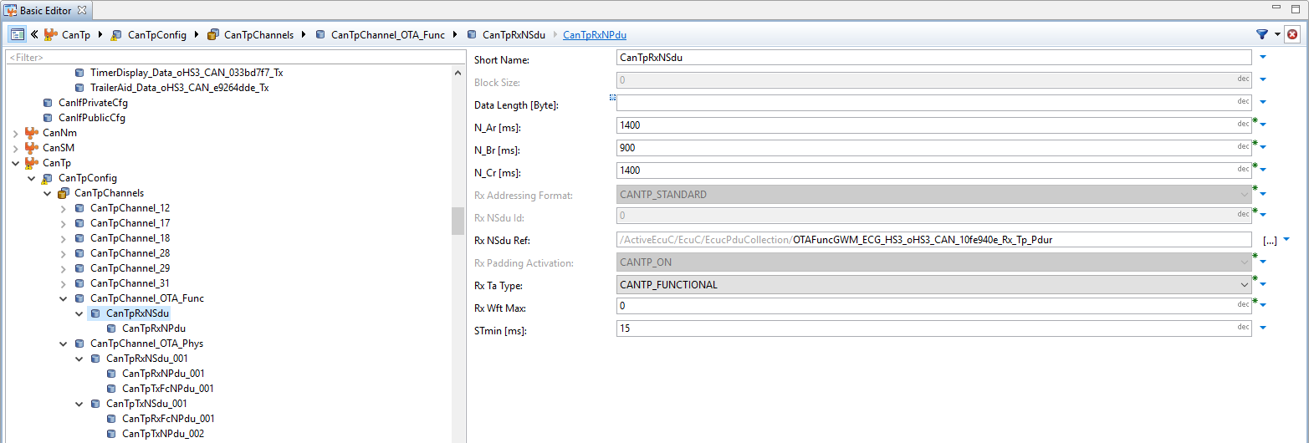
2. DaVinci Configuration
CanTpRxNSdu
Data Length [Byte]: This AUTOSAR parameter is deprecated and no longer used by the CanTp.
N_Ar [ms] This value specifies the N_Ar timeout.
N_Ar is the time for transmission of a CAN frame on the receiver side.
N_Br [ms]: This value specifies the performance parameter N_Br.
If wait frames have to be transmitted, the value of N_Br is used as delay between two FC.WAIT
in order to prevent the transmitter side from running into an N_Bs timeout.
N_Cr [ms]: This value specifies the N_Cr timeout. N_Cr is the time until reception of the next consecutive frame N-PDU.
It must be larger than (N_As + N_Cs) of the transmission side.
Rx Addressing Format: This parameter defines the addressing format used by this Rx N-SDU.
CANTP_STANDARD: Standard addressing format
CANTP_EXTENDED: Extended addressing format
CANTP_MIXED: Mixed addressing format
Rx Nsdu Ref:
Reference to a Pdu in the COM-Stack to establish the communication with the upper layer communictaion module (CanTp to PduR).
CddOvtp
EcucPduCollection/IPdu_Cluster_OTA_Listener_Functional_Ovtp
EcucPduCollection/IPdu_Cluster_OTA_Listener_91a734a6_Rx
EcucPduCollection/IPdu_Cluster_OTA_Client_343c9c5f_Tx
PduR
EcucPduCollection/OTAFuncGWM_ECG_HS3_oHS3_CAN_10fe940e_Rx_Tp_Pdur
EcucPduCollection/OTAPhysGWM_ECGtoIPC_oHS3_CAN_52c66bc5_Rx_Tp_PduR
EcucPduCollection/OTAPhysIPCtoGWM_ECG_oHS3_CAN_96b3fb0b_Tx_PduR_Tp
CanTp
CanIf
CanDrv

Slide 22
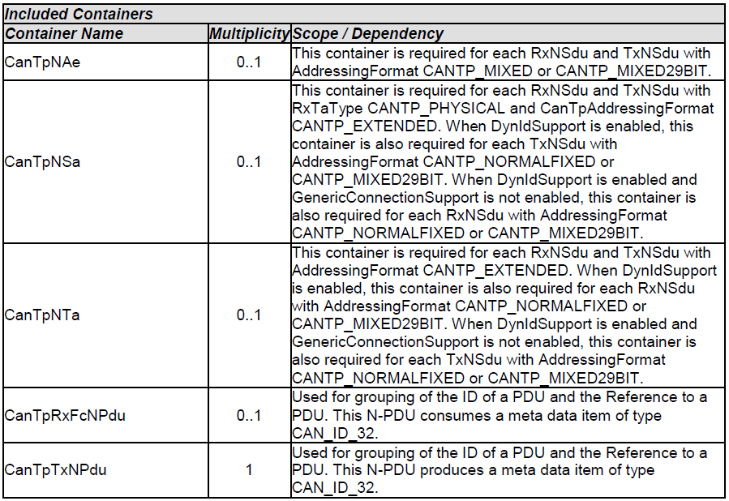
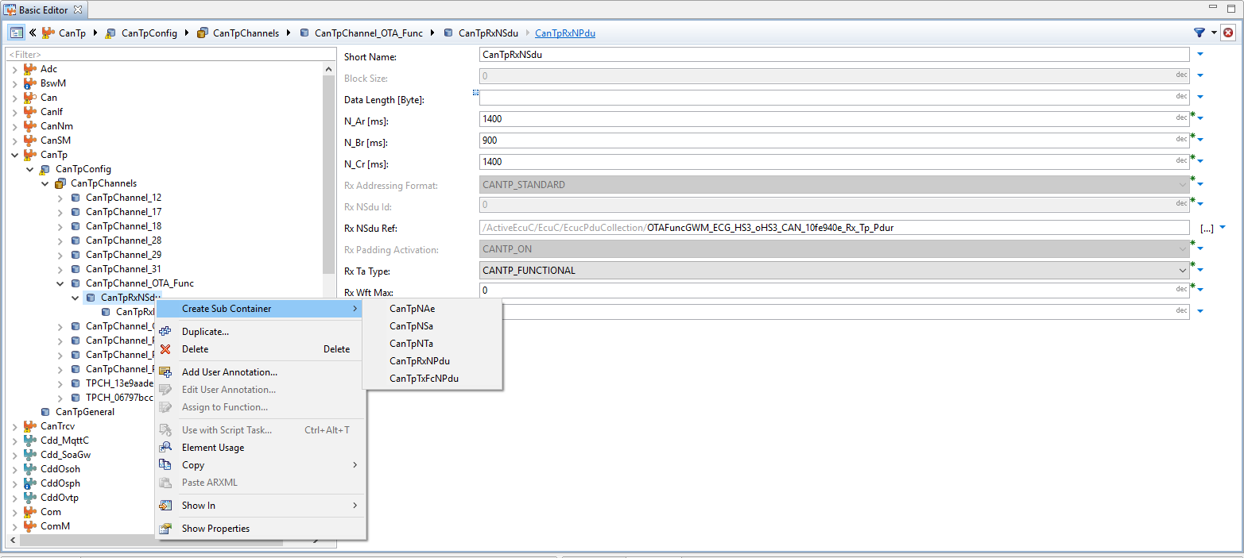
2. DaVinci Configuration
CanTpRxNSdu
CddOvtp
EcucPduCollection/IPdu_Cluster_OTA_Listener_Functional_Ovtp
EcucPduCollection/IPdu_Cluster_OTA_Listener_91a734a6_Rx
EcucPduCollection/IPdu_Cluster_OTA_Client_343c9c5f_Tx
PduR
EcucPduCollection/OTAFuncGWM_ECG_HS3_oHS3_CAN_10fe940e_Rx_Tp_Pdur
EcucPduCollection/OTAPhysGWM_ECGtoIPC_oHS3_CAN_52c66bc5_Rx_Tp_PduR
EcucPduCollection/OTAPhysIPCtoGWM_ECG_oHS3_CAN_96b3fb0b_Tx_PduR_Tp
CanTp
CanIf
CanDrv

Slide 23
2. DaVinci Configuration
CanTpRxNPdu:
Rx Npdu Id: This value specifies the Rx N-PDU identifier attached to the Rx N-SDU. It is used by the CanIf to report the reception of data CAN frames.
Rx Npdu Ref: Reference to a Pdu in the COM-Stack to establish the communication with the lower layer communictaion module (CanIf to CanTp).
CddOvtp
EcucPduCollection/IPdu_Cluster_OTA_Listener_Functional_Ovtp
EcucPduCollection/IPdu_Cluster_OTA_Listener_91a734a6_Rx
EcucPduCollection/IPdu_Cluster_OTA_Client_343c9c5f_Tx
PduR
EcucPduCollection/OTAFuncGWM_ECG_HS3_oHS3_CAN_10fe940e_Rx_Tp_Pdur
EcucPduCollection/OTAPhysGWM_ECGtoIPC_oHS3_CAN_52c66bc5_Rx_Tp_PduR
EcucPduCollection/OTAPhysIPCtoGWM_ECG_oHS3_CAN_96b3fb0b_Tx_PduR_Tp
CanTp
EcucPduCollection/OTAFuncGWM_ECG_HS3_Tp_oHS3_CAN_eda73d75_Rx
CanIf
CanDrv

Slide 24
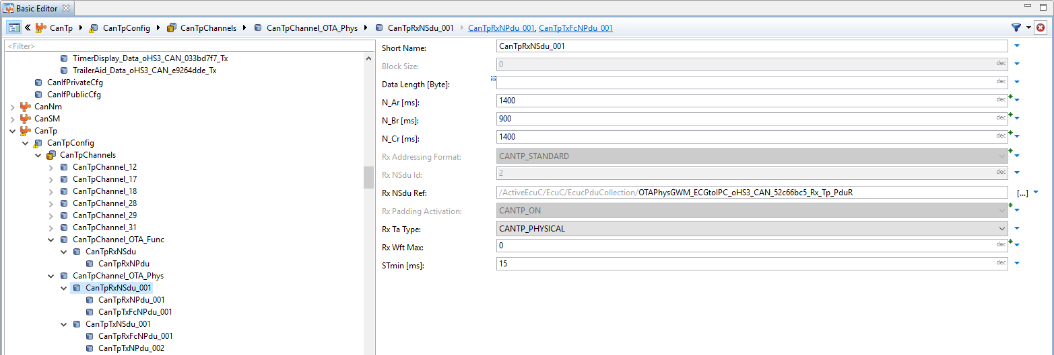
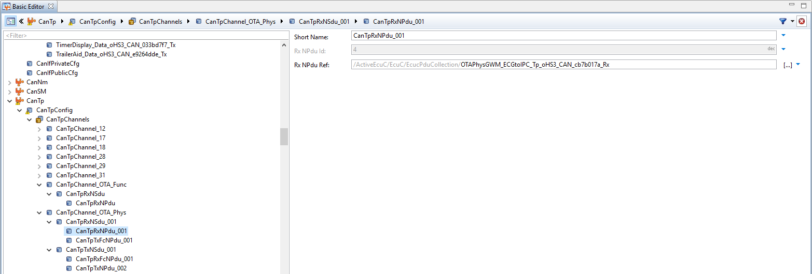
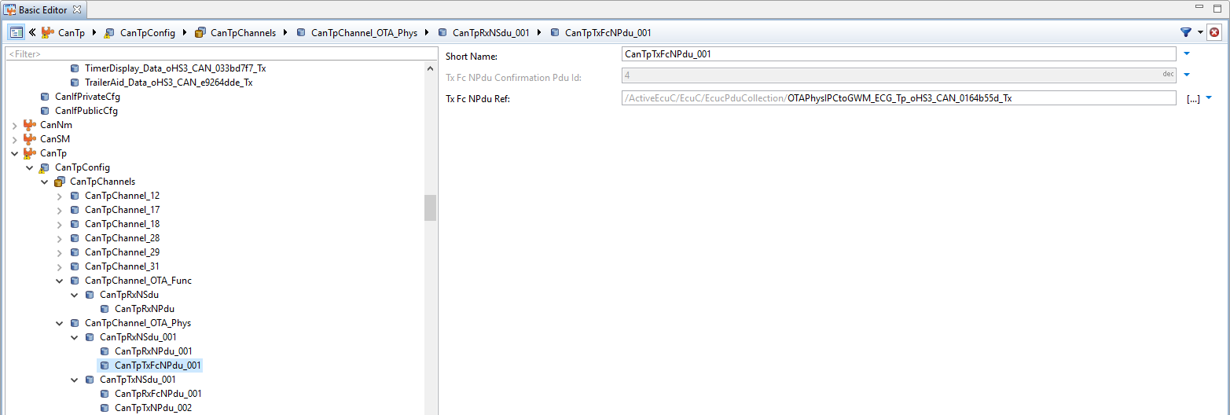
2. DaVinci Configuration
CanTpChannel_OTA_Phys CanTpRxNSdu_001:
CddOvtp
EcucPduCollection/IPdu_Cluster_OTA_Listener_Functional_Ovtp
EcucPduCollection/IPdu_Cluster_OTA_Listener_91a734a6_Rx
EcucPduCollection/IPdu_Cluster_OTA_Client_343c9c5f_Tx
PduR
EcucPduCollection/OTAFuncGWM_ECG_HS3_oHS3_CAN_10fe940e_Rx_Tp_Pdur
EcucPduCollection/OTAPhysGWM_ECGtoIPC_oHS3_CAN_52c66bc5_Rx_Tp_PduR
EcucPduCollection/OTAPhysIPCtoGWM_ECG_oHS3_CAN_96b3fb0b_Tx_PduR_Tp
CanTp
EcucPduCollection/OTAFuncGWM_ECG_HS3_Tp_oHS3_CAN_eda73d75_Rx
EcucPduCollection/OTAPhysGWM_ECGtoIPC_Tp_oHS3_CAN_cb7b017a_Rx
EcucPduCollection/OTAPhysIPCtoGWM_ECG_Tp_oHS3_CAN_0164b55d_Tx
CanIf
CanDrv

Slide 25
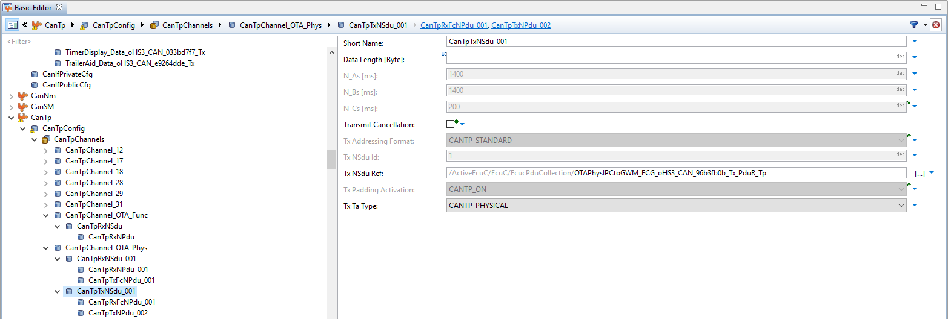
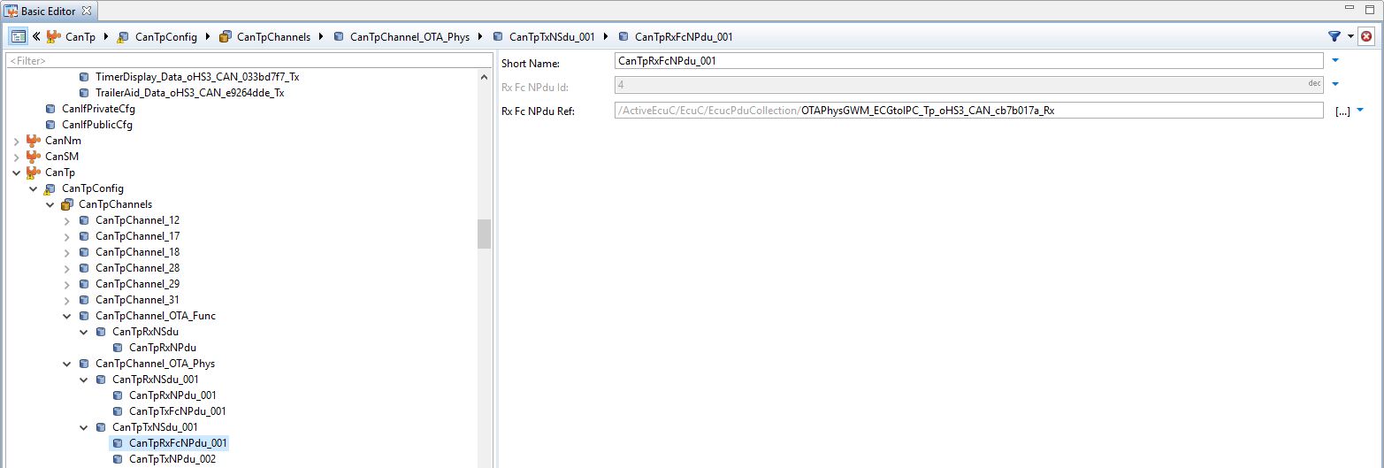
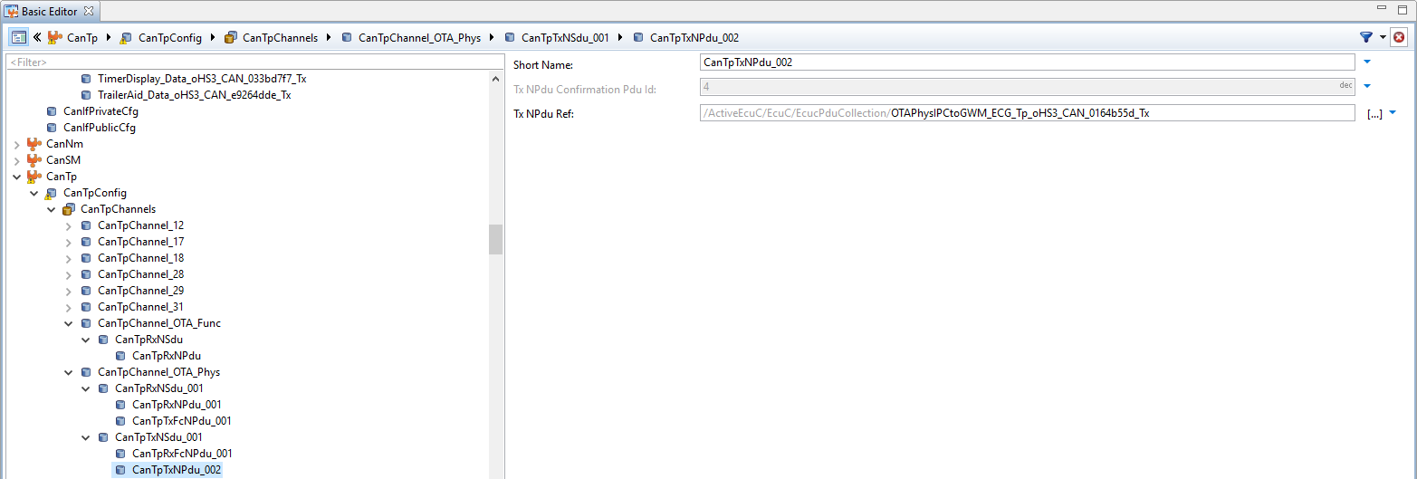
2. DaVinci Configuration
CanTpChannel_OTA_Phys CanTpTxNSdu_001:
CddOvtp
EcucPduCollection/IPdu_Cluster_OTA_Listener_Functional_Ovtp
EcucPduCollection/IPdu_Cluster_OTA_Listener_91a734a6_Rx
EcucPduCollection/IPdu_Cluster_OTA_Client_343c9c5f_Tx
PduR
EcucPduCollection/OTAFuncGWM_ECG_HS3_oHS3_CAN_10fe940e_Rx_Tp_Pdur
EcucPduCollection/OTAPhysGWM_ECGtoIPC_oHS3_CAN_52c66bc5_Rx_Tp_PduR
EcucPduCollection/OTAPhysIPCtoGWM_ECG_oHS3_CAN_96b3fb0b_Tx_PduR_Tp
CanTp
EcucPduCollection/OTAFuncGWM_ECG_HS3_Tp_oHS3_CAN_eda73d75_Rx
EcucPduCollection/OTAPhysGWM_ECGtoIPC_Tp_oHS3_CAN_cb7b017a_Rx
EcucPduCollection/OTAPhysIPCtoGWM_ECG_Tp_oHS3_CAN_0164b55d_Tx
CanIf
CanDrv

Slide 26
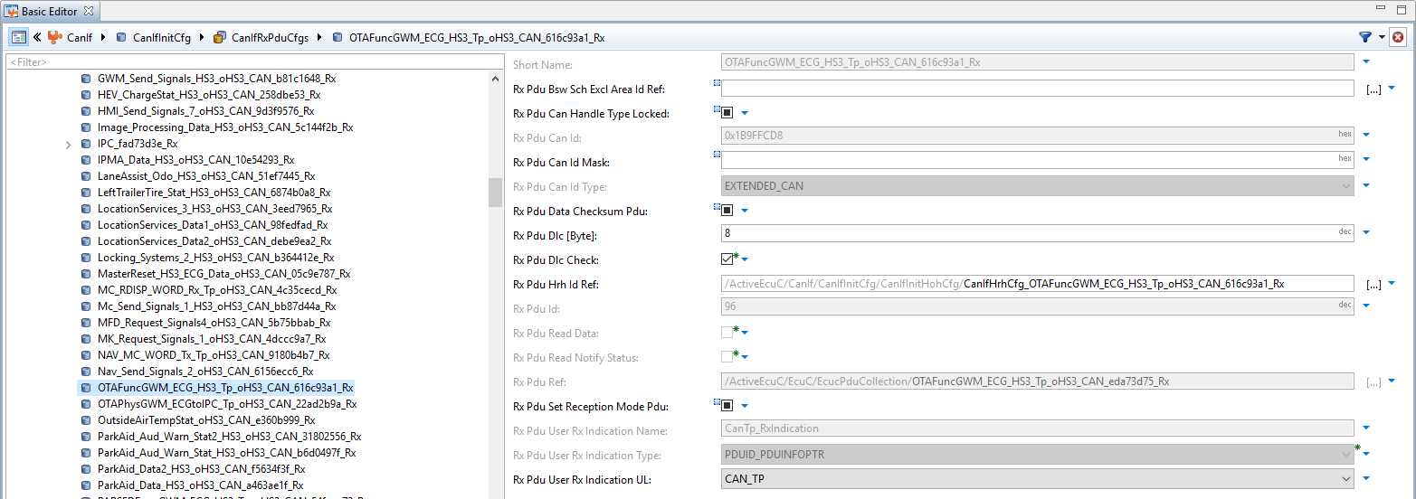
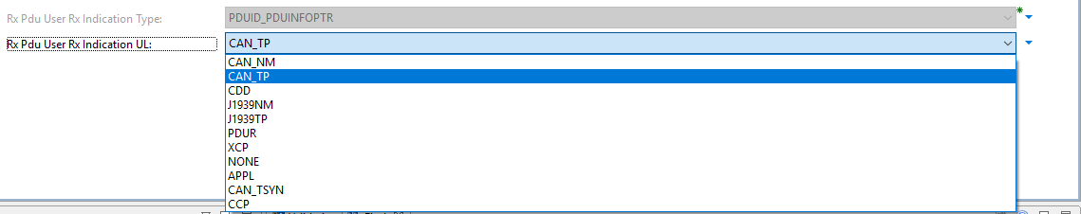
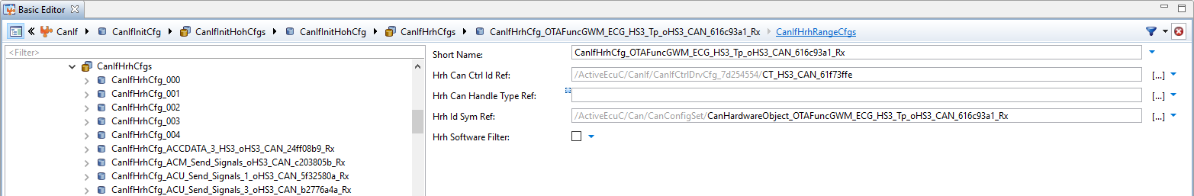
2. DaVinci Configuration
CanIfRxPduCfgs OTAFuncGWM_ECG_HS3_Tp_oHS3_CAN_616c93a1_Rx:
Rx Pdu Hrh Id Ref: The HRH to which Rx L-PDU belongs to is referred through this parameter.
Rx Pdu Ref: Reference to the "global" PDU structure to allow harmonization of handle IDs in the COM-Stack.
Rx Pdu User Rx Indication UL: This parameter defines the upper layer (UL) module to which the indication of the successfully received Rx-PDU has to be routed via the <User_RxIndication>.
CddOvtp
EcucPduCollection/IPdu_Cluster_OTA_Listener_Functional_Ovtp
EcucPduCollection/IPdu_Cluster_OTA_Listener_91a734a6_Rx
EcucPduCollection/IPdu_Cluster_OTA_Client_343c9c5f_Tx
PduR
EcucPduCollection/OTAFuncGWM_ECG_HS3_oHS3_CAN_10fe940e_Rx_Tp_Pdur
EcucPduCollection/OTAPhysGWM_ECGtoIPC_oHS3_CAN_52c66bc5_Rx_Tp_PduR
EcucPduCollection/OTAPhysIPCtoGWM_ECG_oHS3_CAN_96b3fb0b_Tx_PduR_Tp
CanTp
EcucPduCollection/OTAFuncGWM_ECG_HS3_Tp_oHS3_CAN_eda73d75_Rx
EcucPduCollection/OTAPhysGWM_ECGtoIPC_Tp_oHS3_CAN_cb7b017a_Rx
EcucPduCollection/OTAPhysIPCtoGWM_ECG_Tp_oHS3_CAN_0164b55d_Tx
CanIf
CanIfHrhCfgs CanIfHrhCfg_OTAFuncGWM_ECG_HS3_Tp_oHS3_CAN_616c93a1_Rx:
CanIfInitHohCfg/CanIfHrhCfg_OTAFuncGWM_ECG_HS3_Tp_oHS3_CAN_616c93a1_Rx
CanDrv
Can/CanConfigSet/CanHardwareObject_OTAFuncGWM_ECG_HS3_Tp_oHS3_CAN_616c93a1_Rx

Slide 27
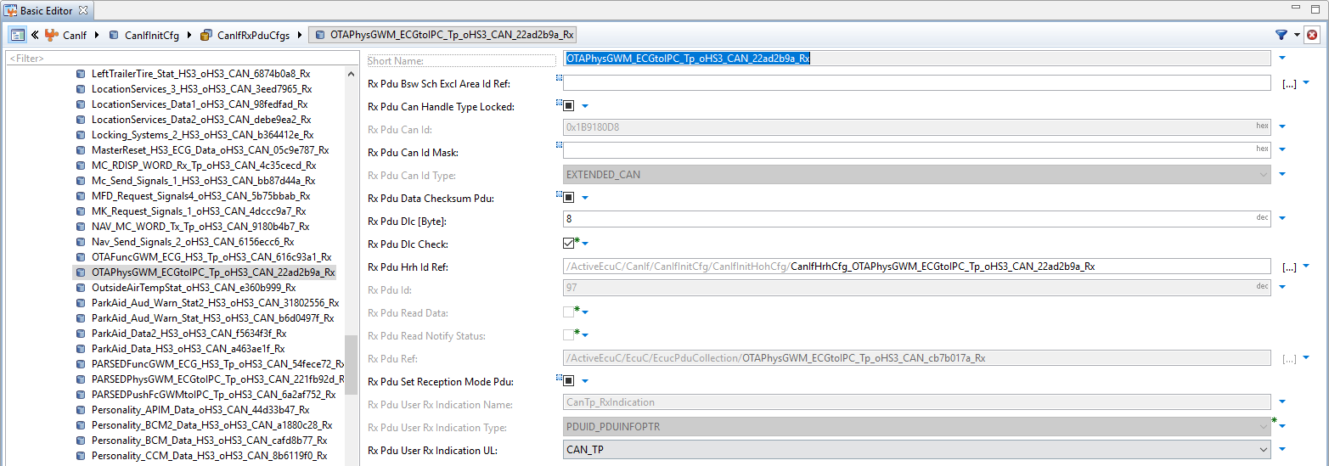
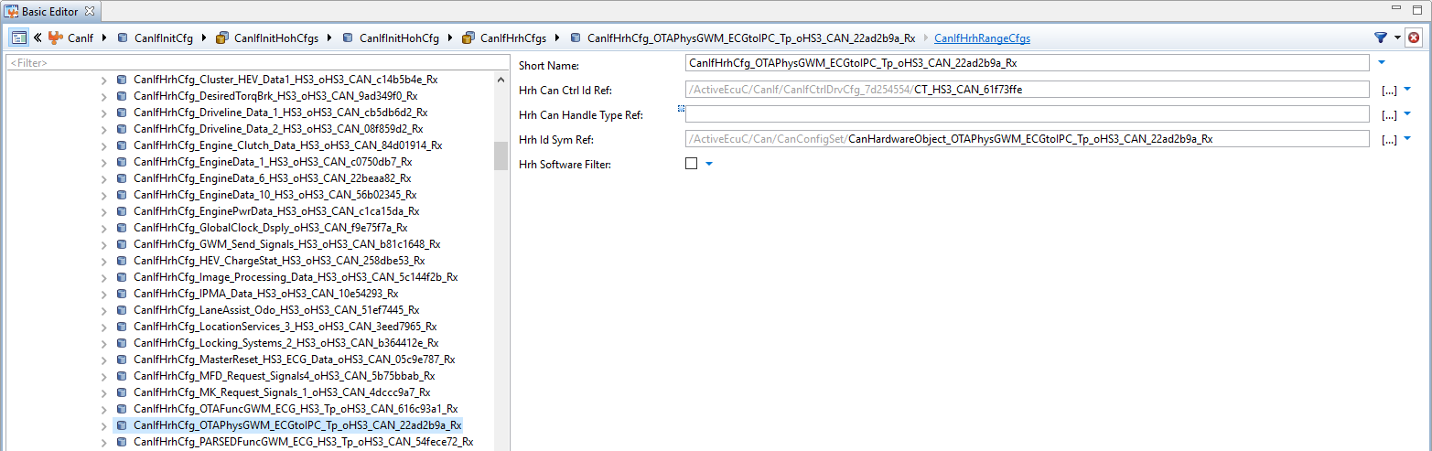
2. DaVinci Configuration
CanIfRxPduCfgs OTAPhysGWM_ECGtoIPC_Tp_oHS3_CAN_22ad2b9a_Rx:
CddOvtp
EcucPduCollection/IPdu_Cluster_OTA_Listener_Functional_Ovtp
EcucPduCollection/IPdu_Cluster_OTA_Listener_91a734a6_Rx
EcucPduCollection/IPdu_Cluster_OTA_Client_343c9c5f_Tx
PduR
EcucPduCollection/OTAFuncGWM_ECG_HS3_oHS3_CAN_10fe940e_Rx_Tp_Pdur
EcucPduCollection/OTAPhysGWM_ECGtoIPC_oHS3_CAN_52c66bc5_Rx_Tp_PduR
EcucPduCollection/OTAPhysIPCtoGWM_ECG_oHS3_CAN_96b3fb0b_Tx_PduR_Tp
CanIfHrhCfgs CanIfHrhCfg_OTAPhysGWM_ECGtoIPC_Tp_oHS3_CAN_22ad2b9a_Rx:
CanTp
EcucPduCollection/OTAFuncGWM_ECG_HS3_Tp_oHS3_CAN_eda73d75_Rx
EcucPduCollection/OTAPhysGWM_ECGtoIPC_Tp_oHS3_CAN_cb7b017a_Rx
EcucPduCollection/OTAPhysIPCtoGWM_ECG_Tp_oHS3_CAN_0164b55d_Tx
CanIf
CanIfInitHohCfg/CanIfHrhCfg_OTAFuncGWM_ECG_HS3_Tp_oHS3_CAN_616c93a1_Rx
CanIfInitHohCfg/CanIfHrhCfg_OTAPhysGWM_ECGtoIPC_Tp_oHS3_CAN_22ad2b9a_Rx
CanDrv
Can/CanConfigSet/CanHardwareObject_OTAFuncGWM_ECG_HS3_Tp_oHS3_CAN_616c93a1_Rx
CanConfigSet/CanHardwareObject_OTAPhysGWM_ECGtoIPC_Tp_oHS3_CAN_22ad2b9a_Rx

Slide 28
2. DaVinci Configuration
CddOvtp
EcucPduCollection/IPdu_Cluster_OTA_Listener_Functional_Ovtp
EcucPduCollection/IPdu_Cluster_OTA_Listener_91a734a6_Rx
EcucPduCollection/IPdu_Cluster_OTA_Client_343c9c5f_Tx
PduR
EcucPduCollection/OTAFuncGWM_ECG_HS3_oHS3_CAN_10fe940e_Rx_Tp_Pdur
EcucPduCollection/OTAPhysGWM_ECGtoIPC_oHS3_CAN_52c66bc5_Rx_Tp_PduR
EcucPduCollection/OTAPhysIPCtoGWM_ECG_oHS3_CAN_96b3fb0b_Tx_PduR_Tp
CanTp
/ActiveEcuC/EcuC/EcucPduCollection/OTAPhysGWM_ECGtoIPC_Tp_oHS3_CAN_cb7b017a_Rx
/ActiveEcuC/EcuC/EcucPduCollection/OTAFuncGWM_ECG_HS3_Tp_oHS3_CAN_eda73d75_Rx
EcucPduCollection/OTAFuncGWM_ECG_HS3_Tp_oHS3_CAN_eda73d75_Rx
EcucPduCollection/OTAPhysGWM_ECGtoIPC_Tp_oHS3_CAN_cb7b017a_Rx
EcucPduCollection/OTAPhysIPCtoGWM_ECG_Tp_oHS3_CAN_0164b55d_Tx
CanIf
CanIfInitHohCfg/CanIfHrhCfg_OTAFuncGWM_ECG_HS3_Tp_oHS3_CAN_616c93a1_Rx
Short name: OTAPhysGWM_ECGtoIPC_Tp_oHS3_CAN_22ad2b9a_Rx
Short name: OTAFuncGWM_ECG_HS3_Tp_oHS3_CAN_616c93a1_Rx
Short name: CanIfHrhCfg_OTAPhysGWM_ECGtoIPC_Tp_oHS3_CAN_22ad2b9a_Rx
CanIfInitHohCfg/CanIfHrhCfg_OTAPhysGWM_ECGtoIPC_Tp_oHS3_CAN_22ad2b9a_Rx
CanIf/CanIfInitCfg/CHNL_5899645a
CanDrv
Can/CanConfigSet/CanHardwareObject_OTAFuncGWM_ECG_HS3_Tp_oHS3_CAN_616c93a1_Rx
CanHardwareObject_OTAGWM_ECGtoIPC_Tp_oHS3_CAN_22ad2b9a_Rx
CanConfigSet/CanHardwareObject_OTAPhysGWM_ECGtoIPC_Tp_oHS3_CAN_22ad2b9a_Rx
CanConfigSet/CN_HS3_CAN_5819f711_Tx
/ActiveEcuC/Can/CanConfigSet/CT_HS3_CAN_93b71957

Slide 29
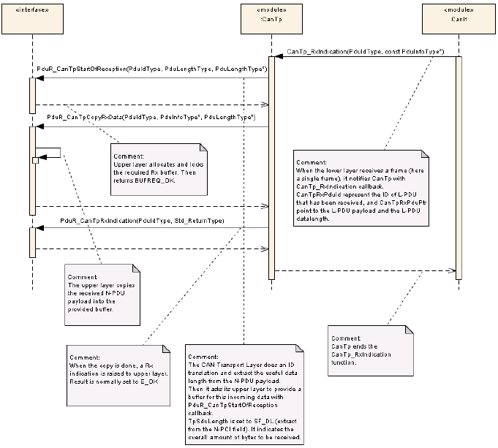
2. DaVinci Configuration

Slide 30
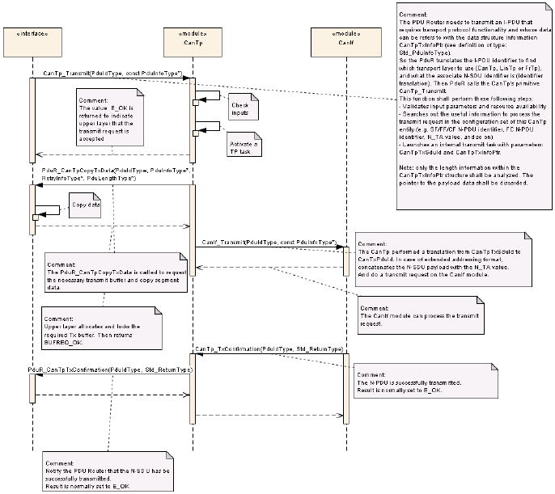
2. DaVinci Configuration

Slide 31
Q&A?

Slide 32
Thank you!

