Slide 1
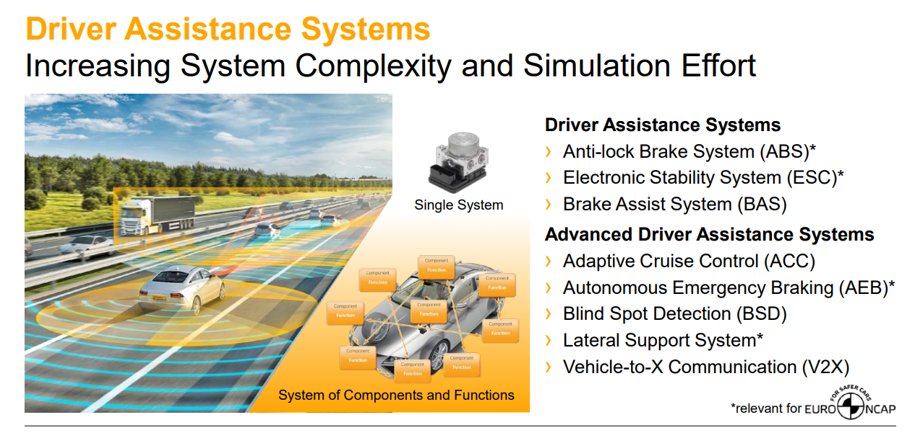
ADAS Advanced Driver Assistance Systems
Reference from Continental

Slide 2
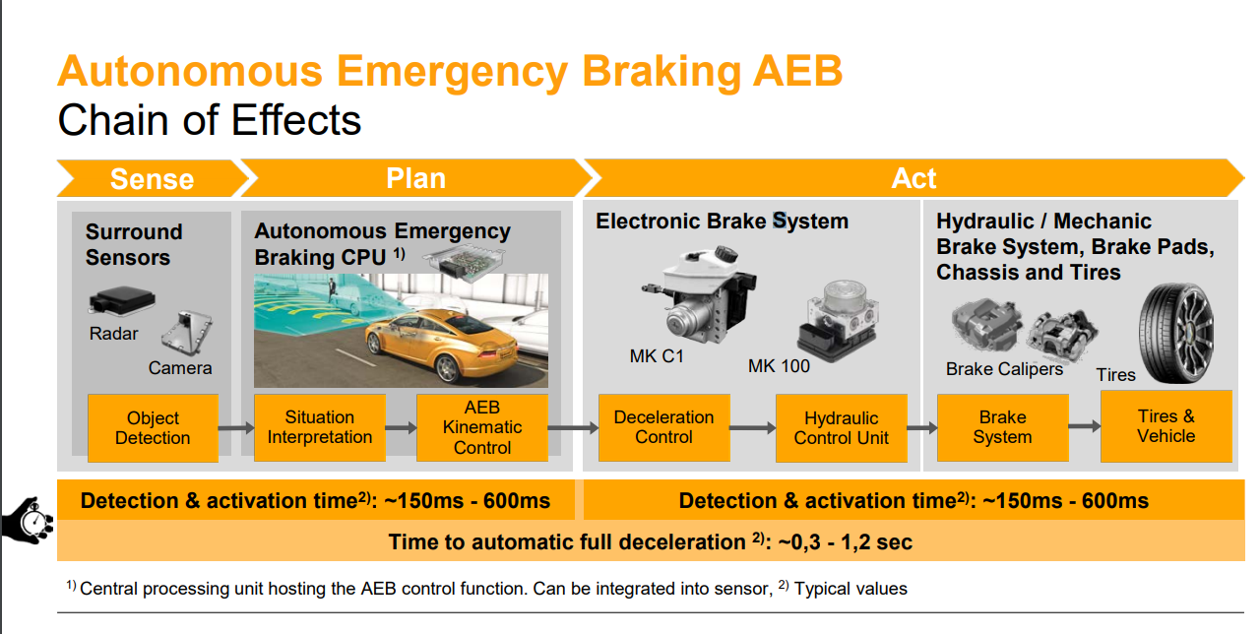
ADAS
Reference from Continental

Slide 3
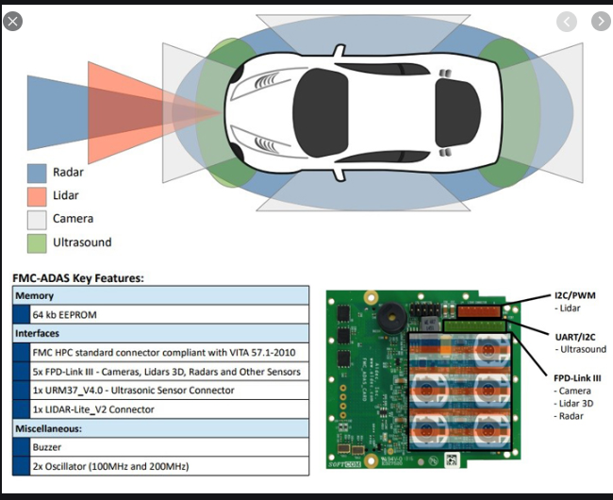
Architecture and Realization of ADAS
Reference from Continental

