Slide 1

DEMO CAN 2.0 USING CAN-SIM AND KIT S32K144EVB

Slide 2
AGENDA
1. What is CAN 2.0 ?
2. Description of project
Hardware Setup
4. Software Implementation
5. Result

Slide 3
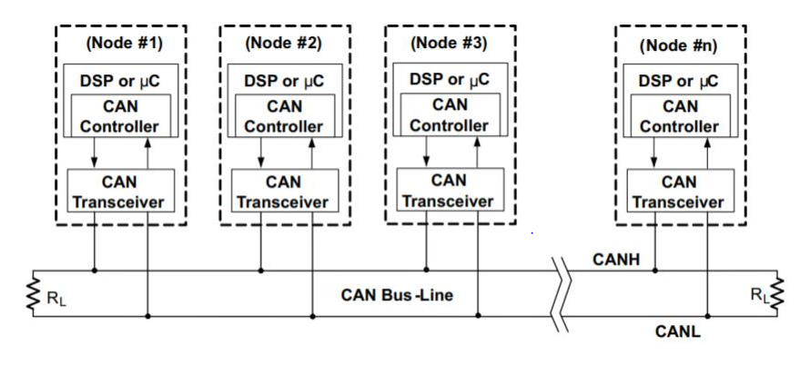
1. What is CAN 2.0?
Physical Connection: CAN is communication using a single terminate twisted pair cable so that CAN devices can communicate with one another
- Maximum speed: 1Mb/s

Slide 4
1. What is CAN 2.0?
- Multi master: All devices on the network can transmit message without being requested by other node and they can see all transmitted messages. Each device can decide if a message is relevant or if it should be filtered
- Priority: Every message has a priority, so if two nodes try to send messages simultaneously into CAN bus, the one with the higher priority gets transmitted and the one with the lower priority gets postponed until the bus becomes available

Slide 5
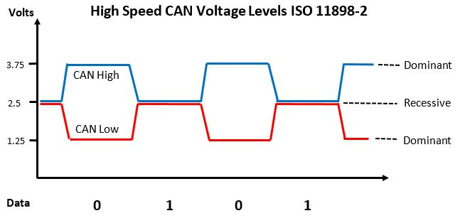
1. What is CAN 2.0?
Signaling
Each CAN node transmits differentially over two wires: CAN High and CAN Low. There are 2 logic states: Dominant – Logic 0 Recessive – Logic 1 Voltage levels vary according to the spec. Here we look at High Speed CAN. + During a recessive (logic 1) transmission the bus is not actively driven and rests at around 2.5V. + During a dominant (logic 0), CAN High is driven towards 3.75 - 5(V)and CAN Low is driven towards 0 - 1.5(V)

Slide 6
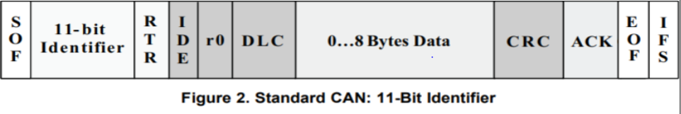
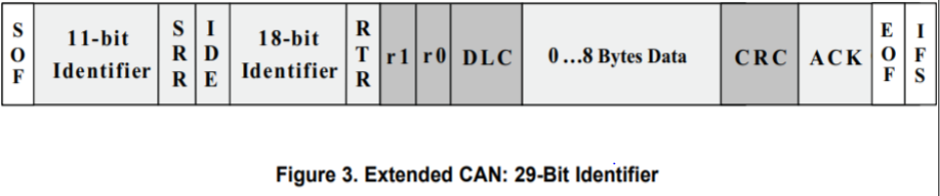
1. What is CAN 2.0?
Frame format

Slide 7
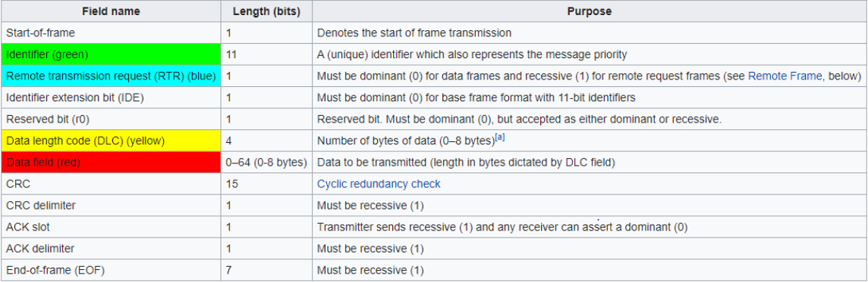
1. What is CAN 2.0?

Slide 8
2. Description of project
- This project demo for CAN 2.0 communication between CAN Simulator(CAN Sim) of FPT and NXP S32K144 at baud rate: 500 (KHz)
- Firstly, CAN Sim will send 2 messages to S32K144:
+ Message 1: ID 0x111 and data: Signal 1 (8 bit).
+ Message 2: ID 0x222 and data: Signal 2 (8 bit).
- When the S32K144 has received those 2 messages, it will send back the data immediately in 2 message with ID 0x333, 0x444 correspondingly. The blue LED (Pin D0) in S32K144 will toggle every 5 messages of both received successfully.

Slide 9
2. Description of project
Message 1: ID 0x111, Data: Signal 1 (8 bit)
Send
Message 2: ID 0x222, Data: Signal 2 (8 bit)
CAN SIMULATOR
S32K144
(Blue led will toggle after receiving 5 messages)
CAN BUS
Message 1: ID 0x333, Data: Signal 1 (8 bit)
Send
Message 2: ID 0x444, Data: Signal 2 (8 bit)

Slide 10
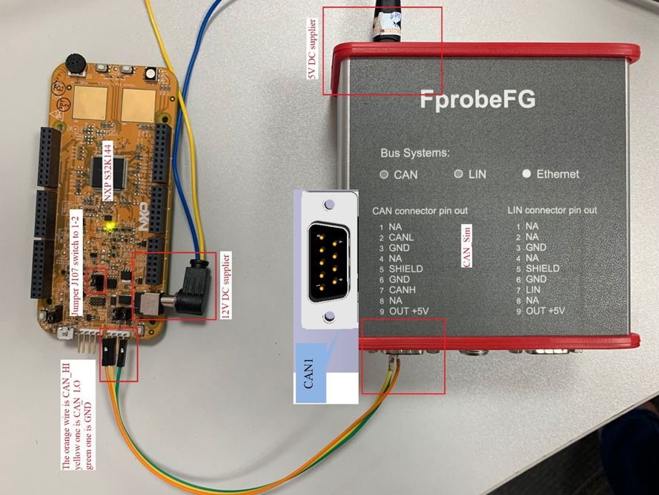
3. Hardware Setup

Slide 11
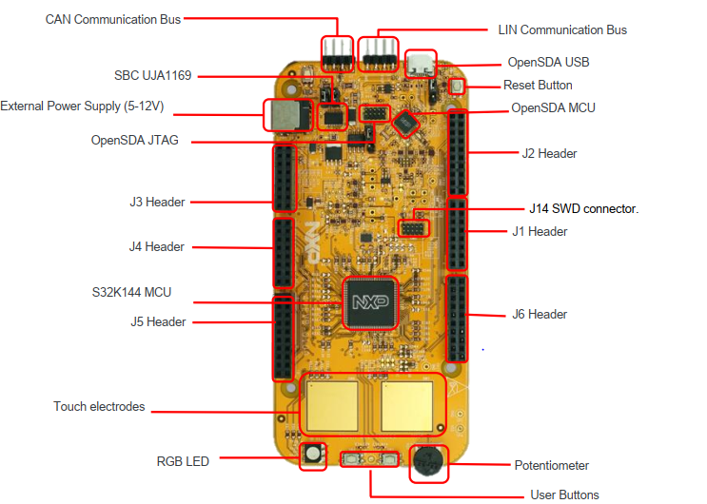
3. Hardware Setup

Slide 12
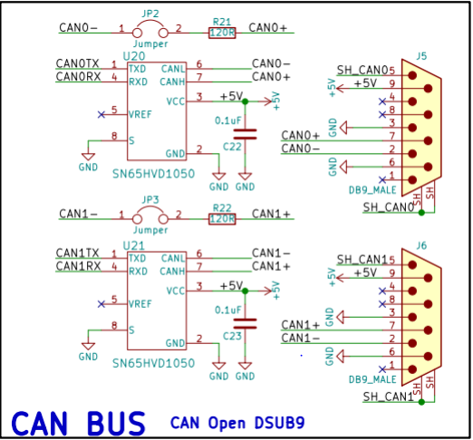
3. Hardware Setup

Slide 13

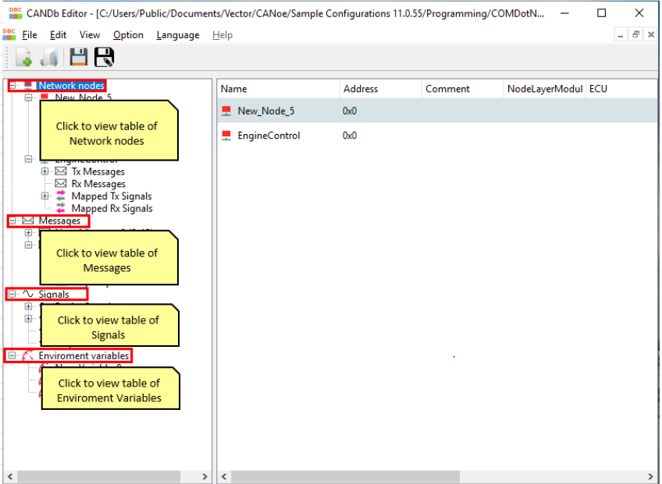
4. Software Implementation
4.1 Creating database
Using software: CANDb Editor to create database

Slide 14
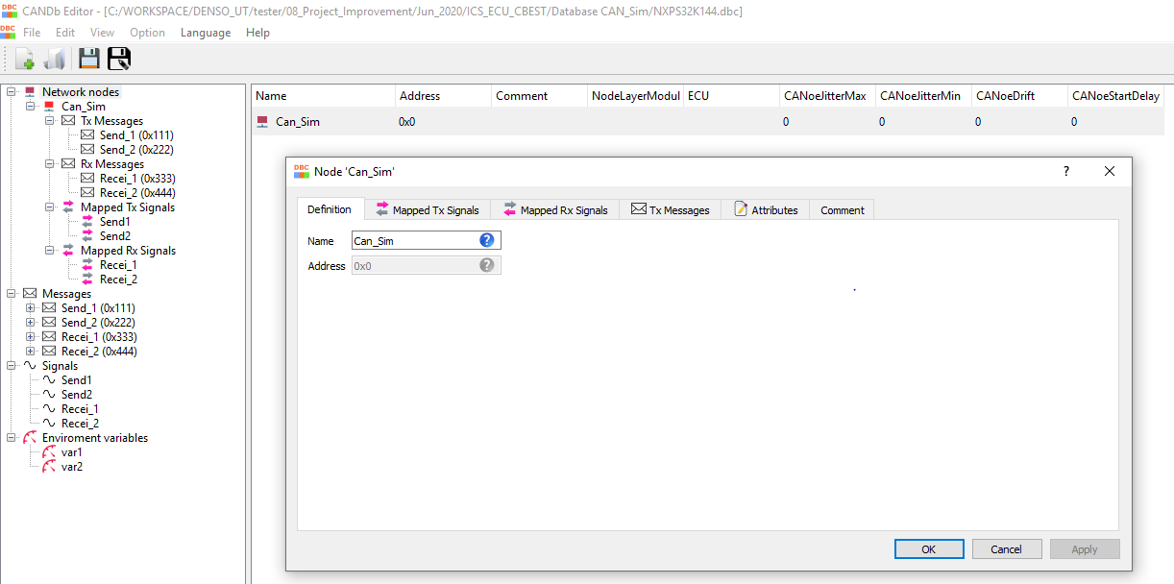
4. Software Implementation
4.1.1 Creating node
Creating node with name: Can_Sim

Slide 15
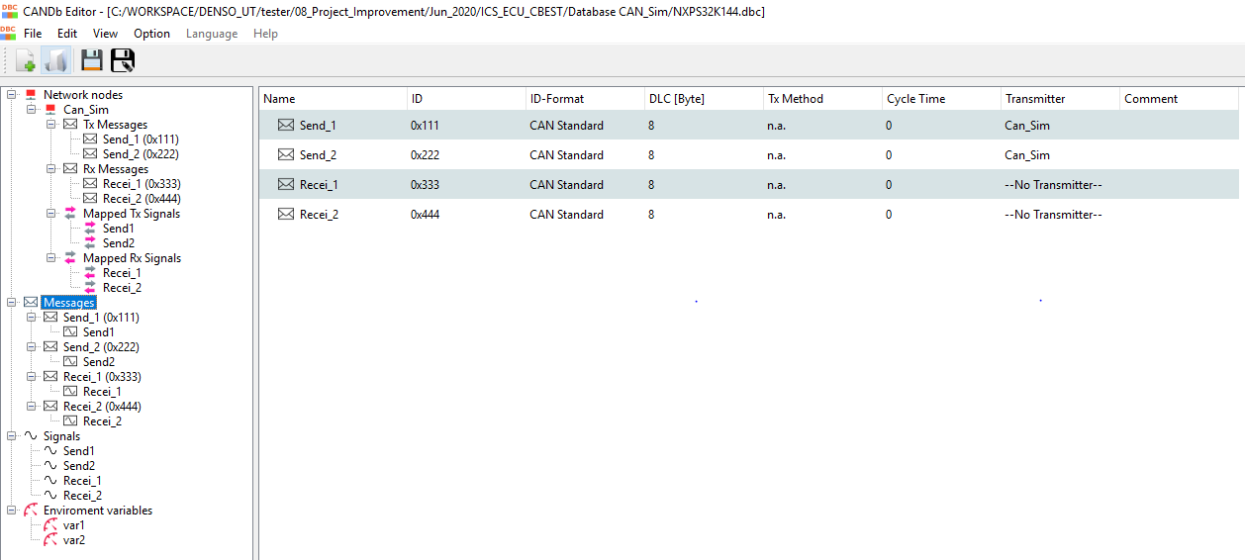
4. Software Implementation
4.1.2 Creating Messages
Creating 4 messages:
Send_1, Send_2 : Sending messages
Recei_1, Recei_2: Receiving messages

Slide 16
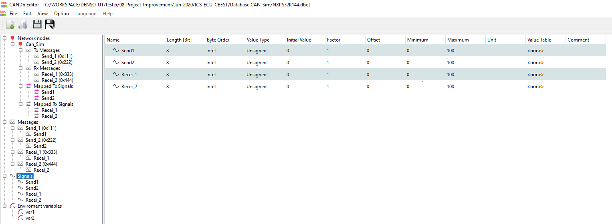
4. Software Implementation
4.1.3 Creating Signals
Creating 4 signals: Send1, Send2, Recei_1, Recei_2 is corresponding to messages: Send_1, Send_2, Recei_1, Recei_2

Slide 17
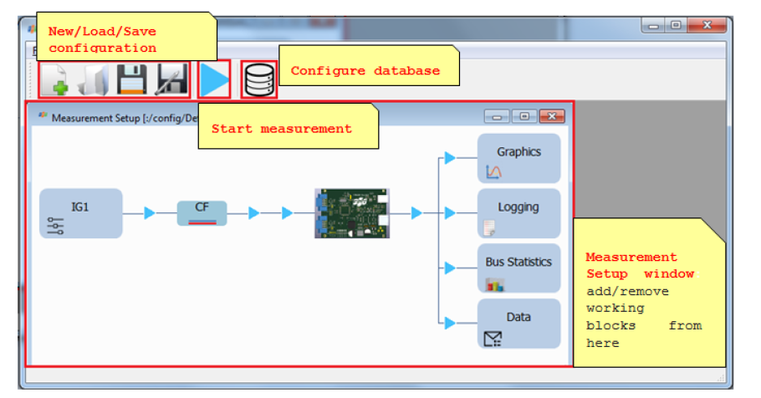
4. Software Implementation
4.1.4 Creating message on CAN bus with CAN Simulator
To create or analyze message on CAN bus

Slide 18
4. Software Implementation
4.2 Programming on S32K144
Design Steps
Initializing SOSC for 8MHz, SYSCLK for 80 MHz
Configuring FlexCAN0:
+ Enable clock module and select clock source for PE
+ Configure bit timing for transmitting and receiving at 500 KHz
+ Clearing message buffer
+ Set incoming mask and global mask bits to check all standard IDs of received messages
+ Configure MB4, MB5 for receiving
+ Negate halt state of module CAN
Initializing port pin
+ Enable clock for PORTE (CAN0 Rx, CAN0 Tx)
+ Pin Mux Control for PTE4, PTE5
+ Enable clock for PORTD (Pin D0)
+ Pin Mux Control
+ Configuring port data direction
Message reception
+ Checking interrupt flag
+ Reading MB4, MB5
+ Read TIMER to unlock message buffers
+ Clearing interrupt flag
Configuring MB0 for transmission

Slide 19
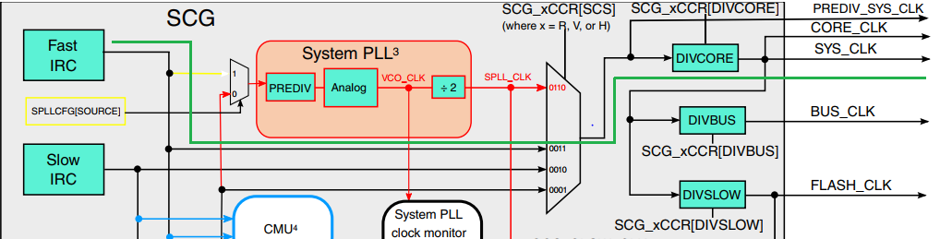
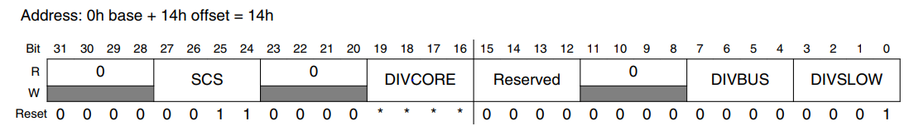
4. Software Implementation
4.2 Programming on S32K144
4.2.1 Initializing SOSC, SYS_CLK
SOSC
Run Clock Control Register (SCG_RCCR)
Address: 0x40064014h
SCS: 0011 -> Fast IRC
DIVCORE: 0000 -> Divide by 1
=> SYS_CLK is supplied by Fast IRC (Default), is 80 MHz

Slide 20
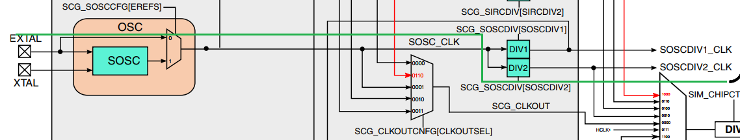
4. Software Implementation
4.2.1 Initializing SOSC, SYS_CLK
SYS_CLK

Slide 21
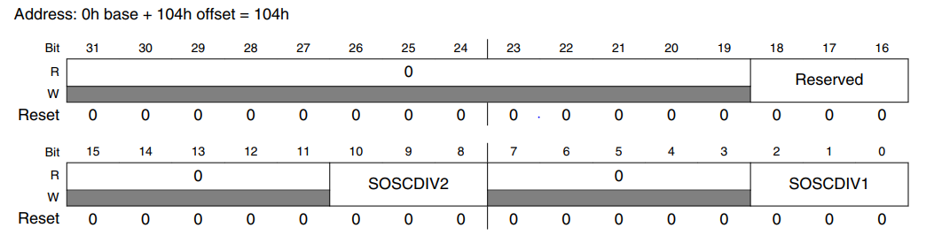
4. Software Implementation
4.2.1 Initializing SOSC, SYS_CLK
System OSC Divide Register (SCG_SOSCDIV)
Address: 0x40064104h
SOSCDIV2: 001 -> Divide by 1
=> SOSCDIV2_CLK is supplied by EXTAL ,is 8 MHz

Slide 22
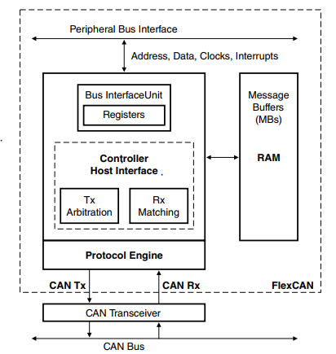
4. Software Implementation
4.2.2 Initializing FlexCAN0
Enable clock module and select clock source for PE
Block diagram of CAN Module

Slide 23
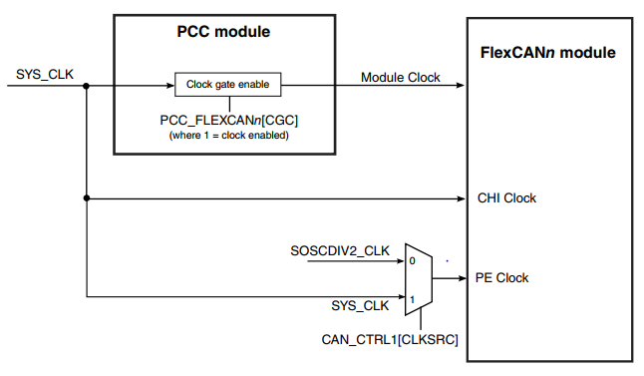
4. Software Implementation
Enable clock module and select clock source for PE
FlexCAN0 module need 3 clock sources:
Module Clock: be supplied to synchronize clock with other module (SYS_CLK)
CHI Clock (Controller Host Interface Clock): clock for controller host interface (SYS_CLK)
- PE Clock (Protocol Engine Clock): clock for Protocol Engine, it is used to calculate time bit (SOSCDIV2_CLK of SYS_CLK)

Slide 24
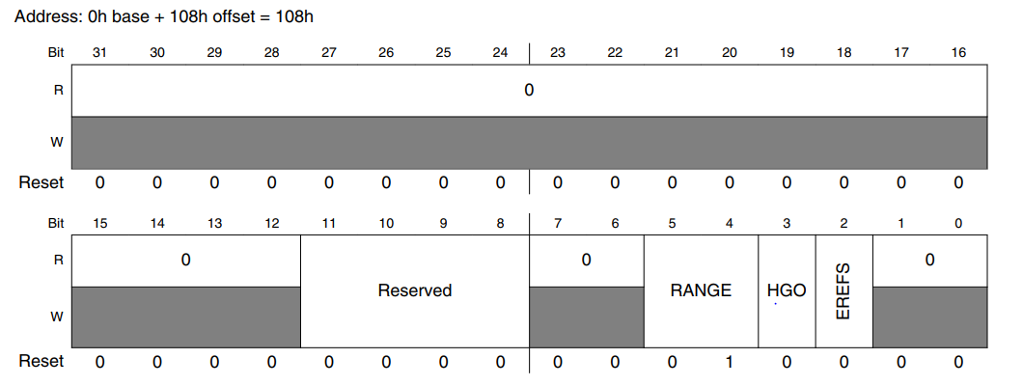
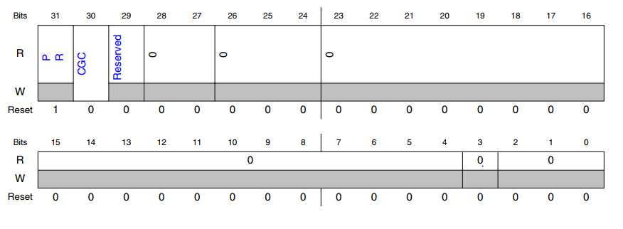
4. Software Implementation
Enable clock module and select clock source for PE
System Oscillator Configuration Register (SCG_SOSCCFG) Address: 0x40064108h
EREFS: 0 -> external reference clock selected (EXTAL)
PCC FlexCAN0 Register (PCC_FlexCAN0)
Address: 0x40064090h
CGC: 1 -> Enable clock for CAN0 module

Slide 25
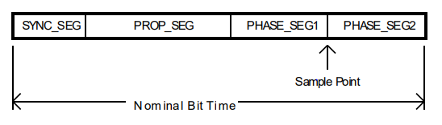
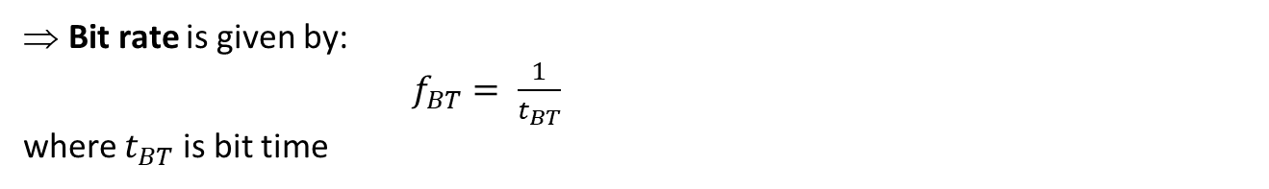
4. Software Implementation
Configure bit timing for transmitting and receiving at 500 KHz
Bit time is duration of an individual one (1) or zero (0) bit in a digital transmission
Bit rate is given by:
$f_{BT}= \frac{1}{t_{BT}}$
where $t_{BT}$ is bit time
A bit is divided into four separate non-overlapping time segments called SYNC_SEG, PROP_SEG, PHASE_SEG1 and PHASE_SEG2.

Slide 26
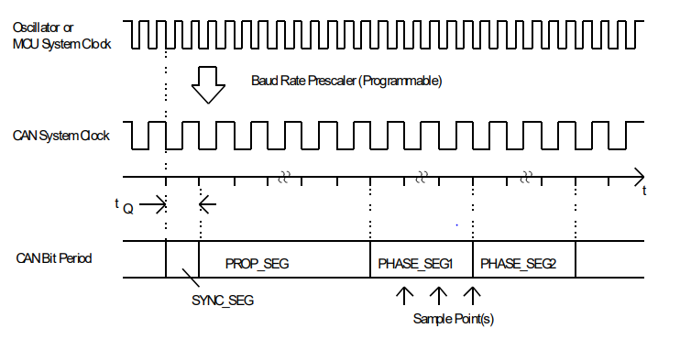
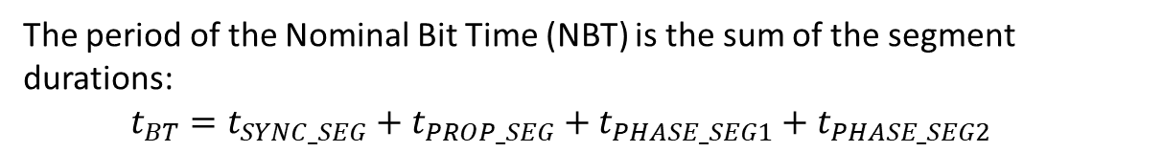
4. Software Implementation
Configure bit timing for transmitting and receiving at 500 KHz
The period of the Nominal Bit Time (NBT) is the sum of the segment durations:
$t_{BT}=t_{SYNC_SEG}+t_{PROP_SEG}+t_{PHASE_SEG1}+t_{PHASE_SEG2}$
Each of these segments is an integer multiple of a unit of time called a Time Quantum, tq. The duration of a Time Quantum is equal to the period of the CAN system clock, which is derived from the microcontroller (MCU) system clock or oscillator by way of a programmable prescaler, called the Baud Rate Prescaler.

Slide 27
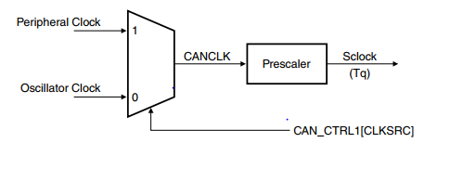
4. Software Implementation
Configure bit timing for transmitting and receiving at 500 KHz
CAN engine clocking scheme

Slide 28
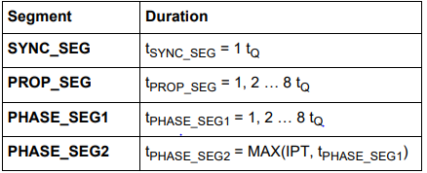
4. Software Implementation
Configure bit timing for transmitting and receiving at 500 KHz
IPT is the Information Processing Time and is equal to 2 (tq)

Slide 29
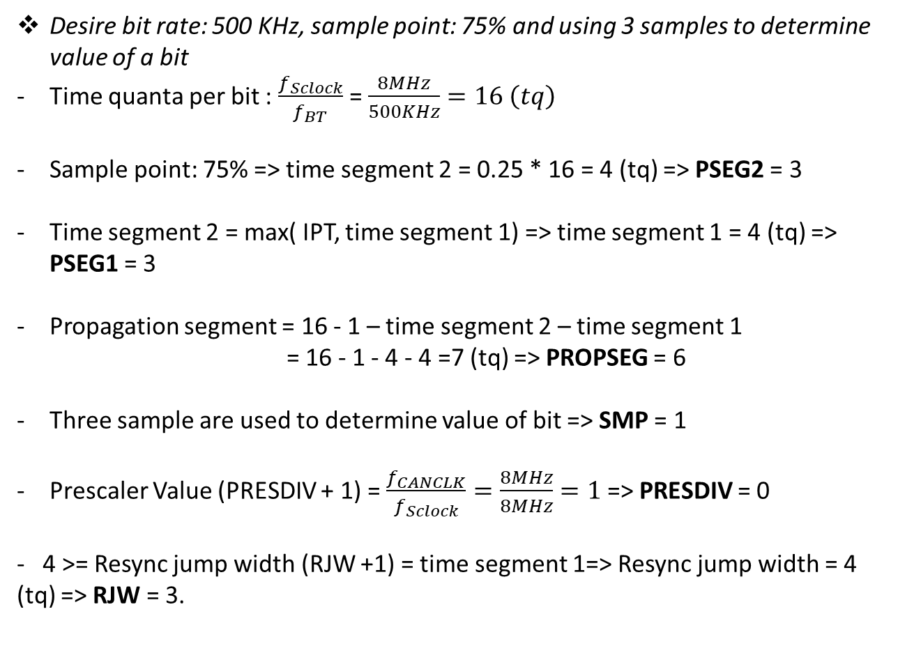
4. Software Implementation
Configure bit timing for transmitting and receiving at 500 KHz
Desire bit rate: 500 KHz, sample point: 75% and using 3 samples to determine value of a bit
Time quanta per bit : $\frac{f_{Sclock}}{f_{BT}}$ = $\frac{8MHz}{500KHz}=16 \left(tq\right)$
Sample point: 75% => time segment 2 = 0.25 * 16 = 4 (tq) => PSEG2 = 3
Time segment 2 = max( IPT, time segment 1) => time segment 1 = 4 (tq) => PSEG1 = 3
Propagation segment = 16 - 1 – time segment 2 – time segment 1
= 16 - 1 - 4 - 4 =7 (tq) => PROPSEG = 6
Three sample are used to determine value of bit => SMP = 1
Prescaler Value (PRESDIV + 1) = $\frac{f_{CANCLK}}{f_{Sclock}}=\frac{8MHz}{8MHz}=1$=> PRESDIV = 0
- 4 >= Resync jump width (RJW +1) = time segment 1=> Resync jump width = 4 (tq) => RJW = 3.

Slide 30
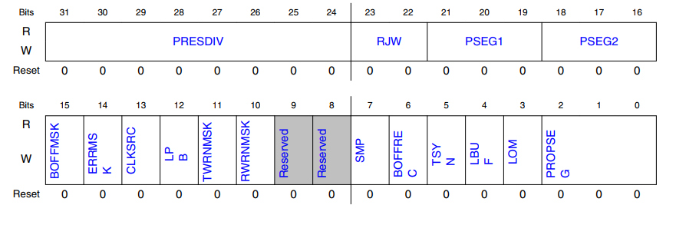
4. Software Implementation
Configure bit timing for transmitting and receiving at 500 KHz
Control 1 register (CTRL1)
Address: 0x40024004h
PRESDIV: 00000000
PSEG1: 011
PSEG2: 011
PROPSEG: 110
RJW: 011
SMP: 1
CLKSRC: 0 -> CAN engine clock source is oscillator clock

Slide 31
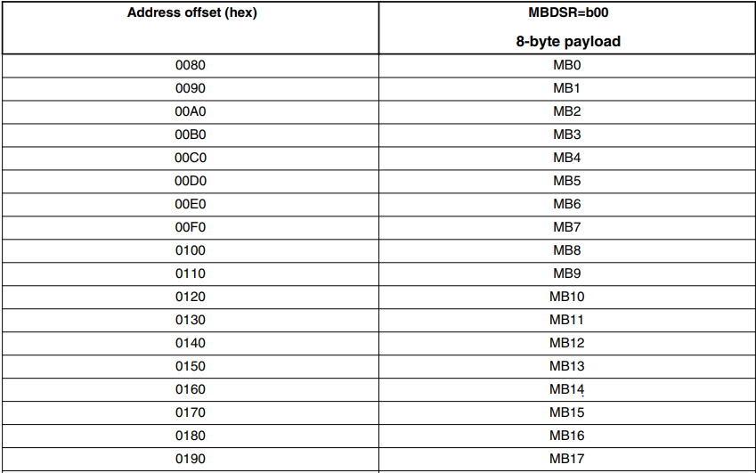
4. Software Implementation
Clearing message buffer
32 messages buffer

Slide 32
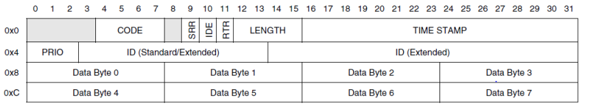
4. Software Implementation
Clearing message buffer
Word 0
Word 1
Word 2
Word 3
Structure of a 8-byte message buffer
A message buffer have 4 words.
- We will assign these 128 words by 0 to clear data of message buffer before transmission or reception.

Slide 33
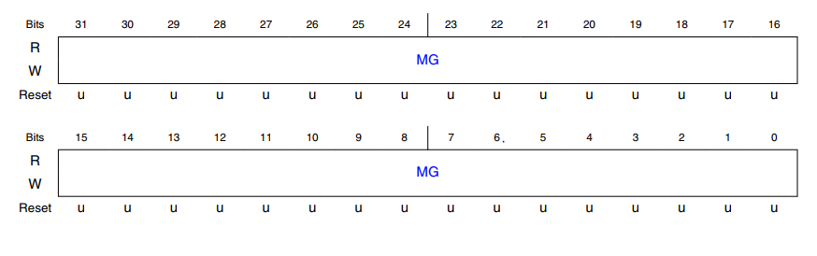
4. Software Implementation
Set global mask bits to check all standard IDs of received messages
Rx Mailboxes Global Mask register (RXMGMASK) Address: 0x40024010h
We will assign 0x1FFFFFFF to check standard IDs of incoming messages

Slide 34
4. Software Implementation
Configure MB4, MB5 for receiving
Offset: MB4: 0x00C0h, MB5: 0x00D0h
Word 0
Word 1
Word 2
Word 3
Word 0 :
CODE: 0100 -> activate RX mailbox
IDE: 0 -> Standard ID (11 bit)
RTR: 0 -> Data frame
LENGTH: 0000 (8 bytes)
Word 1 :
ID: 0x111 (MB4) or 0x222(MB5) -> expected ID is received

Slide 35
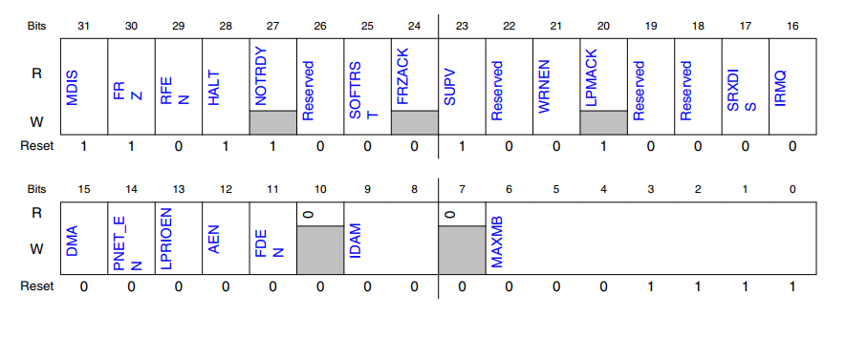
4. Software Implementation
Negate halt state of module CAN
After initializing message buffers, we need exit Freeze mode to perform reception and transmission
Module Configuration register (MCR) Address: 0x40024000h
FRZ : 0 -> Not enable to enter Freeze mode
HALT: 0 -> No Freeze mode request
MAXMB: 0x1F -> Max number of last message buffer which take part in matching and arbitration processes (16 MBs)

Slide 36
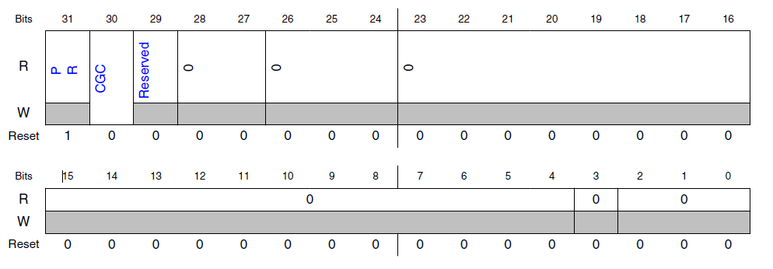
4. Software Implementation
4.2.3 Initializing port pin
Enable clock for PORTE (CAN0 Rx, CAN0 Tx)
PCC PORTE Register (PCC_PORTE)
Address : 0x40024134h
CGC: 1 -> Enable clock for Port E

Slide 37
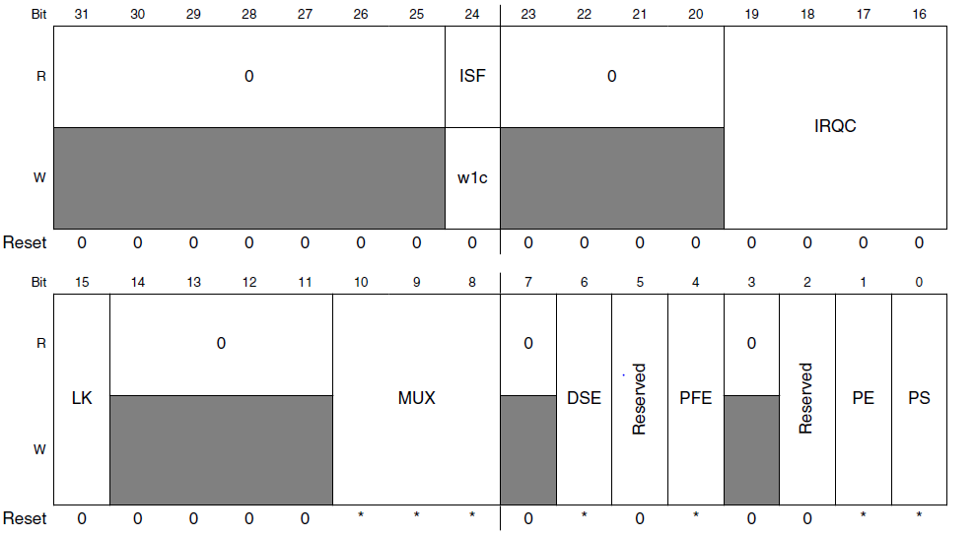
4. Software Implementation
4.2.3 Initializing port pin
Pin Mux Control
Pin Control Register n (PORT_PCR4, PORT_PCR5)
Address: 0x4004D010h and 0x4004D014h
MUX: 101 ->Alternative 5 (Rx, Tx)

Slide 38
4. Software Implementation
4.2.3 Initializing port pin
Enable clock for PORTD (Pin D0)
PCC PORTD Register (PCC_PORTD)
Address : 0x40065130h
CGC: 1 -> Enable clock for Port D

Slide 39
4. Software Implementation
4.2.2 Initializing port pin
Pin Mux Control
Pin Control Register n (PORT_PCR0)
Address: 0x4004C000h
MUX: 001 ->Alternative 1 (GPIO)

Slide 40
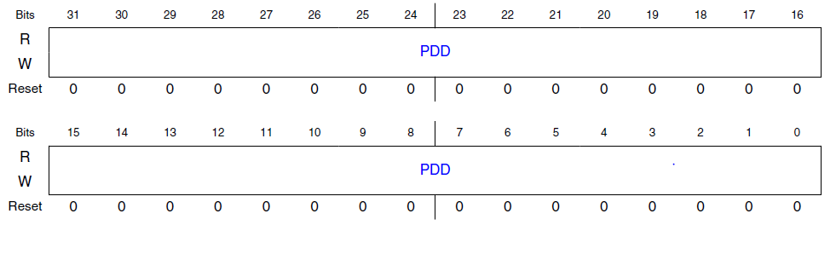
4. Software Implementation
4.2.3 Initializing port pin
Configuring port data direction
Port Data Direction Register (PDDR)
Address: 0x400FF0D4h
Bit 0: 1 -> Configure pin D0 for output

Slide 41
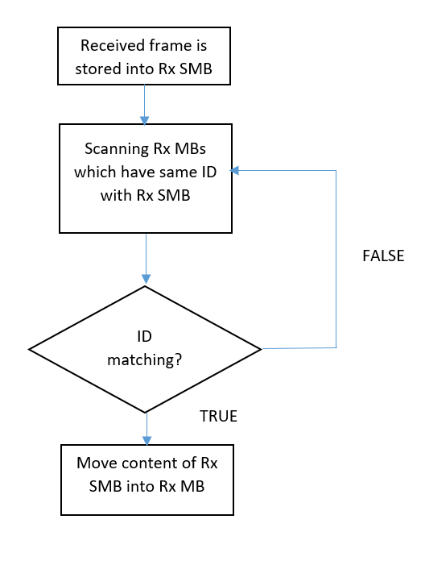
4. Software Implementation
4.2.4 Message reception
Receiving and move - in process
Rx SMB is auxiliary MB called serial message buffer

Slide 42
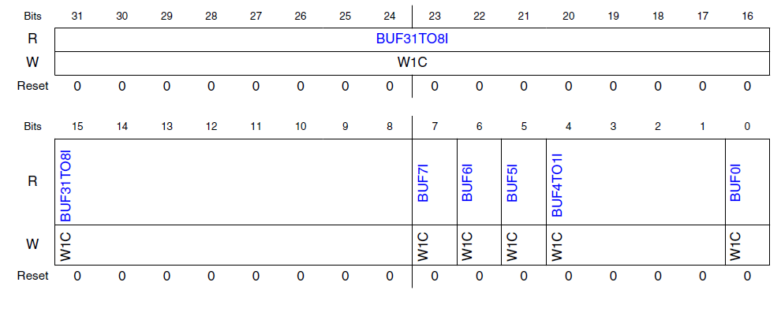
4. Software Implementation
4.2.4 Message reception
Checking interrupt flag
Interrupt Flags 1 register (IFLAG1)
Address: 0x40024030h
If bit 5 and bit 4 = 1, reception is successful

Slide 43
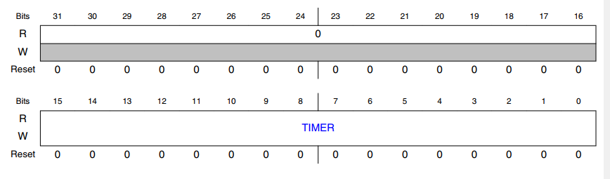
4. Software Implementation
4.2.4 Message reception
Reading MB4, MB5
Offset: MB4: 0x00C0h, MB5: 0x00D0h
Word 0
Word 1
Word 2
Word 3
Reading ID and Data from word 1,2,3.
Read TIMER to unlock message buffers
Free Running Timer (TIMER)
Address: 0x40024008h

Slide 44
4. Software Implementation
4.2.4 Message reception
Clearing interrupt flag
Interrupt Flags 1 register (IFLAG1)
Address: 0x40024030h
Bit 5, bit 4: 1 -> Clear interrupt flag

Slide 45
4. Software Implementation
4.2.2 Message transmission
Configure MB0 for transmission
Address: 0x40024080h
Word 0
Word 1
Word 2
Word 3
Word 0:
CODE: 0xC -> activate TX mailbox
IDE: 0 -> Standard ID (11 bit)
RTR: 0 -> Data frame
LENGTH: 0000 (8 bytes)
Word 1:
ID: 0x333 or 0x444 (MB0) -> expected ID to send
Word 2, 3: Data (Signal)

Slide 46
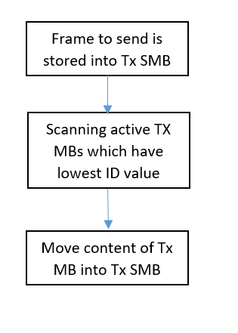
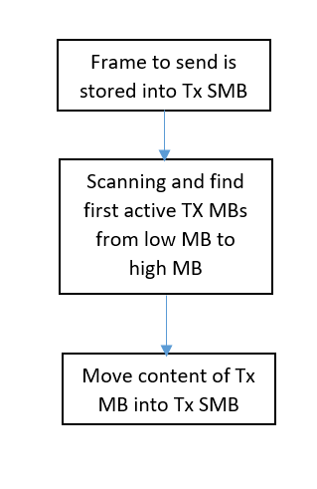
4. Software Implementation
4.2.4 Message transmission
Arbitration process
Highest-priority mailbox first
Lowest-number mailbox first

Slide 47
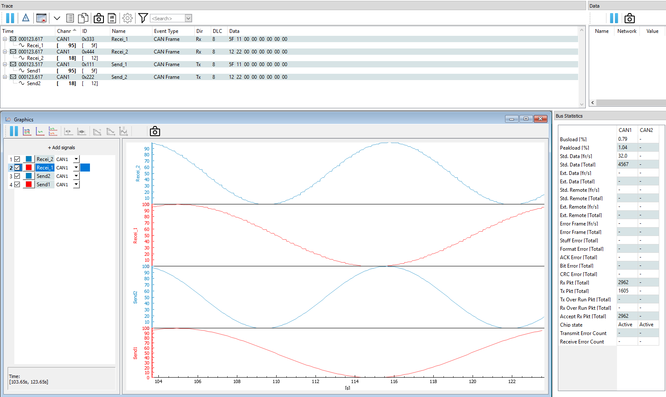
5. Result

Slide 48
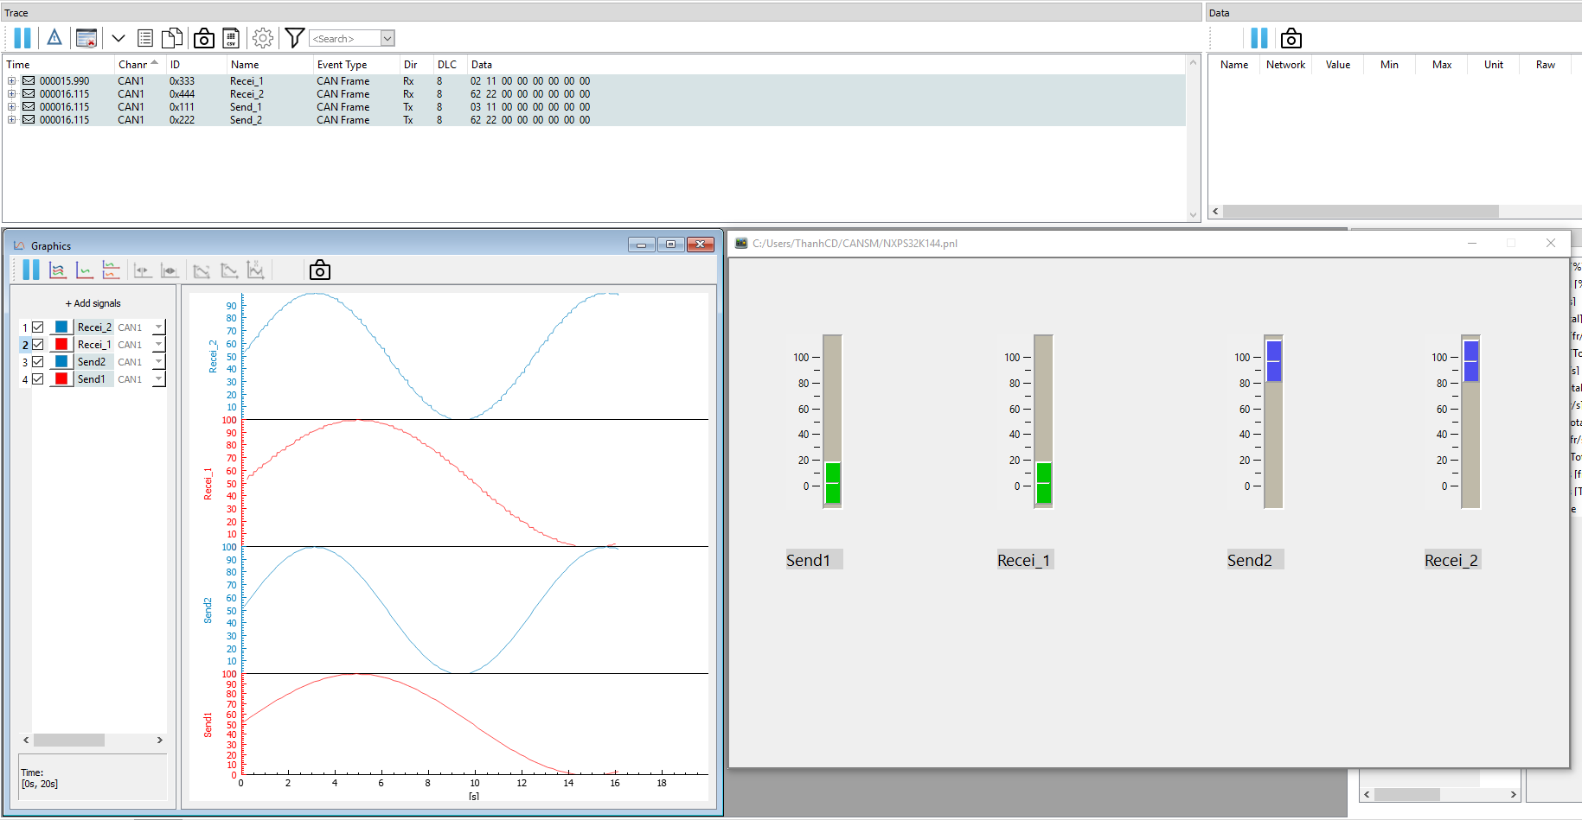
5. Result

Slide 49

Thank you
49

