Slide 1
SW Update Over The Air
Ford ECUs Architecture for OTA Solution
On Vehicle Telematics Protocol
OTA Supported Function IDs
OTA Function ID Flows
Vector solution for SW Update (FULL Update)

Slide 2
Architecture of OTA (Over-The-Air)
Cellular Network
TCU
OVTP Over CAN
Ford Cloud
ECG
(OVTP Client)
IPC
(OVTP Server)
SYNC4
Wifi
IPC communicates with ECG via OVTP
Over CAN ONLY regarding OTA

Slide 3
OVTP (On Vehicle Telematics Protocol) Message
OVTP is a message protocol which is defined by Ford and can be used to communicate between Ford ECU’s applications.
ECG
Client
IPC
IP: 10.2.0.2
OVTP message
OTA Manager
OTA
PARSE
OVTP Message
PARSE PUSH
OVTP Header
OVTP Payload
Protocol Version
Counter
Crypto type
SSN
Extract by OVTP Layer
OVTP Data which is corresponding to OTA Application
OVTP Message

Slide 4
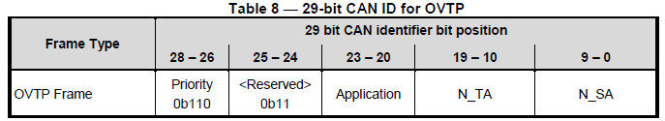
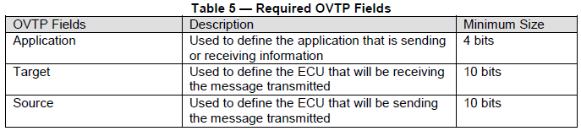
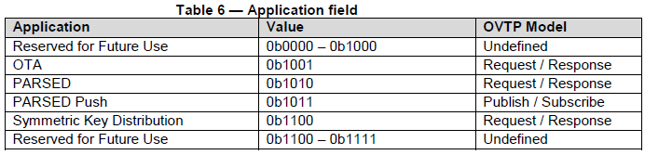
OVTP on Classical CAN or CAN FD
Data Link Layer: only 29-bit CAN IDs shall be utilized for OVTP messages on both Classical CAN and CAN FD.

Slide 5
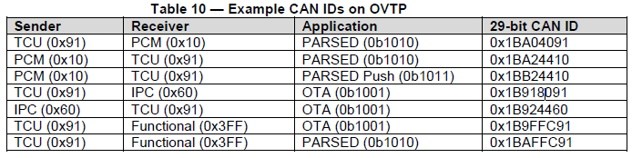
Binary: 0b110 11 1010 0000010000 0010010001
Hex: 0x1BA04091
 | Priority | <Reservaed> | Application | Target (PCM) | Source (TCU)
OVTP Frame | 0b110 | 0b11 | 0b1010 | 0b0000010000 | 0b0010010001
(Tx) 0x1B9180D8 06 41 0F FA 11 D0 29 CC --- Request to Read OTA Data(DID) By Identifier 0xD029
(Rx) 0x1B936060 21 06 00 CC CC CC CC CC --- Pos Resp to Read OTA Data(DID) By Identifier Function 0xD029

Slide 6
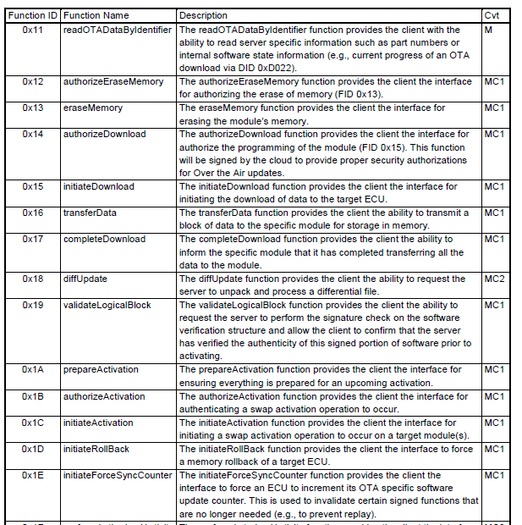
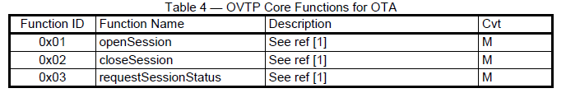
OTA Function Definition
Handle by OVTP Layer
Handle by OTA Application

Slide 7
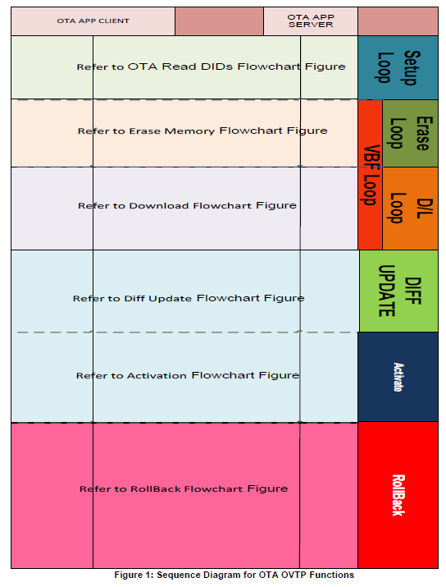
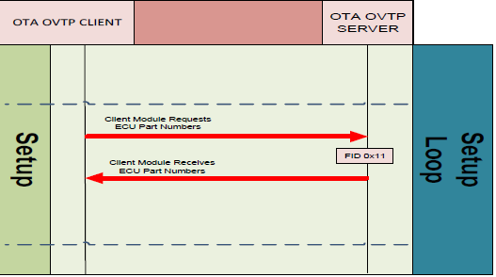
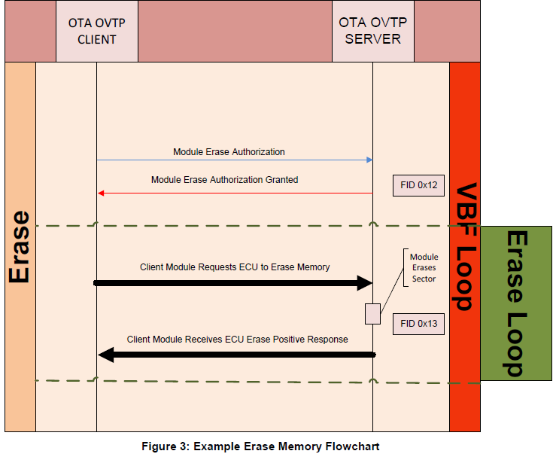
OTA Flows

Slide 8
Vector solution for OTA Stack
Ford App
RTE
Module | Description
CddOvtp | OVTP layer. Session management (open/close/checkstatus) Redirect FIDs/Data to Cddosoh
CddOsoh | OTA Handler OTA FIDs handler Precondition checking for each FID
vSwUpdM | SwUpd Manager Manage SW Update
vMemAccM vMem | Memory Access Manager - Virtual/Physical memory mapping
QSPI | Provide APIs to write to external flash
NvM
DEM
CSM
EcuM
Get active partition
(image)
OS
CddOsph
CddOsOh
DET
CddOvtp
vSwUpdM
PduR
vMemAccM
Get active partition
(image)
CanTp
vMem
PF QSPI Drv
QSPI Ctrl
CanIf
Set active SFMA = addr mode
Set inactive SFMA = OTA mode
Can

Slide 9
IPC Memory Layout (App + GFX)
External ROM (physical address)
RH850 D1M1A Internal ROM
10000000
Chip A
C0000000
Chip B
GFX
00000000
FBL
00017FFF
OTA
ECG -> IPC
00022800
Application
(BSW, Core Apps, HMI control logic)
CFBFFFFF
003FFFFF
APPL | 0x80020000
GFX | 0x90000000
CFC00000
App
Others
(RAM, KAM, Altia Heap, …)
App.vbf
gfx.vbf
Add signature,
Roothash, change to virtual address
CFFDFFFF
Code Flash
Code Flash input
App.hex
gfx.hex
P702_GAS_2.S19
External Flash
Change to address
of external ROM
APPL | 0x1FC00000
GFX | 0x10000000
FBL
App
GFX
EFlashLoad
IPC code

Slide 10
VBF Format
VBF Header Type: text |  | header { [description = { "text string row 1" , } ; ] sw_part_number = "XXXXX_XXX_XX"; sw_part_type = EXE; [data_format_identifier = 0x00;] frame_format = CAN_STANDARD; ecu_address = 0x720; [erase = { { 0x10000000, 0x10000000} };] [verification_structure_address = { 0x20000000 };] [sw_signature = { “signature 1”; ] [public_key_hash = “hash”;] file_checksum = checksum; }
Data Type: binary | Data Segment 1 | VBF_Header cont. |  | DS1_StartAddr =(TBD) 0x1000 0000 |  | DS1_Size =(TBD) 0x1000 0000
 |  | DS1_Data size=DS1_Size Content: Graphics
 |  |  |  |  |  |  |  | DS1_CS
 | VS subsection | VS_StartAddr =0x803F FE84 | VS_Size =4+40*DS_count
 |  | VS_Signature size=0x1 00
 |  |  |  |  | VS_version=0x00 00 | DS_count=0x00 01 | DS1_StartAddr
 |  | DS1_Size
 |  | DS1_Hash size=0x20
 |  |  | VS_CS
Use to validate SW after OTA finish
Use for Erasing phase (Authorize, Erasing). Note: Virtual Address
Use for prepareActivation (calculate SWASH)
Use for validateLogicalBlock
Data
Signature
RootHash

