Slide 1
Dhanushkumar V
Synthetic eye generation

Slide 2
Agenda
Problem statement
Proposed solution
End users
Algorithm and Deployment
Key features
Results and evaluation
conclusions

Slide 3
PROJECT STATEMENT
The project aims to develop a Generative Adversarial Network (GAN) capable of generating realistic eyes with reference to the Kaggle dataset. The Kaggle dataset consists of 14838 grayscale images of eyes and the objective is to create a GAN that can produce synthetic images resembling these eyes..
3/21/2024 Annual Review

Slide 4
PROPOSED SOLUTION
GAN Architecture Design:
Design a GAN architecture consisting of a generator and a discriminator network using TensorFlow/Keras.
Generator:
Implement a neural network with multiple layers of fully connected (Dense) and activation layers (LEAKY RELU).
Experiment with variations in network depth, layer sizes, and normalization techniques (e.g., Batch Normalization).
Discriminator:
Design a neural network with similar architectural choices as the generator but with a binary classification output.
Utilize activation functions such as Leaky ReLU and Sigmoid to introduce non-linearity and produce probability scores.

Slide 5

WHO ARE THE END USERS?
Medical Professionals: Used for training and simulating eye conditions or surgeries.
Augmented Reality (AR) Developers: Employed to create realistic virtual characters with lifelike eye movements.
Entertainment Industry: Utilized for generating realistic characters in movies, games, and animations.
Educational Institutions: Used as educational tools for teaching eye anatomy and disorders.
Cosmetic Industry: Employed for testing makeup products' safety and efficacy.
Accessibility Technology Developers: Utilized in assistive technologies for individuals with visual impairments.
3/21/2024 Annual Review

Slide 6
Algorithm & Deployment
Algorithm:
I utilize Generative Adversarial Networks (GANs) as my framework for generating synthetic eyes.
My Generator Network is responsible for creating synthetic eye images from random noise vectors.
The Discriminator Network learns to distinguish between real and synthetic eye images.
Throughout training, I concurrently train both the generator and discriminator networks. My goal is to generate realistic images to deceive the discriminator.
I apply binary cross-entropy loss functions to train the discriminator and generator networks effectively.
Optimization of network parameters is achieved through techniques such as stochastic gradient descent (SGD) or Adam optimizer.
Deployment:
Upon completion of training, I save my trained generator network as a model.
For deployment, I opt for renowned deep learning frameworks like TensorFlow or PyTorch.
I construct an inference pipeline to process input noise vectors and generate synthetic eye images using the trained generator model.
Integration of the inference pipeline into the target application or system is vital.
I ensure that the deployment setup can handle the computational demands, particularly when generating synthetic eyes in real-time or large batches.

Slide 7
THE WOW IN YOUR SOLUTION
Hyperparameter Sensitivity: My performance is highly sensitive to hyperparameters such as learning rates, batch sizes, and network architectures. Fine-tuning these hyperparameters to achieve optimal training stability and image quality consumes a significant amount of time and requires extensive experimentation.
Data Quality and Quantity: The quality and quantity of available eye image data significantly impact my performance. Limited or biased training data often leads to the generation of unrealistic or biased synthetic eyes. Acquiring labeled eye image datasets with diverse characteristics is challenging and requires significant resources and expertise.
Platform limitation: The colab only provides a maximum of 15gb ram which cant handle the training phase of my code until the end sometimes. It works if reduced the number of epochs as well generating the synthetic images in a long break for like about every 100 epochs.

Slide 8
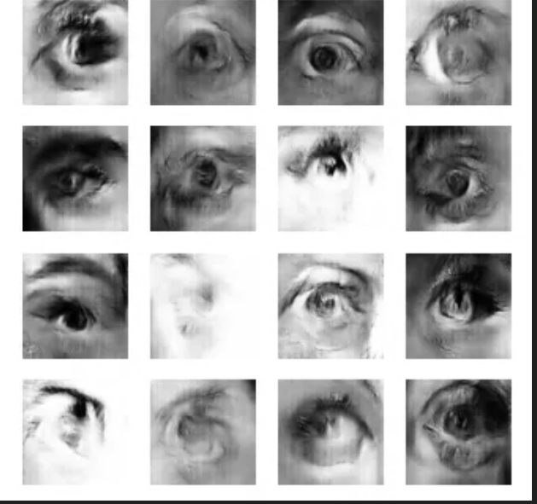
RESULTS
8

Slide 9
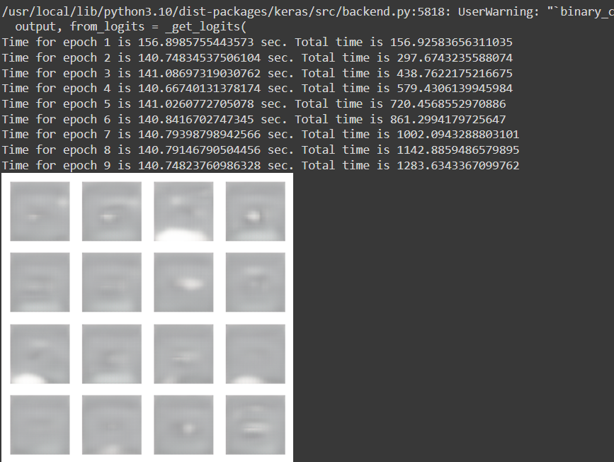

RESULTS
9

Slide 10
Conclusion
The project demonstrates the effectiveness of GANs in generating realistic eyes and provides insights into the challenges and opportunities in training and deploying generative models. Moving forward, further research and experimentation will continue to push the boundaries of generative modeling and its practical applications.
Reference
https://www.tensorflow.org/
https://keras.io/
https://numpy.org/
https://matplotlib.org/
https://www.kaggle.com/datasets/kayvanshah/eye-dataset

