Slide 1
Intro to Git and Github

Slide 2
Key take away
Start using Git/Github in whatever way is most convenient for you
Newbs: Try Github Desktop
Bad git practices are usually better than no git
Just don't post sensitive info to Github

Slide 3



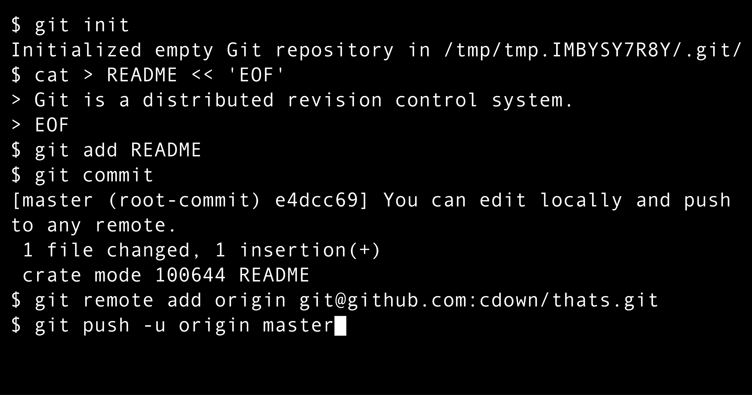
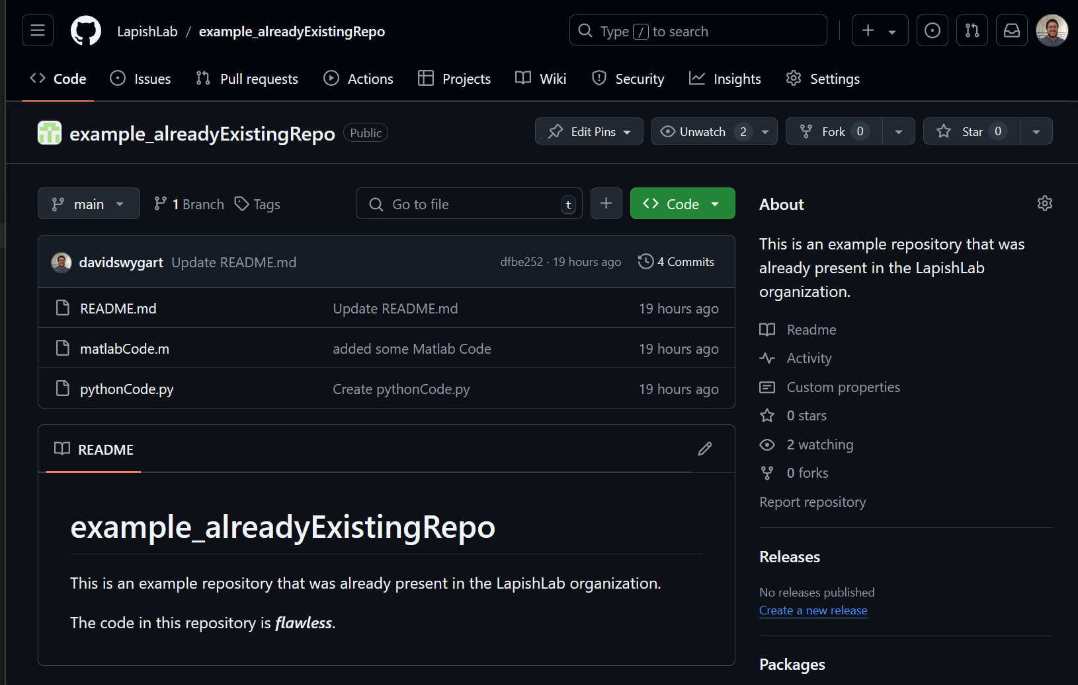
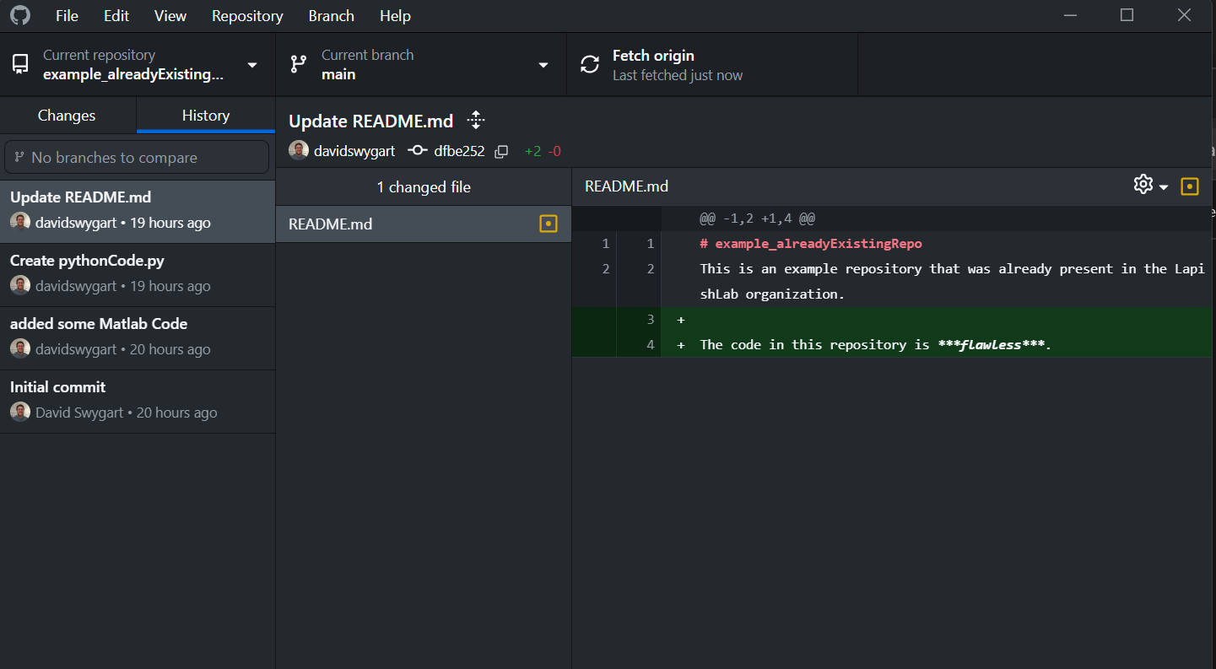


Disentangling the many distinct "git-related" tools
Track file changes
(version control system)
Cloud hosting for code
(git repositories)
Graphical user interface (GUI) for git
Notes:
git 2005
github – 2008 – bought by Microsoft 2018

Slide 4
Disentangling the many distinct "git-related" tools
94%
Track file changes
(version control system)
Alternatives
SVN
Mercurial
Cloud hosting for code
(git repositories)
Alternatives
GitLab
GitBucket
Generic cloud storage (OneDrive, Google Drive, an external hard drive, etc.)
Graphical user interface (GUI) for git
Alternatives
git-gui (comes with git)
GitKraken
IDE integration (Matlab, VS code, Atom, etc.)
Many more!
5%
1%
Notes:
git 2005
github – 2008 – bought by Microsoft 2018

Slide 5
Disentangling the many distinct "git-related" tools
Track file changes
(version control system)
Benefits
History of code changes
Multiple versions (branches) of code
Encouraces focusing on bite-sized changes (commits)
Cloud hosting for code
(git repositories)
Benefits
Backup files
Sharing code
Work across multiple devices
Collaborating with others
Create releases with DOI for publications
Graphical user interface (GUI) for git
Benefits
Buttons!!!
Nice visualization of code changes
Automagically handles Github credentials
Where did I put that repository and what was its name?
Harder to shoot yourself in the foot than git.
Notes:
git 2005
github – 2008 – bought by Microsoft 2018

Slide 6
How do I start!
Install Github Desktop and/or Git
Linux port of Github Desktop
Make a free account on Github.com
Get a git repository

Slide 7
Get a git repository
Create one (git init)
Copy one (git clone)
Lapish lab organization on Github

Slide 8
Typical workflow (command line)
Look at Git Cheat Sheet
git pull
edit code
git status
git diff
git add
git commit –m "description of commit"
git push

Slide 9
Typical workflow (Github Desktop)

Slide 10
Git terms/concepts
Repository: Folder with files + .git folder
Stage: Add file changes to next commit
Commit: Snapshot of code
Remote: external repository (usually Github.com)
Branch: Alternative chain of commits
.gitignore file: Specify files that git should ignore

Slide 11
Repository: Folder with files + .git folder
What kind of files can git track? Any!! **
Can only see human readable changes to text files
Can't upload files >100 MB to Github*
GitHub Large file system allows <2 GB files
Every repository is independent and created equal (decentralized)
Github.com is just another repository.

Slide 12

Branch: Alternative chain of commits
Every branch is independent and created equal*
Default branch is usually named "main" or "master"

