Slide 1
2026 한국정보기술학회 하계 종합학술대회
Kyonggi University · Dept. of AI Computer Engineering
Team. 메디스코프
Deep Learning-Based Chest X-ray
Reading Assistance System
An Explainable Medical Imaging AI Using Grad-CAM
Team Leader: Yongmin Park*, Jiwon Park* · Hosung Song* · Yongjun Lee* · Yoonjin Ha* · Seyeon Son**
Prof. Hyunki Lim***
*경기대학교 AI컴퓨터공학부 **경기대학교 소프트웨어경영학부 ***경기대학교 AI컴퓨터공학부 교수 (교신저자: hlim20@kyonggi.ac.kr)
※ 본 연구는 과학기술정보통신부 및 정보통신기획평가원의 SW중심대학사업의 연구결과로 수행되었음 (2021-0-01393).

Slide 2
Research Background
Chest X-ray reading faces high workload, perceptual errors, and demand for AI-assisted support
1
Clinical Challenge
2
Operational Burden
- Chest X-ray is widely used as a first-line imaging exam - 2D projection causes anatomical overlap - Small or subtle lesions can be missed - Perceptual error is a major cause of missed findings [Gefter et al., 2023]
- High imaging volume increases radiologists’ workload - AI-based normal CXR screening can reduce reading burden [Schalekamp et al., 2024] - AI support may shorten radiologists’ reading time [Shin et al., 2023] - Therefore, AI-assisted reading support is clinically meaningful

Slide 3
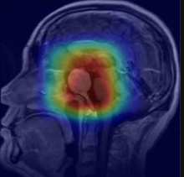
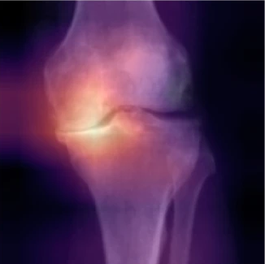
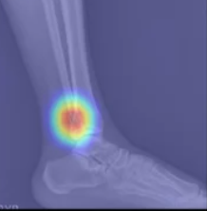
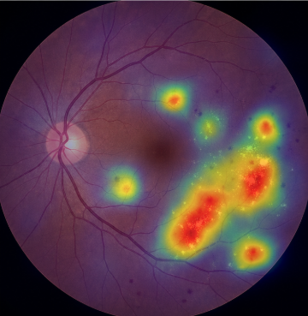
Related Research
CNN and Grad-CAM have been applied to diverse medical imaging tasks, including brain MRI, knee X-ray, ankle MRI, and retinal fundus imaging.
1
Brain MRI
2
Knee X-ray
3
Ankle MRI
4
Retinal Fundus
Brain Tumor
Classification
Knee Osteoarthritis Grading
Ligament Injury
Detection
Disease
Classification

Slide 4
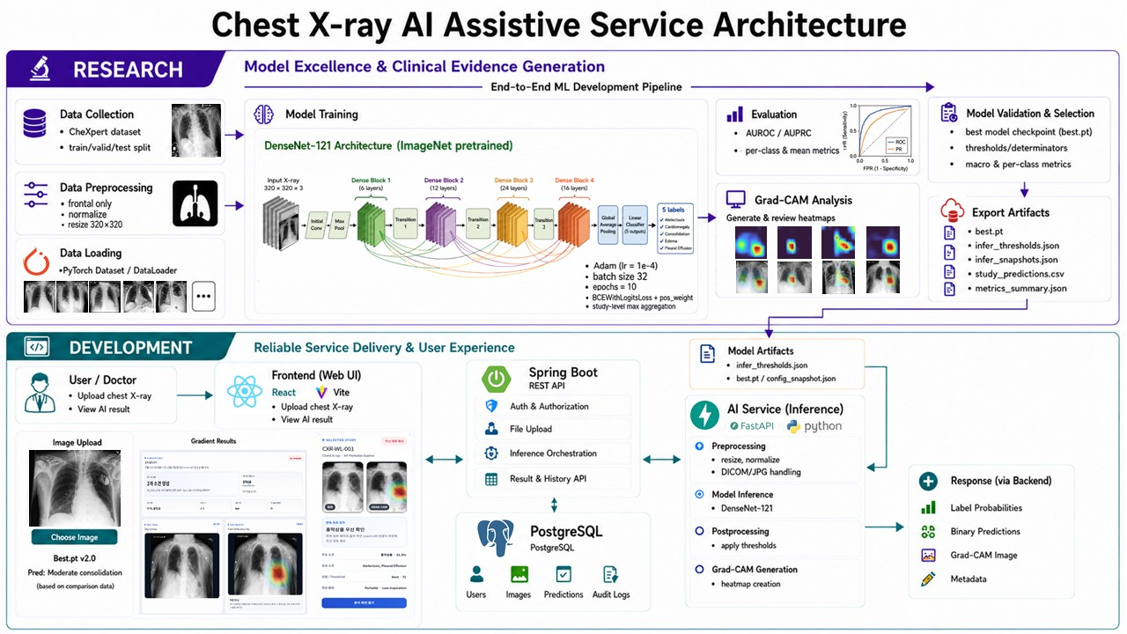
Research-to-Service Architecture

Slide 5
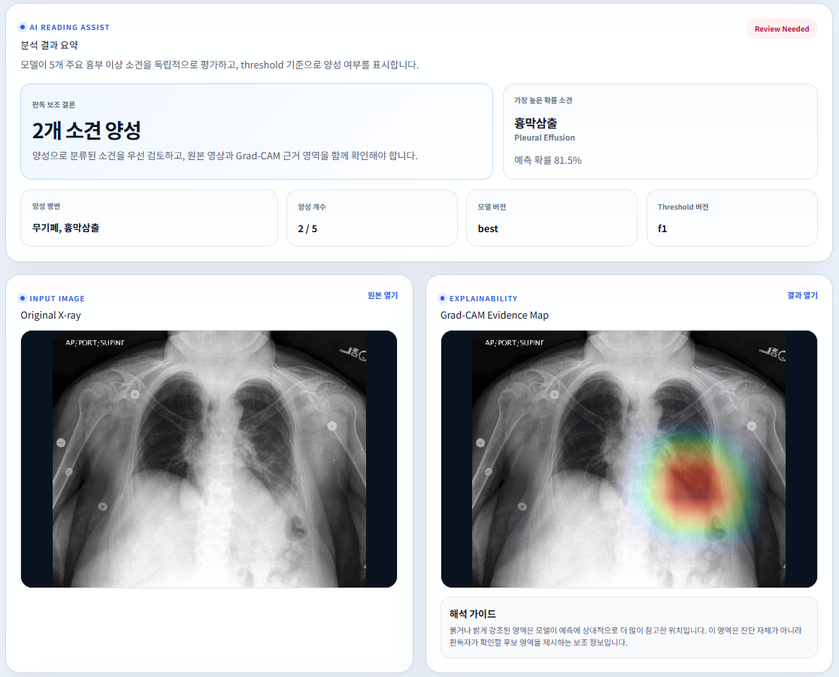
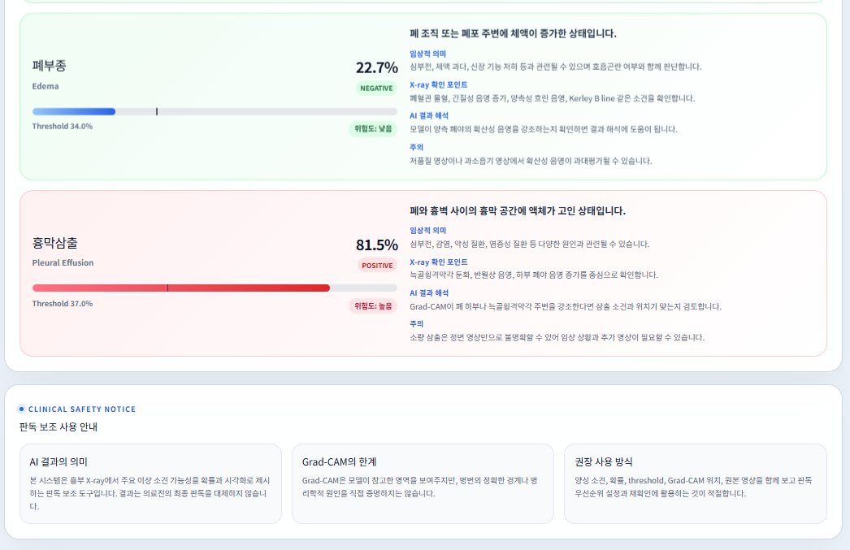
Proposed Method / Implementation
Implemented Web Prototype
Service Flow and Responsibility Separation
The backend remains the single API entry point, while the AI service focuses on model inference and artifact generation.
1
Frontend
Upload X-ray image, preview the input, and render prediction results.
React / Vite
2
Backend
Create analysis requests, manage status/result APIs, and call /predict.
Spring Boot
3
AI Service
Load checkpoint and thresholds, run 5-label inference, and generate Grad-CAM.
FastAPI + DenseNet121
4
Output
Return probabilities, threshold-based binary decisions, and visual evidence.
Clinical support view
Key point: class-specific thresholds convert probabilities into final binary findings, and Grad-CAM is used as supporting visual evidence.

Slide 6

Model Evaluation Metrics & Threshold Selection
▮
Uncertain Label Policy Comparison
⊕
F1-Based Threshold Tuning
Uncertainty Label Handling | Valid AUROC | Valid AUPRC | Test AUROC | Test AUPRC
U-Ignore | 0.8817 | 0.7387 | 0.8927 | 0.6494
U-Ones | 0.8778 | 0.7216 | 0.8715 | 0.6116
U-Zeros | 0.8837 | 0.7302 | 0.8903 | 0.6597
Atelectasis
0.46
Cardiomegaly
0.11
Consolidation
0.47
Edema
0.34
Pleural Effusion
0.37
★
• Representative model: U-Ignore
Class-specific thresholds were tuned on the validation set to maximize per-class F1-score.
• Highest Test AUROC; avoids forcing uncertain labels
✓
U-Ignore: representative policy (mean Test AUROC 0.8927) Class-specific thresholds → final binary decisions
Pleural Effusion & Cardiomegaly showed strong per-class performance.

Slide 7
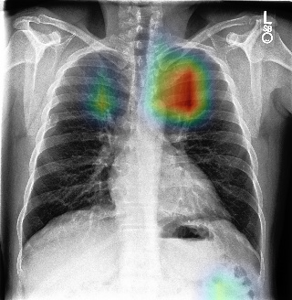
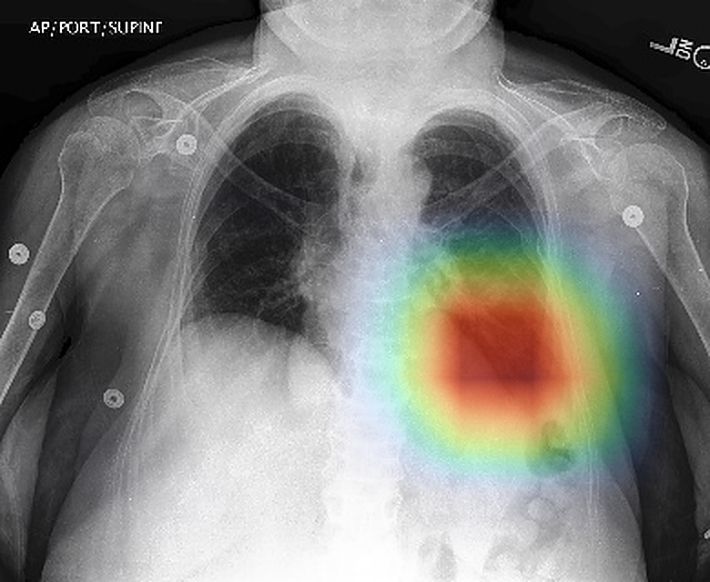
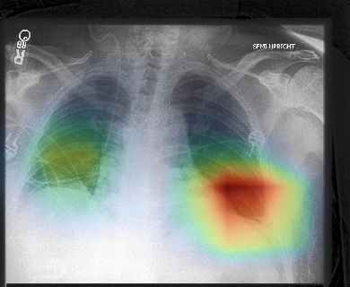
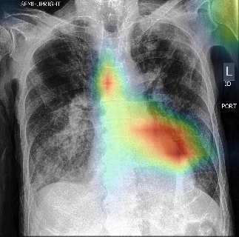
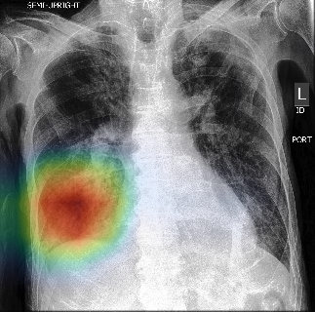
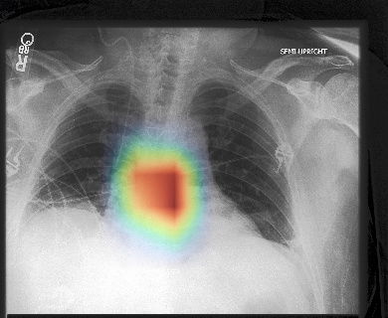
Model Inference & Grad-CAM Visualization
Pleural Effusion
Negative
Atelectasis
No positive finding
Collapsed lung region
Lower lung zone opacity
Grad-CAM spatial validation — representative examples of model attention over clinically relevant regions
Cardiomegaly
Edema
Consolidation
Cardiac silhouette border
Diffuse lower-lung opacity
Localized airspace opacity
✓ Representative examples suggest that Grad-CAM often aligns with plausible lesion regions.
However, it is provided only as supporting evidence and does not replace clinical interpretation.

Slide 8
Conclusions / Future Works
Conclusions
- Implemented a web-based chest X-ray reading assistance system - Trained DenseNet121 on CheXpert-small for 5 major findings - Provided prediction probabilities, threshold-based decisions, and Grad-CAM overlays - Integrated React, Spring Boot, and FastAPI into an end-to-end prototype
Future Works
1
External Validation
2
Expand Pathologies
- Build a Korean chest X-ray external test set - Evaluate generalizability in domestic clinical environments - Validate AUROC, AUPRC, threshold stability, and Grad-CAM results
- Extend beyond the current 5 CheXpert labels - Add clinically relevant findings such as pneumothorax or lung opacity - Improve coverage for practical reading assistance

