Slide 1
Database
Backend

Slide 2
Overview
We are using a SQL model for our database
Our DBMS: Microsoft SQL
Relational DB

Slide 3
Data Validation
Appropriate error-free Field and Table names
Correct links (primary and foreign keys)
Sample Data
Working Queries

Slide 4
Field and Table Names
Easy to understand names
Correct and data optimized data types
Using ints instead of varchars to save DB space (display relevant corresponding information through logic)
Most Tables match pre-existing Excel sheets (relevant frequently used info)
Use queries for pages that require multiple tables

Slide 5
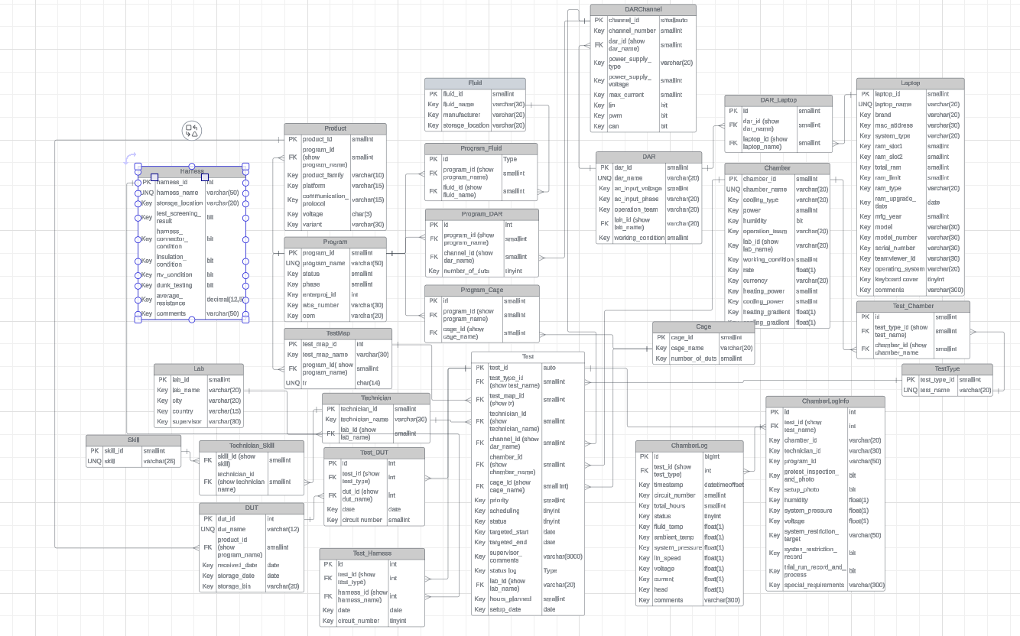

Slide 6
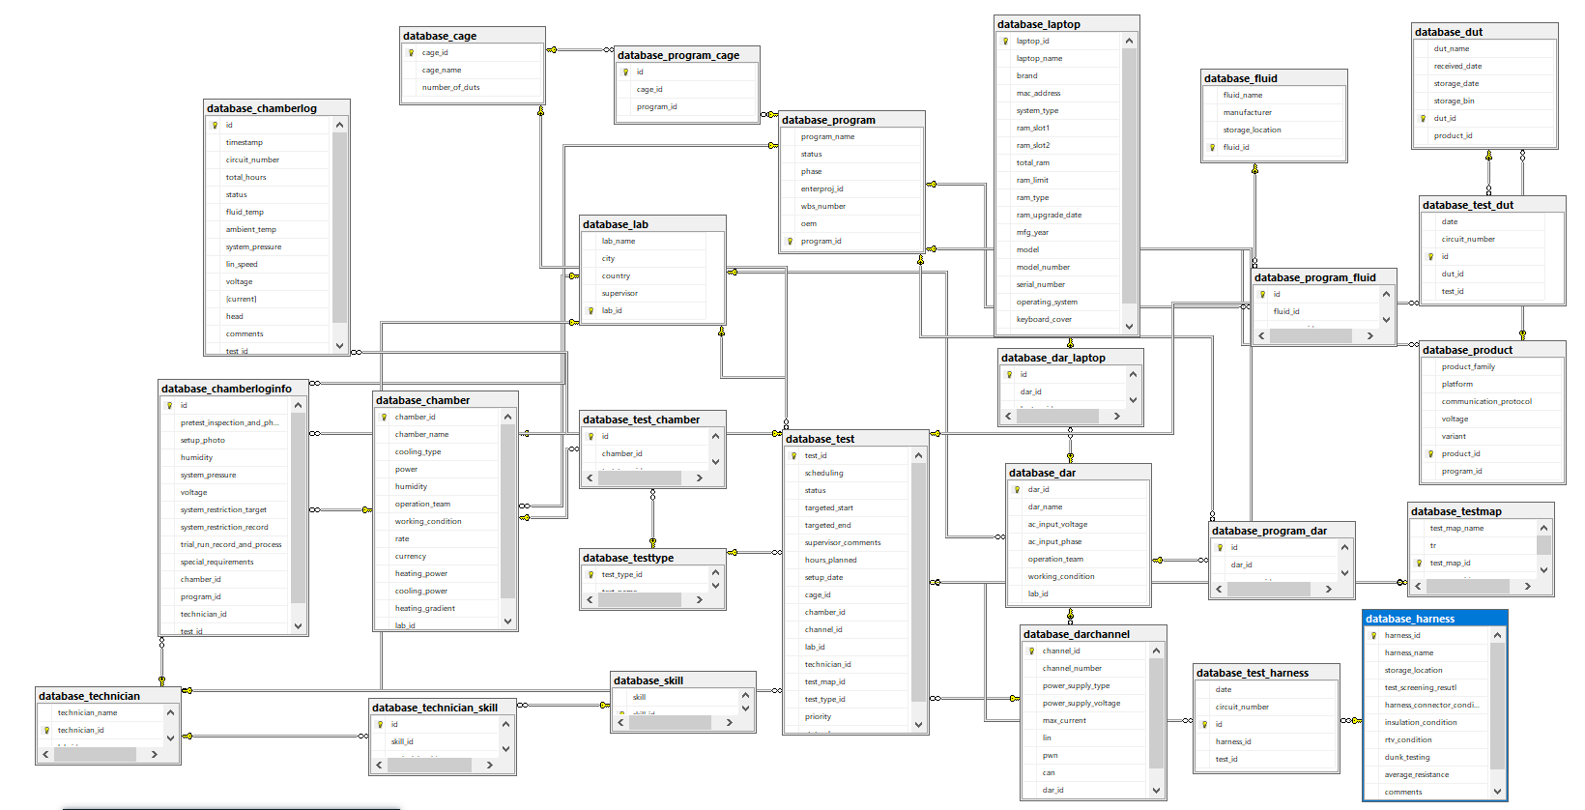

Slide 7
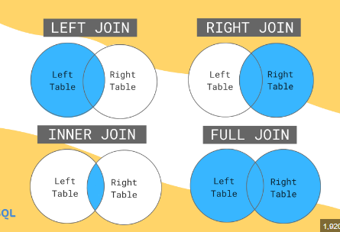
Links
Most links have the same names
Validating through Joins
Joins are used to combine rows from two or more tables, based on a related column between them (foreign keys).
Left/Right/Inner Joins

Slide 8
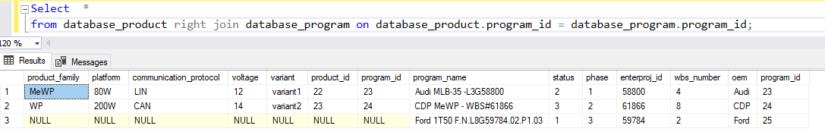
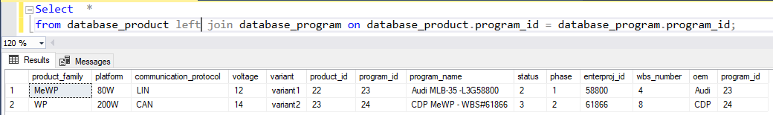
Validating Links through joins
Shows programs and their products (includes programs without any programs)
Shows programs and their products (includes products with no programs but that is
Not possible in our case as every product must be assigned to a program)

Slide 9
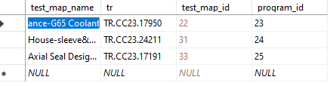
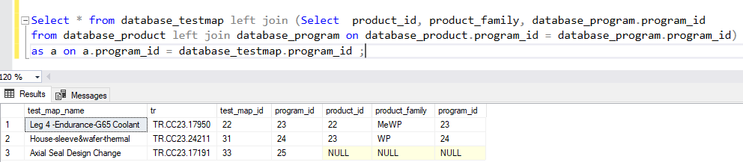
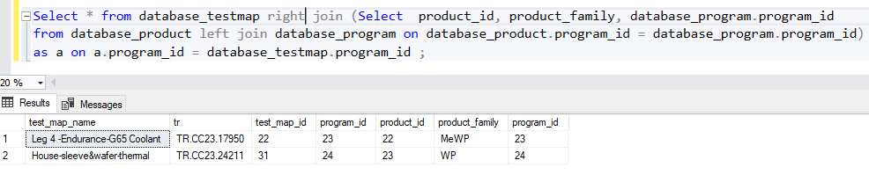
Nested join
Test Maps for products under a program
(includes test maps for all programs even
ones without products)
Test Maps for products under a program
(only for test maps of programs that have
Products assigned to them)

Slide 10
Additionally
Added sample data to all tables for checks (most of which corresponds to actual excel file inputs)
Can perform further queries if required
All checks complete
Data Validated

