Slide 1
Database
Backend

Slide 2
Overview
We are using a SQL model for our database
Our DBMS: Microsoft SQL
Relational DB

Slide 3
Data Validation
Appropriate error-free Field and Table names
Correct links (primary and foreign keys)
Sample Data
Working Queries

Slide 4
Field and Table Names
Easy to understand names
Correct and data optimized data types
Using ints instead of varchars to save DB space (display relevant corresponding information through logic)
Most Tables match pre-existing Excel sheets (relevant frequently used info)
Use queries for pages that require multiple tables

Slide 5
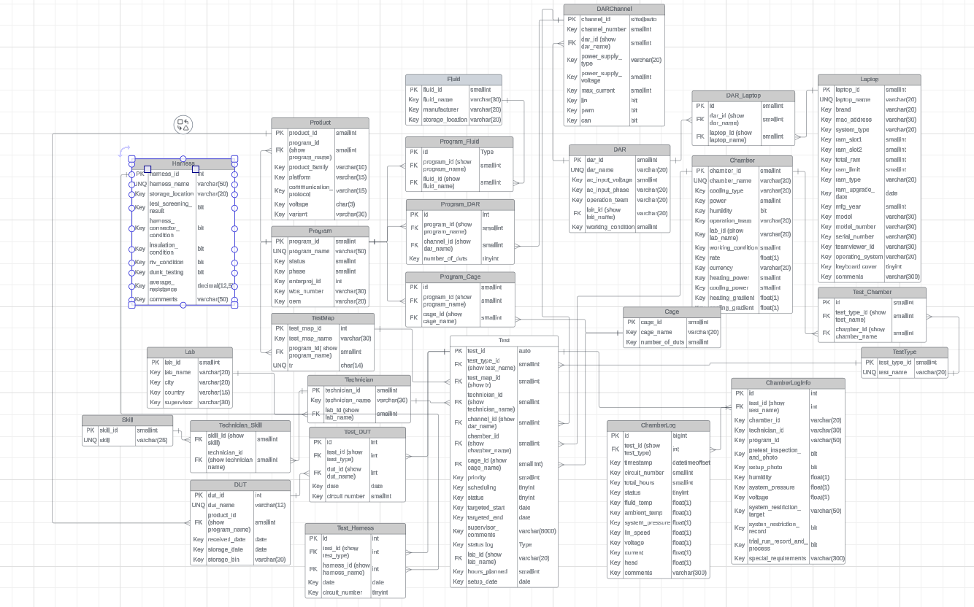

Slide 6
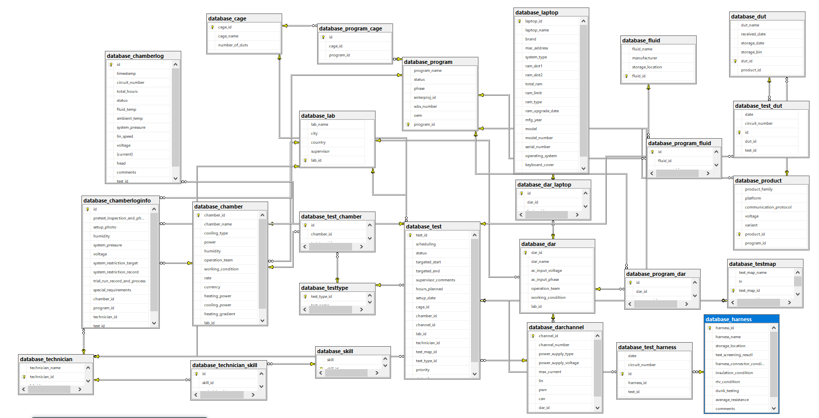

Slide 7
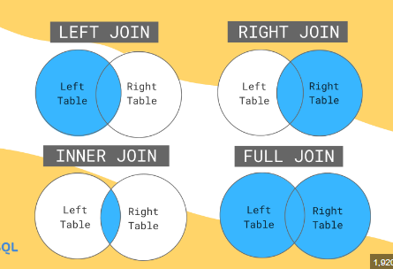
Links
Most links have the same names
Validating through Joins
Joins are used to combine rows from two or more tables, based on a related column between them (foreign keys).
Left/Right/Inner Joins

Slide 8
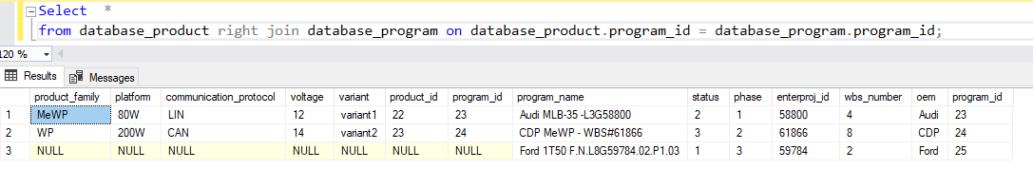
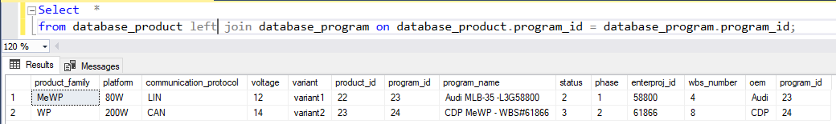
Validating Links through joins
Shows programs and their products (includes programs without any programs)
Shows programs and their products (includes products with no programs but that is
Not possible in our case as every product must be assigned to a program)

Slide 9
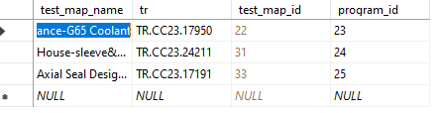
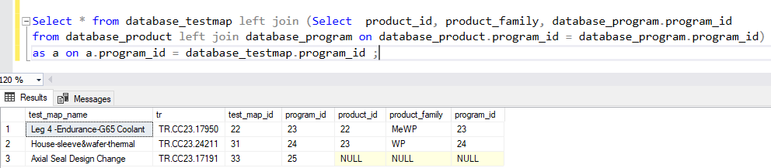
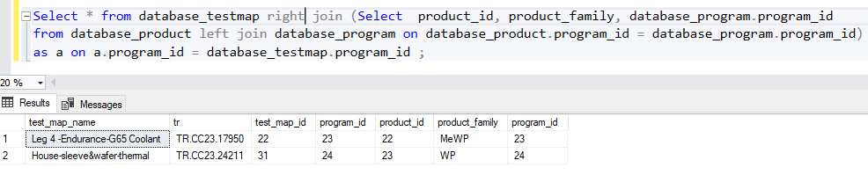
Nested join
Test Maps for products under a program
(includes test maps for all programs even
ones without products)
Test Maps for products under a program
(only for test maps of programs that have
Products assigned to them)

Slide 10
Additionally
Added sample data to all tables for checks (most of which corresponds to actual excel file inputs)
Can perform further queries if required
All checks complete
Data Validated

Slide 11
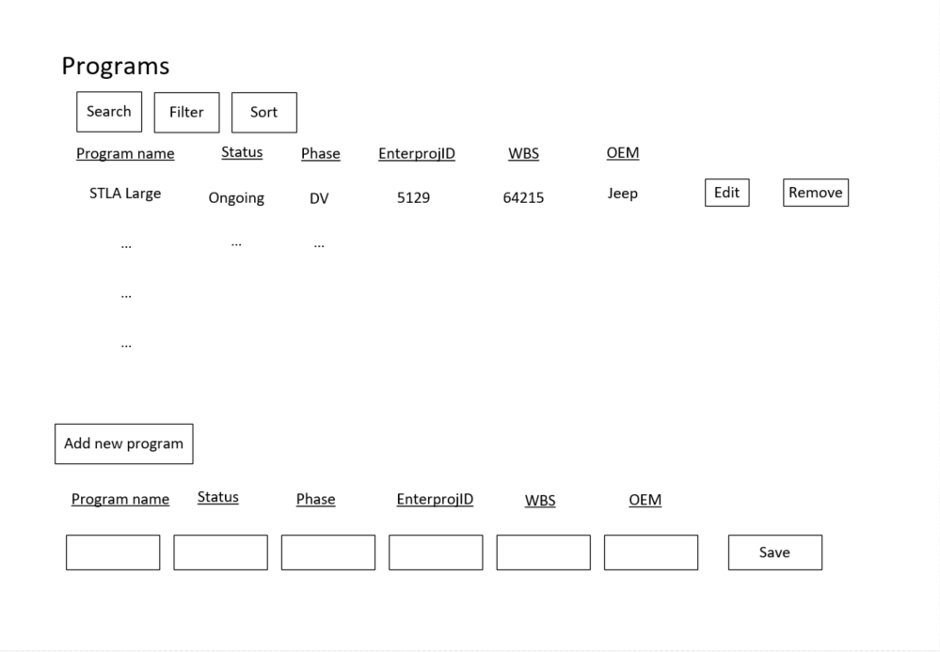
Web pages we will implement
Type 1 – Display all information of a table. Allow users to add, edit, remove data from table.
We will have one for each table except for Test, Chamber Logs, Chamber Log Info tables.

Slide 12
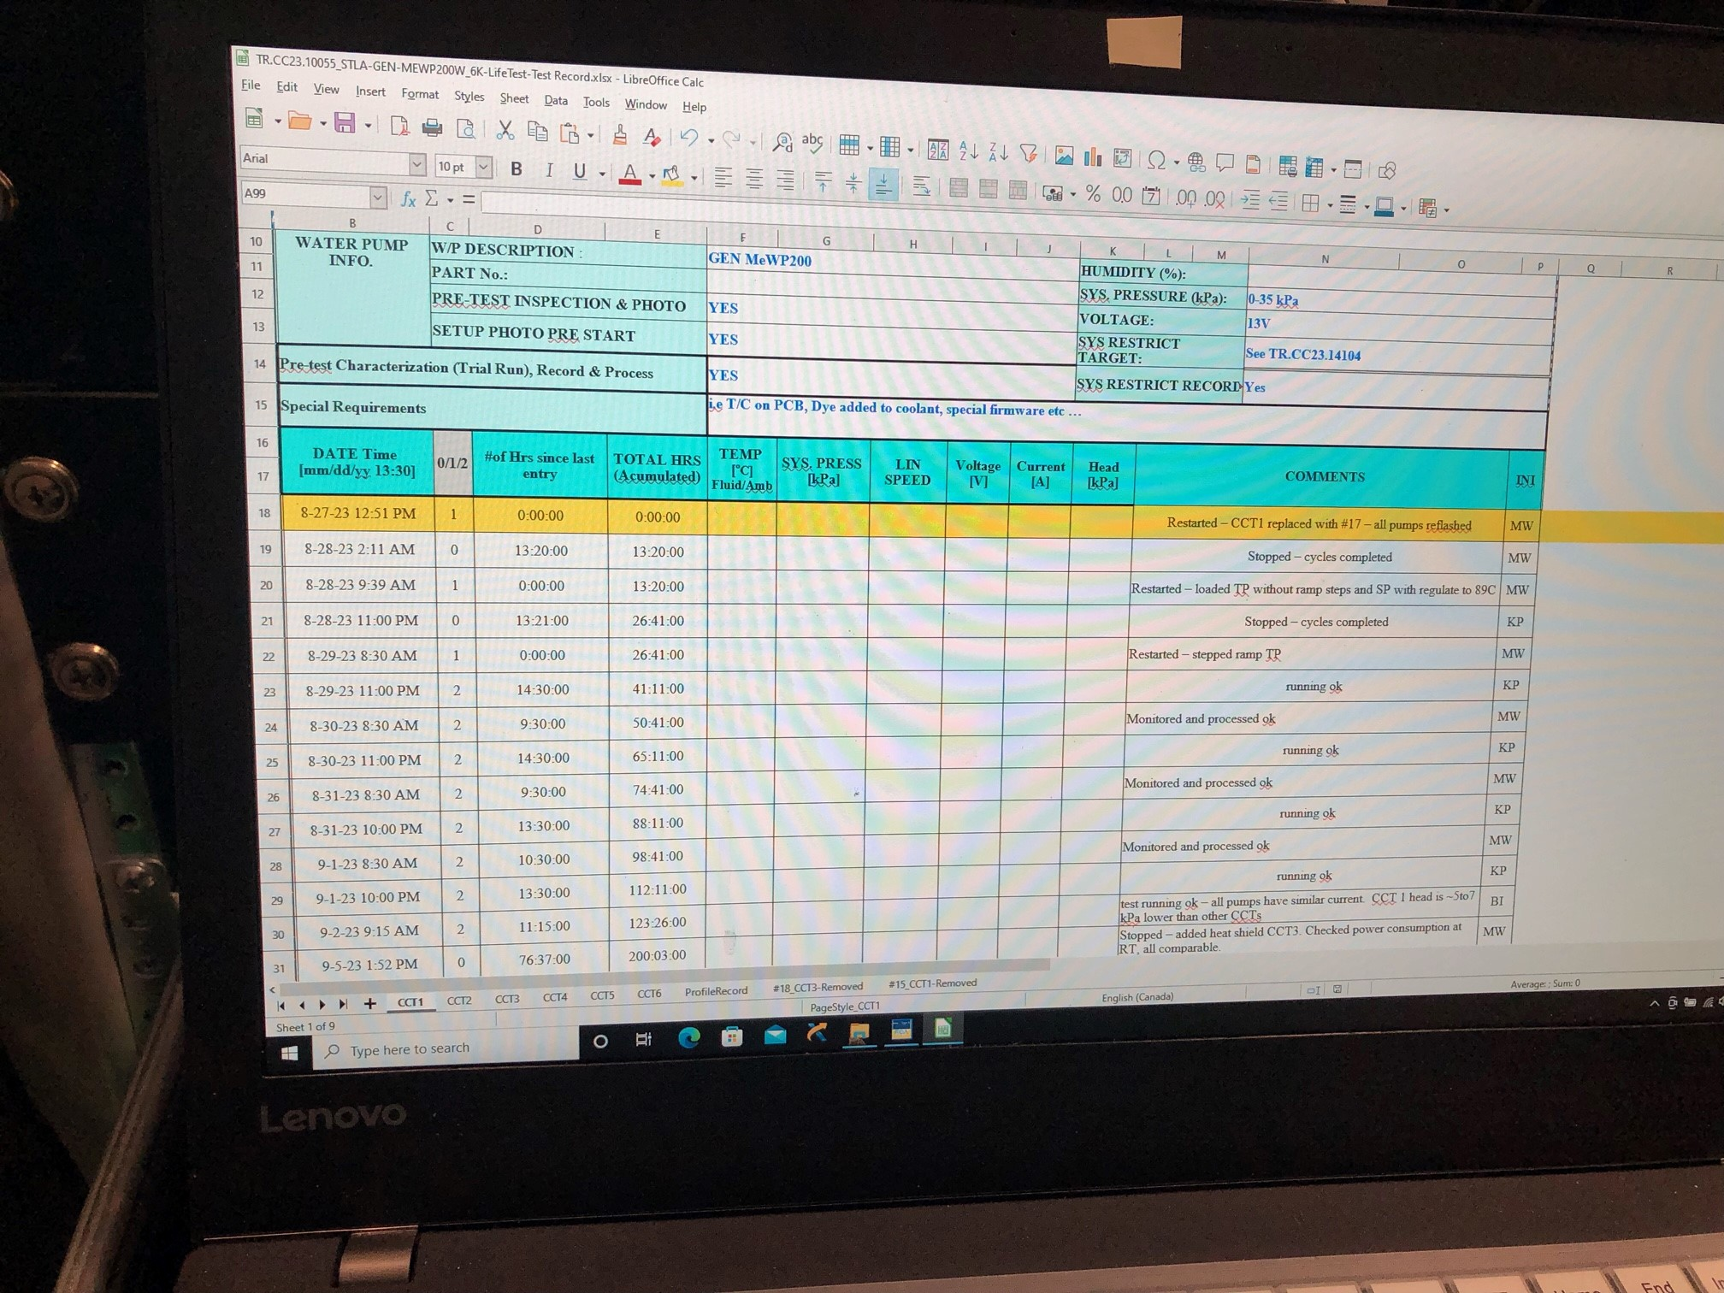
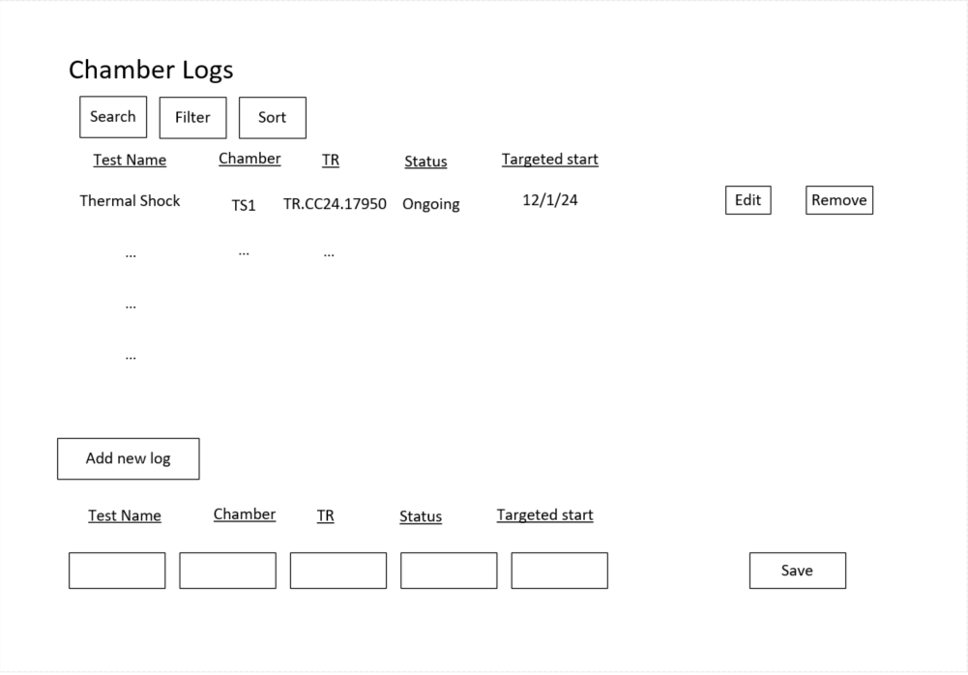
Web pages we will implement
Type 2 – Covers Chamber Logs, Chamber Log Info tables. Chamber Logs web page links to a page that’s identical to our current log file.

Slide 13
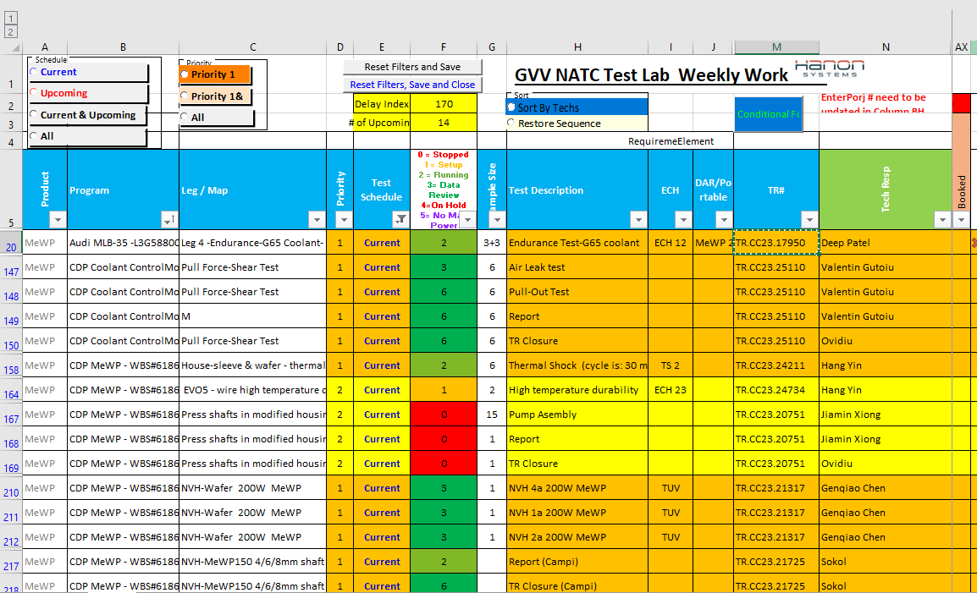
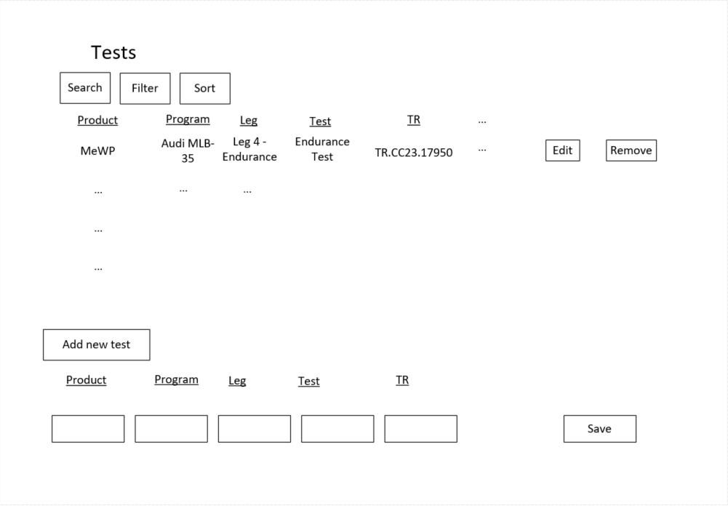
Web pages we will implement
Type 3 – Test web page.
We will add data from other tables to make the web page identical to our equipment status file.

Slide 14
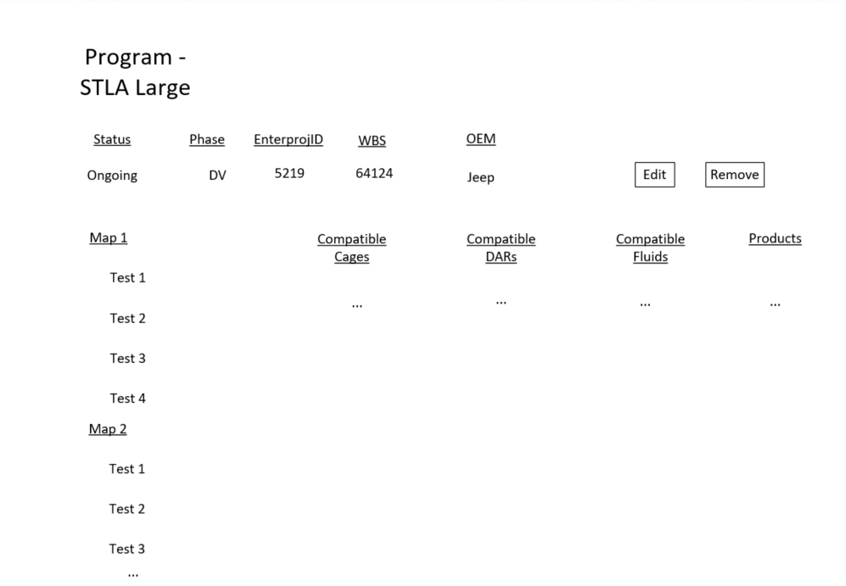
Web pages we will implement
Type 4 – Additional page for programs web page for user friendliness.
This shows a program’s details in its separate page, its tests, maps, compatible equipment.

Slide 15
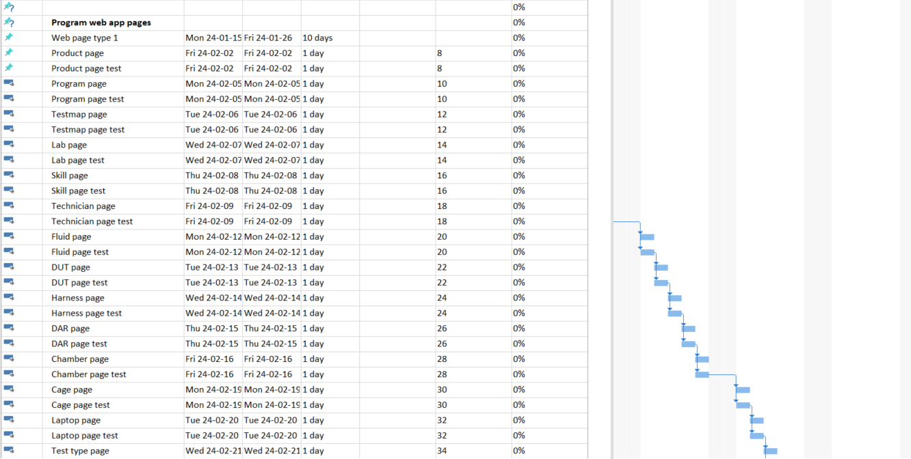
Project timeline estimate
Our method of operation, and estimation:
Will program a web page type, link them to their intended tables, then move onto the next type.
Each type we estimate takes 2 weeks to develop.
Each table link (web page for that table taken from the template) takes a day.
Then, we will create a menu, add user roles, logins, present to the team, do a trial run, publish the web app.
Current estimation is we will have the package ready for trial run by mid-April.

