Slide 1
Grover search for 1101 marked state
Members:
Yugandhara Sherkar
Gaurav Mohol
Ayush Agrawal
Sharad Pratap

Slide 2
Searching the marked Quantum State ∣1101⟩
Given a 4-qubit search space containing 2^4=16 possible quantum basis states.
The objective is to search the marked state ∣1101⟩ using Grover's quantum search algorithm.
Classical search requires checking elements one by one.
Average classical complexity: O(N)
Grover's algorithm performs search in O(N) oracle queries.

Slide 3
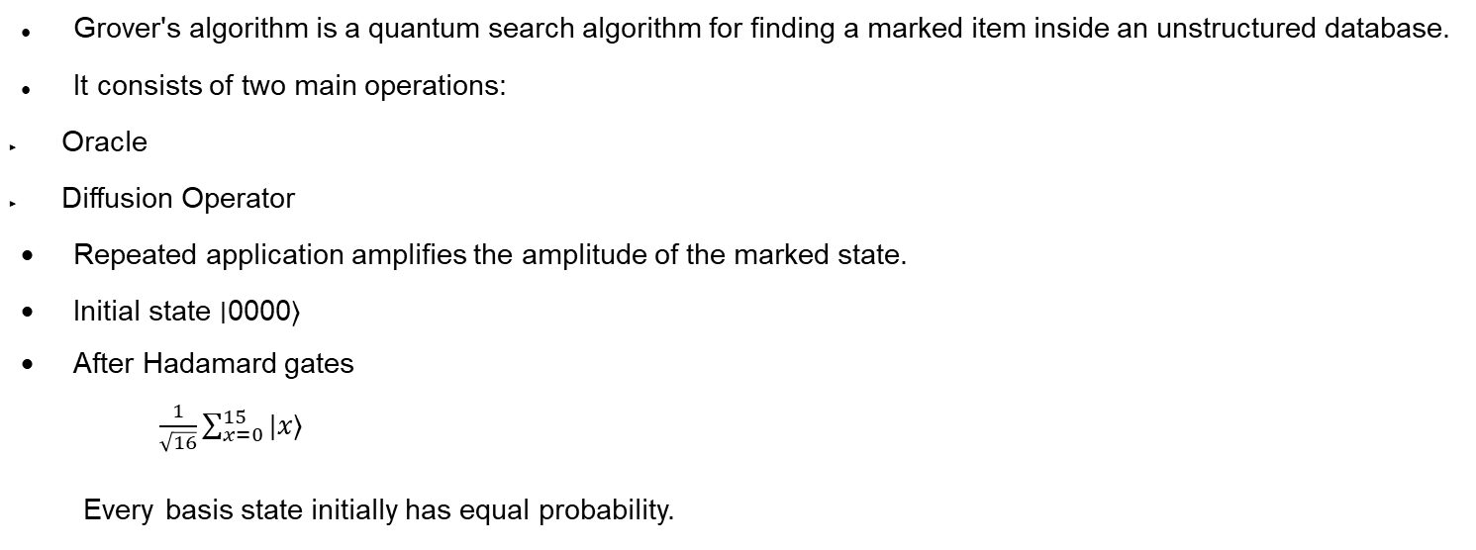
Grover's Algorithm?
Grover's algorithm is a quantum search algorithm for finding a marked item inside an unstructured database.
It consists of two main operations:
Oracle
Diffusion Operator
Repeated application amplifies the amplitude of the marked state.
Initial state ∣0000⟩
After Hadamard gates $\frac{1}{\sqrt{16}}\sum_{x=0}^{15}{|x⟩}$
Every basis state initially has equal probability.

Slide 4
Algorithm Steps
Initialize
Apply Hadamard Gates
Uniform Superposition
Oracle
Marks ∣1101⟩ by by phase inversion ∣1101⟩→−∣1101⟩
Diffusion
Reflects amplitudes around the average amplitude.
This increases the amplitude of the marked state.
Repeat k times
Measurement

Slide 5
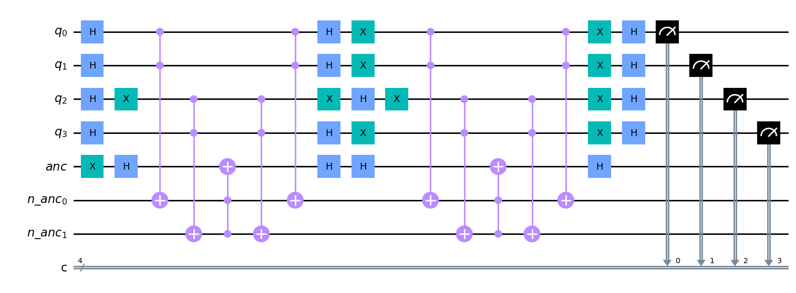
Circuit Implementation

Slide 6
Circuit Implementation Next
4 search qubits
1 ancilla qubit
Auxiliary ancilla qubits for multi-controlled operations
Oracle circuit
Diffusion operator
Measurement circuit

Slide 7
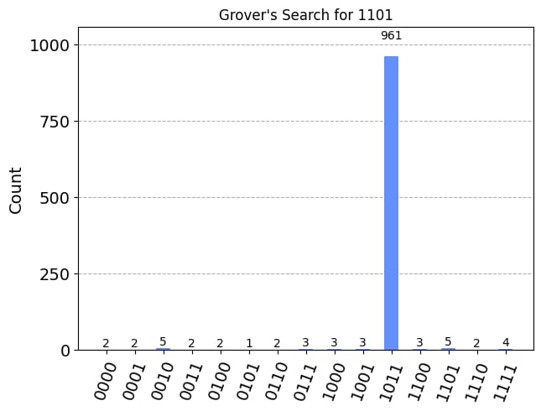
Measurement Outcome at optimal 3 iterations

Slide 8
Simulator Collected
Probability of the marked state
Marked-state amplitude
Average amplitude of the search register
Real component
Imaginary component

Slide 9
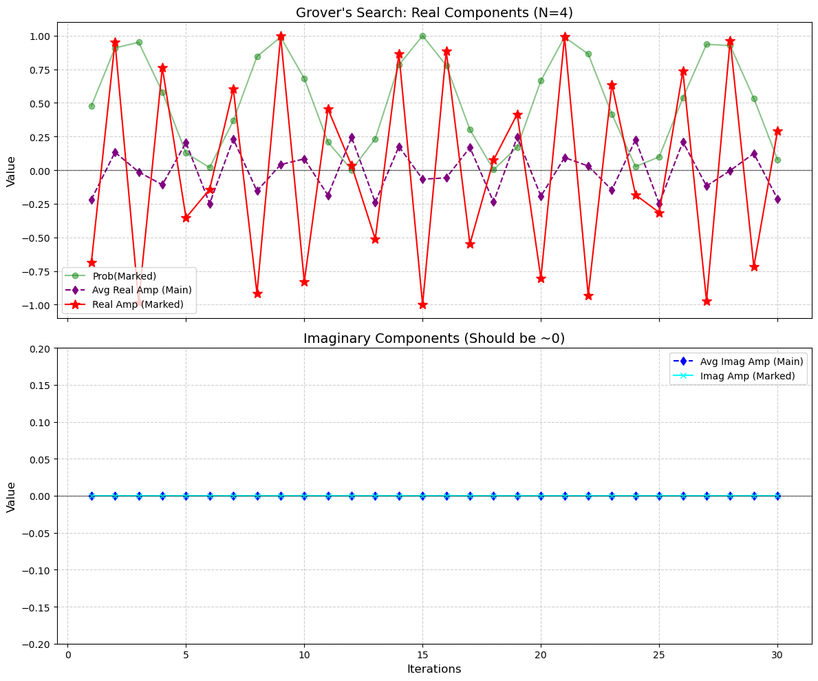
Simulator Results at various iterations
Probability and Amplitudes(Real and Imaginary Components)

Slide 10
Probability, Real Amplitudes and Imaginary Components
The green curve represents the probability of measuring the marked state (|1101>).
The red curve represents the real amplitude of the marked state.
The purple curve represents the average real amplitude of the search register.
The probability of the marked state increases rapidly after successive Grover iterations.
Beyond the optimal number of iterations, the probability decreases due to the oscillatory nature of Grover's algorithm.
Imaginary amplitudes remain approximately zero throughout the computation.
This confirms that the implementation behaves as expected.
The evolution occurs almost entirely in the real amplitude space.

Slide 11
Way Forward and Learning outcomes
Understood the working principle of Grover's Search Algorithm.
Learned Oracle construction.
Learned the Diffusion operator.
Understood amplitude amplification.
Analysed measurement statistics.
Extend the implementation to multiple marked states.
Increase the search space using more qubits.
Compare the algorithm with classical search methods.

Slide 12
References
Qiskit Documentation.
Lov Grover, A Fast Quantum Mechanical Algorithm for Database Search.

