Slide 1

Green Pace
Security Policy Presentation
Developer: Chad Salaets

Slide 2

OVERVIEW: DEFENSE IN DEPTH
Green pace’s security policies are critical to ensure consistent secure coding practices among all developers. The growing team size requires standardized best practices that support defense-in-depth by establishing tangible standards and enforcement mechanisms that align with industry standards like SEI Cert, OWasp, etc).

Slide 3
THREATS MATRIX
Likely: Unsafe String Handling, SQL Injection, Unsafe Values | High-Risk: Type Conversion Errors, SQL Injection, Memory Protection Issues
Low Priority: Assertion Misuse, Poor Exception Handling, Environmental Pointer Reuse. | Unlikely Invalid Bitwise Shifts, Rare Edge cases.
Notes:
"This Threats Matrix shows how we classify our coding vulnerabilities based on likelihood and priority. By mapping risks this way, we can ensure our team addresses the most dangerous issues first while still monitoring the less likely threats."
Likely "The most likely threats come from unsafe string handling, SQL injection, and unconstrained data values. These issues appear often in C++ code if input is not validated. For example, unchecked strings may cause buffer overflows, and unsafe user input may lead to SQL injection. These are highly probable attack vectors, so our policy enforces strict validation and parameterized queries." "Automation tools like Flawfinder, Semgrep, and Clang-Tidy help us catch these early by scanning code for dangerous functions and unsafe query patterns."
Priority "Some vulnerabilities are not only likely but also critical. Type conversion errors and memory protection flaws fall into this category. These can silently corrupt data or open the door to exploits like use-after-free. SQL injection also belongs here because it directly compromises sensitive data. These are our top priority for remediation." "We rely on tools like Cppcheck and Coverity to detect unsafe conversions, memory misuse, and buffer overflows before code is deployed."
Low Priority "Lower-priority risks include assertion misuse, weak exception handling, environmental pointer reuse, and floating-point loop counters. These may not always cause direct exploits, but they can lead to crashes or unreliable behavior. Even though they are lower priority, they’re still monitored because they weaken the reliability of the application." "Automation helps here too. Clang-Tidy flags improper loop counters, while Coverity can check assertion misuse."
Unlikely "Finally, unlikely risks include invalid bitwise shift operations. While rare, they can still cause undefined behavior if inputs are malicious. Because of their low likelihood, these issues are monitored but do not demand immediate attention." "Cppcheck has built-in rules to flag invalid shifts, ensuring that even rare risks are tracked automatically."
"By using automation at each stage of the DevSecOps pipeline, we enforce these policies consistently. This ensures Green Pace developers catch vulnerabilities as code is written, rather than waiting until production to find them."

Slide 4
10 PRINCIPLES
1. Validate Input Data: STD-001 (Types), STD-002 (Values), STD-003 (Strings), STD-004 (SQL), STD-008 (Env), STD-010 (Bitwise)
2. Heed Compiler Warnings : STD-001 (Types)
3. Architect and Design for Security Policies: STD-001, STD-005 (Memory), STD-006 (Assertions), STD-007 (Exceptions), STD-009 (Loops), STD-010
4. Keep It Simple: STD-003, STD-006, STD-009, STD-010
5. Default Deny: STD-002, STD-004, STD-007
6. Principle of Least Privilege: STD-005
7. Sanitize Data Sent to Other Systems: STD-004
8. Practice Defense in Depth: STD-003, STD-004, STD-005, STD-007, STD-008
9. Use Effective QA Techniques: STD-006
10. Adopt a Secure Coding Standard: All 10 coding standards
Notes:
"This slide shows the ten core security principles and how they map to our coding standards. For example, validating input applies to nearly every standard, while principles like defense in depth and secure coding standards provide layered safeguards. This mapping ensures our standards are not isolated rules but are grounded in well-established security principles."

Slide 5
CODING STANDARDS
STD-001: Safe Conversions of Type.
STD-004: Prevent SQL Injection
STD-002: Safe Constrained Data Values
STD-005: Memory Protection
STD-003: Safe String Handling
STD-009: Avoid Floating-Point Loop Counters
STD-010: Prevent Invalid Bitwise Shift
STD-007: Exception-Safe Handling
STD-008: Environmental Pointers
STD-006: Assertions
Notes:
“Here we see the ten C++ secure coding standards prioritized by severity, likelihood, and remediation cost. High-priority items like safe type conversions, SQL injection prevention, and memory protection are addressed first because they pose the greatest risk. Lower-priority issues, such as assertion misuse or floating-point loop counters, are less likely to cause harm but are still enforced to maintain code quality and consistency."

Slide 6
ENCRYPTION POLICIES
Type of Encryption | Details
Encryption at Rest | Applies to databases, file systems, and cloud storages. Should be enforced using a modern standard like AES-256 to protect against device theft or unauthorized access.
Encryption in Flight | Applies to all transmissions between databases like APIs, email, and file transfers. Should be enforced using TLS/SSL, SMTPS, or whatever best practice encryption is available to prevent eavesdropping, tampering, or Man In The Middle attacks.
Encryption in Use | Applies to all sensitive data while it is being processed in memory by the program. Should be enforced by using trusted execution standards with encryption to prevent memory scraping and malware-based attacks.
Notes:
"Our encryption policy covers three areas. At rest, we use AES-256 with centralized key management to secure stored data. In flight, all transmissions must use TLS, SFTP, or similar protocols to prevent interception or tampering. In use, we apply technologies like Intel SGX to protect data in memory during processing. Together, these measures ensure comprehensive protection of sensitive information across its entire lifecycle.”

Slide 7
TRIPLE-A POLICIES
Triple A Policy | Explanation
Authentication | Verify the user or system’s identity with tactics like MFA, biometrics, or digital certificates
Authorization | Enforce roles for each user following the principle of least privilege where the user has minimal privileges to complete their tasks.
Accounting | Enforce auditing, and monitor logs of access, actions performed, and changes made to the system to enforce compliance with standards and making forensic analysis easier for detection of anomalies.

Slide 8
Unit Testing: Bound Validation
What we’re testing: Accessing a container with an invalid index (negative or ≥ size) leads to Undefined Behavior, crashes, or data corruption.
Why it’s common: Off-by-one errors, mixing signed/unsigned, trusting user input.
Policies to Mitigate:
STD-002 (Safe Constrained Data Values),
STD-003 (Strings),
Principle #1 (Validate Input),
Principle #10 (Secure Standard).

Slide 9
Unit Testing: Bound Validation
What we’re testing: Accessing a container with an invalid index (negative or ≥ size) leads to Undefined Behavior, crashes, or data corruption.
Why it’s common: Off-by-one errors, mixing signed/unsigned, trusting user input.
Policies to Mitigate:
STD-002 (Safe Constrained Data Values),
STD-003 (Strings),
Principle #1 (Validate Input),
Principle #10 (Secure Standard).

Slide 10
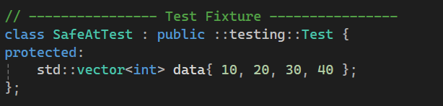
Unit Testing: Bound Validation
What we’re testing: Accessing a container with an invalid index (negative or ≥ size) leads to Undefined Behavior, crashes, or data corruption.
Why it’s common: Off-by-one errors, mixing signed/unsigned, trusting user input.
Policies to Mitigate:
STD-002 (Safe Constrained Data Values),
STD-003 (Strings),
Principle #1 (Validate Input),
Principle #10 (Secure Standard).

Slide 11
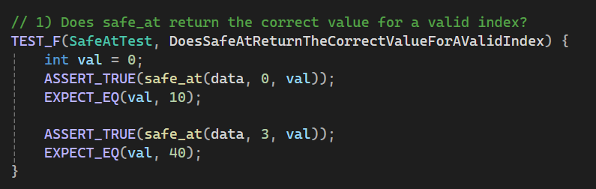
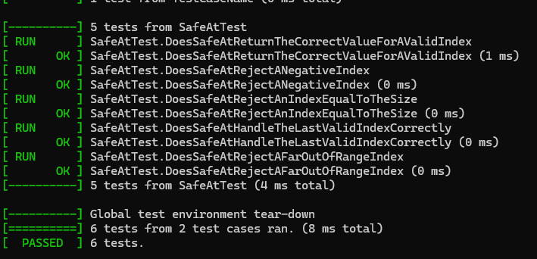
Unit Testing: Bound Validation
Purpose: Positive Pathway. Valid indices must succeed.
Result: Test passed
Rationale: Successfully accessed valid indices without a problem.

Slide 12
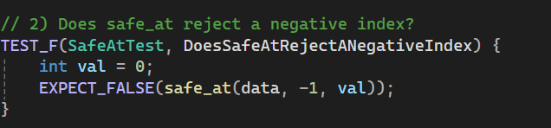
Unit Testing: Bound Validation
Purpose: Negative Indices must be rejected.
Result: Test passed
Rationale: The negative indices must be rejected, flagging a false.

Slide 13
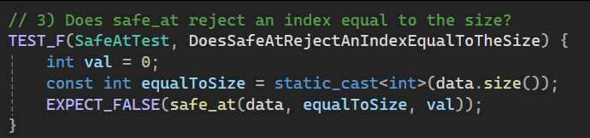
Unit Testing: Bound Validation
Purpose: Indices equal to the length must be rejected. This is a common error.
Result: Test passed
Rationale: Valid indices are always n - 1 where n is the amount of items within it. The first item is accessed with 0 not 1.

Slide 14
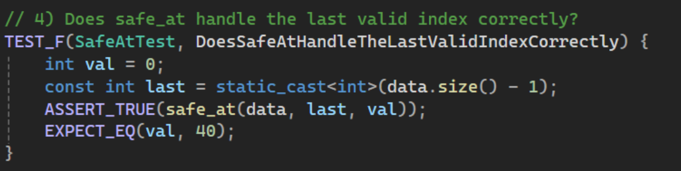
Unit Testing: Bound Validation
Purpose: Bounds must be updated when one is removed.
Result: Test passed
Rationale: Upon deletion of one, the last index should succeed.

Slide 15
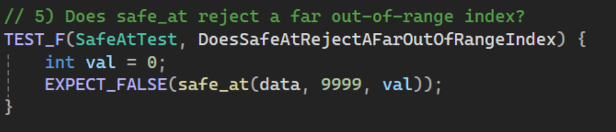
Unit Testing: Bound Validation
Purpose: Vulnerable function should die upon accessing out-of-bounds behavior.
Result: Test passed
Rationale: The function is able to error out when accessed outside of its range.

Slide 16

AUTOMATION SUMMARY

Slide 17
TOOLS
Assess & plan (Pre-production):
IriusRisk – automated threat modeling; generates security requirements and stories that seed the backlog.
Design:
OWASP ASVS / checklists – enforce secure design patterns in PRs.
Semgrep – lightweight rules to flag insecure design/usage patterns in diffs.
Build:
Cppcheck, Clang-Tidy, Coverity – SAST for type/flow/memory issues (e.g., STD-001/002/003/005/010).
OWASP Dependency-Check (+ SBOM) – third-party CVE scanning; fail on high severity.
Verify & test
Google Test – unit tests; coverage gate
OWASP ZAP – DAST against staging to catch injection/misconfig. Transition & health check
Osquery, Tripwire – baseline integrity and config hardening checks.
Targeted pre-go-live pen test on exposed surfaces.

Slide 18
TOOLS
Monitor & detect (Production)
Imperva (WAAP/WAF) – blocks common web attacks.
Splunk SIEM / Fidelis – log collection, correlation, alerting.
Respond
Splunk SOAR / ManageEngine – automated playbooks (block IPs, rotate keys, rollback, open tickets).
Maintain & stabilize
Scheduled CVE rescans (Dependency-Check), patching, drift detection; re-baseline with Osquery/Tripwire.
Feedback loop sends incidents and scan findings back to Assess & Plan.

Slide 19
RISKS AND BENEFITS: Issues and Solutions
Issues
Unpreparedness; No disaster recovery, no regular exercises, or tested plans.
Unknown Threats; No way to keep updated on newest threats.
No monitoring; no auditing; no accountability.
No mentioned standardized security reports, checks, or 3rd party audits.
No mentioned network segmentation for IoT devices.
No mention of security training
No mention of incident handling (10 Common Gaps in Cyber Security, 2025).
Solutions:
Devise and hold an incident response plan with steps at all life cycle (govern, identify, protect, detect, respond, recover) (Nelson et al., 2025).
Maintain a list of all asset inventory and subscribe or join a community for threat sharing (Johnson et al., 2016).
If resources are thin, seek assistance from CISA for cyber threat evaluation (Cyber Threat Hunting, 2025).
Develop extensive logging per NIST guidelines (Scarfone & Souppaya, 2023)

Slide 20
RISKS AND BENEFITS: Time Costs
If we act now — Benefits
Sharp drop in exploit likelihood and mean time to detect/respond.
Lower remediation costs vs post-release fixes with faster audit/compliance readiness.
Higher developer velocity over time (fewer revisions, clearer standards).
If we wait — Risks
Shipping vulnerabilities to production; breach/regulatory exposure
Technical debt compounds; revisions become costly and disruptive.
Emergency patches, unplanned downtime.
Damage to Green Pace’s brand; Loss of customers.

Slide 21
RECOMMENDATIONS
Lacking any form of Secure Software Development Framework (SSDF)
No enforced secure-development practices besides standards.
Security steps are not within the diagram; threat-modeling,scanning, and tests should have mandatory requirements.
No incident responses when the inevitable malicious actor penetrates security (Nelson et al., 2025.
Logging and monitoring baselines are unclear.
How is logging done? How Often? When? Who does it?
No test coverage is listed
How much scanning is enough? What % should it be at?
No code coverage goals.
No third-party vendor checks in place;
No mention of cyber security training.

Slide 22
CONCLUSIONS
Adopt NIST’s Secure Software Development framework as a company-wide standard (Souppaya et al., 2022).
Nist guidelines are more comprehensive than a single word document.
Enforces required checkpoints in the automation summary.
Adopt CISA’s extensive incident response guidelines (Nelson et al., 2025).
Provides steps and guides for tangible documents.
Adopt OWASP Application Security Verification Standard (ASVS) (OWASP Application Security Verification Standard (ASVS, 2018)
Lays foundational standards for testing web applications security controls and requirements for secure development.
Begin audits with CISA’s partners like the Regional Cybersecurity advisory board, Cyber Hygiene Services, Cybersecurity Performance Goals (CPG) (Free Cybersecurity Services & Tools , 2025).

Slide 23
REFERENCES
References
10 Common Gaps in Cyber Security. (2025). Chubb.com. https://www.chubb.com/vn-en/articles/10-common-gaps-in-cyber-security.html
Cross-Sector Cybersecurity Performance Goals | CISA. (2025). Cybersecurity and Infrastructure Security Agency CISA. https://www.cisa.gov/cross-sector-cybersecurity-performance-goals
Cyber Threat Hunting. (2025). Cybersecurity and Infrastructure Security Agency (CISA). https://www.cisa.gov/resources-tools/services/cyber-threat-hunting
Free Cybersecurity Services & Tools . (2025). Cybersecurity and Infrastructure Security Agency (CISA); U.S. Department of Homeland Security. https://www.cisa.gov/resources-tools/resources/free-cybersecurity-services-and-tools
Johnson, C. S., Badger, M. L., Waltermire, D. A., Snyder, J., & Skorupka, C. (2016). Guide to Cyber Threat Information Sharing. Guide to Cyber Threat Information Sharing, 800-150. https://doi.org/10.6028/nist.sp.800-150
Nelson, A., Rekhi, S., Souppaya, M., & Scarfone, K. (2025). Incident Response Recommendations and Considerations for Cybersecurity Risk Management: NIST. https://doi.org/10.6028/nist.sp.800-61r3
OWASP Application Security Verification Standard (ASVS. (2018). OWASP Foundation. https://owasp.org/www-project-application-security-verification-standard/?utm_source=chatgpt.com
Quinn, S., Ivy, N., Barrett, M., Feldman, L., Witte, G., & Gardner, R. K. (2021). Identifying and Estimating Cybersecurity Risk for Enterprise Risk Management. Identifying and Estimating Cybersecurity Risk for Enterprise Risk Management. https://doi.org/10.6028/nist.ir.8286a
Scarfone, K., & Souppaya, M. (2023). Cybersecurity Log Management Planning Guide. NIST Special Publication, 1(1). https://doi.org/10.6028/nist.sp.800-92r1.ipd
Souppaya, M., Scarfone, K., & Dodson, D. (2022). Secure software development framework (SSDF) version 1.1. NIST Special Publication 800-218, 1(1). https://doi.org/10.6028/nist.sp.800-218

Slide 24
Green Pace
Security Policy Presentation
Developer: Chad Salaets

