Slide 1
离散数学及其应用
Discrete Mathematics and Its Applications
（Eighth Edition/Kenneth H.Rosen）
郭少勇 (syguo@bupt.edu.cn)
北京邮电大学
2025.9
Notes:
1

Slide 2
上课说明
成绩组成：
  平时成绩：签到20分（每次2分）、作业80分（正确性、完整性）
  期中测评：100分
  期末考试：100分
总成绩：
  权重1*平时成绩+权重2*期中成绩+权重3*期末成绩=100分

Slide 3

本学期教学安排-提纲
9 Relations
9 Semigroups and Groups
11 Groups and Coding
8 Advanced Counting Techniques
10 Graphs
11 Trees
平台
技术

Slide 4
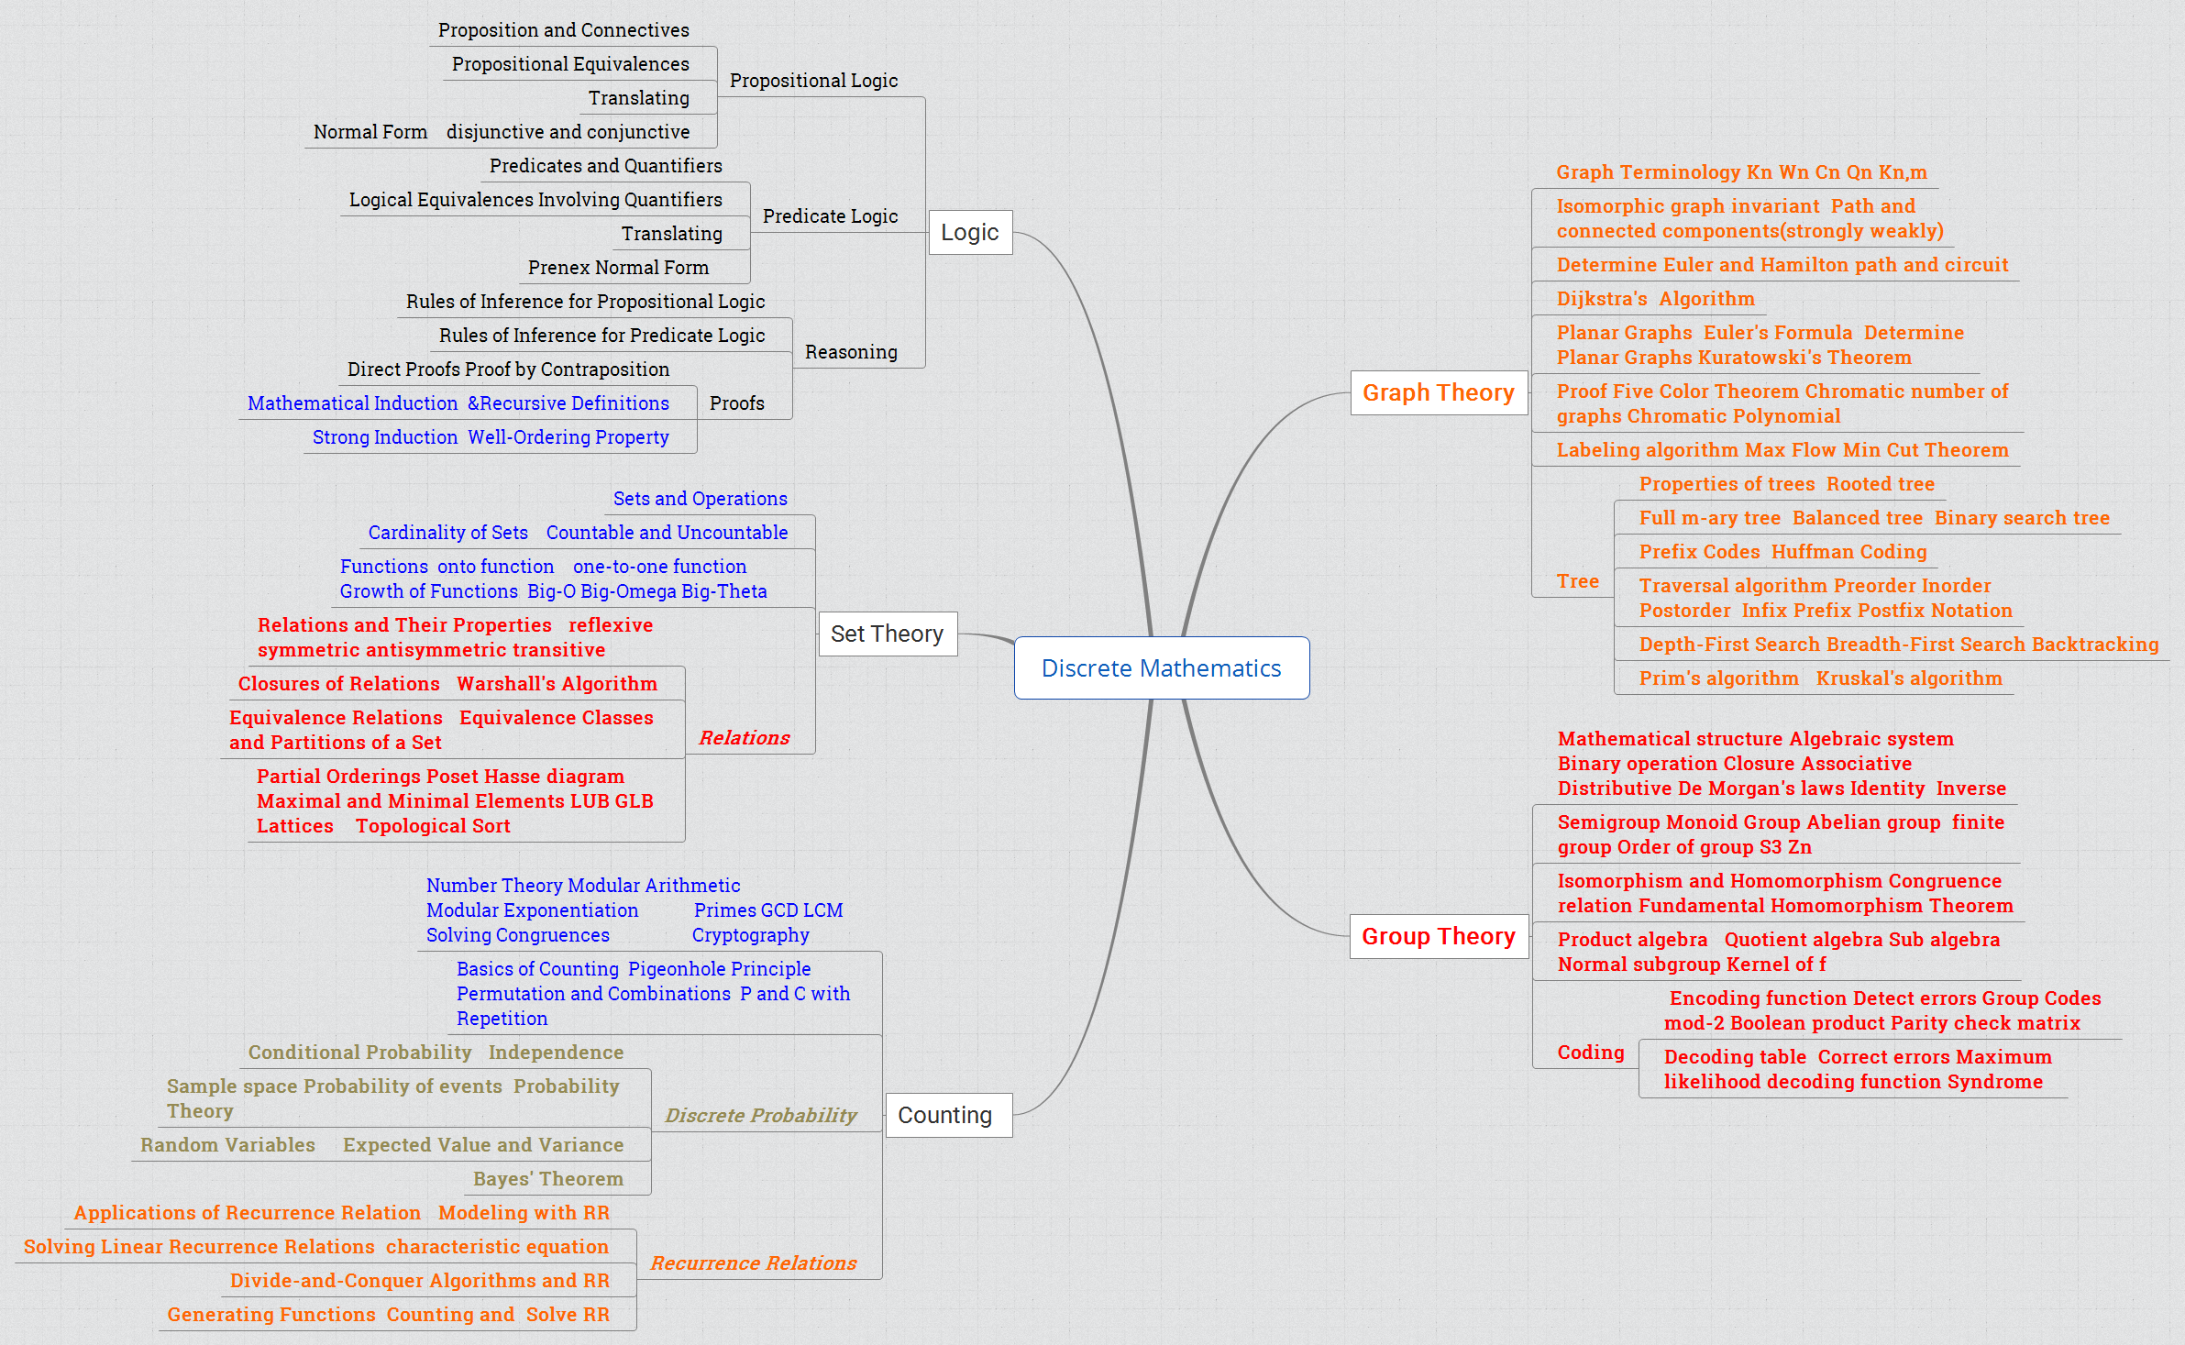

离散数学回顾

Slide 5
Relation（关系）
9.1 Relations and Their Properties 关系及关系性质
9.2 n-ary Relations and Their Applications n元关系及应用
9.3 Representing Relations 关系的表示
9.4 Closures of Relations 关系闭包
9.5 Equivalence Relations 等价关系
9.6 Partial Orderings 偏序关系

Slide 6
9.1 Relations and Their Properties
Introduction
Functions as relations
Relations on Set
Properties of Relations
Combining Relations

Slide 7
9.1 Relations and Their Properties
What are relations?
Relations are a formal means to specify which elements from two or more sets are related to each other
Examples
  {students} who take {courses}
  {businesses} and their {telephone numbers}
  {integers} and their {divisors}
  {program variables} and the {subroutines} they are used in
Notes:
两个元素之间

Slide 8
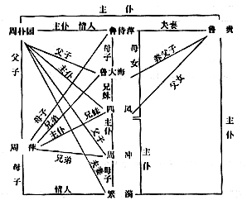
9.1 Relations and Their Properties

Slide 9

9.1 Relations and Their Properties

Slide 10

9.1 Relations and Their Properties

Slide 11
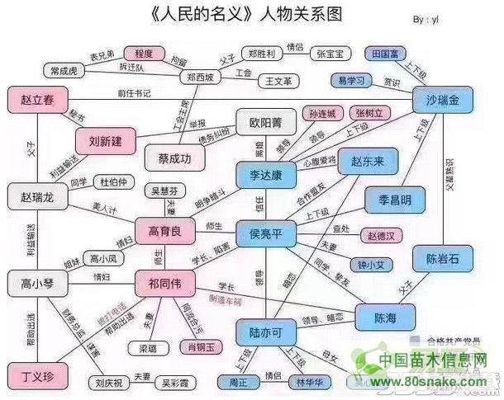
9.1 Relations and Their Properties

Slide 12
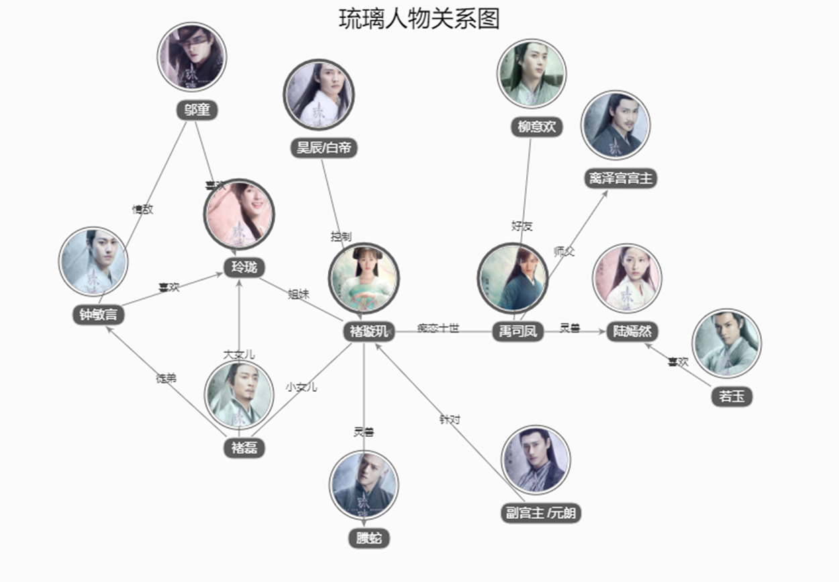
9.1 Relations and Their Properties

Slide 13
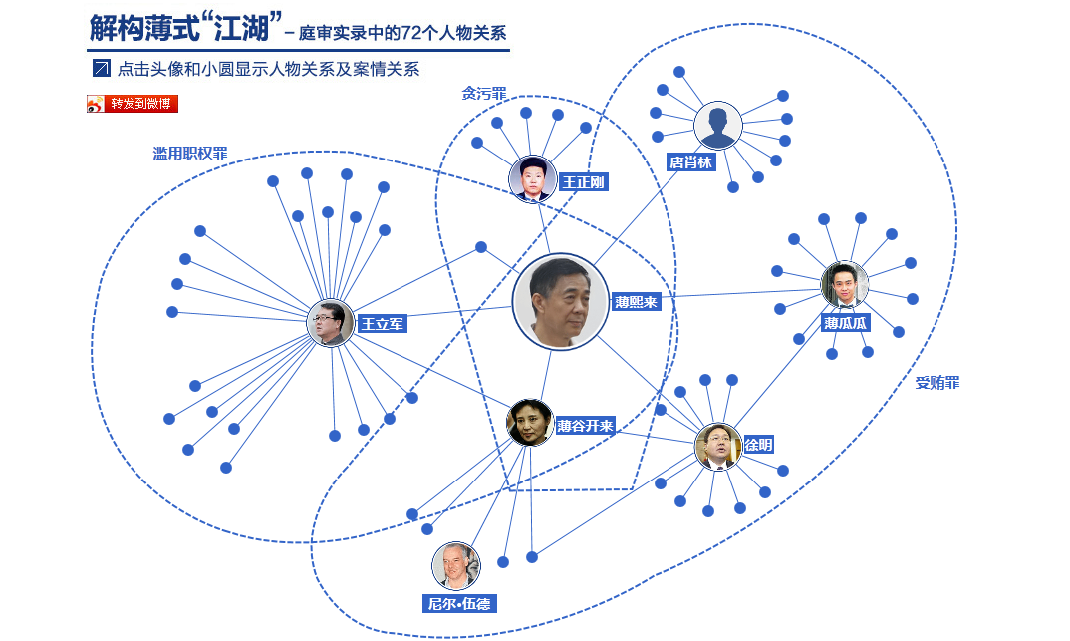
9.1 Relations and Their Properties

Slide 14
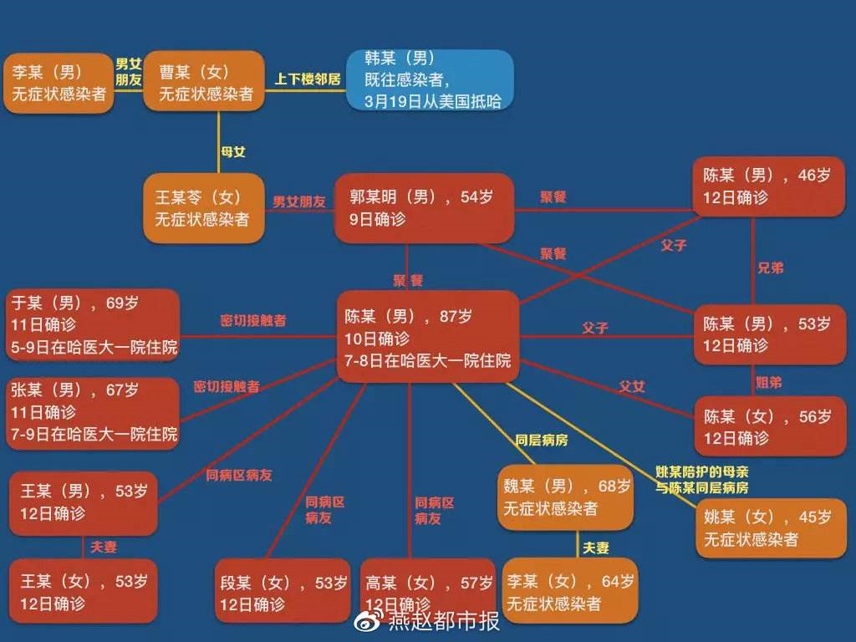
9.1 Relations and Their Properties

Slide 15
9.1 Relations and Their Properties
Definition：Let A and B be sets. A binary relation from A to B is a subset of A × B
  设A和B是集合，一个从A到B的二元关系是A×B的子集。
Definition：Let A1, A2, … , An be sets. An n-ary relation on these sets is a sub sebset of A₁× A₂× … ×A_{n} . The sets A₁, A₂, … , A_{n} are called the domains of the relation, and n is called its degree（阶）.
  设A₁, A₂, … , A_{n} 是集合。定义在这些集合上的n元关系是A₁× A₂× … ×A_{n} 的子集。这些集合A₁, A₂, … , A_{n} 称为关系域，n成为关系的阶。

Slide 16
9.1.1 Binary Relations（二元关系）
Definition：Let A and B be sets. A binary relation from A to B is a subset of A × B
  设A和B是集合，一个从A到B的二元关系是A×B的子集。
Let A，B be any sets. A binary relation R from A to B, written(with signature) R: A×B, or R: A, B, is (can be identified with) a subset of the set A×B.
  换句话说，一个从A到B的二元关系是集合R，其中每个有序对的第一个元素取自A（a∈A）而第二个元素取自B（b∈B）。我们使用记号aRb表示为（a, b）∈R，aRb表示（a, b）∉R。当（a, b）属于R，称a与b有关系R
注意：二元关系是指满足某规律的有序对的全体

Slide 17
9.1.1 Binary Relations（二元关系）
Example 1：Let A be the set of students in your school, and Let B be the set of courses. Let R be the relation that consists of those pairs
  (a, b): {students} who take {courses} {例如, (郭少勇，离散数学)}
Example 2：Let A be the set of cities in the U.S.A., and let B be the set of the 50 states in the U.S.A.. Define the relation R by specifying that (a, b) belongs to R if a city with name a is in the state b.
  (a, b): {city} belongs to {state}{例如，(Red Bank, 新泽西州)}

Slide 18
9.1.1 Binary Relations（二元关系）
Example 3：Let A={0,1,2} and B={a, b}. Then {(0,a), (0,b),(1,a),(2,b)} is a relation from A to B . This means, for instance, that 0Ra,but that 1Rb.
0
R
a
b
a
0
X
X
1
1
X
b
2
X
2

Slide 19
9.1.1 Complementary Relations（补关系）
Let R:A,B be any binary relation.
Then, R:A×B, the complement of R, is the binary relation defined by
R :≡ {(a,b) | (a,b) ∉ R} = (A×B) − R
Note this is just R if the universe of discourse is U = A×B; thus the name complement.
Note the complement of R is R.
Example: < = {(a,b) | (a,b)∉<} = {(a,b) | ¬a<b} = ≥

Slide 20
9.1.1 Inverse Relations （逆关系）
Any binary relation R:A×B has an inverse relation R⁻¹:B×A, defined by
R⁻¹ :≡ {(b,a) | (a,b)∈R}.
E.g., <⁻¹ = {(b,a) | a<b} = {(b,a) | b>a} = >.
E.g., if R:People→Foods is defined by
a R b ⇔ a eats b, then:
b R⁻¹ a ⇔ b is eaten by a. (Passive voice.)

Slide 21
9.1.3 Relations on a Set（集合的关系）
A (binary) relation from a set A to itself is called a relation on the set A.
E.g., the “<” relation from earlier was defined as a relation on the set N of natural numbers.
The (binary) identity relation I_{A} on a set A is the set {(a,a)|a∈A}.

Slide 22
9.1.2 Functions as Relations（函数作为关系）
Recall that a fuction f from a set A to a set B assigns exactly on element of B to each element of A. The graph of f is that set of ordered pairs (a, b) such that b=f(a).
  It satisfies the property: for each x∈A, there is exactly one pair (x, f(x)) in the relation.
Relations are a generalization of functions
  They allow unmapped elements from A
  They allow one-to-many mappings where an element from A maps to multiple elements from B
  They also allow many-to-one and many-to-many mappings

Slide 23
9.1.3 Relations on a Set（集合的关系）
Definition 2：A relations R on a set A is a relation from A to A, that is, a subset of A² = A × A.
Examples (on the set of integers，x∈A and y ∈A):
  x is equal to y
  x is greater than y
  x divides y
Note that in these cases both A and the relation R are infinite sets

Slide 24
9.1.3 Relations on a Set（集合的关系）
Example 4：Let A be the set {1,2,3,4}, Which ordered pairs are in the relation R={(a,b) | a divides b}?
  （学生思考一下）
{(1,1),(2,2),(3,3),(4,4),(1,2),(1,3),(1,4),(2,4)}

Slide 25
9.1.3 Relations on a Set（集合的关系）
Example 5：Consider these relations on the set of integers:
  R1={(a,b) | a≤b},
  R2={(a,b) | a>b},
  R3={(a,b) | a=b or a=-b},
  R4={(a,b) | a=b},
  R5={(a,b) | a=b+1},
  R6={(a,b) | a+b ≤3},
Which of these relations contain each of the pairs (1,1),(1,2),(2,1),(1,-1) and (2,2)?

Slide 26
9.1.3 Relations on a Set（集合的关系）
Example 6：How many relations are there?
  Relations on a set A with n elements
  A² has n² elements. We know that the number of subsets of a set with m elements is 2^{m}, so the desired number is 2^{n2}.
  The number of functions from A to A is
  Is this asymptotically the same?
  n^{n} = (2^{logn})^{n} = 2^{nlogn} which grows slower than 2^{n2}.

Slide 27
9.1.4 Properties of Relations（关系的性质）
Reflexive 自反
Symmetric 对称
Transitive 传递

Slide 28
9.1.4 Properties of Relations - Reflexive（自反）
Definition 3：A relation R on a set A is called reflexive if (a, a)∈R for every element a ∈A。
Example 7：Consider these relations on {1,2,3,4}，Which of these relations are reflexive?
  R1={(1,1),(1,2),(2,1),(2,2),(3,4),(4,1),(4,4)},
  R2={(1,1),(1,2),(2,1)},
  R3={(1,1),(1,2),(1,4),(2,1),(2,2),(3,3),(4,1),(4,4)},
  R4={(2,1),(3,1),(3,2),(4,1),(4,2),(4,3)},
  R5={(1,1),(1,2),(1,3),(1,4),(2,2),(2,3),(2,4),(3,3),(3,4),(4,4)},
  R6={(3,4)}

Slide 29
9.1.4 Properties of Relations - Reflexive（自反）
Example 8,9 Which of the relations from Example 5 are reflexive?
  R1={(a,b) | a≤b},
  R2={(a,b) | a>b},
  R3={(a,b) | a=b or a=-b},
  R4={(a,b) | a=b},
  R5={(a,b) | a=b+1},
  R6={(a,b) | a+b ≤3},
Is the “divides” relation on the set of positive integers reflexive?

Slide 30
9.1.4 Symmetry & Antisymmetry（对称与反对称）
Definition 4：
  A relation R on a set A is called symmetric if (b, a) ∈ R whenever (a, b) ∈ R, for all a, b ∈ A.
  A relation R on a set A such that for all a, b ∈ A, if (a, b) ∈ R and (b, a) ∈ R, then a = b is called antisymmetric.
Notes:
  Examples: < is antisymmetric, “likes” is not.
  Exercise: prove this definition of antisymmetric is equivalent to the statement that R∩R⁻¹ ⊆ I_{A}.

Slide 31
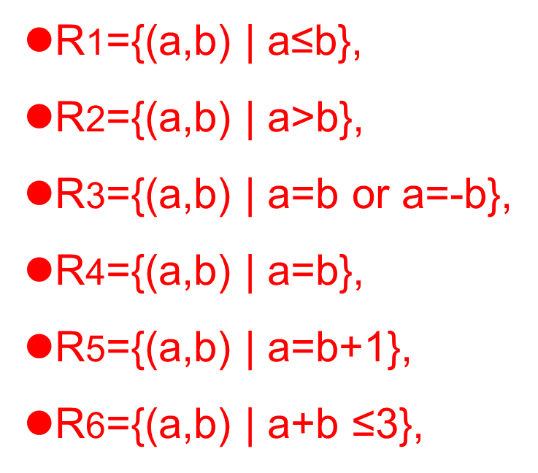
9.1.4 Symmetry & Antisymmetry（对称与反对称）
Example 10 11 12：
  Relations in Example 7
  Relations in Example 5
  “divides” relation
  Symmetry & Antisymmetry?
    R1={(1,1),(1,2),(2,1),(2,2),(3,4),(4,1),(4,4)},
  R2={(1,1),(1,2),(2,1)},
  R3={(1,1),(1,2),(1,4),(2,1),(2,2),(3,3),(4,1),(4,4)},
  R4={(2,1),(3,1),(3,2),(4,1),(4,2),(4,3)},
  R5={(1,1),(1,2),(1,3),(1,4),(2,2),(2,3),(2,4),(3,3),(3,4),(4,4)},
  R6={(3,4)}

Slide 32
9.1.4 Properties of Relations - Transitivity（传递性）
Definition 5：A relation R is transitive if (for all a,b,c)
(a,b)∈R ∧ (b,c)∈R → (a,c)∈R.
A relation is intransitive if it is not transitive.
  Some examples:
  “is an ancestor of” is transitive.
  “likes” between people is intransitive.
  “is located within 1 mile of” is… ?

Slide 33
9.1.4 Properties of Relations - Transitivity（传递性）
Relations in Example 7
Relations in Example 5
“divides” relation
Transitivity?
    R1={(1,1),(1,2),(2,1),(2,2),(3,4),(4,1),(4,4)},
  R2={(1,1),(1,2),(2,1)},
  R3={(1,1),(1,2),(1,4),(2,1),(2,2),(3,3),(4,1),(4,4)},
  R4={(2,1),(3,1),(3,2),(4,1),(4,2),(4,3)},
  R5={(1,1),(1,2),(1,3),(1,4),(2,2),(2,3),(2,4),(3,3),(3,4),(4,4)},
  R6={(3,4)}

Slide 34
9.1.4 Properties of Relations
Examples in Mathematics
= (equality)
≠ (inequality)
∅ (empty relation)

Slide 35
9.1.4 Properties of Relations - 总结
A relation R on a set A is
Reflexive（自反）, if
  ∀x ∈ A, (x, x) ∈ R
Symmetric（对称）, if
  ∀x∀y, (x, y) ∈ R ⇒ (y, x) ∈ R
Antisymmetric（反对称）, if
  ∀x∀y, (x, y) ∈ R and (y, x) ∈ R ⇒ x = y
Transitive（传递）, if
  ∀x∀y∀z, (x, y)∈R and (y, z) ∈ R ⇒ (x, z) ∈ R

Slide 36
9.1.4 Properties of Relations - 总结
Consider the “divides” relation on the set of nonnegative integers: x|y iff x divides y.
Reflexive?
  NO. 0 does not divide 0. (Would be reflexive on the set of positive integers)
Symmetric?
  NO. 2 divides 4, but not the other way around.
Antisymmetric?
Transitive?
YES
YES

Slide 37
9.1.4 Counting the reflexive relations
How many reflexive relations are there on a set A with n elements?
Consider the pairs B：{（x, x）with x ∈A}. There are n such pairs. For every configuration of ther pairs(x, y) with x≠y, one of the 2^{n} subsets of B corresponds to a reflexive relation, and all others do not. So there is one reflexive relation for every 2^{n} , or 2^{n2} / 2^{n} = 2^{n2-n} = 2^{n(n-1)} total reflexive relations

Slide 38
9.1.5 Combining Relations（关系的组合）
Since relations are by definition sets, they can be combined in any way that sets can be combined, including union(并集）, intersection（交集）, and set difference（差集）.

Slide 39
9.1.5 Combining Relations
Example 17：Let A={1,2,3} and B={1,2,3,4}. The relations R₁={(1,1),(2,2),(3,3)} and R₂={(1,1),(1,2),(1,3),(1,4)} can be combined to obtain
  R₁∩R₂ ={(1,1)}
  R₁UR₂ ={(1,1),(1,2),(1,3),(1,4),(2,2),(3,3)}
  R₁-R₂ ={(2,2),(3,3)}
  R₂-R₁ ={(1,2),(1,3),(1,4)}

Slide 40
9.1.5 Combining Relations
Example 18 19
  R₁ consists of all ordered pair (a,b), where a is a student who has taken course b,
  R₂ consists of all ordered pair (a,b), where a is a student who requires course b to graduate.
  What are the relations R₁UR₂ , R₁∩R₂, R₁-R₂, R₂-R₁,
19: R₁“less than” R₂“greater than”

Slide 41
9.1.5 Combining Relations – Composition（合成）
The composition（合成） of two relations R: A→B and S: B→C, denoted S∘R, is the relation from A to C containing all pairs (x, z) such that there is one y∈ B with (x, y) ∈ R and (y, z) ∈ S.
Definition: Suppose
  R₁ is a relation from a set A to a set B.
  R₂ is a relation from B to a set C.
Then the composition (or composite) of R₂ with R₁, is a relation from A to C where
  if (x,y) is a member of R₁ and (y,z) is a member of R₂, then (x,z) is a member of R₂∘ R₁.

Slide 42
9.1.5 Representing the Composition of a Relation
R₁
R₂
w
m
a
x
n
b
y
o
c
p
z
R₂∘ R₁ = {(b,x),(b,z)}

Slide 43
9.1.5 Representing the Composition of a Relation
Example 20:
What is the composite of the relations R and S,
where R is the relation from {1,2,3} to {1,2,3,4} with
R={(1,1),(1,4),(2,3),(3,1),(3,4)}
and S is the relation from {1,2,3,4} to {0,1,2} with
S={(1,0),(2,0),(3,1),(3,2),(4,1)}?

Slide 44
9.1.5 Combining Relations - Powers
The n^{th} power R^{n} of a relation R on a set A can be defined recursively by:
  R⁰ :≡I_{A} ;
  R^{n+1} :≡ R^{n} □ R for all n≥0.
Negative powers of R can also be defined if desired, by R^{−n}:≡ (R⁻¹)^{n}.

Slide 45
9.1.5 Combining Relations - Powers of a relation
Definition: Let R be a binary relation on A. Then the powers R^{n} of the relation R can be defined inductively by:
  Basis Step: R¹ = R
  Inductive Step: R^{n+1} = R^{n} ∘ R
  (see the slides for Section 9.3 for further insights)
The powers of a transitive relation are subsets of the relation. This is established by the following theorem:
  Theorem 1: The relation R on a set A is transitive iff R^{n} ⊆ R for n = 1,2,3 ….
(see the text for a proof via mathematical induction)

Slide 46
9.1.5 Combining Relations - Powers of relations
The n^{th} power of a relation R for n ≥ 1 is defined recursively as
  R¹ = R
  R^{n+1} = R^{n} ∘ R
Example 22: Let R={(1,1), (2,1), (3,2), (4,3)}, Find the power R^{n} , n=2, 3, 4, …

Slide 47
9.1.5 Combining Relations - Powers of relations
Theorem 1:The relation R on a set A is transitive if and only if
for n=1,2,3,…

Slide 48
9.2 n-ary Relation and Their Applications
An n-ary relation R on sets A₁,…,A_{n},
written (with signature) R:A₁×…×A_{n} or R:A₁,…,A_{n}, is simply a subset
R ⊆ A₁× … × A_{n}.
The sets A_{i} are called the domains of R.
The degree（阶） of R is n.
R is functional in the domain A_{i} if it contains at most one n-tuple (…, a_{i} ,…) for any value a_{i} within domain A_{i}.

Slide 49
9.2 n-ary Relation - Relation Databases
A model for relational databases（关系数据模型）, based on relations
A database is viewed as a collection of records（记录）, each being a tuple of the form (value₁, value₂, ..., value_{n})
Because this relation is often given as a table（表）, this term (table) is used as an equivalent for relation in database terminology

Slide 50
9.2 n-ary Relation - Relation Databases
A relational database is essentially just an n-ary relation R.
A domain A_{i} is a primary key （主键）for the database if the relation R is functional in A_{i}.
A composite key （复合主键）for the database is a set of domains {A_{i}, A_{j}, …} such that R contains at most 1 n-tuple (…,a_{i},…,a_{j},…) for each composite value (a_{i}, a_{j},…)∈A_{i}×A_{j}×…

Slide 51
9.2 n-ary Relation - Databases Example
Student name | ID | Major | GPA
John | 1022 | Computer Science | 3.07
Ellen | 2773 | Mathematics | 3.65
Mark | 4975 | Biology | 2.88

Slide 52
9.2 n-ary Relation - Databases intension and extension
The fields（域） of the database (the columns) correspond to the domains of the relation
The number of fields is the degree n
The intension（内涵） of the database (or its schema) is the permanent part of its design, i.e., the fields and the constraints on them
The extension（外延） of the database is its current population of records

Slide 53
9.2 n-ary Relation - Databases Keys
In order to uniquely identify tuples in a database, we need to know where to look, that is specify a field that serves for this purpose. This is the primary key.
Care must be taken to maintain the key property when inserting records
Some databases may have no primary key; instead they use a composite key made up from multiple fields
  A flight database: key = airline + flight number

Slide 54
9.2 Operators on n-ary Relation - Selection（选择）
Let A be any n-ary domain A=A₁×…×A_{n}, and let C:A→{T,F} be any condition (predicate) on elements (n-tuples) of A.
Then, the selection operator s_{C} is the operator that maps any (n-ary) relation R on A to the n-ary relation of all n-tuples from R that satisfy C.
  I.e., ∀R⊆A, s_{C}(R) = {a∈R | s_{C}(a) = T}

Slide 55
9.2 Operators on n-ary Relation - Selection
Suppose we have a domain
A = StudentName × Standing × SocSecNos
Suppose we define a certain condition on A, UpperLevel(name,standing,ssn) :≡
[(standing = junior) ∨ (standing = senior)]
Then, s_{UpperLevel} is the selection operator that takes any relation R on A (database of students) and produces a relation consisting of just the upper-level classes (juniors and seniors).

Slide 56
9.2 Operators on n-ary Relation - Projection（映射）
Let A = A₁×…×A_{n} be any n-ary domain, and let {i_{k}}=(i₁,…,i_{m}) be a sequence of indices all falling in the range 1 to n,
  That is, where 1 ≤ i_{k} ≤ n for all 1 ≤ k ≤ m.
Then the projection operator on n-tuples
is defined by:

Slide 57
9.2 Operators on n-ary Relation - Projection Example
Suppose we have a ternary (3-ary) domain Cars=Model×Year×Color. (note n=3).
Consider the index sequence {i_{k}}= 1,3. (m=2)
Then the projection P simply maps each tuple (a₁,a₂,a₃) = (model,year,color) to its image:
This operator can be usefully applied to a whole relation R⊆Cars (a database of cars) to obtain a list of the model/color combinations available.

Slide 58
9.2 Operators on n-ary Relation - Join（连接）
Puts two relations together to form a sort of combined relation.
If the tuple (A,B) appears in R₁, and the tuple (B,C) appears in R₂, then the tuple (A,B,C) appears in the join J(R₁,R₂).
  A, B, and C here can also be sequences of elements (across multiple fields), not just single elements.

Slide 59
9.2 Operators on n-ary Relation - Join Example
Suppose R₁ is a teaching assignment table, relating Professors to Courses.
Suppose R₂ is a room assignment table relating Courses to Rooms,Times.
Then J(R₁,R₂) is like your class schedule, listing (professor,course,room,time).

Slide 60
9.3 Representing Relations（关系的表示）
Some ways to represent n-ary relations:
  With an explicit list or table of its tuples.
  With a function from the domain to {T,F}.
    Or with an algorithm for computing this function.
Some special ways to represent binary relations:
  With a zero-one matrix（0-1矩阵）.
  With a directed graph（有向图）.

Slide 61
9.3 Representing Relations - Using Zero-One Matrices
To represent a binary relation R:A×B by an
|A|×|B| 0-1 matrix M_{R} = [m_{ij}], let m_{ij} = 1 iff (a_{i},b_{j})∈R.
E.g., Suppose Joe likes Susan and Mary, Fred likes Mary, and Mark likes Sally.
Then the 0-1 matrix representation
of the relation Likes:Boys×Girls
relation is:

Slide 62
9.3 Representing Relations - Zero-One Reflexive, Symmetric
Terms: Reflexive, non-reflexive, irreflexive, symmetric, asymmetric, and antisymmetric.
  These relation characteristics are very easy to recognize by inspection of the zero-one matrix.
any-
thing
any-
thing
anything
anything
any-
thing
any-
thing
Reflexive:
all 1’s on diagonal
Irreflexive:
all 0’s on diagonal
Symmetric:
all identical
across diagonal
Antisymmetric:
all 1’s are across
from 0’s

Slide 63
9.3 Representing Relations - Using Directed Graphs
A directed graph or digraph G=(V_{G},E_{G}) is a set V_{G} of vertices (nodes) with a set E_{G}⊆V_{G}×V_{G} of edges (arcs,links). Visually represented using dots for nodes, and arrows for edges. Notice that a relation R:A×B can be represented as a graph G_{R}=(V_{G}=A∪B, E_{G}=R).
Edge set E_{G}
(blue arrows)
Matrix representation M_{R}:
Graph
rep. G_{R}:
Joe
Susan
Fred
Mary
Mark
Sally
Node set V_{G}
(black dots)

Slide 64
9.3 Representing Relations - Digraph Reflexive, Symmetric
It is extremely easy to recognize the reflexive/ irreflexive/ symmetric/ antisymmetric properties by graph inspection.











Reflexive:
Every node
has a self-loop
Irreflexive:
No node
links to itself
Symmetric:
Every link is
bidirectional
Antisymmetric:
No link is
bidirectional
These are asymmetric & non-antisymmetric
These are non-reflexive & non-irreflexive

Slide 65
9.3 Representing Relations - 关系特征、关系图、关系矩阵
关系特征 | 关系图特征 | 关系矩阵特征
自反 | 每一结点处有一环 | 对角线元素均为1
反自反 | 每一结点处有无环 | 对角线元素均为0
对称 | 两结点间有相反的两边同时出现 | 矩阵为对称矩阵
反对称 | 两结点间没有相反的边成对出现 | 当分量C_{ij}=1(i=j)时C_{ji}=0
传递 | 如果结点v₁,v₂间有边，v₂,v₃间有边，则v₁,v₃间必有边。 | R^{n} ⊆ R

Slide 66
9.3 Representing Relations - Example

Slide 67
9.3 Representing Relations - 二元关系的运算
Relation Operation and Closures
二元关系
  作为集合，存在并，交，差，非和对称差的运算；
  作为函数 也存在复合运算和逆运算；
  作为特殊的集合和函数的推广 还存在闭包运算。

Slide 68
9.1 – 9.3
单词表
relation（关系）
binary relation （二元关系）
degree（阶）
property（性质）
reflexive（自反）
symmetric（对称）
antisymmetry（反对称）
transitive（传递）
combining relations（关系的组合）
union(并集）
intersection（交集）
set difference（差集）
composition（合成）

Slide 69
9.1 – 9.3
单词表
model for relational databases（关系数据模型）
records（记录）
table（表）
primary key （主键）
composite key （复合主键）
fields（域）
intension（内涵）
extension（外延）
operators（运算）
zero-one matrix（0-1矩阵）
directed graph（有向图）

Slide 70
9.1 – 9.3
Homework
§9.1 – 42, 49, 50
§9.2 – 8, 20
§9.3 – 14, 32

Slide 71
9.3 Representing Relations—作业
登录教学云平台：ucloud.bupt.edu.cn
进入云邮教学空间，查看我的课堂，进入课程离散数学(下)，可以看到课程ppt、课本、课后作业等相关课程资源
教学云平台查看并提交课后作业，作业截止前提交

Slide 72
Thank you！！！
Notes:
§9.4 – 20, 22, 28

