Slide 1
离散数学及其应用
Discrete Mathematics and Its Applications
（Eighth Edition/Kenneth H.Rosen）
郭少勇 (syguo@bupt.edu.cn)
北京邮电大学
2024.9
Notes:
1

Slide 2
9.6.1 Introduction - Partial ordered sets （偏序集合）
定义1：Partial order（偏序关系）:A relation R on a set A is called a partial order if R is reflexive（自反）, antisymmetric（反对称）, and transitive（传递）.
Partially ordered set:The set A together with the partial order R is called a partially ordered set（偏序集合）, or simply a poset（偏序集）, and we will denote this poset by (A, R).

Slide 3
9.6.1 Introduction
Example 1:
  Show that the greater than or equal to relation (≥) is a partial ordering on the set of integers.
  Solution: Because a ≥ a for every integer a, ≥ is reflexive. If a ≥ b and b ≥ a, then a = b. Extra ≥ is antisymmetric. Finally, ≥ is transitive because a ≥ b and b ≥ c imply that a ≥ c. It follows that ≥ is a partial ordering on the set of integers and (Z, ≥) is a poset.

Slide 4
9.6.1 Introduction
Example 2:
  The divisibility relation ∣ is a partial ordering on the set of positive integers, because it is reflexive, antisymmetric, and transitive, as was shown in Section 9.1. We see that (Z⁺, ∣) is a poset. Recall that (Z⁺ denotes the set of positive integers.)

Slide 5
9.6.1 Introduction
Example 3:
  Show that the inclusion relation ⊆ is a partial ordering on the power set of a set S.
  Solution: Because A ⊆ A whenever A is a subset of S,⊆ is reflexive. It is antisymmetric because A ⊆ B and B ⊆ A imply that A = B. Finally, ⊆ is transitive, because A ⊆ B and B ⊆ C imply that A ⊆ C. Hence, ⊆ is a partial ordering on P(S), and (P(S),⊆) is a poset.

Slide 6
9.6.1 Introduction
Example 4:
  Let R be the relation on the set of people such that xRy if x and y are people and x is older than y. Show that R is not a partial ordering.
  Solution: Note that R is antisymmetric because if a person x is older than a person y, then y is not older than x. That is, if xRy, then yRx. The relation R is transitive because if person x is older than person y and y is older than person z, then x is older than z. That is, if xRy and yRz, then xRz. However, R is not reflexive, because no person is older than himself or herself. That is, xRx for all people x. It follows that R is not a partial ordering.

Slide 7
9.6.1 Introduction
A relation R on A is called a partial ordering or partial order if it is reflexive, antisymmetric, and transitive.
  We often use a symbol looking something like ≼ (or analogous shapes) for such relations.
  Examples: ≤, ≥ on real numbers, ⊆, ⊇ on sets.
  Another example: the divides relation | on Z⁺.
    Note it is not necessarily the case that either a≼b or b≼a.
A set A together with a partial order ≼ on A is called a partially ordered set or poset and is denoted (A, ≼).

Slide 8
9.6.1 Introduction - Linear Order（线序关系）
定义2：If (A, ≤) is a poset, the elements a and b are said to be
  Comparable（可比的） if a ≤ b or b ≤ a.
  incomparable (不可比的）if neither a ≤ b nor b ≤ a.
Example 5:
  In the poset (Z⁺, ∣), are the integers 3 and 9 comparable? Are 5 and 7 comparable?
  Solution: The integers 3 and 9 are comparable, because 3 ∣ 9. The integers 5 and 7 are incomparable, because 5 ̸| 7 and 7 ̸| 5.

Slide 9
9.6.1 Introduction - Linear Order（线序关系）
定义3：If every pair of elements in a poset A is comparable, we say that A is a linearly ordered set（线序集合）, and the partial order is called a linear order（线序关系）. We also say that A is a chain（链）.
Example 6:
  The poset (Z,≤) is totally ordered, because a ≤ b or b ≤ a whenever a and b are integers.
Example 7:
  The poset (Z⁺, ∣ ) is not totally ordered because it contains elements that are incomparable, such as 5 and 7.

Slide 10
9.6.1 Introduction - Well order （良序关系）
定义4：(S,≤) is a well-ordered set（良序集） if it is a poset such that ≤ is a total ordering and every nonempty subset of S has a least element.
Example 8:
  The set of ordered pairs of positive integers, Z⁺× Z⁺, with (a₁, a₂) (b₁, b₂) if a₁ < b₁, or if a₁ = b₁ and a₂ ≤ b₂ (the lexicographic ordering), is a well-ordered set.
  The verification of this is left as Exercise 53. The set Z, with the usual ≤ ordering, is not well-ordered because the set of negative integers, which is a subset of Z, has no least element.

Slide 11
9.6.2 Lexicographic order（词典顺序）
The words in a dictionary are listed in alphabetic, or lexicographic, order, which is based on the ordering of the letters in the alphabet. This is a special case of an ordering of strings on a set constructed from a partial ordering on the set. We will show how this construction works in any poset.
This ordering is called lexicographic, or “dictionary” order（词典顺序）.
Extended to Cartesian products A₁XA₂…XA_{n}
_{O}

Slide 12
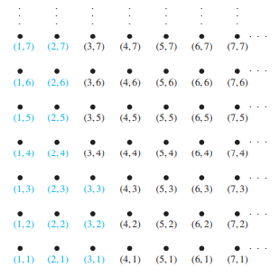
9.6.2 Lexicographic order
Example 9:
  Determine whether (3, 5) ≺ (4, 8), whether (3, 8) ≺ (4, 5), and whether (4, 9) ≺ (4, 11) in the poset (Z × Z, ≤), where is the lexicographic ordering constructed from the usual ≤ relation Z.

Slide 13
9.6.2 Lexicographic order
Solution:
  Because 3 < 4, it follows that (3, 5) ≺ (4, 8) and that (3, 8) ≺ (4, 5). We have (4, 9) ≺ (4, 11), because the first entries of (4, 9) and (4, 11) are the same but 9 < 11. In Figure the ordered pairs in Z⁺ × Z⁺ that are less than (3, 4) are highlighted.
A lexicographic ordering can be defined on the Cartesian product of n posets (A₁, 1), (A₂, 2), … , (A_{n}, n). Define the partial ordering on A₁ × A₂ × ⋯ × A_{n} by (a₁, a₂, … , a_{n}) ≺ (b₁, b₂, … , b_{n}) if a₁ ≺₁ b₁, or if there is an integer i > 0 such that a₁ = b₁, … , a_{i} = b_{i} , and a_{i+1} ≺_{i+1} b_{i+1}.

Slide 14
9.6.2 Lexicographic order
Example 10:
  Note that (1, 2, 3, 5) ≺ (1, 2, 4, 3), because the entries in the first two positions of these 4-tuples agree, but in the third position the entry in the first 4-tuple, 3, is less than that in the second 4-tuple, 4.
  (Here the ordering on 4-tuples is the lexicographic ordering that comes from the usual less than or equal to relation on the set of integers.)

Slide 15
9.6.2 Lexicographic order
Example 11:
  Consider the set of strings of lowercase English letters. Using the ordering of letters in the alphabet, a lexicographic ordering on the set of strings can be constructed.
  A string is less than a second string if the letter in the first string in the first position where the strings differ comes before the letter in the second string in this position, or if the first string and the second string agree in all positions, but the second string has more letters.

Slide 16
9.6.2 Lexicographic order
Example 11:
  This ordering is the same as that used in dictionaries.
  For example,
    discreet ≺ discrete,
  because these strings differ first in the seventh position, and e ≺ t
    Also, discreet ≺ discreetness,
  because the first eight letters agree, but the second string is longer.
    Furthermore, discrete ≺ discretion,
  because
    discrete ≺ discreti.

Slide 17
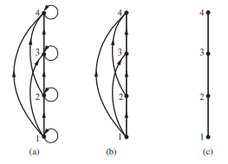
9.6.3 Hasse Diagrams（哈斯图）
Many edges in the directed graph for a finite poset do not have to be shown because they must be present.
For instance, consider the directed graph for the partial ordering {(a, b) ∣ a ≤ b} on the set {1, 2, 3, 4}, shown in Figure (a).
Because this relation is a partial ordering,
it is reflexive, and its directed graph has
loops at all vertices.

Slide 18
9.6.3 Hasse Diagrams
Consequently, we do not have to show these loops because they must be present; in Figure (b) loops are not shown.
Because a partial ordering is transitive, we do not have to show those edges that must be present because of transitivity.

Slide 19
9.6.3 Hasse Diagrams
For example, in Figure (c) the edges (1, 3), (1, 4), and (2, 4) are not shown because they must be present.
If we assume that all edges are pointed “upward” (as they are drawn in the figure), we do not have to show the directions of the edges; Figure (c) does not show directions.

Slide 20
9.6.3 Hasse Diagrams
Hasse Diagram（哈塞图） is the digraph of a partial order on a finite set A that
  deletes all self-cycles
  eliminates all edges that are implied by the transitive property
  draws the digraph with all edges pointing upward

Slide 21
9.6.3 Hasse Diagrams
Example 12:
  Draw the Hasse diagram representing the partial ordering {(a, b)∣a divides b} on {1, 2, 3, 4, 6, 8, 12}.
Solution:
  Begin with the digraph for this partial order, as shown in Figure (a). Remove all loops, as shown in Figure (b).
  Then delete all the edges implied by the transitive property. These are (1, 4), (1, 6), (1, 8), (1, 12), (2, 8), (2, 12), and (3, 12).

Slide 22
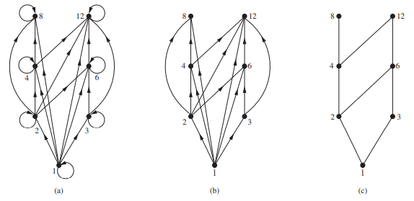
9.6.3 Hasse Diagrams
Solution:
  These are (1, 4), (1, 6), (1, 8), (1, 12), (2, 8), (2, 12), and (3, 12). Arrange all edges to point upward, and delete all arrows to obtain the Hasse diagram. The resulting Hasse diagram is shown in Figure (c).

Slide 23
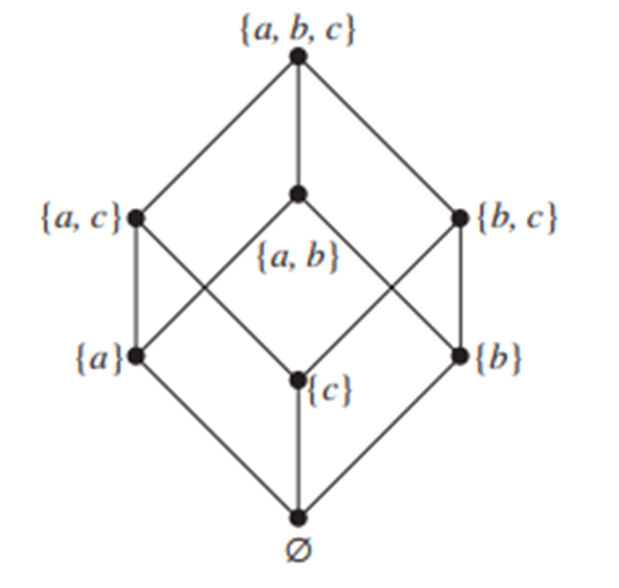
9.6.3 Hasse Diagrams
Example 13:
  Draw the Hasse diagram for the partial ordering {(A, B) ∣ A ⊆ B} on the power set P(S), where S = {a, b, c}.
Solution:
  The Hasse diagram for this partial ordering is obtained from the associated digraph by deleting all the loops and all the edges that occur from transitivity, namely, ( ∅, {a, b} ) , ( ∅, {a, c} ) , ( ∅, {b, c} ) ,
  ( ∅, {a, b, c} ) , ({a}, {a, b, c}), ({b}, {a, b, c}), and ({c}, {a, b, c}).
  Finally, all edges point upward, and arrows are deleted.
  The resulting Hasse diagram is illustrated in Figure.

Slide 24
9.6.4 Extremal elements
maximal element（极大元）
minimal element（极小元）
greatest element（最大元）
  denoted by I and often called the unit element（单位元）
least element（最小元）
  denoted by 0 and often called the zero element（零元）

Slide 25
9.6.4 Extremal elements
Example 14:
  Which elements of the poset ({2, 4, 5, 10, 12, 20, 25}, ∣) are maximal, and which are minimal?
Solution:
  The Hasse diagram in Figure 5 for this poset shows that the maximal elements are 12, 20, and 25, and the minimal elements are 2 and 5.
  As this example shows, a poset can have more than one maximal element and more than one minimal element.

Slide 26
9.6.4 Extremal elements - Maximal(Minimal) element
An element a ∈ A is called a maximal element of A if there is no element c in A such that a<c.
An element b ∈ A is called a minimal element of A if there is no element c in A such that c<b.

Slide 27
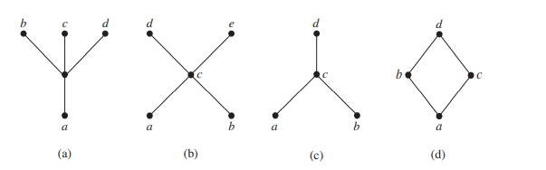
9.6.4 Extremal elements
Example 15:
  Determine whether the posets represented by each of the Hasse diagrams in Figure have a greatest element and a least element.

Slide 28
9.6.4 Extremal elements
Solution:
  The least element of the poset with Hasse diagram (a) is a. This poset has no greatest element.
  The poset with Hasse diagram (b) has neither a least nor a greatest element.
  The poset with Hasse diagram (c) has no least element. Its greatest element is d.
  The poset with Hasse diagram (d) has least element a and greatest element d.

Slide 29
9.6.4 Extremal elements - upper(lower) bound
Example 17:
  Is there a greatest element and a least element in the poset (Z+, ∣)?
Solution:
  The integer 1 is the least element because 1|n whenever n is a positive integer.
  Because there is no integer that is divisible by all positive integers, there is no greatest element.

Slide 30
9.6.4 Extremal elements - upper(lower) bound
LUB（最小上界） GLB（最大下界）
Consider a poset and a subset B of A.
  An element a ∈ A is called a upper bound（上界） of B if b≤a for all b ∈ B.
  An element a ∈ A is called a lower bound（下界）of B if a≤b for all b ∈ B.
  An element a ∈ A is called a least upper bound (LUB) of B if a is an upper bound of B and a≤a’, whenever a’ is an upper bound of B.
  An element a ∈ A is called a greatest lower bound (GLB) of B if a is an lower bound of B and a’≤a, whenever a’ is an lower bound of B.

Slide 31
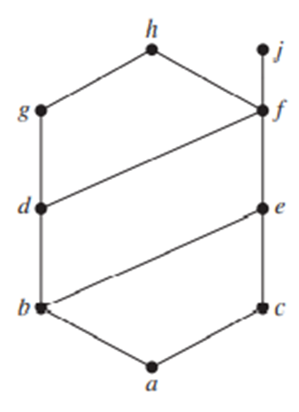
9.6.4 Extremal elements - upper(lower) bound
Example 18:
  Find the lower and upper bounds of the subsets {a, b, c}, {j, h}, and {a, c, d, f } in the poset with the Hasse diagram shown in Figure.
  Solution: The upper bounds of {a, b, c} are e, f, j, and h, and its only lower bound is a. There are no upper bounds of {j, h}, and its lower bounds are a, b, c, d, e, and f . The upper bounds of {a, c, d, f } are f , h, and j, and its lower bound is a.

Slide 32
9.6.4 Extremal elements
Example 19:
  Find the greatest lower bound and the least upper
  bound of {b, d, g}, if they exist, in the poset shown
  in Figure.
  Solution: The upper bounds of {b, d, g} are g and h. Because g ≺ h, g is the least upper bound.The lower bounds of {b, d, g} are a and b. Because a ≺ b, b is the greatest lower bound.

Slide 33
9.6.4 Extremal elements
Example 20:
  Find the greatest lower bound and the least upper bound of the sets {3, 9, 12} and {1, 2, 4, 5, 10}, if they exist, in the poset (Z+, ∣).
Solution:
  An integer is a lower bound of {3, 9, 12} if 3, 9, and 12 are divisible by this integer. The only such integers are 1 and 3.
  Because 1 ∣ 3, 3 is the greatest lower bound of {3, 9, 12}.
  The only lower bound for the set {1, 2, 4, 5, 10} with respect to ∣ is the element 1. Hence, 1 is the greatest lower bound for {1, 2, 4, 5, 10}.

Slide 34
9.6.4 Extremal elements
Solution:
  An integer is an upper bound for {3, 9, 12} if and only if it is divisible by 3, 9, and 12. The integers with this property are those divisible by the least common multiple of 3, 9, and 12, which is 36. Hence, 36 is the least upper bound of {3, 9, 12}.
  A positive integer is an upper bound for the set {1, 2, 4, 5, 10} if and only if it is divisible by 1, 2, 4, 5, and 10.
  The integers with this property are those integers divisible by the least common multiple of these integers, which is 20. Hence, 20 is the least upper bound of {1, 2, 4, 5, 10}.

Slide 35
9.6.4 Extremal elements - Theorems
Let (A, ≤) be a poset
  If A is a finite nonempty, then A has at least one maximal element and at least one minimal element.
  A has at most one greatest element and at most one least element.
  A subset B of A has at most one LUB and at most one GLB.

Slide 36
9.6.4 Extremal elements – Theorems 4
Suppose that (A, ≤) and (A’, ≤’) are isomorphic posets under the isomorphism f: A→A’.
  If a is a maximal (minimal) element of (A, ≤), then f(a) is a maximal (minimal) element of (A’, ≤’).
  If a is a greatest (least) element of (A, ≤), then f(a) is a greatest (least) element of (A’, ≤’).
  If a is an upper bound (lower bound, least upper bound, greatest lower bound) of (A, ≤), then f(a) is an upper bound (lower bound, least upper bound, greatest lower bound) of (A’, ≤’).
  If every subset of (A, ≤) has a LUB (GLB), then every subset of (A’, ≤’) has a LUB (GLB).

Slide 37
9.6.5 Introduction of Lattices（格）
A lattice（格） is a poset in which every subset {a,b} consisting of two elements has a least upper bound and a greatest lower bound.
  denote LUB({a,b}) by a∨b and call it the join（并） of a and b.
  denote GLB({a,b}) by a∧b and call it the meet（交） of a and b.

Slide 38
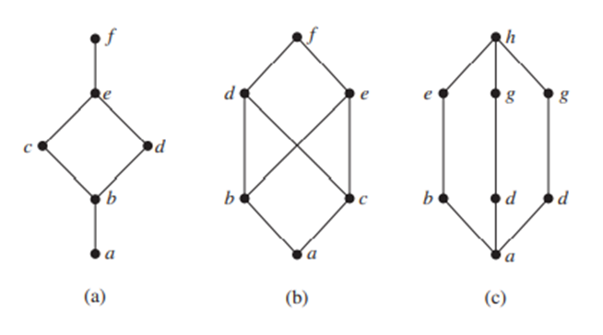
9.6.5 Lattices
Example 21:
  Determine whether the posets represented by each of the Hasse diagrams in Figures are lattices.

Slide 39
9.6.5 Lattices
Solution:
  The posets represented by the Hasse diagrams in (a) and (c) are both lattices because in each poset every pair of elements has both a least upper bound and a greatest lower bound, as the reader should verify.
  On the other hand, the poset with the Hasse diagram shown in (b) is not a lattice, because the elements b and c have no least upper bound.
  To see this, note that each of the elements d, e, and f is an upper bound, but none of these three elements precedes the other two with respect to the ordering of this poset.

Slide 40
9.6.5 Lattices
Example 22:
  Is the poset (Z+, ∣) a lattice?
Solution:
  Let a and b be two positive integers. The least upper bound and greatest lower bound of these two integers are the least common multiple and the greatest common divisor of these integers, respectively, as the reader should verify. It follows that this poset is a lattice.

Slide 41
9.6.5 Lattices
Example 23:
  Determine whether the posets ({1, 2, 3, 4, 5}, ∣) and ({1, 2, 4, 8, 16}, ∣) are lattices.
Solution:
  Because 2 and 3 have no upper bounds in ({1, 2, 3, 4, 5}, ∣), they certainly do not have a least upper bound.
  Hence, the first poset is not a lattice. Every two elements of the second poset have both a least upper bound and a greatest lower bound.

Slide 42
9.6.5 Lattices
Solution:
  The least upper bound of two elements in this poset is the larger of the elements and the greatest lower bound of two elements is the smaller of the elements, as the reader should verify.
  Hence, this second poset is a lattice.

Slide 43
9.6.5 Lattices
Example 24:
  Determine whether (P(S),⊆) is a lattice where S is a set.
Solution:
  Let A and B be two subsets of S. The least upper bound and the greatest lower bound of A and B are A ∪ B and A ∩ B, respectively, as the reader can show. Hence, (P(S),⊆) is a lattice.

Slide 44
9.6.5 Lattices
Example 25:
  The Lattice Model of Information Flow
    In many settings the flow of information from one person or computer program to another is restricted via security clearances. We can use a lattice model to represent different information flow policies. For example, one common information flow policy is the multilevel security policy used in government and military systems. Each piece of information is assigned to a security class, and each security class is represented by a pair (A, C) where A is an authority level and C is a category. People and computer programs are then allowed access to information from a specific restricted set of security classes.

Slide 45
9.6.5 Lattices - Theorem 1
Let L be a lattice（格）. Then for every a and b in L,
  a∨b = b if and only if a≤b.
  a∧b = a if and only if a≤b.
  a∧b = a if and only if a∨b = b

Slide 46
9.6.5 Lattices – Proof
Proof of a∨b = b if and only if a≤b.
⇒ only if
  Suppose a∨b = b, so a∨b ≤ b (reflexive)
  a∨b is an upper bound of a and b, so a ≤ a∨b
  So, a ≤ b (transitive)
⇐ if
  Suppose a≤b
  b≤b (reflexive), b is an upper bound of a and b
  So a∨b≤b (by definition of lub)
  But, b≤a∨b (by definition of lub)
  Therefore, a∨b = b (antisymmetric)

Slide 47
9.6.5 Lattices - Theorem 2
Let L be a lattice. Then
  Idempotent Properties（幂等律）
    (a) a∨a = a
    (b) a∧a = a
  Commutative Properties（交换律）
    (a) a∨b = b∨a
    (b) a∧b = b∧a

Slide 48
9.6.5 Lattices - Theorem 2
  Associative Properties（结合律）
    (a) a∨(b∨c) = (a∨b)∨c
    (b) a∧(b∧c) = (a∧b) ∧c
  Absorption Properties（吸收律）
    (a) a∨(a∧b) = a
    (b) a∧(a∨b) = a

Slide 49
9.6.5 Lattices - Theorem 3
Let L be a lattice. Then for every a, b, and c in L,
If a≤b, then
  a ∨ c ≤ b∨c.
  a∧c ≤ b∧c.
a≤c and b≤c if and only if a∨b≤c.
c≤a and c≤b if and only if c≤a∧b.
If a≤b and c≤d, then
  a∨c ≤ b∨d.
  a∧c ≤ b∧d.

Slide 50
9.6.5 Lattices - Proof of 3. (a)
Since a∧b≤a and a≤a, we see that a is an upper bound of a∧b and a; so a∨(a∧b)≤a. On the other hand, by the definition of LUB, we have a≤a∨(a∧b), so a∨(a∧b) = a.
  Q.E.D
It follows from property 3 that we can write a∨(b∨c) and (a∨b) ∨c merely as a∨b∨c, and similarly for a∧b∧c.

Slide 51
9.6.5 Lattices - Theorem 4
Let L = {a₁, a₂, …, a_{n}} be a finite lattice. Then L is bounded.
Proof
  The greatest element of L is a₁∨a₂ ∨ … ∨ a_{n},
  and its least element is a₁∧a₂∧…∧a_{n}

Slide 52
9.6.5 Lattices - Theorem 5
A lattic L is nondistributive if and only if it contains a sublattice that is isomorphic to one of the above two lattices.
Proof:
  omitted

Slide 53
9.6.5 Lattices - Theorem 6
Let L be a bounded distributive lattice. If a complement exists, it is unique.
(1₁ ,1₂)
(1₁ ,a)
(1₁ ,b)
(0₁ ,1₂)
(1₁ ,0₂)
(0₁ ,a)
(0₁ ,b)
(0₁ ,0₂)

Slide 54
9.6.5 Lattices - Proof of 6
Let a’ and a’’ be complements of the element a∈L. Then
  a∨a’ = I, a∨a’’ = I, a∧a’ = 0, a∧a’’ = 0.
Using the distributive laws, we obtain
  a’ = a’∨0 = a’∨(a∧a’’) = (a’∨a) ∧(a’∨a’’) = I∧(a’ ∨a’’) = a’∨a’’
Also
  a’’ = a’’∨0 = a’’∨(a∧a’)= (a’’∨a)∧(a’’∨a’) = I∧(a’’∨a’) = a’∨a’’
Hence a’ = a’’.

Slide 55
9.6.6 Topological Sorting（拓扑排序）
A total ordering ≼ is said to be compatible with the partial ordering R if a ≼ b whenever aRb.
Constructing a compatible total ordering from a partial ordering is called topological sorting（拓扑排序）.

Slide 56
9.6.6 Topological Sorting

Slide 57
9.6.6 Topological Sorting - Theorem
Every finite nonempty poset (S, ≼) has at least one minimal element.
Proof:
Choose an element a₀ of S. If a₀ is not minimal, then there is an element a₁ with a₁ ≺ a₀. If a₁ is not minimal, there is an element a2 with a₂ ≺ a₁. Continue this process, so that if an is not minimal, there is an element a_{n+1} with a_{n+1} ≺ a_{n}. Because there are only a finite number of elements in the poset, this process must end with a minimal element a_{n}.

Slide 58
9.6.6 Topological Sorting – Sort Algorithm
procedure topological sort ((S, ≤): finite poset)
k := 1
while S ≠ ∅
ak := a minimal element of S {such an element exists by Lemma 1}
S := S − {ak}
k := k + 1
return a1, a2,… , an {a1, a2,… , an is a compatible total ordering of S}

Slide 59
9.6.6 Topological Sorting
Example 26:
  Find a compatible total ordering for the poset ({1, 2, 4, 5, 12, 20}, ∣).
Solution:
  The first step is to choose a minimal element. This must be 1, because it is the only minimal element.
  Next, select a minimal element of ({2, 4, 5, 12, 20}, ∣). There are two minimal elements in this poset, namely, 2 and 5. We select 5.

Slide 60
9.6.6 Topological Sorting
Solution:
  The remaining elements are {2, 4, 12, 20}.The only minimal element at this stage is 2.
  Next, 4 is chosen because it is the only minimal element of ({4, 12, 20}, ∣). Because both 12 and 20 are minimal elements of ({12, 20}, ∣), either can be chosen next.
  We select 20, which leaves 12 as the last element left. This produces the total ordering
  1 ≺ 5 ≺ 2 ≺ 4 ≺ 20 ≺ 12.
  The steps used by this sorting algorithm are displayed in Figure .

Slide 61
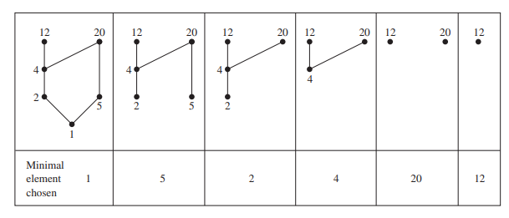
9.6.6 Topological Sorting
  Solution:

Slide 62
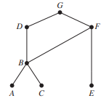
9.6.6 Topological Sorting
Example 27:
  A development project at a computer company requires the completion of seven tasks. Some of these tasks can be started only after other tasks are finished. A partial ordering on tasks is set up by considering task X ≺ task Y if task Y cannot be started until task X has been completed. The Hasse diagram for the seven tasks, with respect to this partial ordering, is shown in Figure . Find an order in which these tasks can be carried out to complete the project.

Slide 63
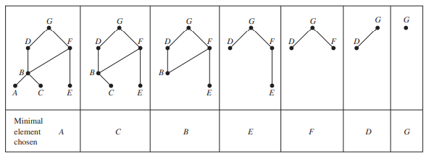
9.6.6 Topological Sorting
  Solution:
    An ordering of the seven tasks can be obtained by performing a topological sort. The steps of a sort are illustrated in Figure. The result of this sort, A ≺ C ≺ B ≺ E ≺ F ≺ D ≺ G, gives one possible order for the tasks.

Slide 64
9.6 Partial Orderings
Homework
§9.6 – 12, 28, 36, 44

Slide 65
Semigroup and Groups
9.7 二元运算/Binary Operations Revisited
9.8 半群/Semigroups
9.9 乘积半群与商半群/Products and Quotients of Semigroups
9.10 群/Groups
9.11 乘积群与商群/Products and Quotients of Groups

Slide 66
9.7 Binary Operations Revisited
Binary operations(二元运算)
A binary operation on a set A is an everywhere defined function f:A × A → A.
A binary operation must satisfy:
  f assigns an element f(a,b) of A to each ordered pair (a,b) in A × A.
  Since a binary operation is a function. Only one element of A is assigned to each ordered pair.

Slide 67
9.7 Binary Operations Revisited
Note
It’s customary to denote binary operations by a symbol such as *, instead of f, and to denote the element assigned to (a, b) by a*b [instead of *(a, b)].
A is closed(封闭的) under the operation * , if a and b are elements in A, a*b ∈ A.

Slide 68
9.7 Binary Operations Revisited
Example 1:
  Let A = Z. Define a*b as a + b.
    * is a binary operation on Z.

Slide 69
9.7 Binary Operations Revisited
Example 2:
  Let A = R . Define a*b as a/b.
    * is not a binary operation, since it is not defined for every ordered pair of elements of A.
    For example, 3*0 is not defined, since we can not divide by zero.

Slide 70
9.7 Binary Operations Revisited
Example 3:
  Let A = Z⁺. Define a*b as a-b.
    * is not a binary operation since it does not assign an element of A to every ordered pair of elements of A; for example,2*5 ∉ A.

Slide 71
9.7 Binary Operations Revisited
Example 4:
  Let A = Z. Define a*b as a number less than both a and b.
    * is not a binary operation, since it does not assign a unique element of A to each ordered pair of elements of A; for example, 8*6 could be 5, 4, 3, l, and so on.
    in this case, * would be a relation from A×A to A, but not a function

Slide 72
9.7 Binary Operations Revisited
Example 5:
  Let A = Z. Define a*b as max{a, b}.
    * is a binary operation; for example,2*4 = 4, -3*(-5)=-3.

Slide 73
9.7 Binary Operations Revisited
Example 6:
  Let A = P(S), for some set S. If V and W are subsets of S, define V*W as V∪W.
    * is a binary operation on A.
    if we define V *' W as V∪W, then *' is another binary operation on A.
      Note: It’s possible to define many binary operations on the same set.

Slide 74
9.7 Binary Operations Revisited
Example 7:
  Let M be the set of all n×n Boolean matrices for a fixed n. Define A*B as A∨B
    * is a binary operation.
    This is also true of A∨B.

Slide 75
9.7 Binary Operations Revisited
Example 8:
  Let L be a lattice. Define a*b as a∨b.
    * is a binary operation on L.
    This is also true of a∨b

Slide 76
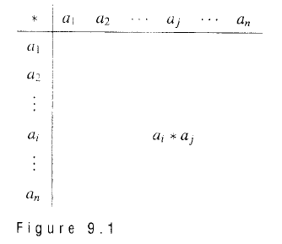
9.7 Binary Operations Revisited
Tables – 运算表
If A = {a_{l}, a₂,..., a_{n}} is a finite set（有限集合）, we can define a binary operation on A by means of a table

Slide 77
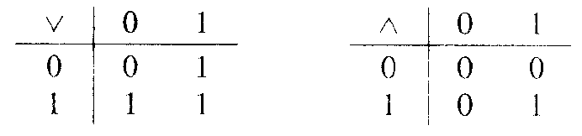
9.7 Binary Operations Revisited
Example 9:
  Let
    A = {0, l }.
  Define binary operations ∨ and ∧ by the following tables:

Slide 78
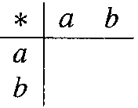
9.7 Binary Operations Revisited
How many operations?
If A = {a, b}, how many binary operations can be defined on A.
  Every binary operation * on A can be described by a table
There are 2•2•2•2 = 2⁴ or 16 ways to complete the table.

Slide 79
9.7 Binary Operations Revisited
Properties of Binary Operations
For all elements a, b, and c in A
Commutative(交换律)
  a*b = b*a
Associative(结合律)
  a*(b*c) = (a*b)*c
Idempotent(等幂律)
  a*a = a

Slide 80
9.7 Binary Operations Revisited
Commutative - 交换律
A binary operation on a set A is said to be commutative （交换的）if a*b = b*a for all elements a and b in A.
Example:
  The binary operation of addition on Z is commutative.
  The binary operation of subtraction on Z is not commutative, since2-3 ≠ 3-2.

Slide 81
9.7 Binary Operations Revisited
Commutative - 交换律
A binary operation that is described by a table is commutative
  if and only if
The entries in the table are symmetric with respect to the main diagonal.

Slide 82
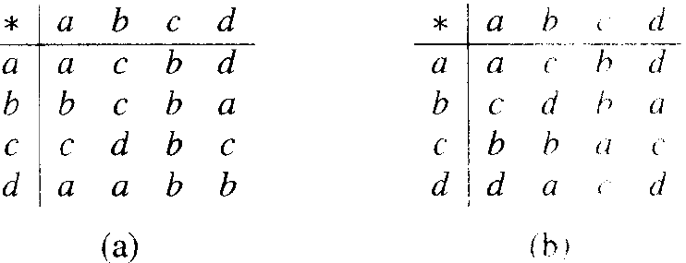
9.7 Binary Operations Revisited
Example 12:
  Which of the fol1owing binary operations on A = {a, b, c, d} are commutative?

Slide 83
9.7 Binary Operations Revisited
Associative - 结合律
A binary operation * on a set A is said to be associative（结合的） if a*(b*c) = (a*b)*c for all elements a, b, and c in A.
Example:
  The binary operation of addition on Z is associative.
  The binary operation of subtraction on Z is not associative, since2-(3-5) ≠ (2-3)-5.

Slide 84
9.7 Binary Operations Revisited
Example 15:
  Let L be a lattice. The binary operation defined by a*b = a∧b is
    commutative and
    associative.
    It also satisfies the idempotent（幂等） property a∧a = a.

Slide 85
9.7 Binary Operations Revisited
Example 16:
  Let * be a binary operation on a set A, and suppose that * satisfies the following properties for any a, b, and c in A:
    a = a*a Idempotent property（幂等）
    a*b = b*a Commutative property（交换）
    a*(b*c) = (a*b)*c Associative property（结合）

Slide 86
9.7 Binary Operations Revisited
Example 16:
  Define a relation ≤ on A by
    a ≤ b
      if and only if
    a = a*b.
  Show that (A, ≤ ) is a poset, and for all a, b in A, GLB(a, b) = a*b.

Slide 87
9.7 Binary Operations Revisited
Example 16:
  Solution：
    We must show that
      ≤ is reflexive, antisymmetric and transitive.
      a*b = a∧b for all a and b in A.

Slide 88
9.7 Binary Operations Revisited
Example 16:
  Solution：
    ≤ is reflexive
      a ≤ b if and only if a = a*b
    Since a = a*a,
      a ≤ a for all a in A, and
      ≤ is reflexive.

Slide 89
9.7 Binary Operations Revisited
Example 16:
  Solution：
    ≤ is antisymmetric
      a ≤ b if and only if a = a*b
    Now suppose that
      a ≤ b and b ≤ a.
      Then, by definition and property 2,
      a = a*b = b*a = b,
      so a = b.
      Thus ≤ is antisymmetric.

Slide 90
9.7 Binary Operations Revisited
Example 16:
  Solution：
    ≤ is transitive
      a ≤ b if and only if a = a*b
    If a ≤ b and b ≤ c,
      then a = a*b = a*(b*c) = (a*b)*c = a*c,
      so a ≤ c and
      ≤ is transitive.

Slide 91
9.7 Binary Operations Revisited
Example 16:
  Solution：
    a*b = a∧b, for all a and b in A
      a ≤ b if and only if a = a*b
    We have
      a*b = a*(b*b) =(a*b)*b,
      so a*b ≤ b.
      In a similar way a*b ≤a.
      so a*b is a lower bound for a and b.

Slide 92
9.7 Binary Operations Revisited
Example 16:
  Solution：
    Now, if c ≤ a and c ≤ b.
      then c = c*a and c = c*b by definition.
      Thus c = (c*a)*b = c*(a*b).
      so c ≤ a*b.
      This shows that a*b is the greatest lower bound of a and b.

Slide 93
9.7 Binary Operations Revisited
Homework
20 P323
24, 28 P324

Slide 94
9.6 – 9.7
单词表
partial order（偏序关系）
poset / partially ordered set（偏序集合）
linear order（线序关系）
linearly ordered set（线序集合）
chain（链）
well order（良序关系）
lexicographic order（词典顺序）
maximal element（极大元）
minimal element（极小元）
greatest element（最大元）
unit element（单位元）
least element（最小元）
zero element（零元）

Slide 95
9.6 – 9.7
单词表
upper bound（上界）
lower bound（下界）
least upper bound (LUB) （最小上界）
greatest lower bound (GLB) （最大下界）
lattice（格）
Idempotent Properties（幂等律）
Commutative Properties（交换律）
Associative Properties（结合律）
topological sorting（拓扑排序）
binary operations(二元运算)

