Slide 1
离散数学及其应用
Discrete Mathematics and Its Applications
（Eighth Edition/Kenneth H.Rosen）
郭少勇 (syguo@bupt.edu.cn)
北京邮电大学
2025.10
Notes:
1

Slide 2
11.1(补) Groups and Coding
Coding theory
In today’s modern world of communication, data items are constantly being transmitted from point to point. The basic problem in transmission of data is that of receiving the data as sent and not receiving a distorted piece of data.
Coding theory has developed techniques for introducing redundant information(引入冗余信息) in transmitted data that help in detecting, and sometimes in correcting, errors.

Slide 3
11.1(补) Groups and Coding
Unit of information
The basic unit of information, called a message(消息), is a finite sequence of characters from a finite alphabet. We shall choose as our alphabet the set B = {0, 1}. Every character or symbol that we want to transmit is now represented as a sequence of melements from B. That is, every character or symbol is represented in binary form.
Our basic unit of information, called a word(字), is a sequence of m 0's and 1's.

Slide 4
11.1(补) Groups and Coding
Groups
The set B is a group under the binary operation + (mod 2 addition )
It follows that B^{m} = B×B × … × B (n factors) is a group under the operator ⊕ defined by
(x₁, x₂,…, x_{m}) ⊕ (y₁, y₂ ,…, y_{m})
= (x₁ + y₁, x₂ + y₂ , …, x_{m} + y_{m})
An element in Bm will be written as (b₁,b₂,..., b_{m}) or more simply as b₁b₂...b_{m}

Slide 5

11.1(补) Groups and Coding
Transmission channel and Noise - 传输通道和噪音
An element x ∈ B^{m} is sent through the transmission channel and is received as an element x_{t} ∈ B^{m}.
Noise(噪声) in the transmission channel may cause a 0 to be received as a l, or vice versa, lead x ≠ x_{t}
对
错
对
对
时

Slide 6
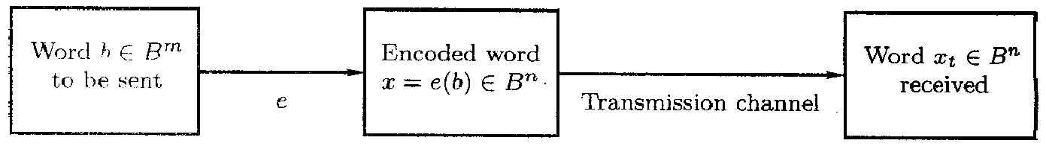
11.1(补) Groups and Coding
Encoding function - 编码函数
Choose: an integer n>m and a one-to-one function e:
B^{m} → B^{n}
  e is called an (m, n) encoding function, representing every word in B^{m} as a word in B^{n}.
  If b ∈ B^{m}, then e(b) is called the code word(码字) representing b.

Slide 7
11.1(补) Groups and Coding
Encoding function - 编码函数
If the transmission channel is noiseless, then x_{t} = x for all x in B^{n}.
In this case x = e(b) is received for each b ∈ B^{m}, and since e is a known function, b may be identified.

Slide 8
11.1(补) Groups and Coding
Encoding function - 编码函数
In general, errors in transmission do occur.
We will say that the code word x = e(b) has been transmitted with k or fewer errors(k 或更少的错误) if x and x_{t} differ in at least 1 but no more than k positions.

Slide 9
11.1(补) Groups and Coding
Error detect - 差错检测
Let e: B^{m} → B^{n} be an (m, n) encoding function.
e detects k or fewer errors(检测 k 或更少的错误) if whenever x = e(b) is transmitted with k or fewer errors, then x_{t} is not a code word (thus x_{t} could not be x and therefore could not have been correctly transmitted).
For b ∈ B^{n}, the number of 1‘s in x is called the weight(权) of x and is denoted by |x|.

Slide 10
11.1(补) Groups and Coding
Example 1:
  Find the weight of each of the following words in B5.
1.x=01000; 2.x=11100; 3.x=00000; 4. x=11111
Solution:
1. |x|=1; 2. |x|=3; 3.|x|=0; 4.|x|=5

Slide 11
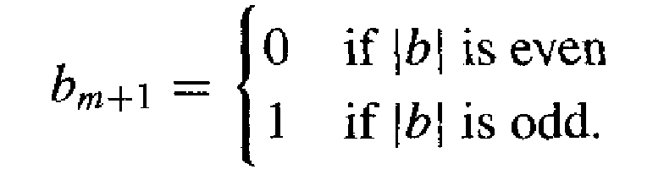
11.1(补) Groups and Coding
parity check code - 奇偶校验码
Example 2:
  The following encoding function e: B^{m} → B^{m+1} is called the parity (m, m+1) check code: If b = b₁b₂…b_{m} ∈ B^{m}, define
  e(b) = b₁b₂…b_{m} b_{m+1}
  where

Slide 12
11.1(补) Groups and Coding
Solution:
  For a concrete illustration of this encoding function, Let m = 3. Then
      e(000) = 0000
      e(001) = 0011
      e(010) = 0101
      e(011) = 0110
      e(100) = 1001
      e(101) = 1010
      e(110) = 1100
      e(111) = 1111
  Suppose now that b = 111. Then x = e(b) = 1111, If the transmission channel transmits x as x, =1101, then |xi =3, and we know that an odd number of errors (at least one) has occurred.

Slide 13
11.1(补) Groups and Coding
Example 3:
  Consider the (m, 3m) encoding function e: B^{m} → B^{3m}.
  If b = b₁b₂…b_{m} ∈ B^{m}, define
  e(b) = b₁b₂…b_{m}b₁b₂…b_{m}b₁b₂…b_{m}

Slide 14
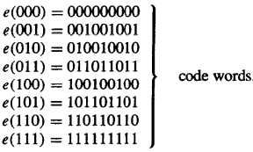
11.1(补) Groups and Coding
Solution:
  That is, the encoding function e repeats each word of B"three times. For a concrete example, let m =3. Then
Suppose now that b = 011,Then e(011) = 011011011.
Assume now we receive the word 011111011. This is not a code word, so we have detected the error.

Slide 15
11.1(补) Groups and Coding
(00,10,01,11)
(00,11)
(1,0)
(1,1)
(0,0)
(0,1)

Slide 16
11.1(补) Groups and Coding
B^{m}(0,1)->B^{n}(000,111)
(0,0,1)
(1,0,1)
  (0,1,1)
(1,1,1)
(0,0,0)
(1,0,0)
(0,1,0)
(1,1,0)

Slide 17
11.1(补) Groups and Coding
Hamming distance - 海明距离
Let x and y be words in B^{m}. The Hamming distance δ(x, y) between x and y is the weight, |x ⊕ y|, of x ⊕ y.
The distance between x = x₁x₂…x_{m} and y = y₁y₂…y_{m} is the number of various of i such that x_{i} ≠ y_{i}, that is, the number of positions in which x and y differ.
Using the weight of x ⊕ y is a convenient way to count the number of different positions.

Slide 18
11.1(补) Groups and Coding
Example 4:
  Find the distance between x and y:
    (a) x = 110110, y = 000101
    (b) x = 001100, y = 010110.
Solution:
    (a) x ⊕ y = 110011, so | x ⊕ y | = 4
    (b) x ⊕ y = 011010, so | x ⊕ y | = 3

Slide 19
11.1(补) Groups and Coding
Theorem 1
Let x, y, and z be elements of B^{m}. Then
  (a) δ(x, y) = δ(y, x)
  (b) δ(x, y)≥0
  (c) δ(x, y) = 0 if and only if x = y
  (d) δ(x, y) ≤ δ(x, z) + δ(z, y)
Proof of (d)
δ(x, y) = | x ⊕ y | = | x ⊕ 0 ⊕ y |
= | x ⊕ z ⊕ z ⊕ y | ≤ | x ⊕ z |+| z ⊕ y | = δ(x, z) + δ(z, y)

Slide 20
11.1(补) Groups and Coding
Minimum distance - 最小距离
The minimum distance of an encoding function e:
B^{m} → B^{n} is the minimum of the distances between all distinct pairs of code words; that is,
min{δ(e(x), e(y)) | x, y ∈ B^{m}}

Slide 21

11.1(补) Groups and Coding
Example 5:
  Consider the following (2, 5) encoding function e:
Solution:
    The minimum distance is 2, as can be checked by computing the minimum of the distances between all six distinct pairs of code words.

Slide 22
11.1(补) Groups and Coding
Theorem 2
An (m, n) encoding function e: B^{m} → B^{n} can detect k or fewer errors if and only if its minimum distance is at least k + 1.
补充一下中文

Slide 23
11.1(补) Groups and Coding
Proof
⇐ the minimum distance is at least k + 1
Let b ∈ B^{m} , and let x = e(b) ∈ B^{n} be the code word representing b.
  x is transmitted and is received as x_{t} If x_{t} were a code word different from x, then δ(x, x_{t}) ≥ k+1, so x would be transmitted with k + l or more errors. Thus, if x is transmitted with k or fewer errors, then x_{t} cannot be a code word. This means that e can detect k or fewer errors.

Slide 24
11.1(补) Groups and Coding
Proof
e can detect k or fewer errors ⇒
Suppose that the minimum distance between code words is r ≤ k
  Let x and y be code words with δ (x, y) = r.
    If x = y, that is, if x is transmitted and is mistakenly received as y, then r ≤ k errors have been committed and have not been detected.
  Thus it contradict with e can detect k or fewer errors.

Slide 25
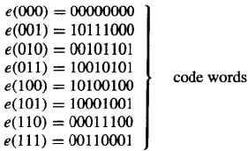
11.1(补) Groups and Coding
Example 6:
  Consider the (3, 8) encoding function e: B³ → B⁸ defined by
  How many errors will e detect?

Slide 26
11.1(补) Groups and Coding
Solution:
    The minimum distance of e is 3, as can be checked by computing the minimum of the distances between all 28 distinct pairs of code words. By Theorem 2, the code will detect k or fewer errors if and only if its minimum distance is at least k + 1. Since the minimum distance is 3, we have 3 ≥ k+1or k < 2. Thus the code will detect two or fewer errors.

Slide 27
11.1(补) Groups and Coding
Group Codes - 群码
An (m, n) encoding function e: B^{m} → B^{n} is called a group code if
  e(B^{m}) = {e(b) | e(b) ∈ B^{n} } = Ran(e)
is a subgroup of B^{n}

Slide 28
11.1(补) Groups and Coding
Subgroups
Recall from the definition of subgroup give in Section 9.4 that N is a subgroup of B^{n} if
  (a) the identity of B^{n} is in N,
  (b) if x and y belong to N, then x ⊕ y ∈ N, and
  (c) if x is in N, then its inverse is in N.

Slide 29
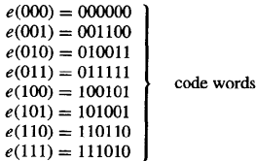
11.1(补) Groups and Coding
Example 7:
  Consider the (3, 6) encoding function e: B³ → B⁶ defined by
  Show that this encoding function is a group code.

Slide 30
11.1(补) Groups and Coding
Solution:
    We must show that the set of all code words
      N = {000000, 001100, 010011, 011111, 100101, 101001, 110110, 111010}
    is a subgroup of B⁶. This is done by first noting that the identity of B⁶ belongs to N. Next we verify，by trying all possibilities，that if x and y are elements in N，then x y is in N. Hence N is a subgroup of B6，and the given encoding function is a group code.

Slide 31
11.1(补) Groups and Coding
Theorem 3
Let e: B^{m} → B^{n} be a group code. The minimum distance of e is the minimum weight of a nonzero code word.

Slide 32
11.1(补) Groups and Coding
Proof
Let δ be the minimum distance of the group code, and suppose that δ = δ(x, y), where x and y are distinct code words.
Also, let η be the minimum weight of a nonzero code word and suppose that η = |z| for a code word z.

Slide 33
11.1(补) Groups and Coding
Proof
Since e is a group code, x ⊕ y is a nonzero code word. Thus
  δ = δ(x, y) = |x ⊕ y| ≥ η.
On the other hand, since 0 and z are distinct code words,
  η = |z| = |z ⊕ 0 | = δ(z, 0) ≥ δ
Hence η = δ.

Slide 34
11.1(补) Groups and Coding
Example 8:
  The minimum distance of the group code in Example 7 is 2, since by Theorem 3: this distance is equal to the smallest number of 1's in any of the seven nonzero code words. To check this directly would require 28 different calculations.

Slide 35
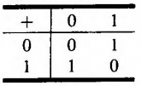
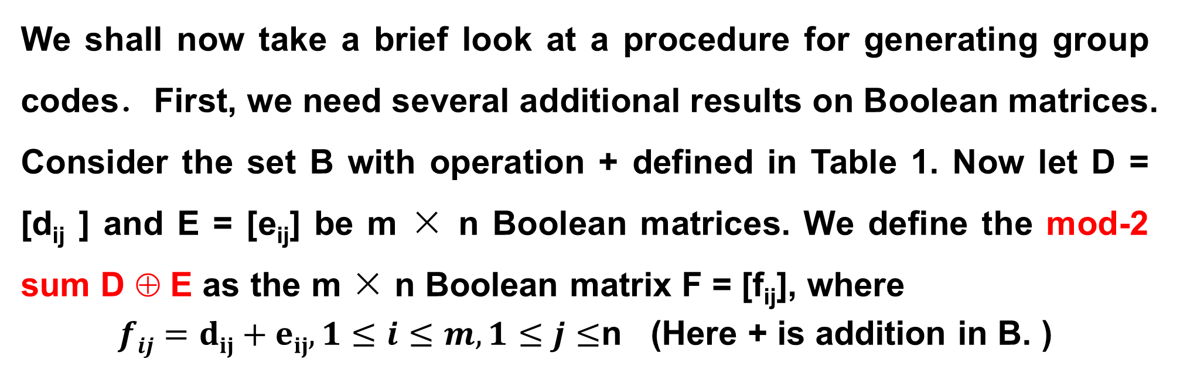
11.1(补) Groups and Coding
We shall now take a brief look at a procedure for generating group codes．First, we need several additional results on Boolean matrices. Consider the set B with operation + defined in Table 1. Now let D = [d_{ij} ] and E = [e_{ij}] be m × n Boolean matrices. We define the mod-2 sum D ⊕ E as the m × n Boolean matrix F = [f_{ij}], where
$fij=dij+eij,1≤i≤m,1≤j≤$n (Here + is addition in B. )
Table 1

Slide 36
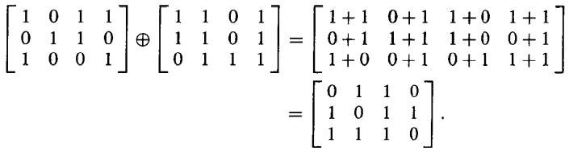
11.1(补) Groups and Coding
Example 9:
  We have
Observe that if F = D ⊕ E, then f_{ij}, is zero when both d_{ij} and e_{ij} are zero or both are one.

Slide 37
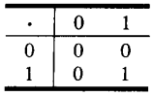
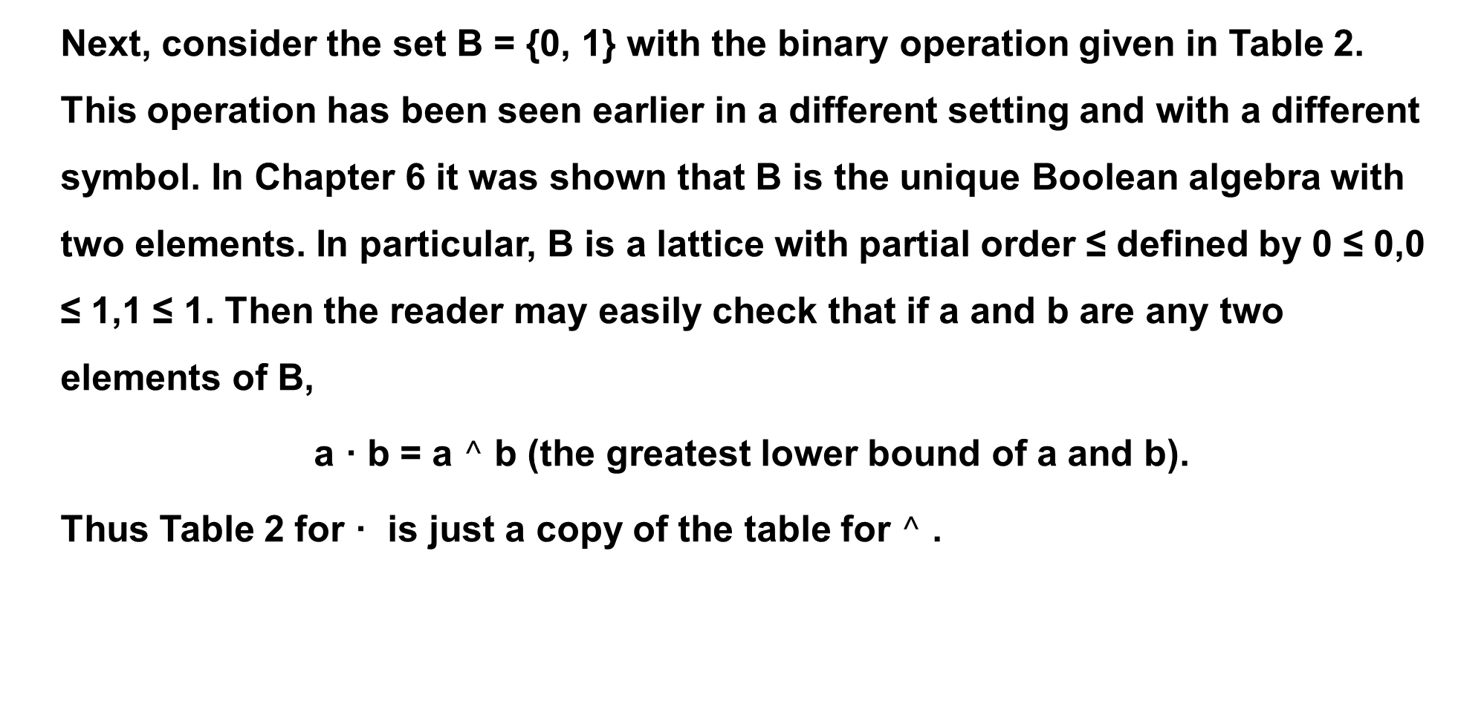
11.1(补) Groups and Coding
  Next, consider the set B = {0, 1} with the binary operation given in Table 2. This operation has been seen earlier in a different setting and with a different symbol. In Chapter 6 it was shown that B is the unique Boolean algebra with two elements. In particular, B is a lattice with partial order ≤ defined by 0 ≤ 0,0 ≤ 1,1 ≤ 1. Then the reader may easily check that if a and b are any two elements of B,
  a · b = a $^$ b (the greatest lower bound of a and b).
  Thus Table 2 for · is just a copy of the table for $^$ .
Table 2

Slide 38
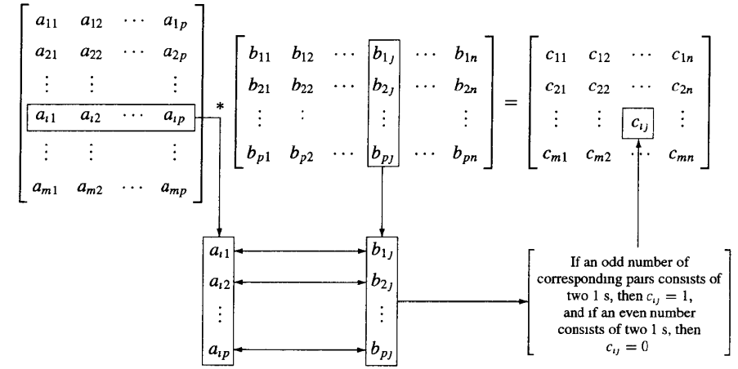

11.1(补) Groups and Coding
Let D =[ d_{ij} ] be an m × p Boolean matrix, and let E =[ e_{ij} ] be a p × n Boolean matrix. We define the mod-2 Boolean product D * E(布尔乘积) as the m x n matrix F=[ f_{ij} ], where
$fij=di1·e1j+di2·e2j+…+dip·epj,1≤i≤m,1≤j≤$n
This type of multiplication is illustrated in Figure 1.
Figure 1

Slide 39
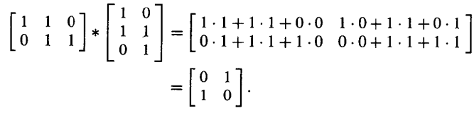
11.1(补) Groups and Coding
Example 10:
  We have
The proof of the following theorem is left as an exercise.

Slide 40
11.1(补) Groups and Coding
Boolean Products
Let A=[a_{ij}] be an m×k zero-one matrix,
& let B=[b_{ij}] be a k×n zero-one matrix,
The boolean product of A and B is like normal matrix ×, but using ∨ instead of + in the row-column “vector dot product”:
A⊙B

Slide 41
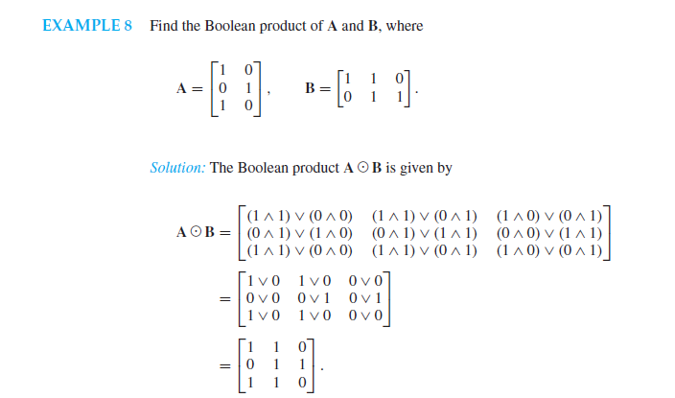
11.1(补) Groups and Coding

Slide 42
11.1(补) Groups and Coding
Notation
We shall now consider the element
  x = x₁x₂…x_{n} ∈ B^{n}
  as the 1 × n matrix
  [x₁ x₂ … x_{n} ]

Slide 43
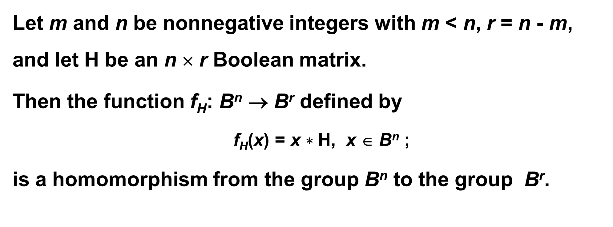
11.1(补) Groups and Coding
Theorem 5
Let m and n be nonnegative integers with m < n, r = n - m, and let H be an n × r Boolean matrix.
Then the function f_{H}: B^{n} → B^{r} defined by
  f_{H}(x) = x $∗$H, x ∈ B^{n} ;
is a homomorphism from the group B^{n} to the group B^{r}.

Slide 44
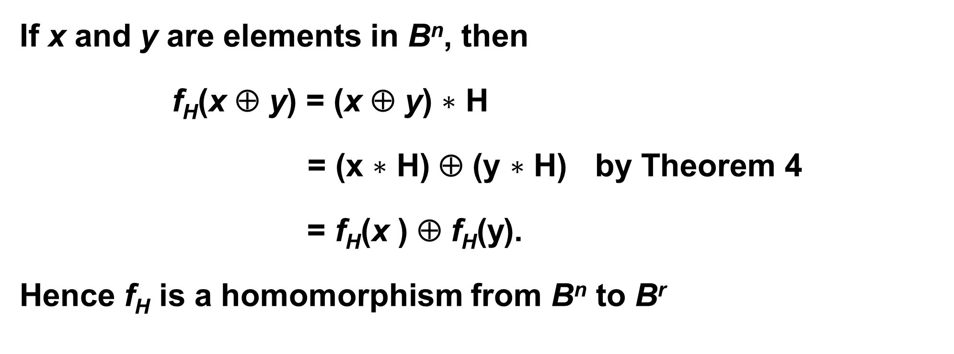
11.1(补) Groups and Coding
Proof
If x and y are elements in B^{n}, then
f_{H}(x ⊕ y) = (x ⊕ y) $∗$ H
= (x $∗$ H) ⊕ (y $∗$ H) by Theorem 4
= f_{H}(x ) ⊕ f_{H}(y).
Hence f_{H} is a homomorphism from B^{n} to B^{r}

Slide 45
11.1(补) Groups and Coding
Corollary 1
Let m, n, r, H, and f_{H} be as in Theorem 5. Then
N = {x ∈ B^{n} | x * H = 0}
is a normal subgroup of B^{n}.
Proof:
  N is the kernel of the homomorphism f_{H}, so it is a normal subgroup of B^{n}.

Slide 46
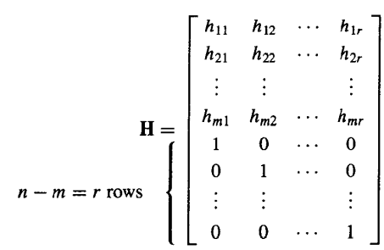
11.1(补) Groups and Coding
Parity check matrix - 一致性检验矩阵
  Let m < n and r = n - m. the following n × r Boolean matrix is called a parity check matrix.

Slide 47
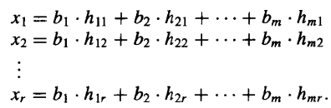
11.1(补) Groups and Coding
Encoding function
  Define an encoding function e_{H}: B^{m} → B^{n}
  If b = b₁b₂…b_{m}, let x = e_{H}(b) = b₁b₂…b_{m} x₁x₂…x_{r}, where

Slide 48
11.1(补) Groups and Coding
e_{H}: B^{m} → B^{n} in matrix format

Slide 49
11.1(补) Groups and Coding
Theorem 6
Let x = y₁y₂…y_{m}x₁… x_{r} ∈ B^{n}. Then
  x * H = 0
if and only if
  x = e_{H}(b) for some b ∈ B^{m}.

Slide 50
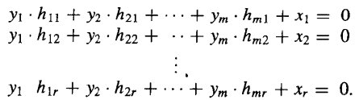
11.1(补) Groups and Coding
Proof: x * H = 0 ⇒ x = e_{H}(b) for some b ∈ B^{m}
Suppose that x * H = 0

Slide 51
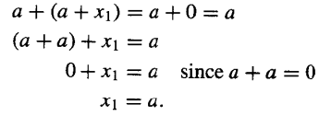
11.1(补) Groups and Coding
Proof: x * H = 0 ⇒ x = e_{H}(b) for some b ∈ B^{m}
The first equation is of the form
Adding a to both sides, we obtain
This can be done for each row; therefore,

Slide 52
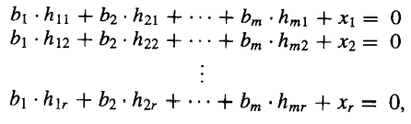
11.1(补) Groups and Coding
Proof: x * H = 0 ⇒ x = e_{H}(b) for some b ∈ B^{m}
Letting b₁ = y₁, b₂ = y₂,..., b_{m} = y_{m}, we see that x₁, x₂,..., x_{r} satisfy the equations in (l). Thus b = b₁b₂…b_{m} ∈ B^{m} and x = e_{H}(b).
Conversely if x = e_{H}(b), the equations in (1) can be rewritten by adding x_{i} to both sides of the ith equation, i = l, 2,..., n, as
which shows x * H = 0.

Slide 53
11.1(补) Groups and Coding
Corollary 2
  e_{H}(B^{m} ) = {e_{H}(b) | b ∈ B^{m}} is a subgroup of B^{n}
Proof :
The result follows from the observation that
e_{H}(B^{m} ) = ker(f_{H})
and from Corollary 1,Thus e_{H} is a group code.

Slide 54
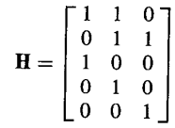
11.1(补) Groups and Coding
Example 11:
Let m = 2, n = 5, and
Determine the group code e_{H}: B²→ B⁵.

Slide 55
11.1(补) Groups and Coding
Solution 11:
We have B2=(00, 10, 01, 11). Then
e(00) = 00x₁x₂x₃,
where x₁, x₂, and x₃ are determined by the equations in (1). Thus
x₁ = x₂ = x₃ = 0
And
e(00) = 00000.
Next
e(10) = 10x₁x₂x₃.

Slide 56
11.1(补) Groups and Coding
Solution 11:
Using the equations in (1) with b₁ = 1 and b₂ = 0, we obtain
x₁ = 1·1 + 0·0 = 1
x₂ = 1·1 + 0·1 = 1
x₃ = 1·0 + 0·1 = 0.
Thus x₁ = 1, x₂ = 1, and x₃ = 0, so
e(10) = 10110.
Similarly (verify),
e(01) = 01011
e(11) = 11101.

Slide 57
11.1(补) Groups and Coding
Homework
11.1(补)
  19,23,25,27 P412

Slide 58
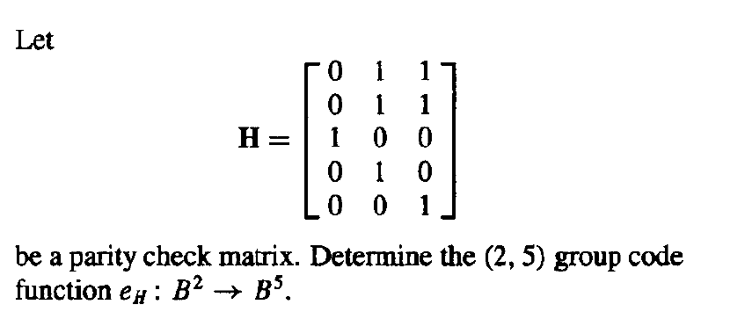
11.1(补) Groups and Coding
练习

Slide 59
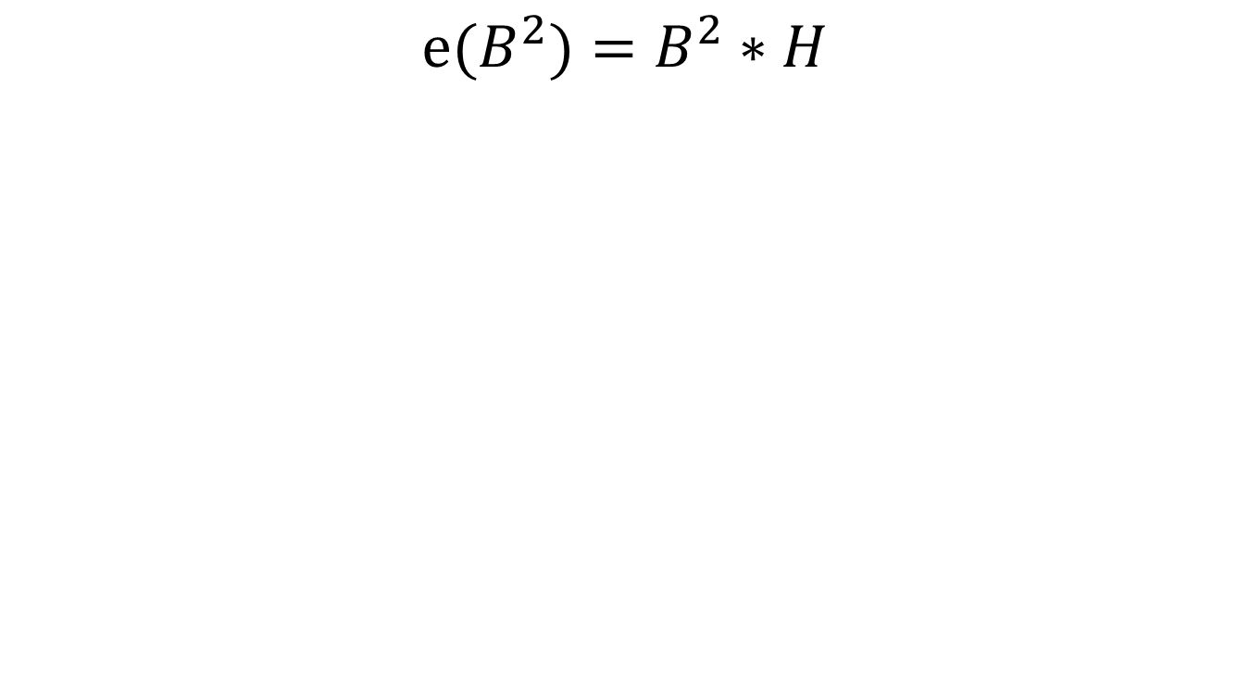
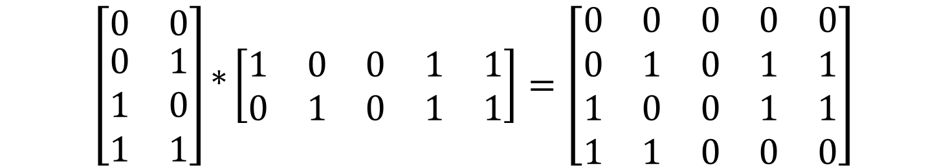
11.1(补) Groups and Coding
练习

Slide 60
11.2(补) Decoding and Error Correction
Consider an (m, n) encoding function e: B^{m}→B^{n}. Once the encoded word x = e(b)∈B^{n}, for b∈B^{m}, is received as the word x_{t}, we are faced with the problem of identifying the word b that was the original message.

Slide 61
11.2(补) Decoding and Error Correction
An onto function d: B^{n}→B^{m} is called an (n, m) decoding function associated with e(与e关联的译码函数) if d(x_{t}) = b' ∈ B^{m} is such that when the transmission channel has no noise, then b' = b, that is,
  d o e = I_{Bm}
Where I_{Bm} is the identity function on B^{m}

Slide 62
11.2(补) Decoding and Error Correction
The decoding function d is required to be onto so that every received word can be decoded to give a word in B^{m}. It decodes properly received words correctly, but the decoding of improperly received words may or may not be correct.

Slide 63
11.2(补) Decoding and Error Correction
Example 1:
  Consider the parity check code that is defined in Example 2 of Section 11.1. We now define the decoding function d: B^{m+1}→B^{m}. If y = y₁ y₂ … y_{m} y_{m+1}∈ B^{m+1}, then
    d(y) = y₁ y₂ … y_{m}
  Observe that if b = b₁ b₂ … b_{m}∈ B^{m}, then
    (d o e)(b) = d(e(b)) = b
  so d o e = 1_{Bm}
  For a example, let m = 4. Then d(10010) = 1001 and d(11001) = 1100

Slide 64
11.2(补) Decoding and Error Correction
Let e be an (m, n) encoding function and let d be an (n, m) decoding function associated with e. We say that the pair (e, d) corrects k or fewer errors if whenever x = e(b) is transmitted correctly or with k or fewer errors and x_{t} is received, then d(x_{t}) = b. Thus x_{t} is decoded as the correct message b.

Slide 65

11.2(补) Decoding and Error Correction
Example 2:
  Consider the (m, 3m) encoding function defined in Example 3 of Section 11.1. Define the decoding function d: B_{m}→B_{3m}.Let
    y = y₁ y₂ … y_{m} y_{m+1} … y_{2m} y_{2m+1} … y_{3m},
  Then
    d(y) = z₁ z₂ … z_{m}
  where
  E.g. x_{t} = 011011111, then d(x_{t}) = 011

Slide 66
11.2(补) Decoding and Error Correction
Given an (m,n) encoding function e: B^{m}→B^{n}, we often need to determine an (n,m) decoding function d: B^{n}→B^{m} associated with e. We now discuss a method, called the maximum likelihood technique(极大似然方法), for determining a decoding function d for a given e.
Since B^{m} has 2^{m} elements, there are 2^{m} code words in B^{n}. We first list the code words in a fixed order:
  x⁽¹⁾, x⁽²⁾, ..., x^{(2m)}

Slide 67

11.2(补) Decoding and Error Correction
If the received word is x_{t}, we compute δ(x^{(i)}, x_{t}) for 1 ≤ i ≤ 2^{m} and choose the first code word, say it is x^{(s)}, such that
That is, x^{(s)} is a code word that is closest to x_{t} and the first in the list. If x^{(s)} = e(b), we define the maximum likelihood decoding function(最大似然译码函数) d associated with e by
  d(x_{t})=b

Slide 68
11.2(补) Decoding and Error Correction
Theorem 1
Suppose that e is an (m, n) encoding function and d is a maximum likelihood decoding function associated with e. Then (e, d) can correct k or fewer errors if and only if the minimum distance of e is at least 2k + 1.

Slide 69
11.2(补) Decoding and Error Correction
Proof
Assume that the minimum distance of e is at least 2k + 1. Let b∈B^{m} and x = e(b)∈B^{n}. Suppose that x is transmitted with k or fewer errors, and x_{t} is received. This means that δ(x, x_{t})≤ k. If z is any other code word, then
  2k+1 ≤ δ(x, z) ≤ δ(x, x_{t}) + δ(x_{t}, z) ≤ k + d(x_{t}, z).
Thus δ(x_{t}, z) ≥ 2k+1-k = k+1.This means that x is the unique code word that is closest to x_{t}, so d(x_{t}) = b. Hence (e, d) corrects k or fewer errors.

Slide 70
11.2(补) Decoding and Error Correction
Proof
Conversely, assume that the minimum distance between code words is r ≤ 2k, and let x = e(b) and x’ = e(b’) be code words with δ(x, x’) = r. Suppose that x’ precedes x in the list of code words used to define d. Write x = b₁b₂...b_{n}, x’ = b’₁ b’₂ ... b’_{n}. Then b_{t} ≠ b’_{t} for exactly r integers i between 1 and n. Assume, for simplicity, that b₁ ≠ b’₁, b₂ ≠ b’₂, ..., b_{r} ≠ b’_{r}, but b_{t} ≠ b’_{t} , when i > r. Any other case is handled in the same way.

Slide 71
11.2(补) Decoding and Error Correction
Proof
(a)Suppose that r ≤ k. lf x is transmitted as x_{t} = x’, then r≤k errors have been committed, but d(x_{t}) = b’; so (e, d) has not corrected the r errors.
(b) Suppose that k +1 ≤ r ≤ 2k, and let
  y = b’₁ b’₂ ... b’_{k} b_{k+1} ... b_{n}.
If x is transmitted as x_{t} = y, then δ(x_{t}, x’) = r-k ≤ k and δ(x_{t}, x) > k. Thus x' is at least as close to x_{t} as x is, and x' precedes x in the list of code words; so d(x_{t}) ≠ b.Then we have committed k errors, which (e,d) has not corrected.

Slide 72
11.2(补) Decoding and Error Correction
Example 3:
  Let e be the (3, 8) encoding function defined in Example 6 of Section 11.1, and let d be an (8,3) maximum likelihood decoding function associated with e. How many errors can (e,d) correct?
Solution:
  Since the minimum distance ofe is 3,
  we have 3 ≥ 2k +1, so k ≤1.
  Thus (e,d) can correct one error.

Slide 73
11.2(补) Decoding and Error Correction
We now discuss a simple and effective technique for determining a maximum likelihood decoding function associated with a given group code. First, we prove the following result.

Slide 74
11.2(补) Decoding and Error Correction
Theorem 2
If K is a finite subgroup of a group G, then every left coset of K in G has exactly as many elements as K.

Slide 75
11.2(补) Decoding and Error Correction
Proof
Let aK be a left coset of K in G, where a∈G. Consider the function f: K→aK defined by
  f(k) = ak, for k∈K.
We show that f is one to one and onto.
To show that f is one to one, we assume that
  f(k₁) = f(k₂), k₁, k₂∈K.

Slide 76
11.2(补) Decoding and Error Correction
Proof
Then
  ak₁ = ak₂
By Theorem 2 of Section 9.4, k₁ = k₂. Hence f is one to one.
To show that f is onto, let b be an arbitrary element in aK. Then b = ak for some k∈K. We now have
  f(k) = ak = b
so f is onto. Since f is one to one and onto, K and aK have the same number of elements.

Slide 77
11.2(补) Decoding and Error Correction
Let e: B^{m}→B^{n} be an (m, n) encoding function that is a group code. Thus the set N of code words in Bn is a subgroup of B^{n} whose order is 2^{m}, say N = {x⁽¹⁾, x⁽²⁾, ..., x^{(2m)} }.
Suppose that the code word x = e(b) is transmitted and that the word x_{t} is received. The left coset of x_{t} is
  x_{t} ⨁ N = {ɛ₁, ɛ₂,..., ɛ_{2m}}
where ɛ_{i} = x_{t} ⨁ x^{(i)}

Slide 78
11.2(补) Decoding and Error Correction
The distance from x_{t} to code word x^{(i)} is just |ɛ_{i}|, the weight of ɛ_{i}.Thus, if ɛ_{j} is a coset member with smallest weight, then x^{(j)} must be a code word that is closest to x_{t}. In this case, x^{(j)} = Ō ⨁ x^{(j)} = x_{t} ⨁ x_{t} ⨁ x^{(j)} = x_{t} ⨁ ɛ_{j.} An element ɛ_{j}, having smallest weight, is called a coset leader(陪集首部). Note that a coset leader need not be unique.

Slide 79
11.2(补) Decoding and Error Correction
If e:B^{m}→B^{n} is a group code, we now state the following procedure for obtaining a maximum likelihood decoding function associated with e.

Slide 80
11.2(补) Decoding and Error Correction
Step 1: Determine all the left cosets of N = e(B^{m}) in B^{n}
Step 2: For each coset, find a coset leader (a word of least weight).
Step 3: If the word x_{t} is received, determine the coset of N to which x_{t} belongs.
Step 4: Let ɛ be a coset leader for the coset determined in Step 3. Compute x = x_{t} ⨁ ɛ. If x = e(b), we let d(x_{t}) = b. That is, we decode x_{t} as b.

Slide 81
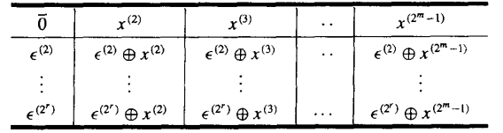
11.2(补) Decoding and Error Correction
Decoding table(译码表)
Constructing a decoding table, each row is a left coset of N with the first element ɛ^{(i)} the coset leader.

Slide 82
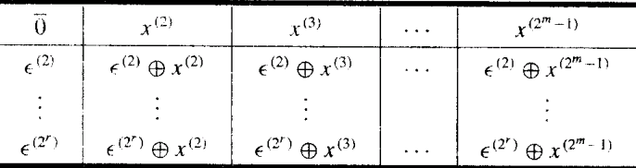
11.2(补) Decoding and Error Correction
Decoding table(译码表)
If we receive the word x_{t}, we locate it in the table. If x is the element of N that is at the top of the column containing x_{t}, then x is the code word closest to x_{t}.
if x = e(b), then d(x_{t}) = b.

Slide 83
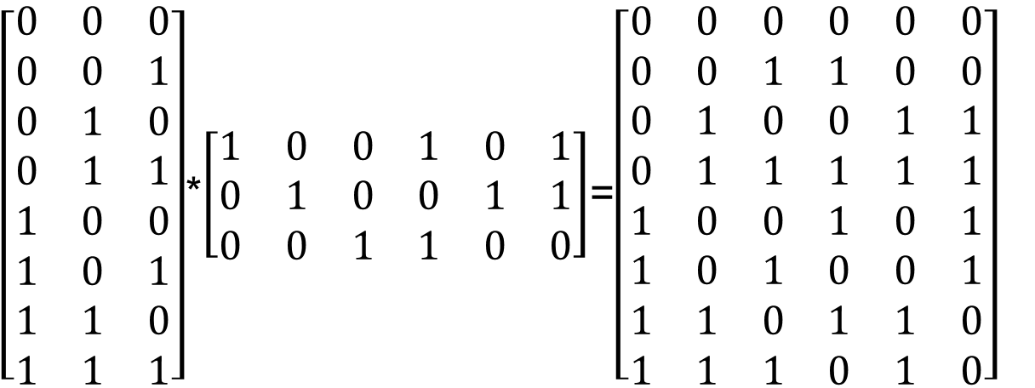
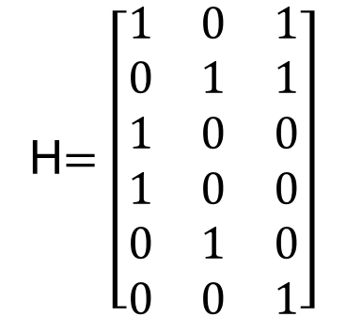
11.2(补) Decoding and Error Correction
Example 4
Consider the (3, 6) group code
  N = {000000, 001100, 010011, 011111, 100101, 101001, 110110, 111010}
  = {x⁽¹⁾, x⁽²⁾,..., x⁽⁸⁾}.

Slide 84
11.2(补) Decoding and Error Correction
Constructing decoding table:
==============================================================
000000 001100 010011 011111 100101 101001 110110 111010
--------------------------------------------------------------
000001 001101 010010 111110 100100 101000 110111 111011
000010 001110 010001 011101 100111 101011 110100 111000
000100 001000 010111 011011 100001 101101 110010 111110
010000 011100 000011 001111 110101 111001 100110 101010
100000 101100 110011 111111 000101 001001 010110 011010
000110 001010 010101 011001 100011 101111 110000 111100
010100 011000 000111 001011 110001 111101 100010 101110
==============================================================
001010 000110 011001 010101 101111 100011 111100 110000

Slide 85
11.2(补) Decoding and Error Correction
Simplified decoding technique
Suppose that the (m, n) group code is e_{H}: B^{m} → B^{n} , where H is a given parity check matrix.
Then the function f_{H}: B^{n} → B^{r} defined by f_{H}(x) = x*H, x ∈ B^{n} is a homomorphism from the
group B^{n} to the group B^{r}.

Slide 86
11.2(补) Decoding and Error Correction
Theorem 3
If m, n, r, H, and f_{H} are as defined, then
  f_{H} is onto.
Proof
  Let b = b₁b₂…b_{r} be any element in B^{r}.
  Letting x = 0₁…0_{m}b₁b₂…b_{r}
  Then x*H = b.
  Thus f_{H}(x) = b, so f_{H} is onto.

Slide 87
11.2(补) Decoding and Error Correction
It follows from Corollary l of Section 9.5 that B^{r} and B^{n}/N are isomorphic, where
  N = {x ∈ B^{n} | x*H = 0} = ker(f_{H}) = e_{H}(B^{m} )
under the isomorphism g: B^{n}/N → B^{r} defined by g(xN) = f_{H}(x) = x*H
The element x*H is called the syndrome of x

Slide 88
11.2(补) Decoding and Error Correction
Theorem 4
Let x and y be elements in B^{n}. Then x and y lie in the same left coset of N in B^{n} if and only if f_{H}(x) = f_{H}(y)
if and only if they have the same syndrome.

Slide 89
11.2(补) Decoding and Error Correction
Proof
It follows from Theorem 4 of Section 9.5 that x and y lie in the same left coset of N in B^{n} if and only if x ⊕ y = (-x) ⊕ y ∈ N.
Since N = ker(f_{H}), x ⊕ y ∈ N if and only if
  f_{H}(x ⊕ y) = 0_{Br}
  f_{H}(x) ⊕ f_{H}(y) = 0_{Br}
  f_{H}(x) = f_{H}(y)

Slide 90
11.2(补) Decoding and Error Correction
Decoding procedure
Suppose that we compute the syndrome of each coset leader. If the word x_{t} is received, we also compute f_{H}(x_{t}), the syndrome of x_{t}. By comparing f_{H}(x_{t}) and the syndromes of the coset leaders, we find the coset in which x_{t} lies. Suppose that a coset leader of this coset is ε. We now compute x = x_{t} ⊕ ε. If x = e(b), we then decode x_{t} as b.

Slide 91
11.2(补) Decoding and Error Correction
New procedure
Step 1: Determine all left cosets of N = e_{H}(B^{m} ) in B^{n}.
Step 2: For each coset, find a coset leader, and compute the syndrome of each leader
Step 3: If x_{t} is received, compute the syndrome of x_{t} and find the coset leader ε having the same syndrome. Then x_{t} ⊕ ε = x is a code word e_{H}(b), and d(x_{t}) = b.

Slide 92
11.2(补) Decoding and Error Correction
Example 5
Consider the parity check matrix and the (3, 6) group code e_{H}: B³ → B⁶.

Slide 93
11.2(补) Decoding and Error Correction
Example 5
  N = {000000, 001011, 010101, 011110, 100110, 101101, 110011, 111000}
  Syndrome of Coset Leader | Coset leader
  --------------------------+-------------------
  000 | 000000
  001 | 000001
  010 | 000010
  011 | 001000
  100 | 000100
  101 | 010000
  110 | 100000
  111 | 001100
  --------------------------+-------------------

Slide 94
11.2(补) Decoding and Error Correction
Example 5
  If x_{t} = 001110, then f_{H}(x_{t}) = x_{t} * H = 101, same as ε=010000.
  x = x_{t} ⊕ ε = 001110 ⊕ 01000 = 011110 = e(011), so decode 001110 as 011.
  Syndrome of Coset Leader | Coset leader
  --------------------------+-------------------
  000 | 000000
  001 | 000001
  010 | 000010
  011 | 001000
  100 | 000100
  101 | 010000
  110 | 100000
  111 | 001100
  --------------------------+-------------------

Slide 95
11.2(补) Decoding and Error Correction
Key ideas for review
Message, word
(m, n) encoding function, one-to-one
  Code word, parity check code
  Detect, correct, k or fewer errors
Hamming distance
  Properties of distance
Group code and parity check matrix
  Minimum distance of a group code
Maximum likelihood technique
  Maximum likelihood decoding function
  Syndrome and decoding procedure for group code

Slide 96
11.2(补) Decoding and Error Correction
Homework
11.2(补)
  14, 18, 22 P421
  24 P422

Slide 97
11.1(补)-11.2(补)
单词表
message（消息）
word（字）
noise（噪声）
transmission channel（传输通道）
encoding function（编码函数）
code word（码字）
weight（权）
parity check code （奇偶校验码）
hamming distance （海明距离）
minimum distance （最小距离）
group code（群码）
parity check matrix（一致性检验矩阵）

Slide 98
11.1(补)-11.2(补)
单词表
maximum likelihood technique（极大似然方法）
maximum likelihood decoding function（最大似然译码函数）
coset leader（陪集首部）
decoding table（译码表）

