Slide 1
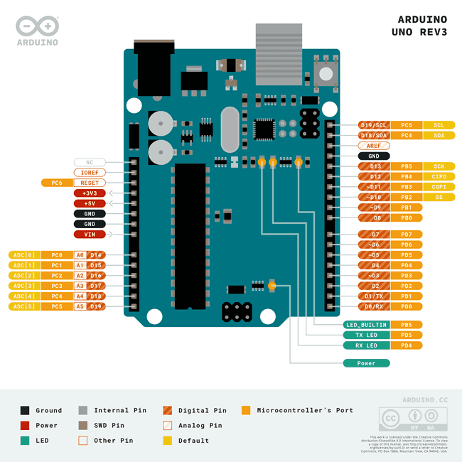
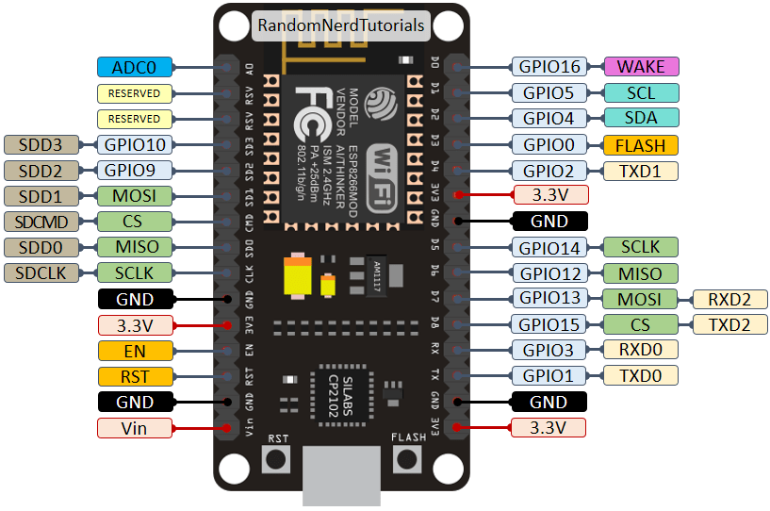




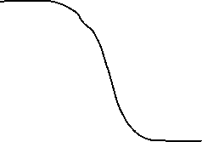
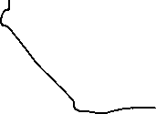


GND
Vin
Dout
EngineHall Sensor
GND
Vin
Dout
Gearbox Hall sensor
Tx - Rx

Slide 2
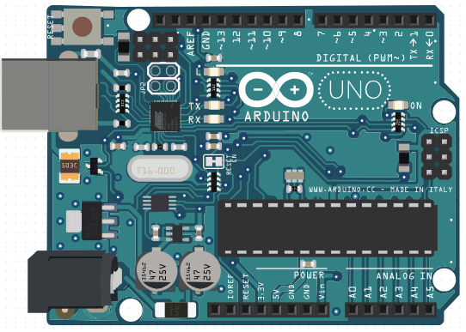
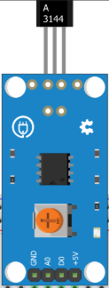
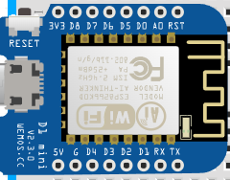
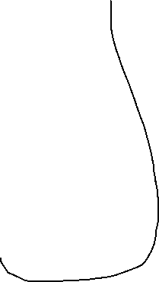
Gearbox
Engine
GND
5v+
GND
5v+
Arduino D2
Arduino D3
Serial: D8 -> ESP D5
Conectar tierras

Slide 3
Diagrama de GPS pendiente

