Slide 1
British airway
Sentiment analysis on negative reviews
Wed 7 December 2022

Slide 2
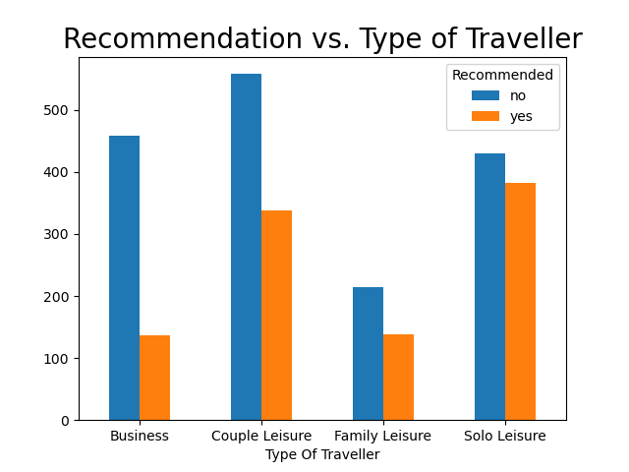
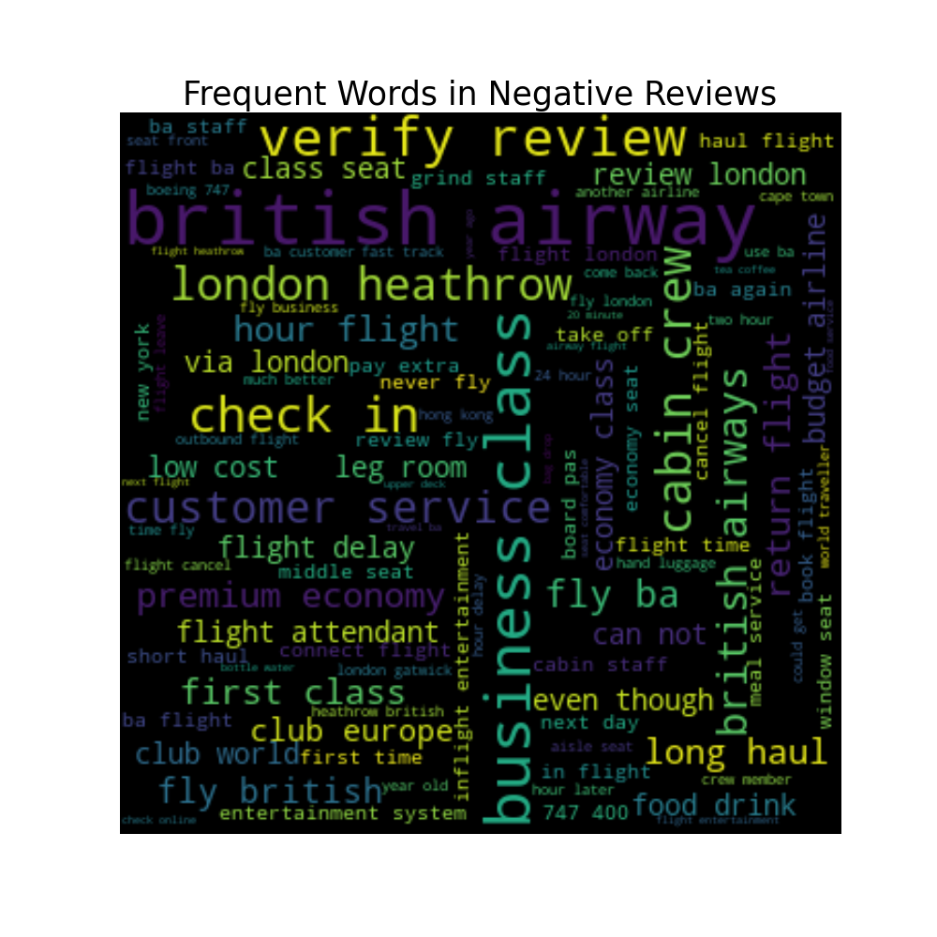
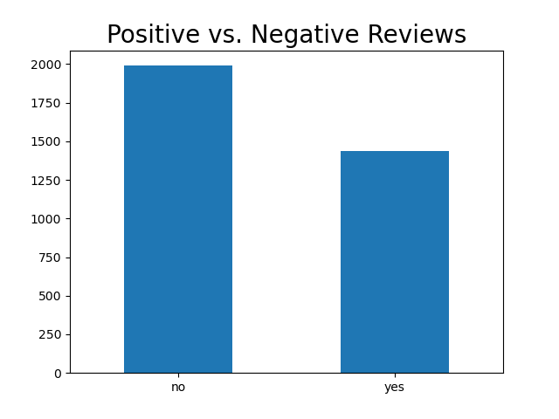
Insights from Reviews
Wordcloud on the reviews text (only negative)
We can see that most frequent clauses are for example “cabin crew”, “leg room”, “business class” and so on
Recommendation vs. Type of Traveller
Business and Couple Leisure are more prone to not recommend this service.
Positive vs. Negative Reviews
Distribution of costumer reactions.

