Slide 1
Predictive analysis
Analysis of customers behaviuor
Date

Slide 2
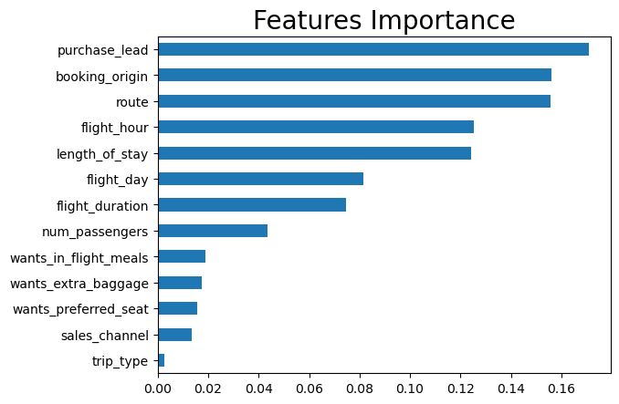
Predictive analysis results
Results:
The most important feature is “purchase_lead” (time between purchase and departure)
“booking_origin” and flight info are also very important.
“sales_channel” is not relevant as well as “trip_travel”

