Slide 1
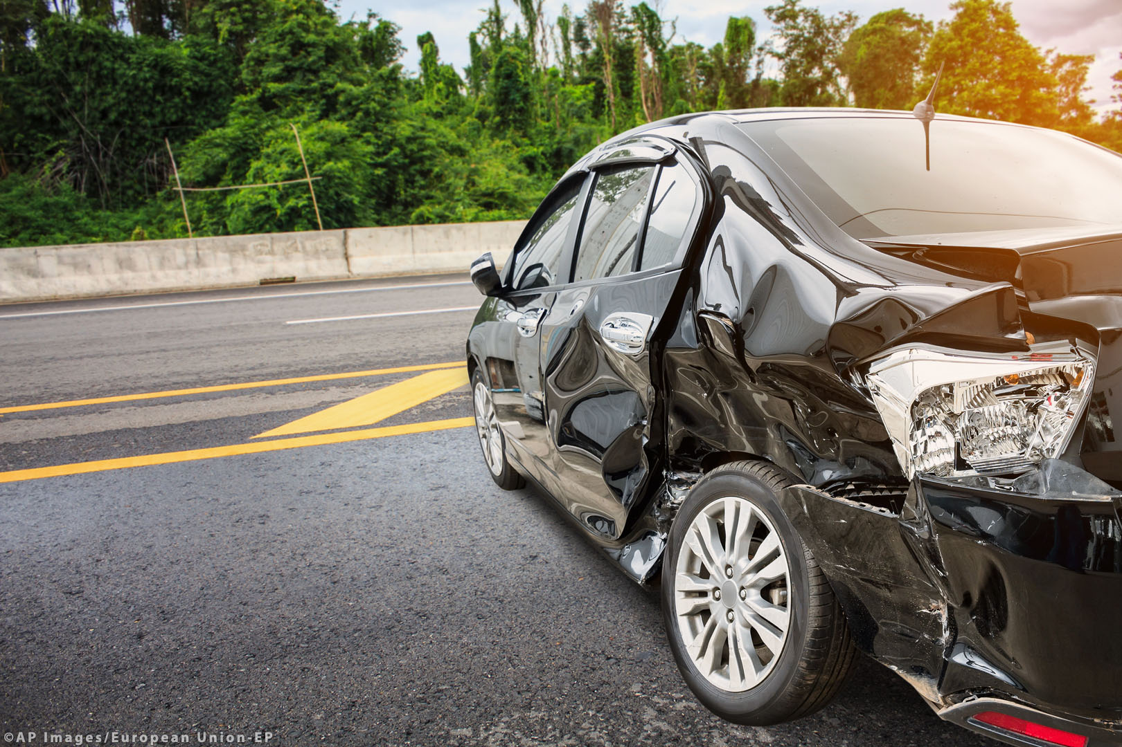
PREDICTING THE SEVERITY OF ROAD
VEHICLE ACCIDENTS
How to improve rescue services in road vehicle accidents by implementing a machine learning classifier
28.08.2020, Germany

Slide 2
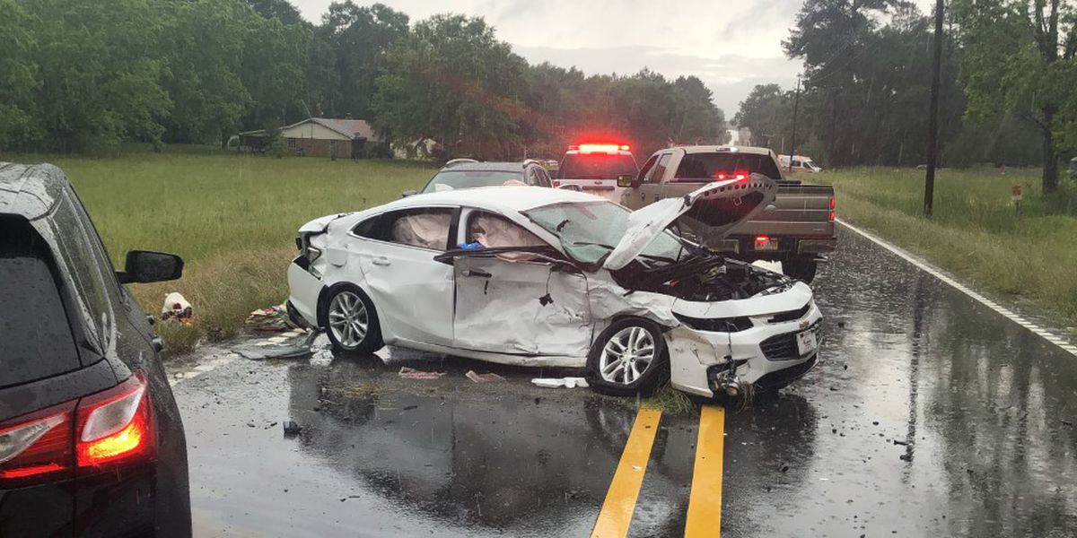
Content
1
Business Understanding
2
Data Understanding
3
Methodology
4
Results
5
Discussion
6
Conclusion

Slide 3




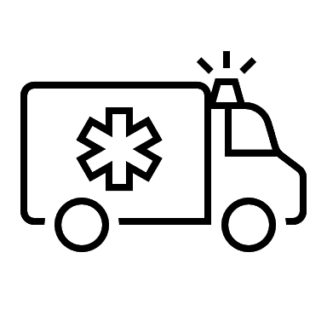

Business Understanding
In the US there are:
280 million vehicles
How to reduce fatality rate?
ML classifier to predict severity of accidents
6 million accidents per year
Enable rescue services to send appropriate equipment and number of paramedics
35.600 fatalities per year (2018)

Slide 4
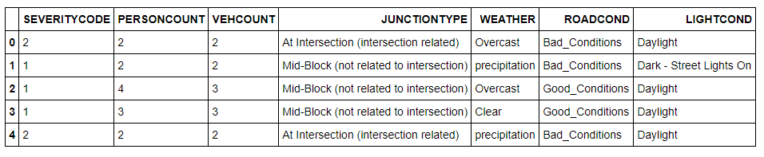
Data Understanding
Data set
SDOT Traffic Management Division
Traffic Records Group
2004 to present date
194.673 data points
38 columns
2 severity codes (prop damage / injury)
Feature selection
External/environmental features only
Must be possible to visually/directly determine feature by anyone
5 features selected for modeling:
Person count
Vehicle count
Junction type
Weather
Road conditions
Light conditions
First five rows of resulting data frame

Slide 5
Methodology
1
2
3
Data cleaning
Exploratory Analysis
Predictive Modeling
Delete rows with na
Delete duplicates
Drop rows with “other” or “unknown” values
Summarize attributes
Balance sample set
One hot encoding
Distribution of values
Correlation weekday and severity
Detection of outliers
Modeling four different algorithms with changing parameters (iterative)
K-nearest neighbors
Decision Tree
Random Forest
Logistic Regression
Evaluation based on accuracy, f1 and log loss

Slide 6
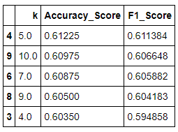
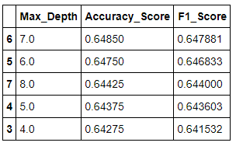
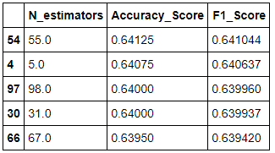
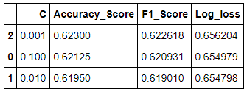
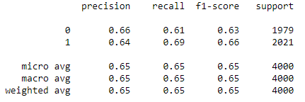
Results
Knn
Decision Tree
Random Forest
Logistic Regression
Highest accuracy with decision tree with max_depth = 7

Slide 7
Discussion and Conclusion
Discussion
Max accuracy of 0.6485
Further data might be needed
Choice of features must be optimized
Classifier is not biased towards a certain result
Future research might include:
Possibility to predict probability of accident
Include further severity grades
Conclusion
Machine learning classifier was developed in order to predict the severity of an accident
Based on data set of accidents in Seattle (2004 to today)
Best model was found by using Decision Tree with max_depth = 7
Model can be of great help for rescue services

